Slide 2
Theory of International Economic Integration I - Introduction.
Radomír Kaňa
Department of International Economic Relations

Slide 3
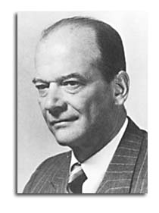
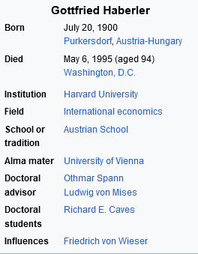
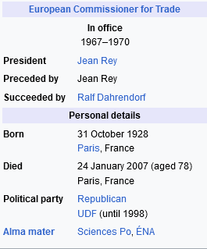
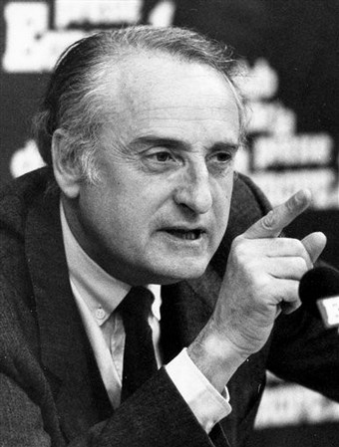
Introduction – Theory of Integration
Contemporary economic theories do not present comprehensive „picture“ of present processes of the international economic integration
Obtaining of the observation from integration reality
Gottfried Haberler
Jean Francois Deniau

Slide 4
Introduction – Theory of Integration
Objective character of international economic integration is given by internationalization processes
Internationalization = intergrowing (root penetration) of the national economies … due to
International division of labour … with
Interdependency of national economies

Slide 5

Introduction – Theory of Integration
Integration = flashpoint (culmination) of the internationalization processes
Objective process of joining (linking) and connecting through of the national economies into bigger units (supranational units?)

Slide 6

Introduction – Theory of Integration
Jacques Pelkmans … the author of a classical textbook on European integration, formulates it this way:
„Economic integration is defined as the elimination of economic frontiers between two or more economies.“
…. But this does not necessarily mean the elimination of borders (territorial and political ones) between states.

Slide 7
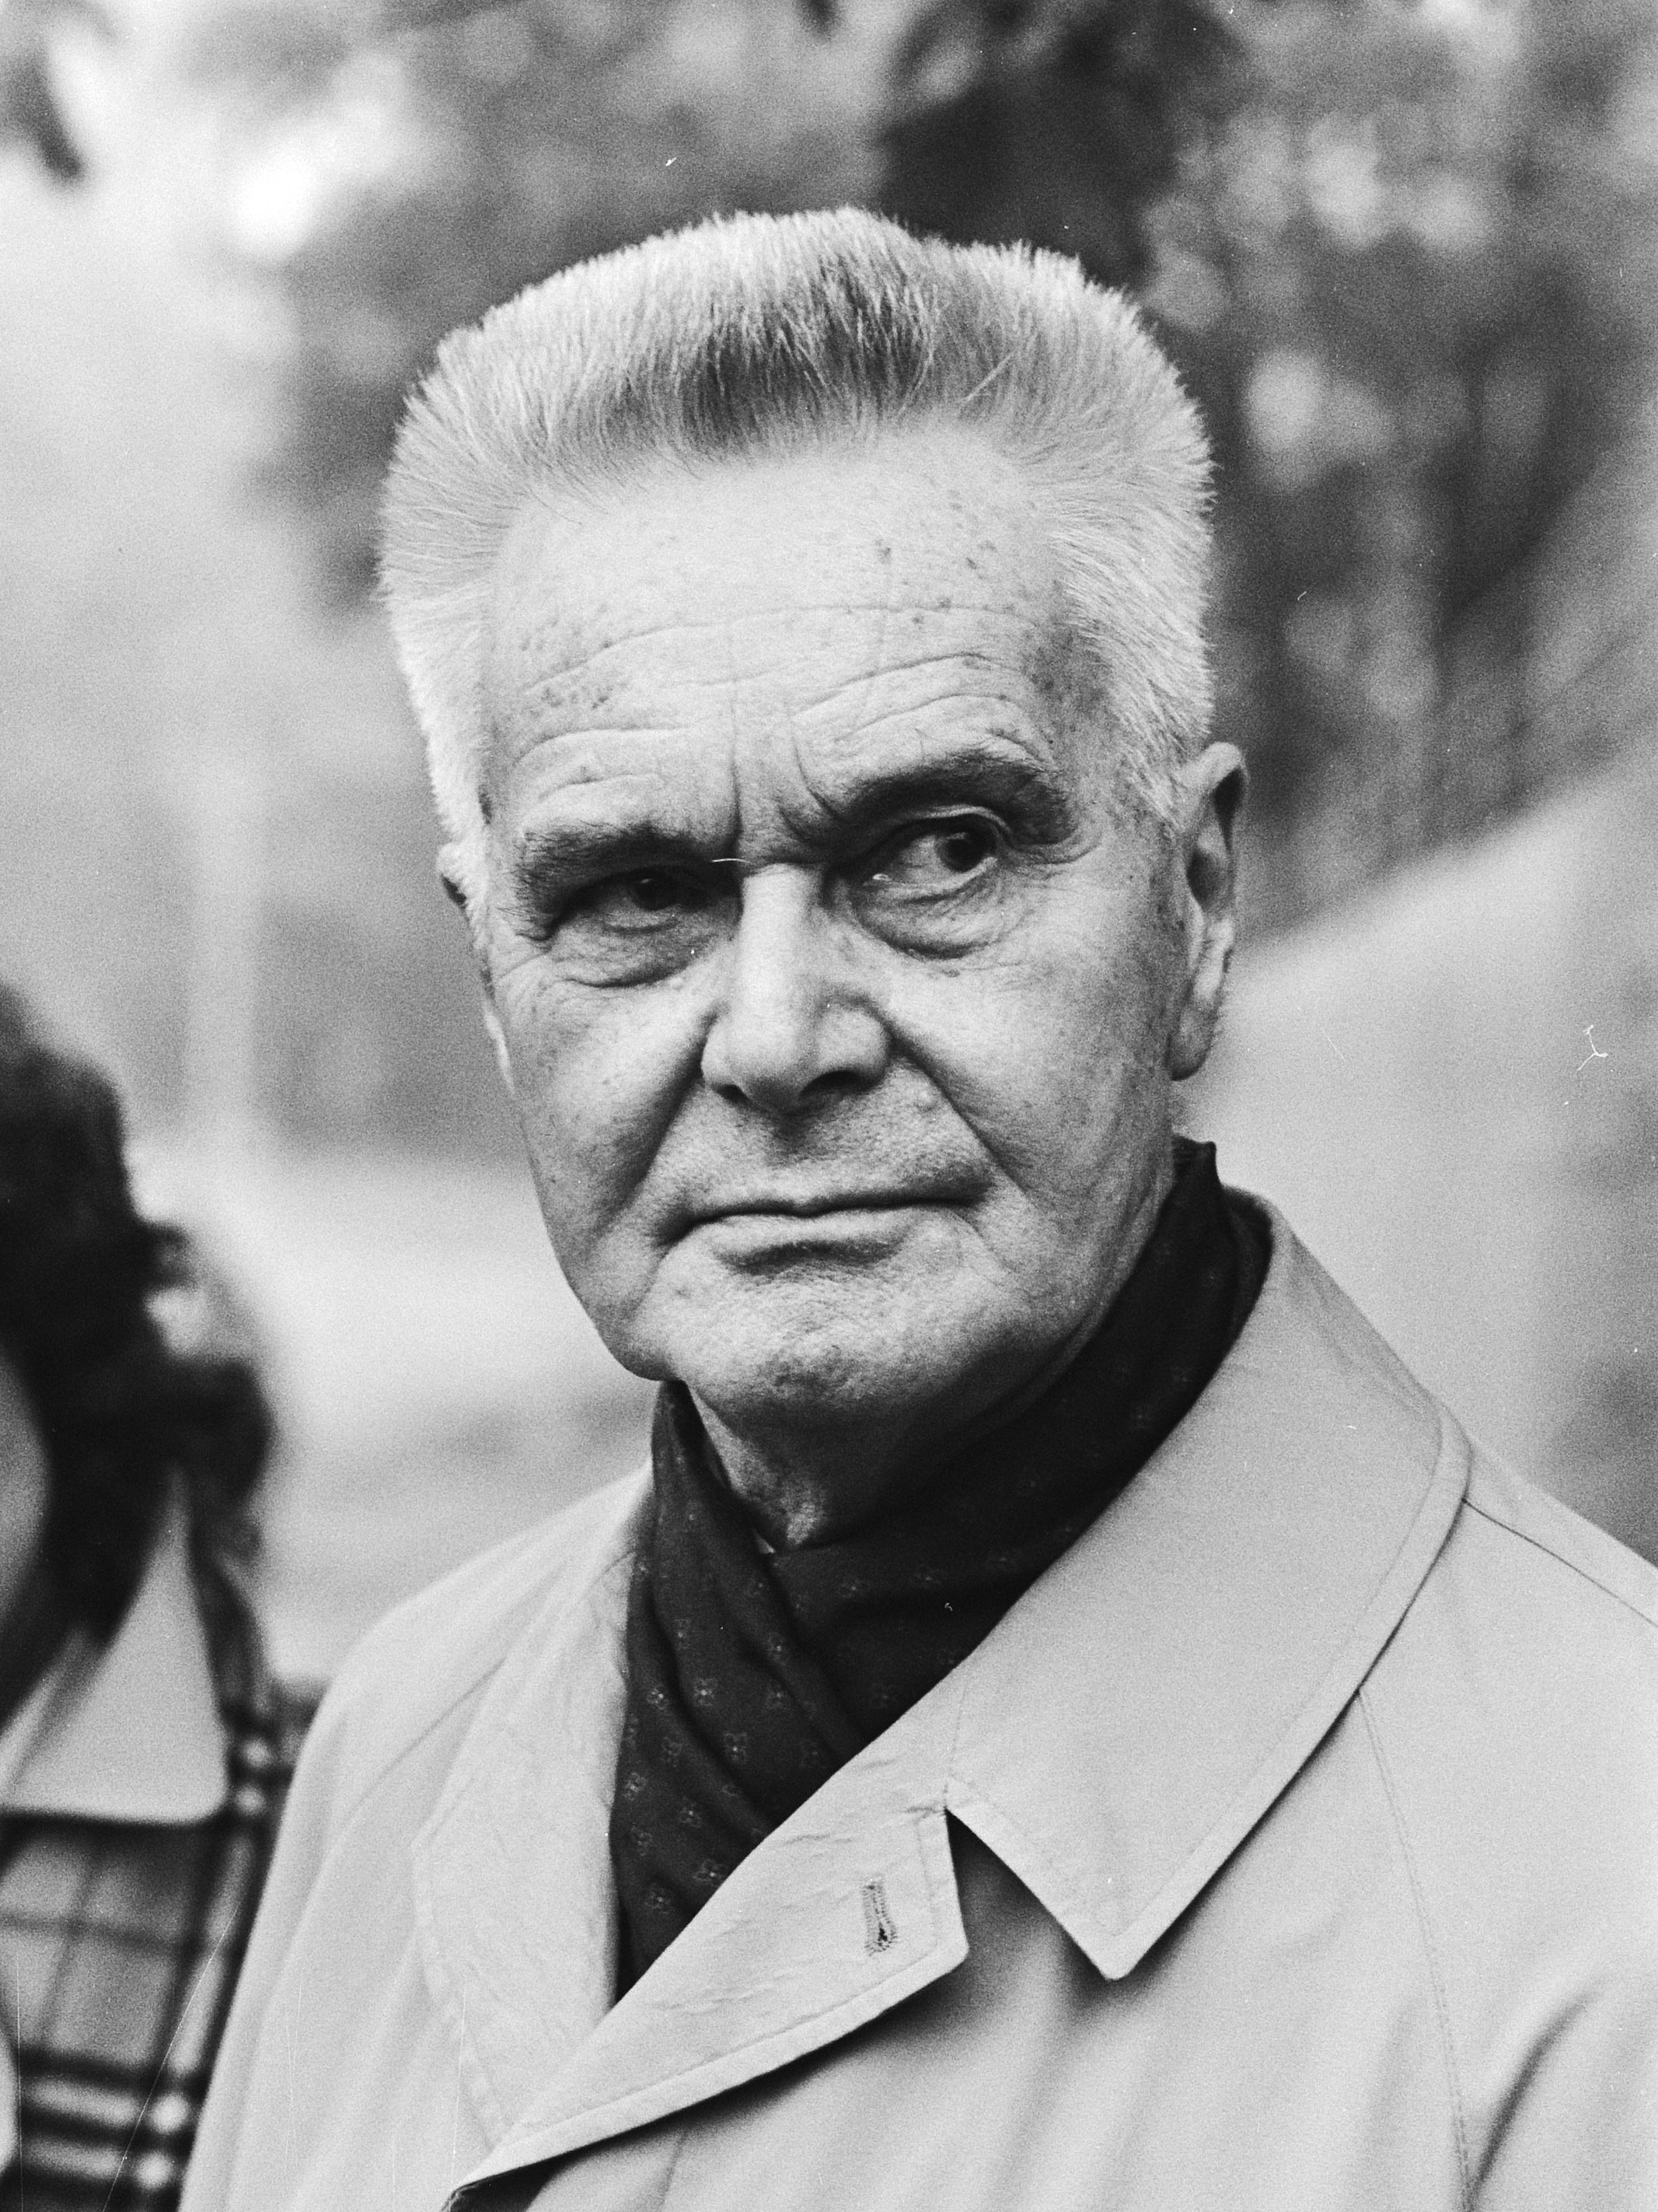
Introduction – Theory of Integration
Jan Tinbergen (Nobel Price in Economics) distinguishes between positive and negative integration:
NEGATIVE integration denotes the removal of discrimination in economic rules and policies under joint surveillance.
POSITIVE integration refers to the transfer to common institutions, or the joint exercise of at least some powers.

Slide 8
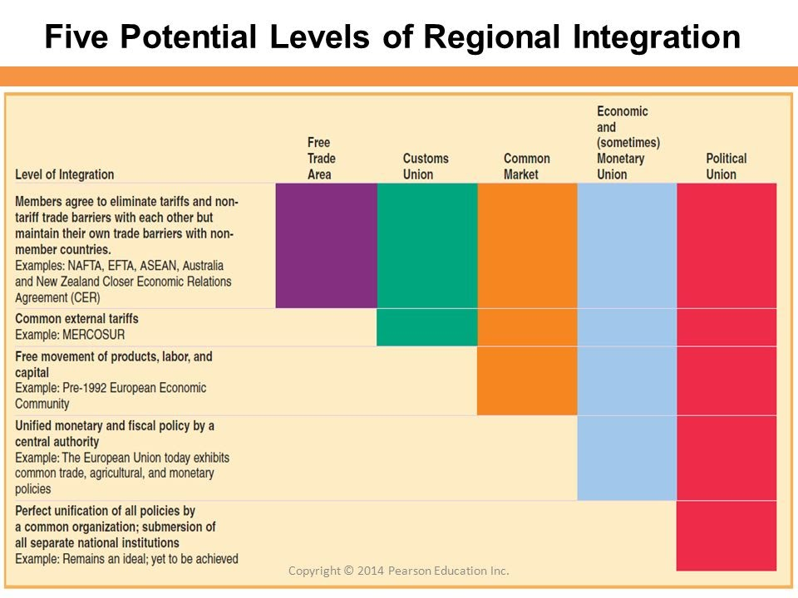
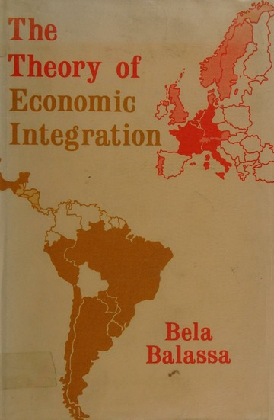
Introduction – Theory of Integration
An economic view of integration according to levels/stages of economic maturity

Slide 9
Introduction – Theory of Integration …summary of the concept…
International integration… „refers“ to the process by which supranational institutions come to replace national ones- the gradual shifting upward of sovereignty from the state to regional or global structures.
„The ultimate expression“ of integration would be the merger of several (or many) states into a single state- or ultimately into a single world government. Such a shift in sovereigty to the supranational level would probably entail some version of federalism (see later), in which states (or other political units) would recognize the sovereigty of a central government while retaining certain powers for themselves.

Slide 10
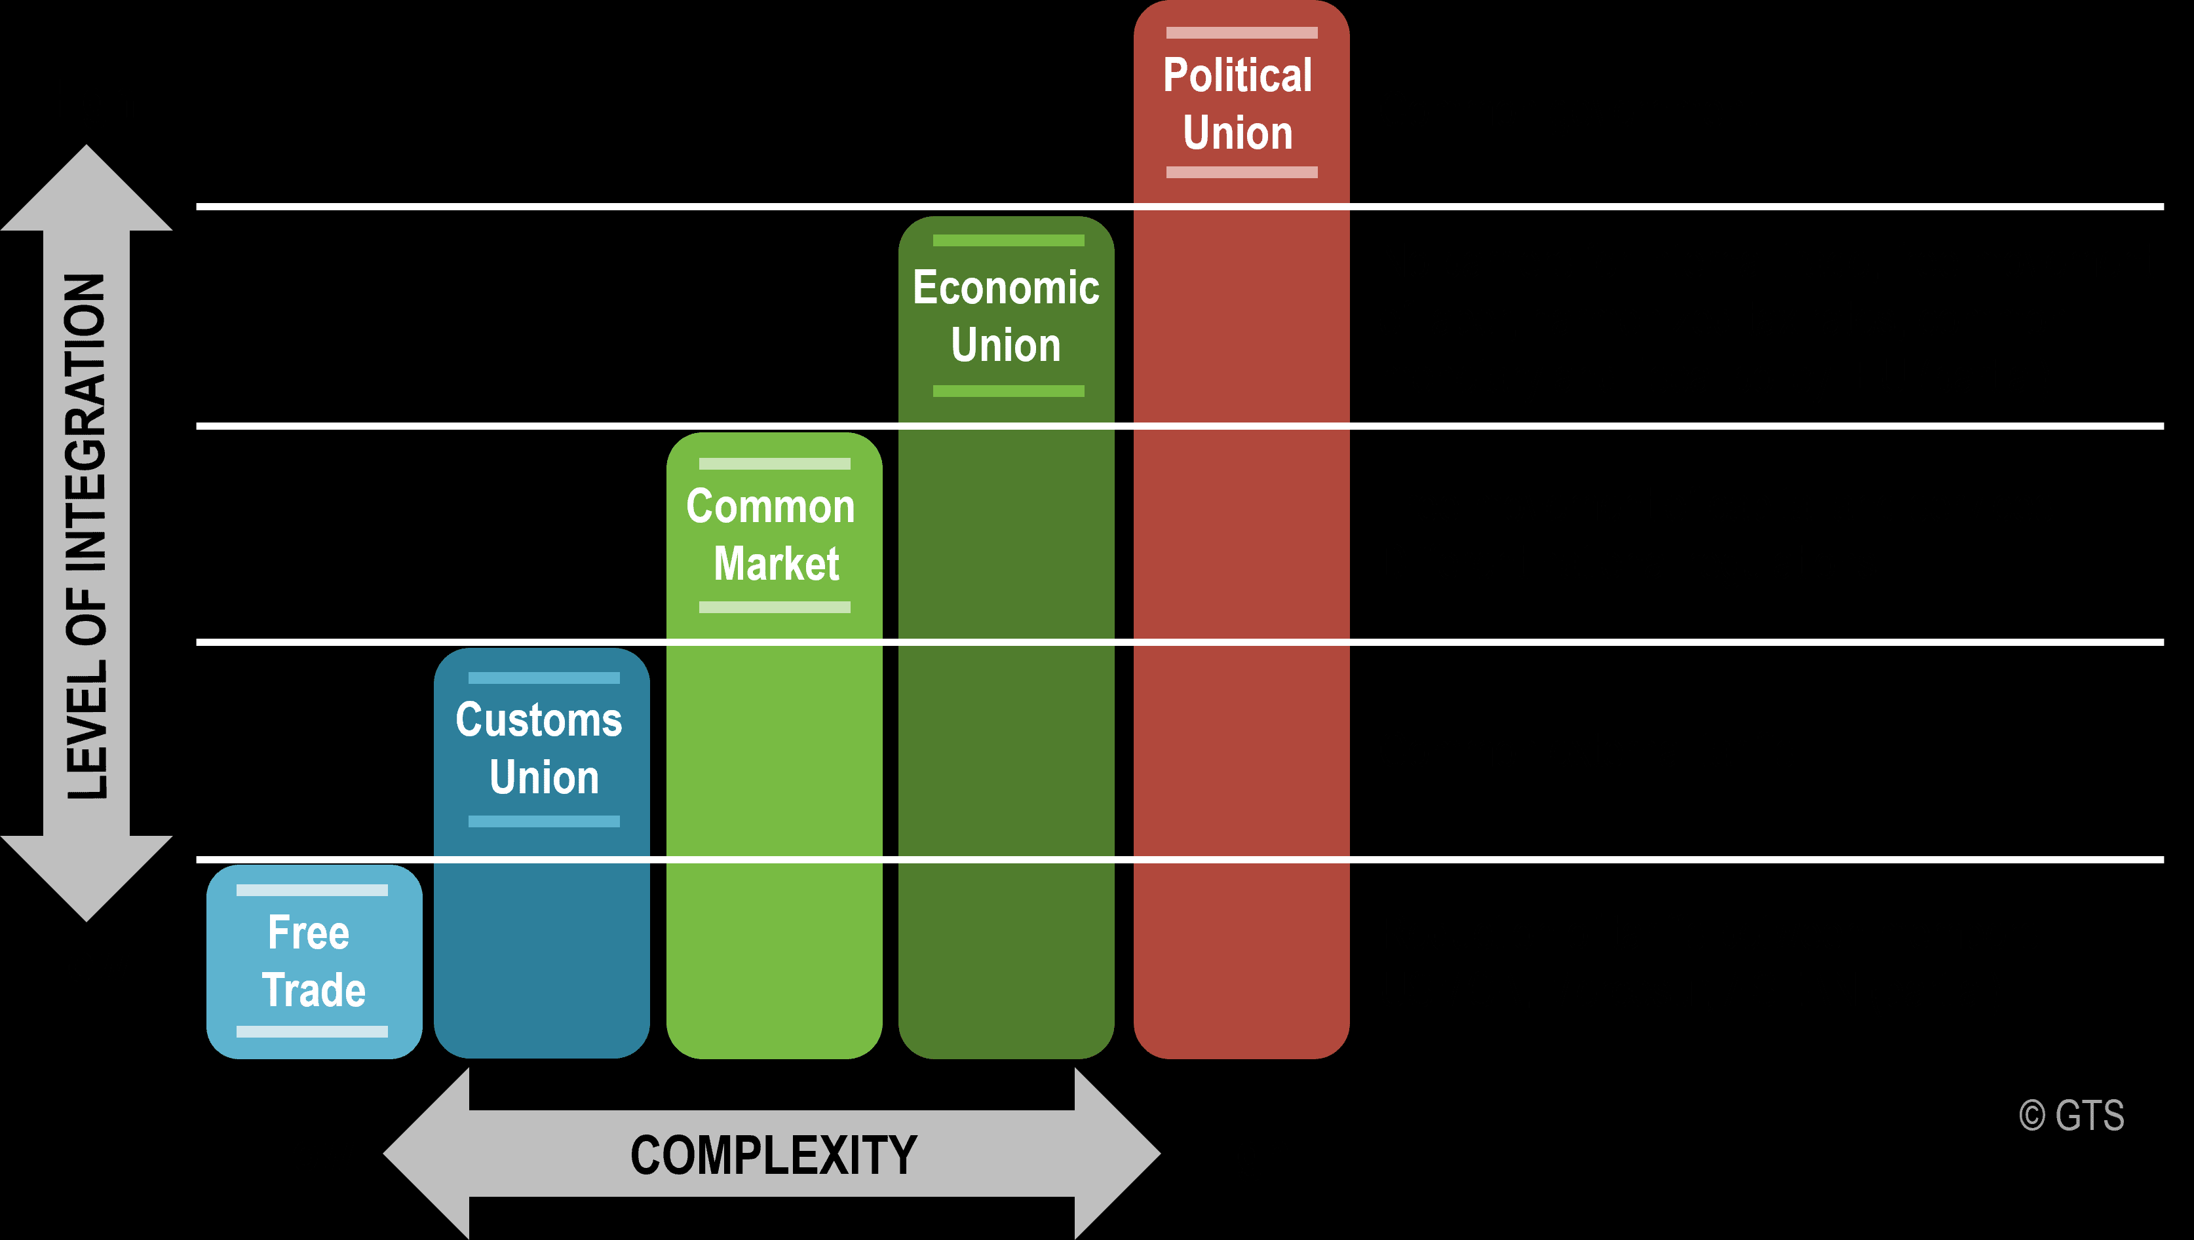
Introduction – Theory of Integration
Basic methods of integration (international economic integration – IEI)
Functional method – „market“ forces, „from below“
Institutional method – activity of the state and its institutions

Slide 11
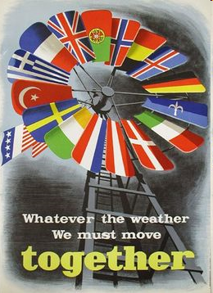
Introduction – Theory of Integration
Forms of the realization of integration in the world economy
Geographical approach (aspect)
  Global integration
  Regional integration
National economy sphere approach
  Partial integration (e.g. external trade)
  Universal integration

Slide 12
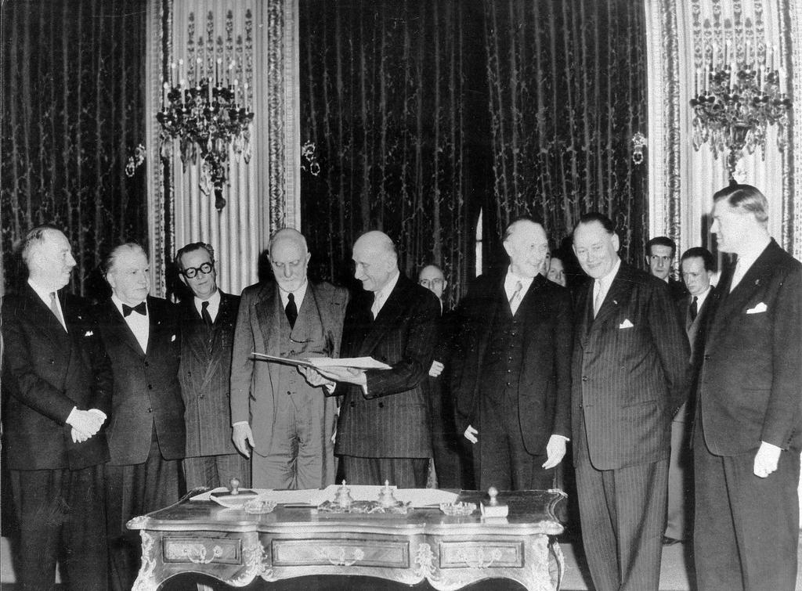
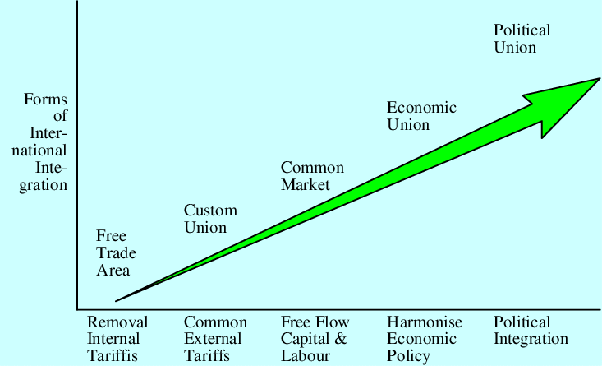
Introduction – Theory of Integration
Branch (sector) approach
  Vertical integration (sectoral – European Coal and Steel Community)
  Horizontal integration
Institutional approach
  Intergovernmental integration
  Supranational integration

Slide 13
Introduction – Theory of Integration
Economic integration - the elimination of economic barriers and cooperation between two or more economies on different levels.
Political integration - the creation within a given geographical territory, of a sense of community, based on shared values (including defence/security), and the necessary institutions.
MARKET INTEGRATION is a behavioural notion indicating that activities of market participants in different regions are geared towards supply and demand conditions in the entire Union.
POLICY INTEGRATION is a less precise concept. It may cover very different types of economic policies, using different kinds of instruments.

Slide 14
Introduction – Theory of Integration
Counter integration forces in the world economy (integration like overcoming of the barriers, obstacles)
Antiintegration forces – intercepting integration processes, deceleration
Disintegration forces – weakening of existing integration
Counter integration forces … with
Subjective character
Objective character

Slide 15


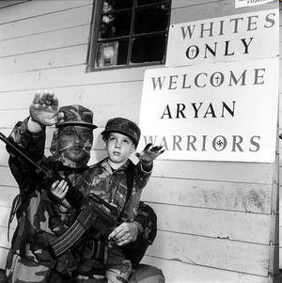
Introduction – Theory of Integration
Nationalism x national movement!!!
  It is very difficult to judge the disintegration processes of federal states in Europe – USSR, Czechoslovakia, Yugoslavia
  X
  Spain (Basque☺), United Kingdom (Nothern Ireland)

Slide 16

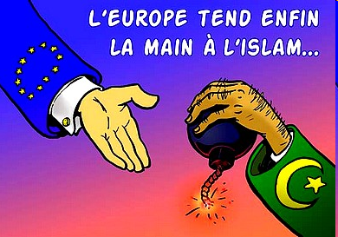
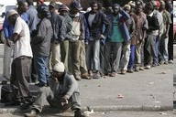
Introduction – Theory of Integration
Integration like a threat (menace) for national states
  European Union and its citizens, free movement
  Single European Market – without internal borders
  Schengen area
  Europe of the regions x regional Europe

Slide 17
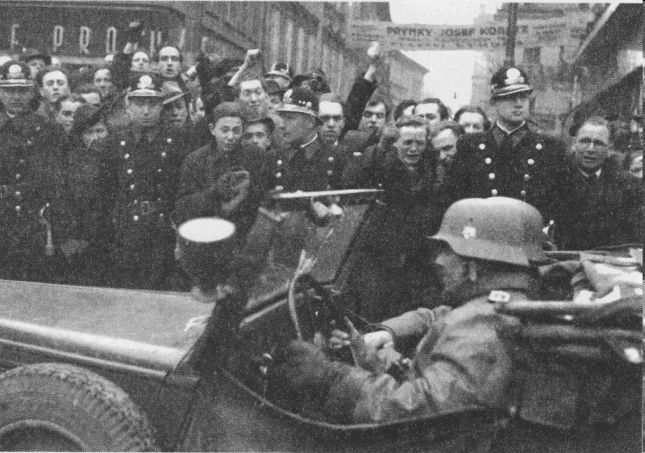
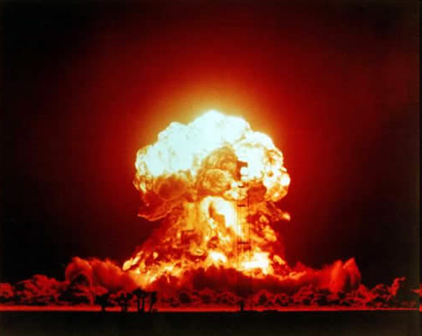
Introduction – Theory of Integration
Historical „weight“ (burden) of international relations (between neighbouring states)
  Wars, animosity relations, occupation regime
    Czech Republic x Germany
    Former FYROM (now North Macedonia) x Greece
Border disputes (battles)
    India x Pakistan

Slide 18
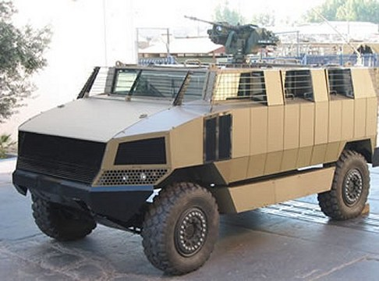
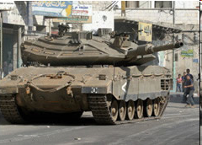
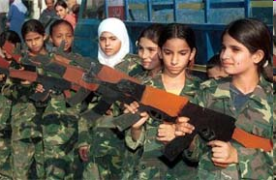
Introduction – Theory of Integration
Implications of agression policy, annexation policy
  Relations between Turkey and Greece (Cyprus)
  Relations on the Near East – Israel x Palestinians
Religion conflicts
Economic nationalism
Xenophobia
XXX

Slide 19
THANK YOU FOR YOUR ATTENTION

