Slide 2
Theory of International Economic Integration II – Stages of Integration.
Radomír Kaňa
Department of International Economic Relations

Slide 3
Stages/levels of international economic integration
Traditional division – reflects the situation in integration processes during the 1950s and 1960s
New model – reflects changes in European integration
https://www.youtube.com/watch?v=Do2G4zcrDqY – see the video about levels/stages of integration

Slide 4
Traditional division („old model“)
Free Trade Area - FTA
Customs Union - CU
Common Market - CM
Economic Union, Economic and Monetary Union – EU, EMU
Political Union - PU

Slide 5
New model
Free Trade Area - FTA
Customs Union – CU
Primary Economic Union – PEU
Advanced Economic Union – AEU
Formative Economic and Monetary Union – FEMU
Complete Economic and Monetary Union – CEMU
Economic and Political union - EPU

Slide 6
… in some publications…before „Free Trade Area“ is mentioned…
A Preferential trade area (also Preferential trade agreement, PTA) is a trading bloc which gives preferential access to certain products from the participating countries. This is done by reducing tariffs, but not by abolishing them completely.
A PTA can be established through a trade pact. The line between a PTA and a Free trade area (FTA) may be blurred, as almost any PTA has a main goal of becoming a FTA in accordance with the General Agreement on Tariffs and Trade.
These tariff preferences have created numerous departures from the normal trade relations principle, namely that World Trade Organization (WTO) members should apply the same tariff to imports from other WTO members

Slide 7
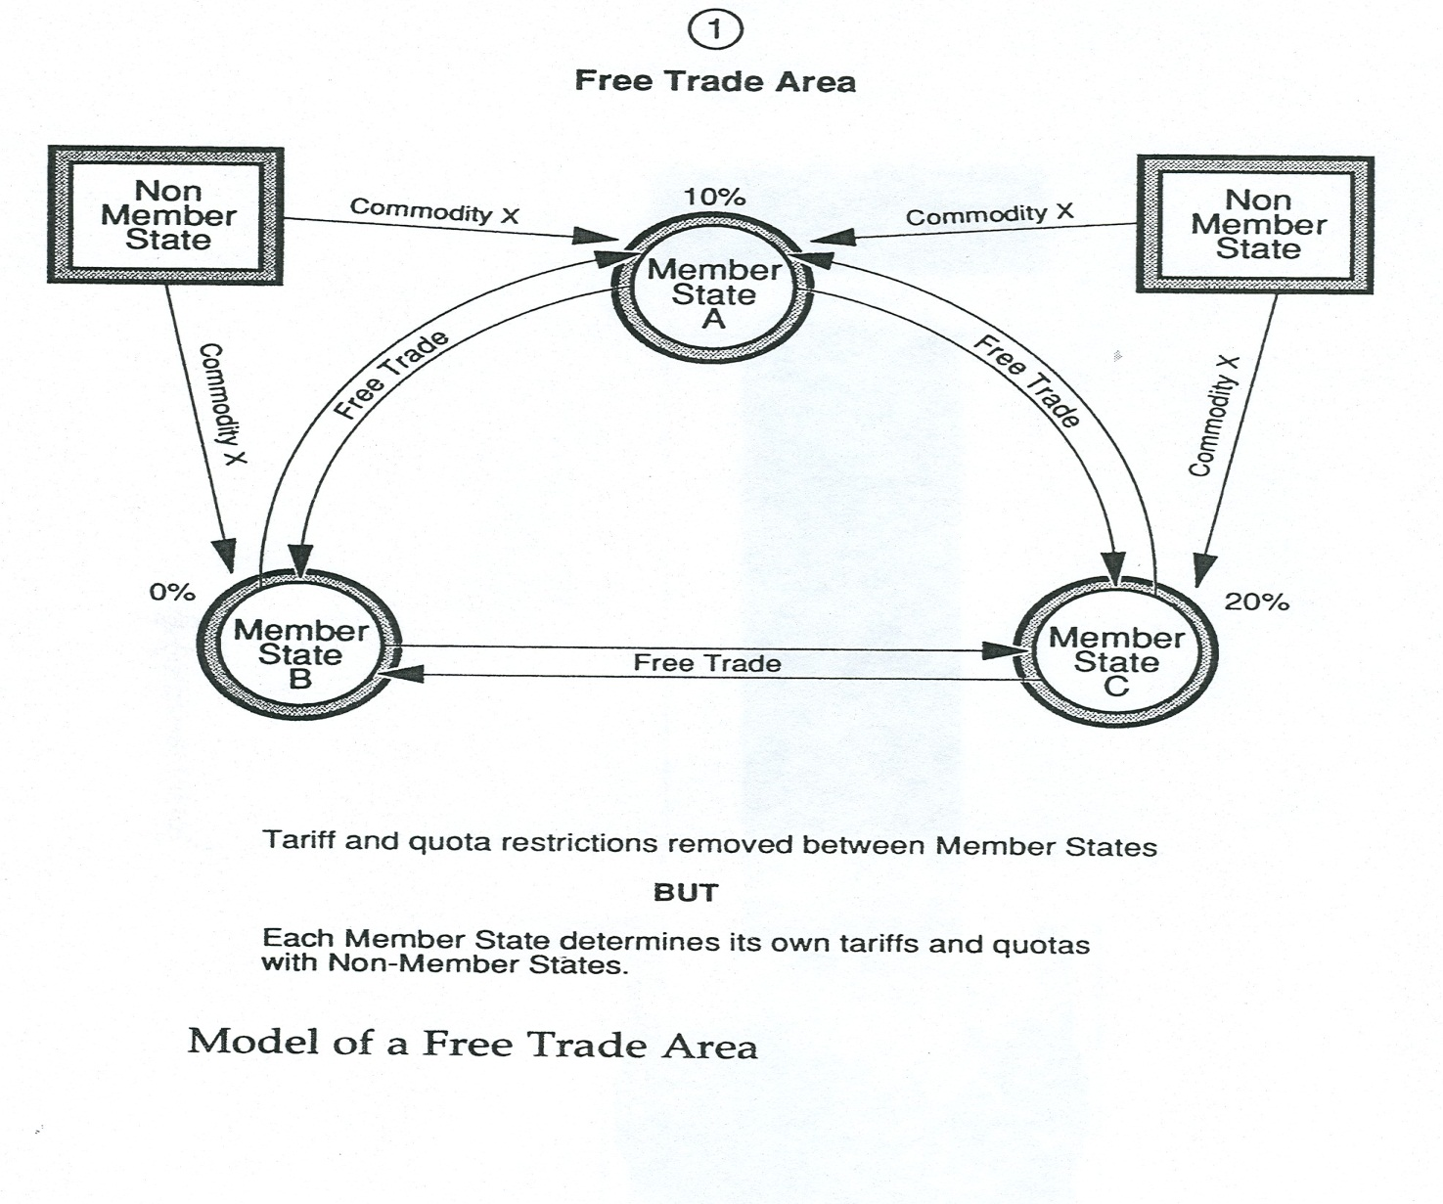
Free Trade Area

Slide 8
Free Trade Area
A free-trade area is a trade bloc whose member countries have signed a free-trade agreement (FTA), which eliminates tariffs, (or import quotas) and preferences on most goods traded between them.
It can be considered the first stage of economic integration. Countries choose this kind of economic integration if their economical structures are complementary. If their economical structures are competitive, it is likely there will be no incentive for a FTA, or only selected areas of goods and services will be covered to fulfill the economic interests between the two signatories of FTA.

Slide 9
Free Trade Area
Members of a free-trade area do not have a common external tariff, which means they have different quotas and customs, as well as other policies with respect to non-members.
To avoid tariff evasion (through re-exportation) the countries use the system of certification of origin most commonly called rules of origin, where there is a requirement for the minimum extent of local material inputs and local transformations adding value to the goods. Only goods that meet these minimum requirements are entitled to the special treatment envisioned by the free trade area provisions.

Slide 10
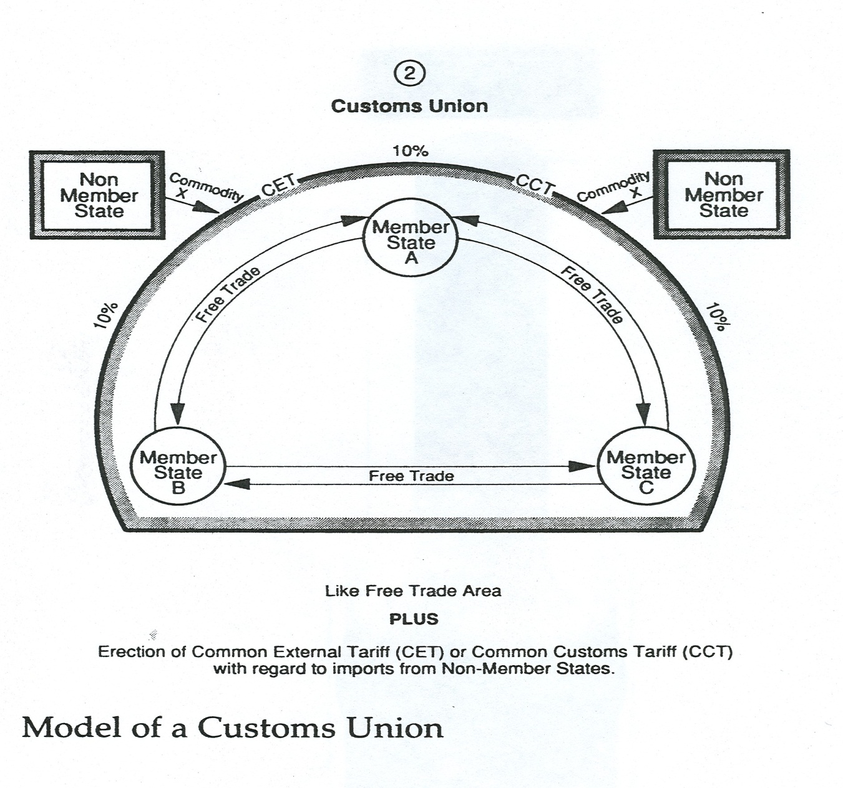
Customs Union

Slide 11
Customs Union
… it has long been recognized that tariff barriers generally reduce the quantity of trade between countries. Under most circumstances this reduction in trade protects certain domestic producers, but it also translates into higher costs for consumers in both the importing and the exporting country
many governments attempt to resolve this problem by protecting politically favoured producers while also reducing consumer costs. Customs unions, along with other forms of partial economic integration, offer one means of achieving that balance.
Customs Union - a trade agreement by which a group of countries charges a common set of tariffs to the rest of the world while granting free trade among themselves. It is a partial form of economic integration that offers a step between free-trade areas and common markets

Slide 12
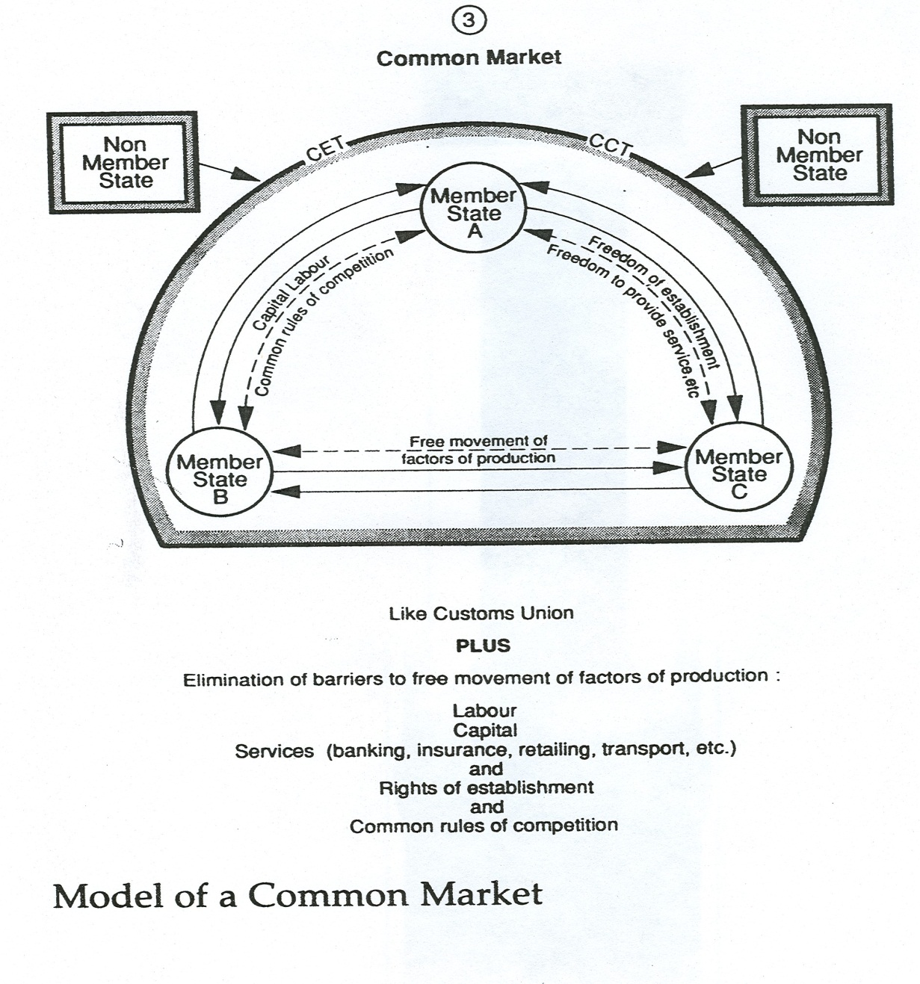
Common Market

Slide 13
Common Market
formed by countries within a geographical area to promote duty free trade (goods and services) and free movement of labor and capital among its members
A common market could be… a first stage towards a single market (in the case of EU), and may be limited initially to a free trade area with relatively free movement of capital and of services, but not so advanced in reduction of the rest of the trade barriers (non-tariff barriers)

Slide 14
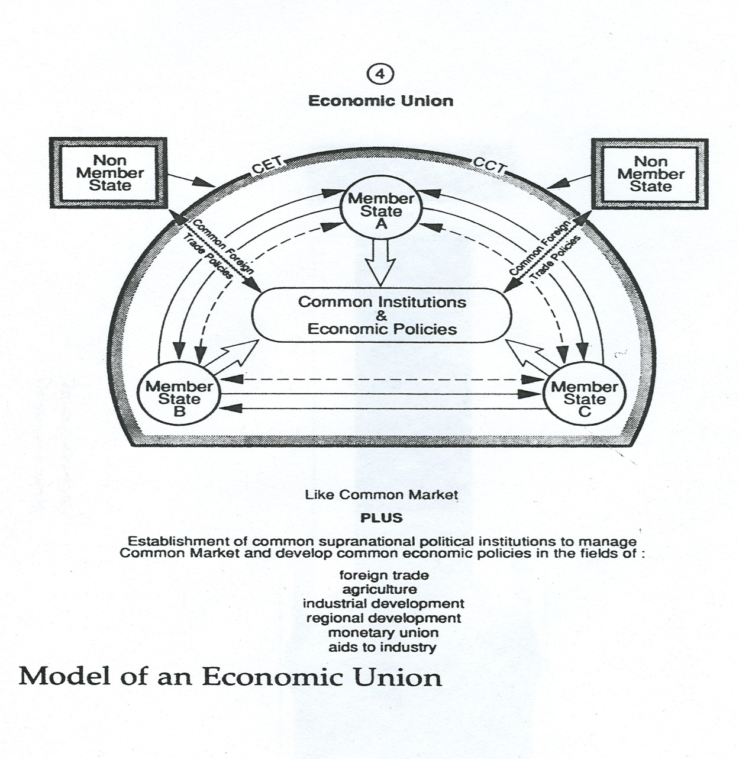
Economic Union

Slide 15
Economic Union
An agreement between two or more countries that allows the free movement of capital, labor, and all goods and services, and involves the harmonization and unification of „selected“ economic policies – monetary policy, fiscal policy, agriculture, fisheries, transport …
Purposes for establishing an economic union normally include increasing economic efficiency and establishing closer political and cultural ties between the member states

Slide 16
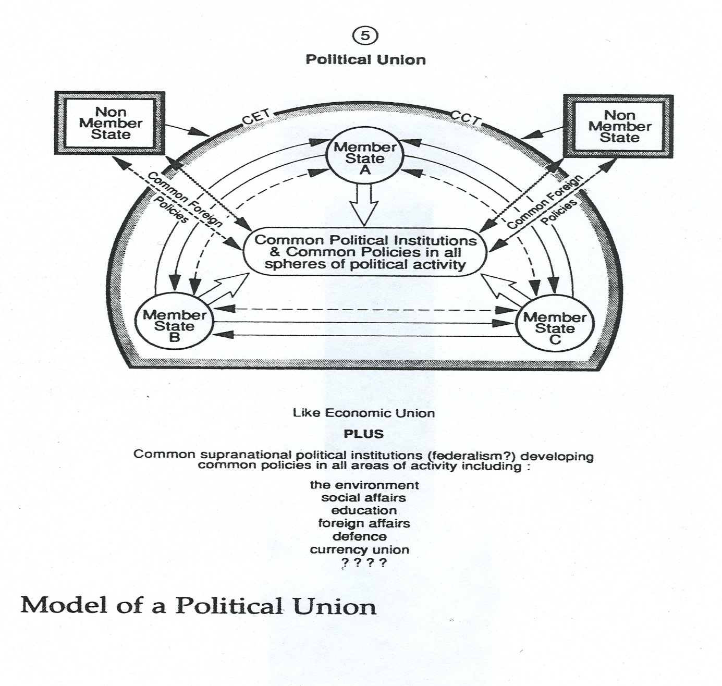
Political Union

Slide 17
Political Union
type of „state“ (or consolidated group of nations) which is composed of or created out of smaller states. Unlike a personal union, the individual states share a kind of central government and the union is recognized internationally as a single political entity.
… a political union may also be called a legislative union or state union

Slide 18
New model
Free Trade Area - FTA – like old model
Customs Union – CU – like old model
Primary Economic Union – PEU – with nontariff barriers (ntbs)
Advanced Economic Union – AEU – without nontariff barriers
Formative Economic and Monetary Union – FEMU – e.g. without common fiscal policy
Complete Economic and Monetary Union – CEMU – with common fiscal policy
Economic and Political union – EPU – like old model

Slide 19
THANK YOU FOR YOUR ATTENTION

