Slide 2
Development of integration in Europe, historical aspects.
Radomír Kaňa
Department of International Economic Relations

Slide 3
… historical steps …
Also created, in order to manage the ECSC, were a group of ‘supranational’ (a level of governance above the nation state) bodies:
a Council of Ministers, a Common Assembly, a High Authority and a Court of Justice, all to legislate, develop ideas and resolve disputes.
It was from these key bodies that the later EU would emerge, a process which some of the ECSC’s creators had envisaged, as they explicitly stated the creation of a federal Europe as their long term goal.

Slide 4
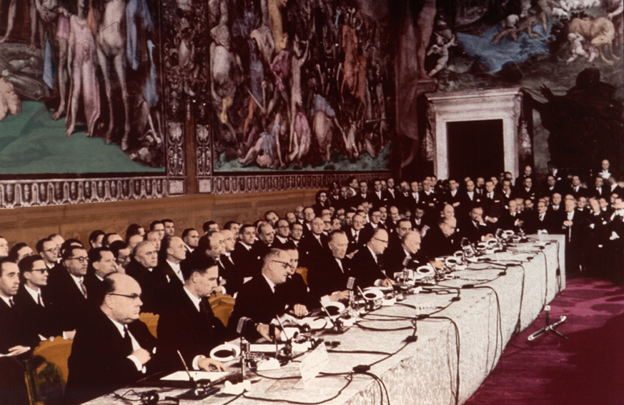
Treaty of Rome - Signed in 1957 by the heads of government of France, Belgium, Luxembourg, West Germany, the Netherlands and Italy, the treaty was the result of eleven years of attempts to reconstruct the European continent after World War II.

Slide 5
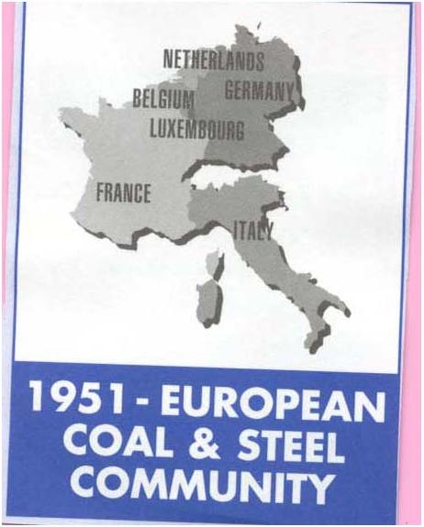
… historical steps …
A false step was taken in the mid 1950s when a proposed „European Defence Community“ among the ESSC’s six states was drawn up: it called for a joint army to be controlled by a new supranational Defence Minister. The initiative had to be rejected after France’s National Assembly voted it down.
The Six then decided, on 25 March 1957 with the Treaty of Rome, to build a European Economic Community (EEC) and European Atomic Energy Community (Euratom). EEC has been based on a wider common market covering a whole range of goods and services. Customs duties between the six countries were completely abolished on 1 July 1968 and common policies, notably on trade and agriculture, were also put in place during the 1960s.

Slide 6
… historical steps …
Like the ECSC, the EEC created several supranational bodies: a Council of Ministers to make decisions, a Common Assembly (called the European Parliament from 1962) to give advice, a court which could overrule member states and a Commission to put the policy into affect.
The 1965 (1967) Brussels Treaty merged the Commissions and Councils of the EEC, ECSC and Euratom to create a joint and permanent civil service….European Communities

Slide 7
… historical steps …
In the late 1960s a power struggle established the need for unanimous agreements on key decisions, effectively giving member states a veto - Luxembourg Compromise 1966. It has been argued that this slowed Union by two decades.
Over the 70s and 80s the membership of the EEC expanded, allowing Denmark, Ireland and the UK in 1973, Greece in 1981 and Portugal and Spain in 1986.
Britain had changed its mind after seeing its economic growth lag behind the EEC, and after America indicated it would support Britain as a rival voice in the EEC to France and Germany. However, Britain’s first two applications were vetoed by France (De Gaulle). Norway applied at the same time, but withdrew after a referendum said „no“.
Meanwhile member states began to see European integration as a way to balance the influence of both Russia and now America.

Slide 8
… historical steps …
At the same time, new social and environmental policies were implemented, and the European Regional Development Fund (ERDF) was established in 1975.
June 1979 saw a decisive step forward for the European Community, with the first direct elections to the European Parliament by direct universal suffrage. These elections are held every five years.
The worldwide economic recession in the early 1980s brought with it a wave of ‘euro-pessimism’. However, hope sprang anew in 1985 when the European Commission, under its President Jacques Delors, published a White Paper setting out a timetable for completing the European Single Market by 1 January 1993. This ambitious goal was enshrined in the Single European Act, which was signed in February 1986 and came into force on 1 July 1987.

Slide 9
… historical steps …
The political shape of Europe was dramatically changed when the Berlin Wall fell in 1989. This led to the unification of Germany in October 1990 and the coming of democracy to the countries of central and eastern Europe as they broke away from Soviet control. The Soviet Union itself ceased to exist in December 1991.
At the same time, the member states were negotiating the new Treaty on European Union, On February 7th 1992 European integration moved a step further when the Treaty on European Union, (better known as the Maastricht Treaty) was signed.
This came into force on 1 November 1993 and changed the EEC into the newly named European Union. The change was to broaden the work of the supranational bodies, based around three „pillars“: the European Communities, giving more power to the European parliament; a Common Foreign and Security Policy; involvement in the domestic affairs of member nations on „Justice and Home Affairs“.

Slide 10
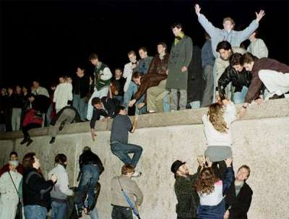
The Berlin Wall was pulled down in 1989 and the old divisions
of the European continent gradually disappeared.

Slide 11
… historical steps …
The EU also set out guidelines for the creation of a single currency, ….. Currency and economic reform were now being driven largely by the fact that the US and Japanese economies were growing faster than Europe’s, especially after expanding quickly into the new developments in electronics.
There were objections from poorer member nations, who wanted more money from the Union, and from larger nations, who wanted to pay less; a compromise was eventually reached.
One planned side effect of the closer economic union and the creation of a single market was the greater co-operation in social policy which would have to occur as a result.
The Maastricht Treaty also formalised the concept of EU citizenship…

Slide 12
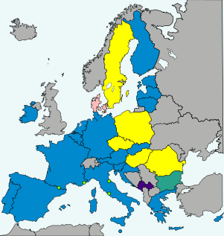

1 January 1999 - the euro is introduced in 11 countries (joined by Greece in 2001) for commercial and financial transactions only. Notes and coins will come later. The euro countries are Belgium, Germany, Greece, Spain, France, Ireland, Italy, Luxembourg, the Netherlands, Austria, Portugal, Finland, Slovenia, Cyprus, Malta, Slovakia, Estonia, Latvia, Lithuania, Croatia (2023…20 members). The seven non-eurozone members of the EU are Bulgaria, Czech Republic, Denmark, Hungary, Poland, Romania, and Sweden. They continue to use their own national

Slide 13
… historical steps …
In 1995 Sweden, Austria and Finland joined, …in 1999 the Treaty of Amsterdam came into effect, bringing employment, working and living conditions and other social and legal issues (foreign and security) into the EU remit.
…Europe was facing great changes caused by the collapse of the Soviet dominated east and the emergence of economically weakened, but newly democratic, eastern nations.
The 2001 (2003) Treaty of Nice tried to prepare for this, and a number of states entered into special agreements where they initially joined parts of the EU system, such as the free trade zones … discussions over streamlining voting and modifying the CAP
By this time there had been agreements to apply majority voting to more issues, but national vetoes remained on tax, security and other issues.

Slide 14
Scarcely had the European Union grown to 15 members when preparations began for a new enlargement on an unprecedented scale . In the mid-1990s, the former Soviet-bloc countries (Bulgaria, the Czech Republic, Hungary, Poland, Romania and Slovakia), the three Baltic states that had been part of the Soviet Union (Estonia, Latvia and Lithuania), one of the republics of former Yugoslavia (Slovenia) and two Mediterranean countries (Cyprus and Malta) began knocking at the EU’s door.
The EU welcomed this chance to help stabilise the European continent and to extend the benefits of European integration to these young democracies. Negotiations on future membership opened in December 1997. The EU enlargement to 25 countries took place on 1 May 2004 when 10 of the 12 candidates joined. Bulgaria and Romania followed on 1 January 2007…. Croatia (2013).

Slide 15
… March 2000, the EU adopted the „Lisbon strategy“ (2000 – 2010)
for modernising the European economy and enabling it to compete on the world market with other major players such as the United States … involved encouraging innovation and business investment and adapting Europe’s education systems to meet the needs of the information society
… in 2004, Wim Kok, headed up a review of the program and presented a report on the Lisbon strategy concluding that even if some progress was made, most of the goals were not achieved
Official valuation of the Lisbon Strategy took place in March 2010 at a European Summit, where the new Europe 2020 strategy was also launched.

Slide 16
… historical steps …
The Convention on the Future of Europe was created in 2002 to create an EU constitution, and the draft, signed in 2004, aimed to install a permanent EU president, a Foreign Minister and a Charter of Rights. It would have also allowed the EU to make many more decisions instead of the heads’ of the individual nation states. It was rejected in 2005, when France and the Netherlands failed to ratify it
… the Lisbon Treaty … still aimed to install an EU president and Foreign Minister, as well as expand the EU’s legal powers, but only through developing the existing bodies.
… signed in 2007,… initially rejected, by voters in Ireland … in 2009 Irish voters passed the treaty. By the winter 2009 all 27 EU states had ratified the process, and it took effect.
Herman Van Rompuy, at that time Belgium Prime Minister, became the first „President of the European Council“, and Britain’s Baroness Ashton „High Representative for Foreign Affairs“.

Slide 17
Appendix – The Lisbon Strategy
The Lisbon Strategy, also known as the Lisbon Agenda or Lisbon Process, was an action and development plan devised in 2000, for the economy of the European Union between 2000 and 2010.
Its aim was to make the EU "the most competitive and dynamic knowledge-based economy in the world capable of sustainable economic growth with more and better jobs and greater social cohesion", by 2010.
It was set out by the European Council in Lisbon in March 2000. By 2010, most of its goals were not achieved.

Slide 18
Appendix – The Lisbon Strategy
The main fields were economic, social, and environmental renewal and sustainability. The Lisbon Strategy was heavily based on the economic concepts of:
Innovation as the motor for economic change (based on the writings of Joseph Schumpeter)
The "learning economy"
Social and environmental renewal
Under the strategy, a stronger economy would create employment in the EU, alongside inclusive social and environmental policies, which would themselves drive economic growth even further.
An EU research group found in 2005 that current progress had been judged "unconvincing", so a reform process was introduced wherein all goals would be reviewed every three years, with assistance provided on failing items.

Slide 19
Appendix – The Lisbon Strategy
Between April and November 2004, Wim Kook headed up a review of the program and presented a report on the Lisbon strategy concluding that even if some progress was made, most of the goals were not achieved:
European Union and its Member States have clearly themselves contributed to slow progress by failing to act on much of the Lisbon strategy with sufficient urgency. This disappointing delivery is due to an overloaded agenda, poor coordination and conflicting priorities. Still, a key issue has been the lack of determined political action
The European Commission used this report as a basis for its proposal in February 2005 to refocus the Lisbon Agenda on actions that promote growth and jobs in a manner that is fully consistent with the objective of sustainable development. The Commission's communication stated that "making growth and jobs the immediate target goes hand in hand with promoting social or environmental objectives
In 2009 Swedish prime minister Fredrik Reinfeldt admitted: Even if progress has been made it must be said that the Lisbon Agenda, with only a year remaining before it is to be evaluated, has been a failure.

Slide 20
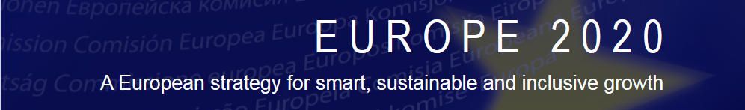
Appendix – Europe 2020
Europe 2020 was a 10-year strategy proposed by the European Commission on 3 March 2010 for advancement of the economy of the European Union. It aims at "smart, sustainable, inclusive growth" with greater coordination of national and European policy. It follows the Lisbon Strategy for the period 2000–2010.
See Europe 2020 strategy
https://ec.europa.eu/eu2020/pdf/COMPLET%20EN%20BARROSO%20%20%20007%20-%20Europe%202020%20-%20EN%20version.pdf

Slide 21
Appendix – Europe 2020
The strategy identifies five headline targets the European Union should take to boost growth and employment. These are:
To raise the employment rate of the population aged 20–64 from the current 69% to at least 75%.
To achieve the target of investing 3% of GDP in R&D in particular by improving the conditions for R&D investment by the private sector, and develop a new indicator to track innovation.
To reduce greenhouse gas emissions by at least 20% compared to 1990 levels or by 30% if the conditions are right, increase the share of renewable energy in final energy consumption to 20%, and achieve a 20% increase in energy efficiency.
To reduce the share of early school leavers to 10% from the current 15% and increase the share of the population aged 30–34 having completed tertiary from 31% to at least 40%.
To reduce the number of Europeans living below national poverty lines by 25%, lifting 20 million people out of poverty.

Slide 22
Appendix – Europe 2020
On 26 March 2010, the European Council agreed on the key elements of the new strategy. President Herman Van Rompuy who chaired the meeting pointed out that the strategy sums up the European model of social market economy with a strong environmental dimension.
The strategy elements were formally adopted on 17 June 2010.
Monitoring progress and ensuring the active involvement of EU countries are key elements of the strategy. This is done through the European Semester, an annual cycle of macro-economic, budgetary and structural policy coordination.
See European Semester
https://commission.europa.eu/business-economy-euro/economic-and-fiscal-policy-coordination/european-semester_en

Slide 23
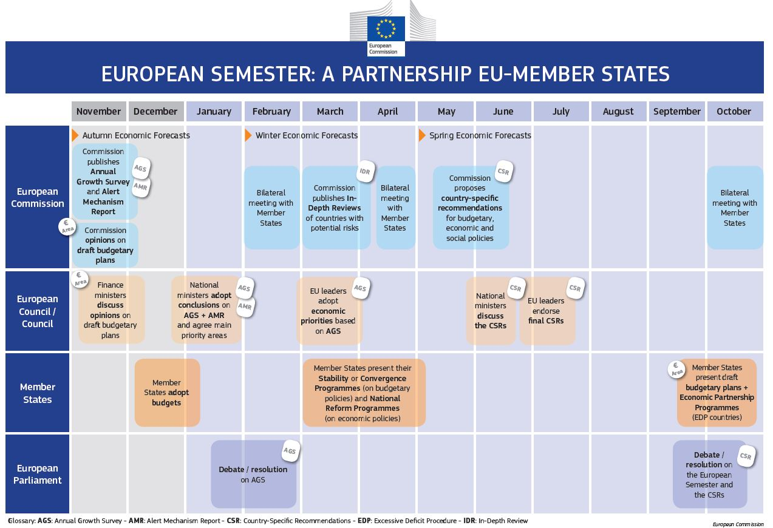

Slide 24
European Green Deal
The European Green Deal, approved in 2020, is a set of policy initiatives by the European Commission with the overarching aim of making the European Union (EU) climate neutral in 2050.
An impact assessed plan will also be presented to increase the EU's greenhouse gas emission reductions target for 2030 to at least 50% and towards 55% compared with 1990 levels. The plan is to review each existing law on its climate merits, and also introduce new legislation on the circular economy, building renovation, biodiversity, farming and Innovation.
„Implementing the European Green Deal“ https://cor.europa.eu/en/engage/studies/Documents/European%20Green%20Deal%20Handbook.pdf

Slide 25
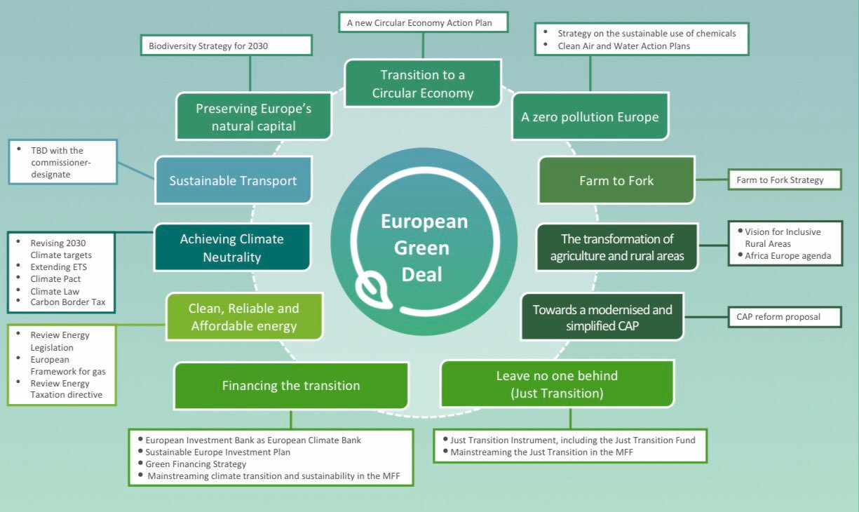

Slide 26
THANK YOU FOR YOUR ATTENTION

