Slide 2
Main Architects of European integration.
Radomír Kaňa
Department of International Economic Relations

Slide 3







Konrad Adenauer
Sir Winston Churchill
Alcide de Gasperi
Jean Monnet
Robert Schuman
Paul Henri Spaak
Altiero Spinelli
See EU pioneers:
https://european-union.europa.eu/principles-countries-history/history-eu/eu-pioneers_en

Slide 4
Jean Omer Marie Gabriel Monnet
Jean Monnet (1888-1979) – „founding father“ As top advisor of the French government, he was the main inspiration behind the famous "Schuman declaration" of 9 May 1950, which led to the creation of the European Coal and Steel Community and, as such, is considered to be the birth of the European Union. Between 1952-55 he was the first president of its executive body.
In 1955, Monnet founded the Action Committee for the United States of Europe. It brought political parties and European trade unions together to become a driving force behind the initiatives which laid the foundation for the European Union as it eventually emerged: first the European Economic Community (EEC) and Euratom (1958) which was established by the Treaty of Rome of 1957; later the European Communities (1967) with its corresponding bodies …the European Commission and the European Council of Ministers, British membership in the Community (1973), the European Council (1974), the European Monetary System (1979), and the European Parliament (1979). This process reflected Monnet's belief in a gradualist approach for constructing European unity.

Slide 5
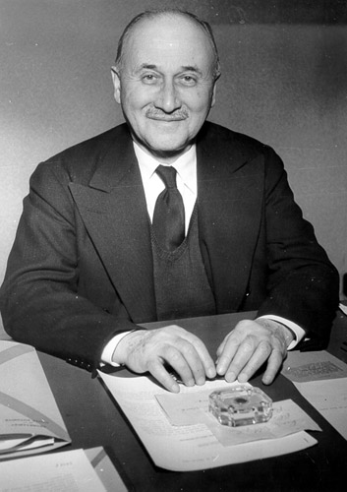
Jean Omer Marie Gabriel Monnet
On 6 December 1963, Monnet was presented with the Presidential Medal of Freedom, with Special Distinction, by President Lyndon Johnson. He died in 1979 at the age of 90. In 1988, by order of the president François Mitterrand, Jean Monnet's remains were transferred to the Pantheon of Paris
It would, however, be unjust to limit Monnet's influence to the economic sphere. His famous and much-quoted phrase was "We unite people, not states". Today's EU programmes for cultural and educational exchange follow in this tradition.

Slide 6
Robert Schuman
Robert Schuman (1886-1963) The politician Robert Schuman, a qualified lawyer and French foreign minister between 1948 and 1952, is regarded as one of the founding fathers of European unity. In cooperation with Jean Monnet he drew up the internationally renowned Schuman Plan, which he published on 9 May 1950, the date now regarded as the birth of the European Union. He proposed joint control of coal and steel production, the most important materials for the armaments industry. The basic idea was that whoever did not have control over coal and steel production would not be able to fight a war. The French Government agreed to the Schuman Declaration which invited the Germans and all other European countries to manage their coal and steel industries jointly and democratically in Europe's first supranational Community with its foundational institutions. On 18 April 1951 six founder members signed the Treaty of Paris that formed the basis of the European Coal and Steel Community. They declared this date and the corresponding democratic, supranational principles to be the 'real foundation of Europe'. In 1950 Schuman also launched a plan for an integrated European army, but that project was defeated in the French Chamber in 1954.

Slide 7
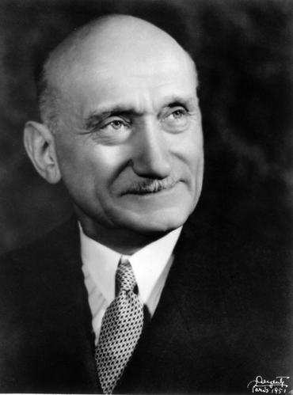
Robert Schuman
In 1958 Schuman was elected first president of the European Parliamentary Assembly, the consultative body of the Common Market, a position in which he served for 2 years. For his efforts in the cause of European unity he was awarded the Charlemagne Prize by the city of Aachen in 1958 and the Erasmus Prize by the European Cultural Foundation in 1959.

Slide 8
Altiero Spinelli
Altiero Spinelli (1907-1986)The Italian politician Altiero Spinelli was one of the fathers of the European Union…(Italian political theorist and a „European federalist“)… in early 1944 he was one of the initiators of a proposal for a European Manifest (Ventotene Manifesto). At the end of the war, he founded the federal European movement in Italy.
In the role of advisor to personalities like de Gasperi, Spaak and Monnet, he worked for European unification. He was the leading figure behind the European Parliament's complete proposal for a Treaty on a federal European Union - the so-called Spinelli Plan. The idea was that the European Parliament should act as a constituent assembly, although Spinelli was prepared to make compromises on the way to secure broad majorities behind the process.
On 14 February 1984, the European Parliament adopted his report and approved the Draft Treaty Establishing the European Union. The decision was taken with 237 votes for and 31 against (43 abstentions).

Slide 9
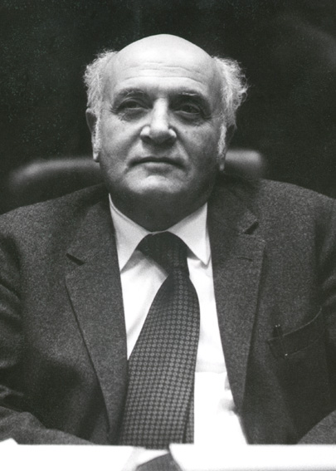
Altiero Spinelli
Spinelli's project was soon buried by the governments of the member states. However, it provided an impetus for the negotiations which led to Single European Act of 1986 and the Maastricht Treaty of 1992.
… his plan so provided an important inspiration for the strengthening of the EU Treaties in the 1980s and 90s.

Slide 10
Paul Henri Charles Spaak
Paul Henri Spaak (1899 – 1972) was a Belgian Socialist politician and statesman, who served as Prime Minister of Belgium (1938–1939, 1946 and 1947–1949), as the first President of the United Nations General Assembly (1946–1957), as the first President of the Common Assembly of the European Coal and Steel Community (1952–1954), and as the second Secretary General of NATO (1957–1961). He received the Charlemagne Prize in 1957.
The experiences of World War II decisively affected Spaak's orientation. During the war he served as foreign minister in the Belgian government-in-exile in London.
Spaak became a staunch supporter of regional co-operation and collective security after 1944. While still in exile in London, he promoted the creation of a customs union uniting Belgium, the Netherlands and Luxembourg (Benelux).
In 1955, the Messina Conference of European leaders appointed him as chairman of a preparatory committee (Spaak Committee) charged with the preparation of a report on the creation of a common European market.

Slide 11
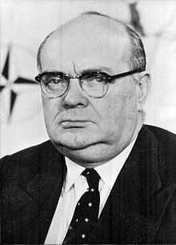
Paul Henri Charles Spaak
The so-called „Spaak Report“ formed the cornerstone of the Intergovernmental Conference and led to the signature, on 25 March 1957, of the Treaties of Rome establishing a European Economic Community and the European Atomic Energy Community (Euratom).

Slide 12
THANK YOU FOR YOUR ATTENTION

