Slide 2
EU Institutions
Radomír Kaňa
Department of International Economic Relations

Slide 3
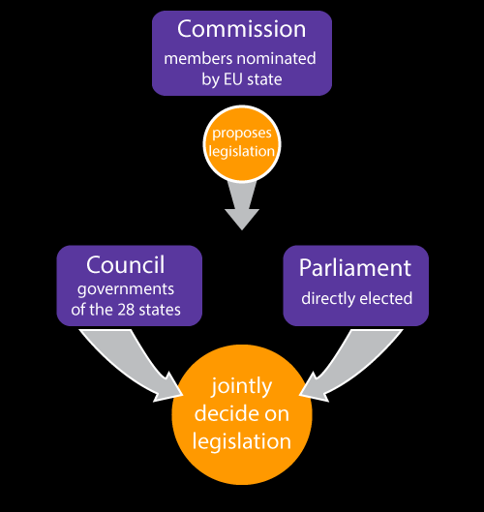
Major and other institutions
Council of the European Union
European Parliament
European Commission
= institutional triangle
+ European Council

Slide 4
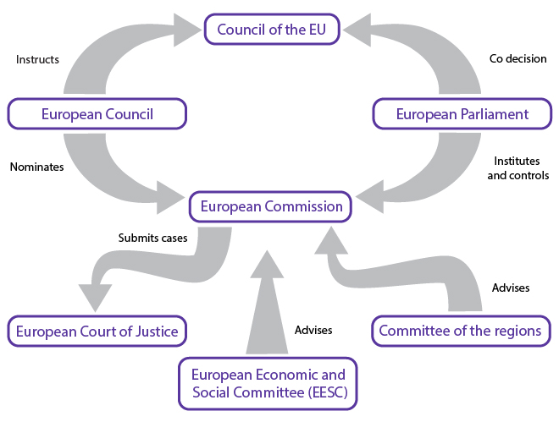
Major and other institutions
Court of Justice of the European Union
European Court of Auditors
European Central Bank
European External Action Service
European Economic and Social Committee
European Committee of the Regions
European Investment Bank
European Ombudsman
European Data Protection Supervisor
European Personnel Selection Office
Publications Office
of the European Union Agencies

Slide 5
The Institutional Triangle
The European Commission, the European Parliament and the Council of the European Union are the three central legislative institutions of the EU.
The European Commission represents the interests of the EU as a whole.
The European Parliament represents the interests of European Citizens.
The Council of the European Union (often referred to as just the Council or the Council of Ministers) represents the member state governments.
There are other EU institutions we should also consider:
The European Council gives the impetus and directions to European integration
The Committee of Regions & The Economic and Social Committee are advisory bodies
The European Court of Justice settles disputes

Slide 6

The European Council
The Heads of State or Government and the Presidents of the Commission and Council meet in the European Council (Article 15 TEU) at least twice every half a year in Brussels.
The EC defines the general political aims and priorities of the EU.
Composition:
  Heads of State or Government of the Member States
  President of the European Council
  President of the European Commission
  High Representative of the Union for Foreign Affairs and Security Policy
The European Council does not exercise legislative functions. Its function is to establish the general policy guidelines for EU action. These take the form of ‘conclusions’, which are adopted by consensus and contain basic policy decisions or instructions and guidelines to the Council or the European Commission.

Slide 7
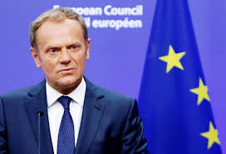
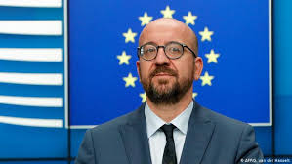
The President of European Council
The Treaty of Lisbon created the office of President of the European Council.
The President, unlike the presidency up to now, has a European mandate, not a national one, running for 2.5 years on a full-time basis.
The person appointed President should be an outstanding personality, selected by qualified-majority voting of the Members of the European Council.
Re-election is possible once.
The President’s tasks comprise the preparation and follow-up of European Council meetings and representing the EU at international summits in the area of foreign and security policy.
Donald Tusk (12/2014–11/2019)
Charles Michel (12/2019 – …

Slide 8
The Council of the European Union
The Council (Article 16) is made up of representatives of the governments of the Member States.
All 27 Member States send one representative — as a rule, though not necessarily, the departmental or junior minister responsible for the matters under consideration. It is important that these representatives be empowered to act with binding effect on their governments.
In fact that governments may be represented in various ways obviously means that there are no permanent members of the Council; instead, the representatives sitting in the Council meet in 10 different configurations depending on the subjects under discussion.

Slide 9
The Council of the European Union
The Council has those key tasks:
It carries out legislation together with the Parliament in the ordinary legislative procedure.
It is responsible for ensuring coordination of the economic policies of the Member States.
It develops the EU’s common foreign and security policy on the basis of guidelines set by the European Council.
It is responsible for concluding agreements between the EU and non-member states or international organisations.
It establishes the budget on the basis of a preliminary draft from the Commission, which must then be approved by the Parliament.
It is also responsible for appointing the members of the Court of Auditors, the Economic and Social Committee and the Committee of the Regions.

Slide 10
The Council of the European Union
THE 10 CONFIGURATIONS OF THE COUNCIL
One representative of each Member State government at ministerial level, with the composition varying according to the subject discussed.
Chaired by the High Representative of the Union for Foreign Affairs and Security Policy
Foreign Affairs
Chaired by the Member State holding the presidency of the Council:
General Affairs
Economic and Financial Affairs
Justice and Home Affairs
Employment, Social Policy, Health and Consumer Affairs
Competitiveness
Transport, Telecommunications and Energy
Agriculture and Fisheries
Environment
Education, Youth, Culture and Sport

Slide 11
The presidency of the Council
Presidency is held by each Member State in turn for 6 months (with the exception of the ‘Foreign Affairs Council’, which is chaired by the High Representative of the Union for Foreign Affairs and Security Policy).
Each presidency bases its action on a work programme agreed with the next two presidencies and therefore valid for a period of 18 months (‘trio/team presidency’).
The presidency is mainly responsible for overall coordination of the work of the Council and the committees providing it with input.
Two main tasks: (i) planning and chairing meetings in the Council and its preparatory bodies and (ii) representing the Council, mediating and brokering compromises between the EU member states and between EU institutions such as the Council, European Commission and European Parliament.
The Member State holding the Council presidency enjoys an enhanced role on the world stage, and small Member States in particular are thus given an opportunity to rub shoulders with the ‘major players’ and make their mark in European politics.
The Council’s work is prepared by a considerable number of preparatory bodies composed of representatives from the Member States. The most important of the preparatory bodies is the Permanent Representatives Committee (‘Coreper I and II’).

Slide 12

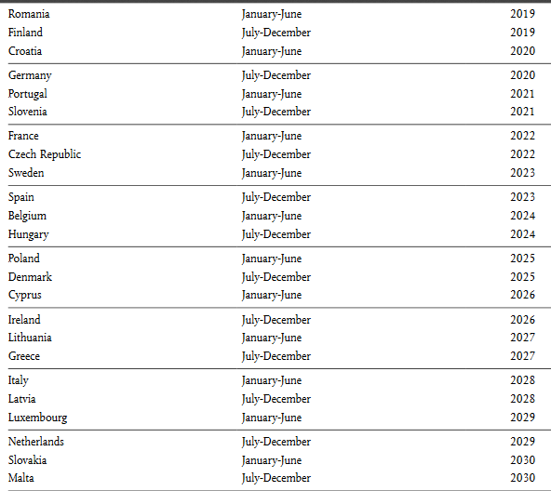
The presidency of the Council

Slide 13
Negotiations and decision-making in the Council
Under the EU treaties, the majority rule is applied in Council voting — as a general rule, a qualified majority is sufficient (Article 16(3) TEU).
According to the double majority system, a qualified majority is achieved when the Commission proposal is supported by at least 55 % of the members of the Council, comprising at least 16 Member States representing at least 65 % of the EU population (Article 16(4) TEU).
A simple majority, where each Council member has one vote, is applied only in certain areas, particularly procedural issues. (The simple majority for 28 Member States is achieved with 15 votes.)
To prevent less populous Member States from blocking the adoption of a decision, a blocking minority must consist of at least four Member States representing at least 35 % of the EU population.
In sensitive political areas, the treaties require unanimity (taxes, social security and social protection of workers, principles for common foreign and security policy and implementing or certain decisions in the area of police and judicial cooperation in criminal matters.)

Slide 14
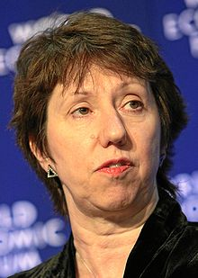
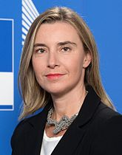
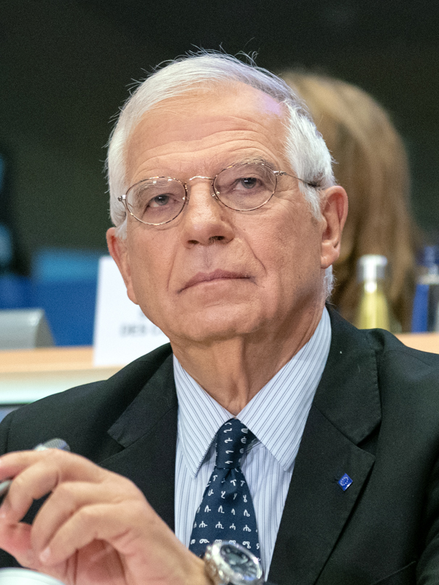
The High Representative of the Union for Foreign Affairs and Security Policy
The High Representative is appointed by the European Council, acting by a qualified majority, with the agreement of the President of the Commission.
HE/She ensures the consistency of the EU's external action - is in charge, within the Commission, of responsibilities incumbent to her mission in external relations and of coordinating other aspects of the EU's external action.
He or she is assisted by a European External Action Service (EEAS), which was newly created in 2011 and was formed by a merger of the foreign policy departments of the Commission and the Council and the integration of diplomats from the national diplomatic services.
The first holder was Javier Solana, Secretary General of the Council of the European Union. The Lisbon Treaty maintains the function of the High Representative for Foreign Affairs and Security Policy. Federica Mogherini was appointed to the post for the 2014-2020 period. She succeeds Catherine Ashton who held the post between 2009 and 2014. Since November 2019 Josep Borrell is nominated.

Slide 15
The European Commission
The European Commission (EC) is part of the executive of the European Union (EU), together with the European Council.
It operates as a cabinet government, with 27 members of the Commission (directorial system, informally known as "Commissioners") headed by a President.
It includes an administrative body of about 32,000 European civil servants. The Commission is divided into departments known as Directorates-General (DGs) that can be likened to departments or ministries each headed by a Director-General who is responsible to a Commissioner.
There is one member per member state, but members are bound by their oath of office to represent the general interest of the EU as a whole rather than their home state.

Slide 16
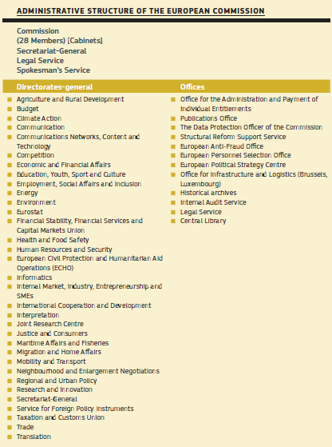

The European Commission

Slide 17
The President of European Commission
The Commission is led by a President, who has a strong position within the Commission. The President is no longer merely ‘first among equals’ but enjoys a prominent position in that he or she lays down guidelines within which the Commission is to work and also decides on the internal organisation of the Commission.
The President and Members of the Commission are appointed for a term of 5 years using the investiture procedure.
The Presidential candidate selects potential Vice-Presidents and Commissioners based on suggestions from the EU countries. The list of nominees has to be approved by national leaders in the European Council.
Each nominee appears before the European Parliament to explain their vision and answer questions. Parliament then votes on whether to accept the nominees as a team. Finally, they are appointed by the European Council, by a qualified majority.

Slide 18
What does the European Commission do?
Proposes new laws
is the sole EU institution tabling laws for adoption by the Parliament and the Council that:
protect the interests of the EU and its citizens on issues that can't be dealt with effectively at national level;
get technical details right by consulting experts and the public.
Manages EU policies & allocates EU funding
Sets EU spending priorities, together with the Council and Parliament.
Draws up annual budgets for approval by the Parliament and Council.
Supervises how the money is spent, under scrutiny by the Court of Auditors.
Enforces EU law
Together with the Court of Justice, ensures that EU law is properly applied in all the member countries.
Represents the EU internationally
Speaks on behalf of all EU countries in international bodies, mainly in areas of trade policy and humanitarian aid.
Negotiates international agreements for the EU.

Slide 19
The European Commission 2019-2024
On September 10, Ursula von der Leyen, President-elect of the European Commission, presented her new team.
Twenty-three out of 26 candidates were confirmed by the European Parliament after two weeks of committee hearings.
Von der Leyen’s eventual Commission will have three executive vice-presidents in Frans Timmermans, Margrethe Vestager and Valdis Dombrokvskis. They will also serve as regular Commissioners, not just coordinators.
There will also be five regular vice-presidents: Josep Borrell, Věra Jourová, Margaritis Schinas, Maroš Šefčovič and Dubravka Šuica.
The European Parliament expects the new EU Commission to start work with at least a month's delay (a new deadline of 1 December).

Slide 20
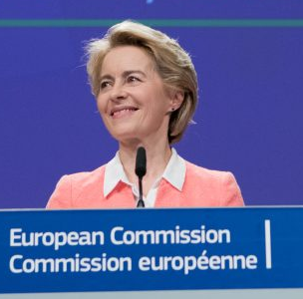
The European Commission 2019-2024
Ursula von der Leyen is the first woman to be President-elect of the European Commission.
Ursula von der Leyen announced that she will focus on an ambitious climate agenda to make Europe the first climate-neutral continent by 2050.
She also committed to working closely with the European Parliament to strengthen democracy and a fair social market economy in Europe.
Ursula von der Leyen also gave a very personal insight into her idea of Europe’s path amid global challenges: “We need to do it the European way”.

Slide 21
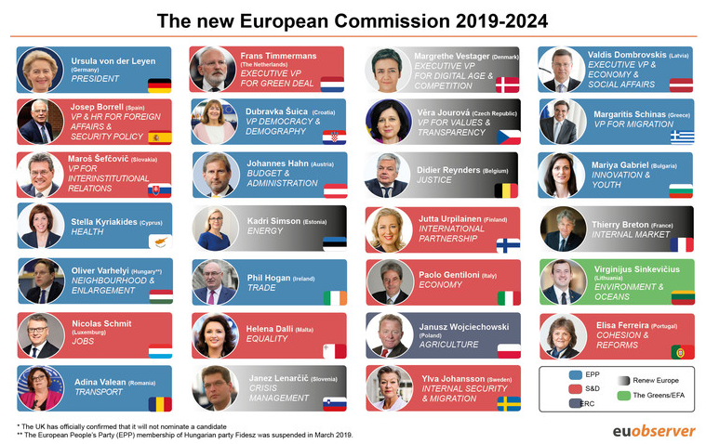

Slide 22

The European Parliament
The European Parliament represents the peoples of the EU Member States.
Problem of "democratic deficit“- up to 1979, representatives in the European Parliament were selected from the membership of national parliaments and delegated by them to the European Parliament.
The direct general election of Members of Parliament (MEPs) by the peoples of the Member States was provided for in the treaties themselves, but the first direct elections were not held until June 1979, a number of earlier initiatives having been fruitless. Elections are now held every 5 years, which corresponds to the length of a ‘legislative period’.
The rights of the Parliament been continually extended - the Treaty of Lisbon has explicitly established the obligation for action by the EU to adhere to the principle of representative democracy.

Slide 23
The Members of European Parliament
President
14 Vice-Presidents
5 Quaestors (advisory)
The President, Vice-Presidents and Quaestors (Members of the European Parliament entrusted with administrative and financial tasks) make up the Bureau, which is elected by Parliament for terms of 2.5 years.
There is also a Conference of Presidents, which consists of the President of the Parliament and the chairmen of the political groups. It is responsible for the organisation of the Parliament’s work, and relations with the other EU institutions and with non-Union institutions.

Slide 24
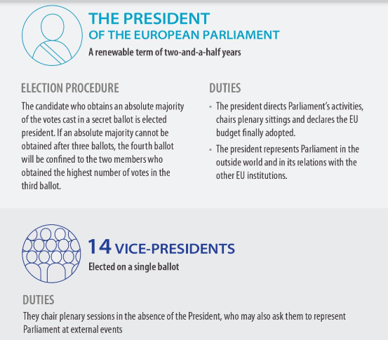
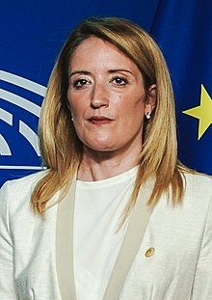
The President of European Parliament
Roberta Metsola
President of the European Parliament

Slide 25
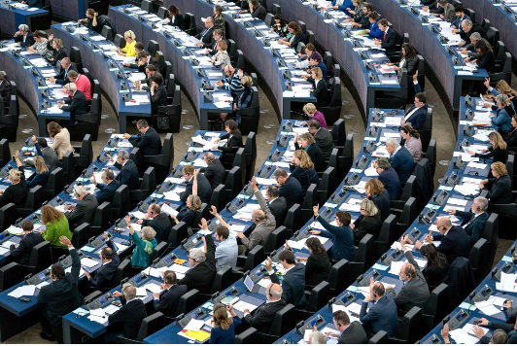
What does the European Parliament do?
The Parliament has 3 main roles:
1. Legislative
Passing EU laws, together with the Council of the EU, based on European Commission proposals
Deciding on international agreements
Deciding on enlargements
Reviewing the Commission's work programme and asking it to propose legislation

Slide 26
What does the European Parliament do?
2. Supervisory
Democratic scrutiny of all EU institutions
Electing the Commission President and approving the Commission as a body. Possibility of voting a motion of censure, obliging the Commission to resign
Granting discharge, i.e. approving the way EU budgets have been spent
Examining citizens' petitions and setting up inquiries
Discussing monetary policy with the European Central Bank
Questioning Commission and Council
Election observations
3. Budgetary
Establishing the EU budget, together with the Council
Approving the EU's long-term budget, the "Multiannual Financial Framework"

Slide 27
How does the European Parliament work ?
Parliament's work comprises two main stages:
Committees - to prepare legislation.
The Parliament numbers 20 committees and two subcommittees, each handling a particular policy area. The committees examine proposals for legislation, and MEPs and political groups can put forward amendments or propose to reject a bill. These issues are also debated within the political groups.
Plenary sessions – to pass legislation.
This is when all the MEPs gather in the chamber to give a final vote on the proposed legislation and the proposed amendments. Normally held in Strasbourg for four days a month, but sometimes there are additional sessions in Brussels.
The Parliament has its seat in Strasbourg, where the 12 periods of monthly plenary sessions, including the budget session, are held. The periods of additional plenary sessions are held in Brussels, where the committees also meet. The Parliament’s Secretariat-General is based in Luxembourg.

Slide 28
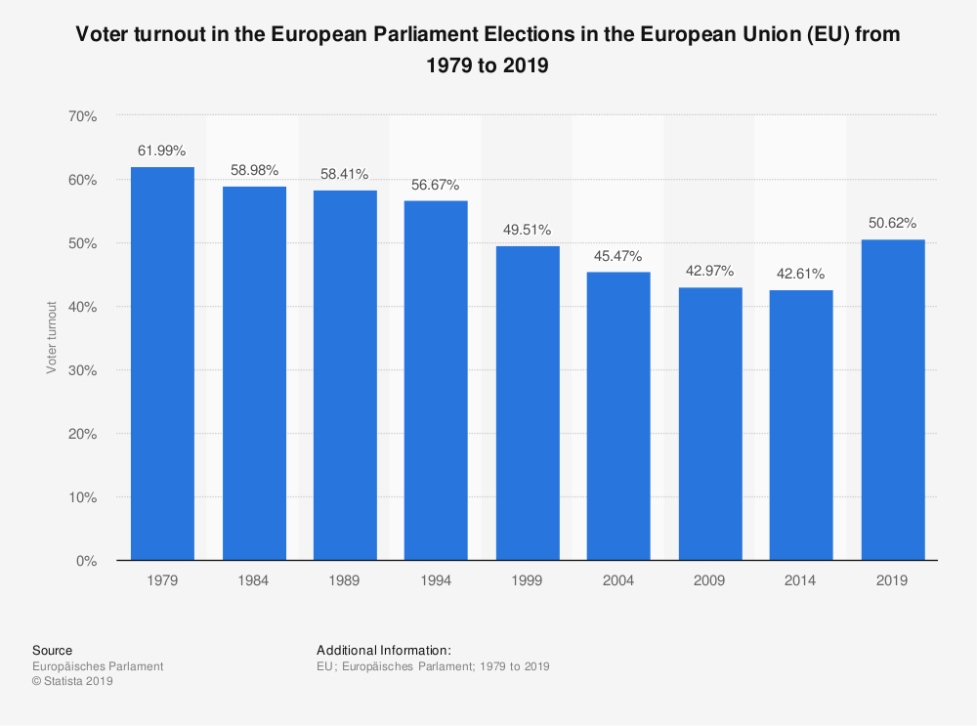
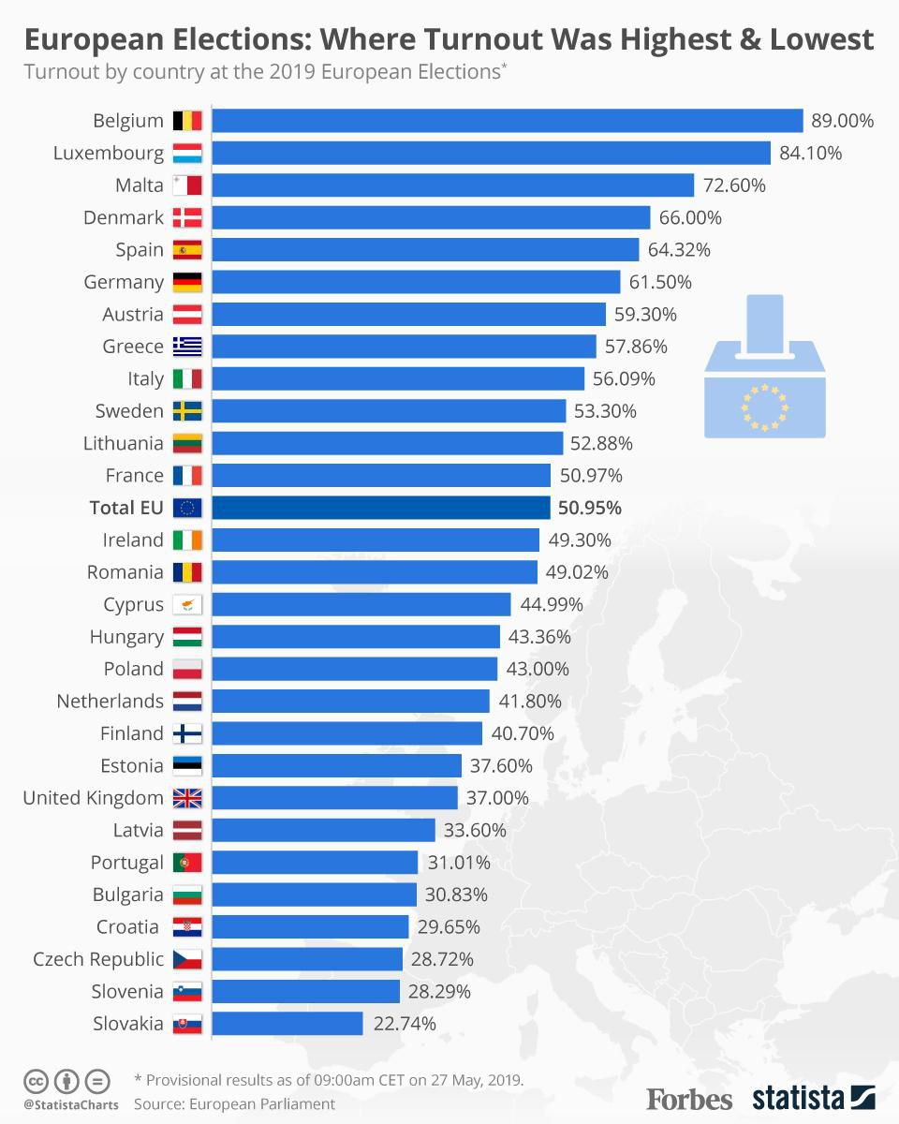
2019 European elections: 23 - 26 May

Slide 29
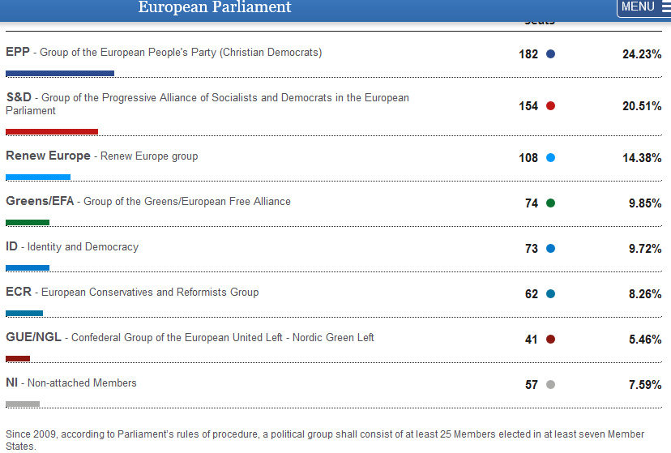
2019 Seven Political Groups

Slide 30
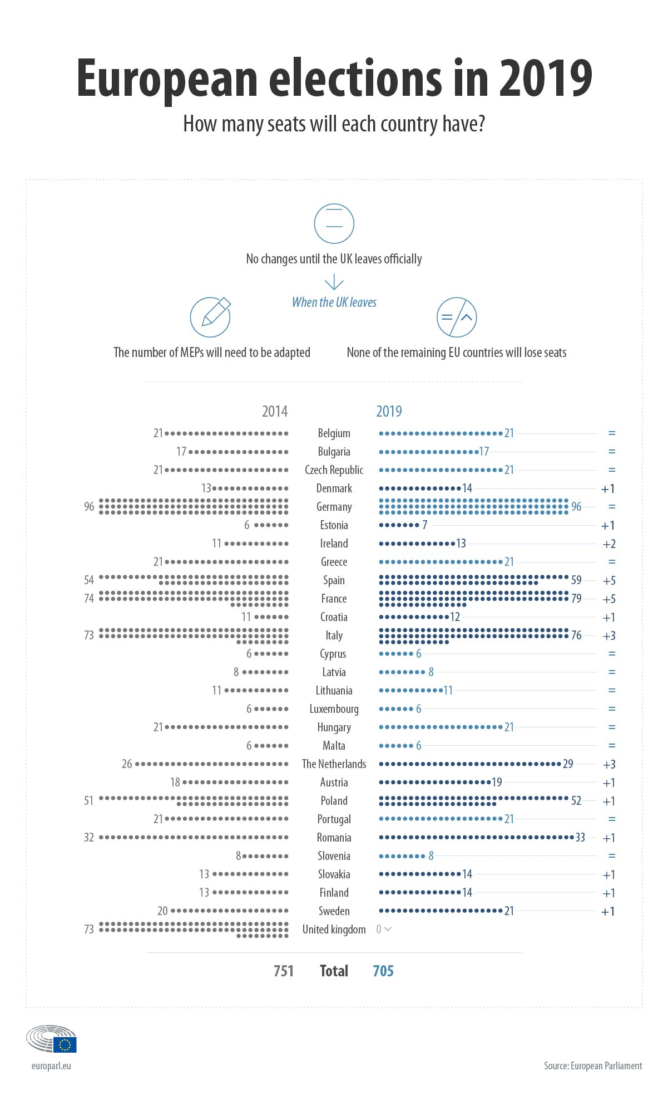
2019 European elections

Slide 31
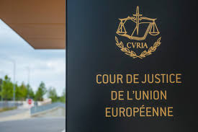
The Court of Justice of the European Union
Ensuring EU law is interpreted and applied the same in every EU country; ensuring countries and EU institutions abide by EU law
The judicial work is now carried out on two levels by:
  the CJEU, as the highest instance in the legal order of the Union (Article 253 TFEU) - 1 judge from each EU country, plus 11 advocates general; deals with requests for preliminary rulings from national courts, certain actions for annulment and appeals.
  the General Court (Tribunal, Article 254 TFEU) - Since 2020 the court is composed of 54 judges - rules on actions for annulment brought by individuals, companies and, in some cases, EU governments. In practice, this means that this court deals mainly with competition law, State aid, trade, agriculture, trade marks
Each judge and advocate general is appointed for a renewable 6-year term, jointly by national governments. In each Court, the judges select a President who serves a renewable term of 3 years.

Slide 32
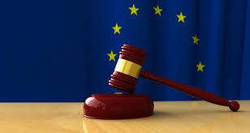
What does the CJEU do?
The CJEU gives rulings on cases brought before it. The most common types of case are:
interpreting the law (preliminary rulings) – national courts of EU countries are required to ensure EU law is properly applied, but courts in different countries might interpret it differently. If a national court is in doubt about the interpretation or validity of an EU law, it can ask the Court for clarification. The same mechanism can be used to determine whether a national law or practice is compatible with EU law.
enforcing the law (infringement proceedings) – this type of case is taken against a national government for failing to comply with EU law. Can be started by the European Commission or another EU country. If the country is found to be at fault, it must put things right at once, or risk a second case being brought, which may result in a fine.

Slide 33
What does the CJEU do?
annulling EU legal acts (actions for annulment) – if an EU act is believed to violate EU treaties or fundamental rights, the Court can be asked to annul it – by an EU government, the Council of the EU, the European Commission or (in some cases) the European Parliament.
Private individuals can also ask the Court to annul an EU act that directly concerns them
ensuring the EU takes action (actions for failure to act) – the Parliament, Council and Commission must make certain decisions under certain circumstances. If they don't, EU governments, other EU institutions or (under certain conditions) individuals or companies can complain to the Court.
sanctioning EU institutions (actions for damages) – any person or company who has had their interests harmed as a result of the action or inaction of the EU or its staff can take action against them through the Court.

Slide 34
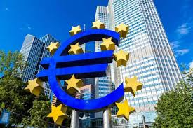
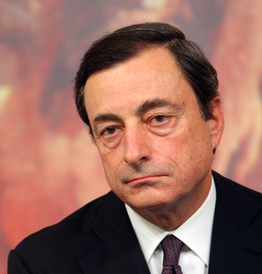
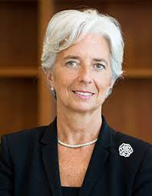
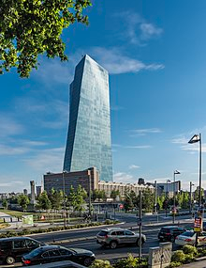
The European Central Bank
The ECB, based in Frankfurt-am-Main, is at the heart of economic and monetary union.
Its task is to maintain the stability of the EU currency, the euro, and control the amount of currency in circulation (Article 128 TFEU).
The European System of Central Banks is composed of the ECB and of the central banks of the Member States (Article 129 TFEU). It has the task of defining and implementing the monetary policy of the Union, and has the exclusive right to authorise the issue of banknotes and coins within the Union. It also manages the official currency reserves of the Member States and ensures the smooth operation of payments systems.
Christine Lagarde
The current president of the European Central Bank

Slide 35
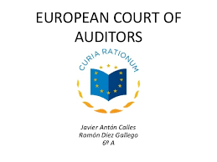
The Court of Auditors
Role: To check EU funds are collected and used correctly, and help improve EU financial management.
It consists of 27 members appointed for 6 years by the Council, which approves, by qualified majority and following consultation with the European Parliament, a list of members drawn up in accordance with proposals from the Member States (Article 286(2) TFEU).
President: Klaus-Heiner Lehne
What does the ECA do?
Audits EU revenue & expenditure, to check EU funds are correctly raised, spent, achieve value for money and accounted for.
Checks any person or organisation handling EU funds – including spot checks in EU institutions (especially the Commission), EU countries and countries receiving EU aid.
Writes up findings and recommendations in audit reports, for the European Commission and national governments.
Reports suspected fraud, corruption or other illegal activity to the European Anti-Fraud Office (OLAF)
Gives its expert opinion to EU policymakers on how EU finances could be better managed and made more accountable to citizens.

Slide 36

European Economic and Social Committee
Advisory body. The purpose is to give the various economic and social groups (especially employers and employees, farmers, carriers, business people, craft workers and the professions and managers of small and medium-sized businesses) representation in an EU institution. It also provides a forum for consumers, environmental groups and associations.
In certain circumstances, it must be consulted in the legislative procedure. It also issues opinions on its own initiative.
Members belong to one of three groups: employers, workers, other interest groups (e.g. farmers, consumers).
329 members, drawn from the most representative organisations in the individual Member States. They are appointed for 5 years by the Council, which adopts a list of members drawn up in accordance with the proposals made by each Member State.

Slide 37

Committee of the Regions of the European Union
Like the European Economic and Social Committee, it is not strictly an EU institution, as its function is purely advisory. Established in: 1994
The members (329) are representatives of regional and local authorities in the Member States who must have a mandate based on elections from the authorities they represent, or must be politically accountable to them.
There are a number of areas in which consultation by the Council of the European Union or the Commission is required (‘mandatory consultation’): education; culture; public health; trans-European networks; transport, telecommunications and energy infrastructure; economic and social cohesion; employment policy and social legislation.
The Council also consults the Committee of the Regions regularly, and without any legal obligation, in connection with a wide range of draft legislation (‘non-mandatory consultation’).

Slide 38

The European Investment Bank
The EIB provides loans and guarantees in all economic sectors, especially to promote the development of less-developed regions, to modernise or convert undertakings or create new jobs and to assist projects of common interest to several Member States.
President: Werner Hoyer
Board of Directors: comprises one director per EU country, plus one from the European Commission
All EU countries are shareholders in the EIB.
The EIB is the majority shareholder of the European Investment Fund (EIF), which provides funding to small and medium-sized enterprises (SMEs) through venture capital and risk finance instruments. Other shareholders are the European Commission and financial institutions from across Europe.
Established in 1994, the Fund is active in all EU countries, prospective member countries, Liechtenstein and Norway.

Slide 39
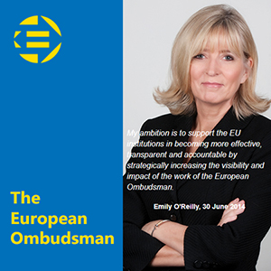
European Ombudsman
Investigates complaints against EU institutions, bodies, offices & agencies
Established in: 1995
The Ombudsman investigates different types of poor administration, for example: unfair conduct, discrimination, abuse of power, lack of information or refusal to provide it unnecessary delays, incorrect procedures.
The Ombudsman's office launches investigations either in response to complaints or on its own initiative. An impartial body, it takes no orders from any government or other organisation. It produces an annual activity report for the European Parliament.
The European Parliament elects the Ombudsman for a renewable 5-year term. This is one of its first tasks when newly elected.
Ombudsman: Emily O'Reilly

Slide 40
THANK YOU FOR YOUR ATTENTION

