Slide 2
Primary and secondary law
The decision making process
- Legislative procedures
Radomír Kaňa
Department of International Economic Relations

Slide 3
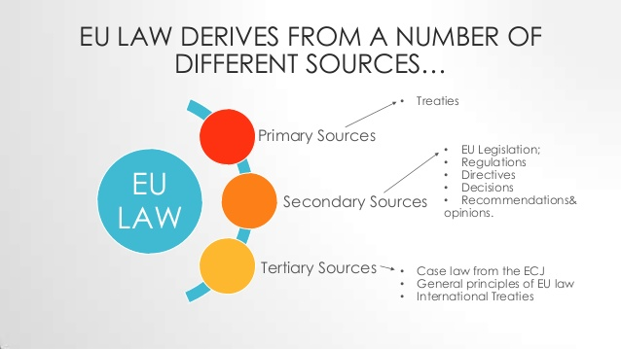
Legal sources of law

Slide 4

Primary source of Union law
The first source of Union law in this sense is the EU founding treaties, with the various annexes, appendices and protocols attached to them, and later additions and amendments.
The Treaty of Paris (1951)
The Treaties of Rome (1957)
The Merger Treaty (1965)
The Single European Act (1986)
The Maastricht Treaty (1991)
The Amsterdam Treaty (1997)
The Nice Treaty (1999)
The Lisbon Treaty (2007)

Slide 5
The Treaty of Lisbon
The Treaty of Lisbon (initially known as the Reform Treaty) is an international agreement that amends the two treaties which comprise the constitutional basis of the EU. It is composed of:
Treaty on European Union (TEU; also known as the Treaty of Maastricht)
Treaty on the Functioning of the European Union (TFEU; it replaced the original Treaty Establishing the European Community)
The Main PROCLAMATIONS of the Lisbon Treaty: a more democratic and transparent Europe; a more efficient Europe; a Europe of rights and values, freedom, solidarity and security Europe as an actor on the global stage.

Slide 6
Secondary source of Union law
It consists of legislative acts, non-legislative acts (simple legal instruments, delegated acts, implementing acts), non-binding instruments (opinions, recommendations) and other acts that are not legal acts (e.g. interinstitutional agreements, resolutions, declarations, action programmes).
‘Legislative acts’ are legal acts adopted by ordinary or special legislative procedure (Article 289 TFEU).
‘Delegated acts’ (Article 290 TFEU) are non-legislative acts of general and binding application to supplement or amend certain non-essential elements of a legislative act.
These legislative and non-legislative acts can take very different forms. The most important of these are listed and defined in Article 288 TFEU.

Slide 7
Secondary source of Union law
The legal basis for the enactment of regulations is Article 288 of the Treaty on the Functioning of the European Union(formerly Article 249 TEC):
A regulation shall have general application. It shall be binding in its entirety and directly applicable in all Member States.
A directive shall be binding, as to the result to be achieved, upon each Member State to which it is addressed, but shall leave to the national authorities the choice of form and methods.
A decision shall be binding in its entirety upon those to whom it is addressed.
Recommendations and opinions shall have no binding force.
Many other legal acts do not fit into specific categories: resolutions, declarations, action programmes and White and Green Papers.

Slide 8
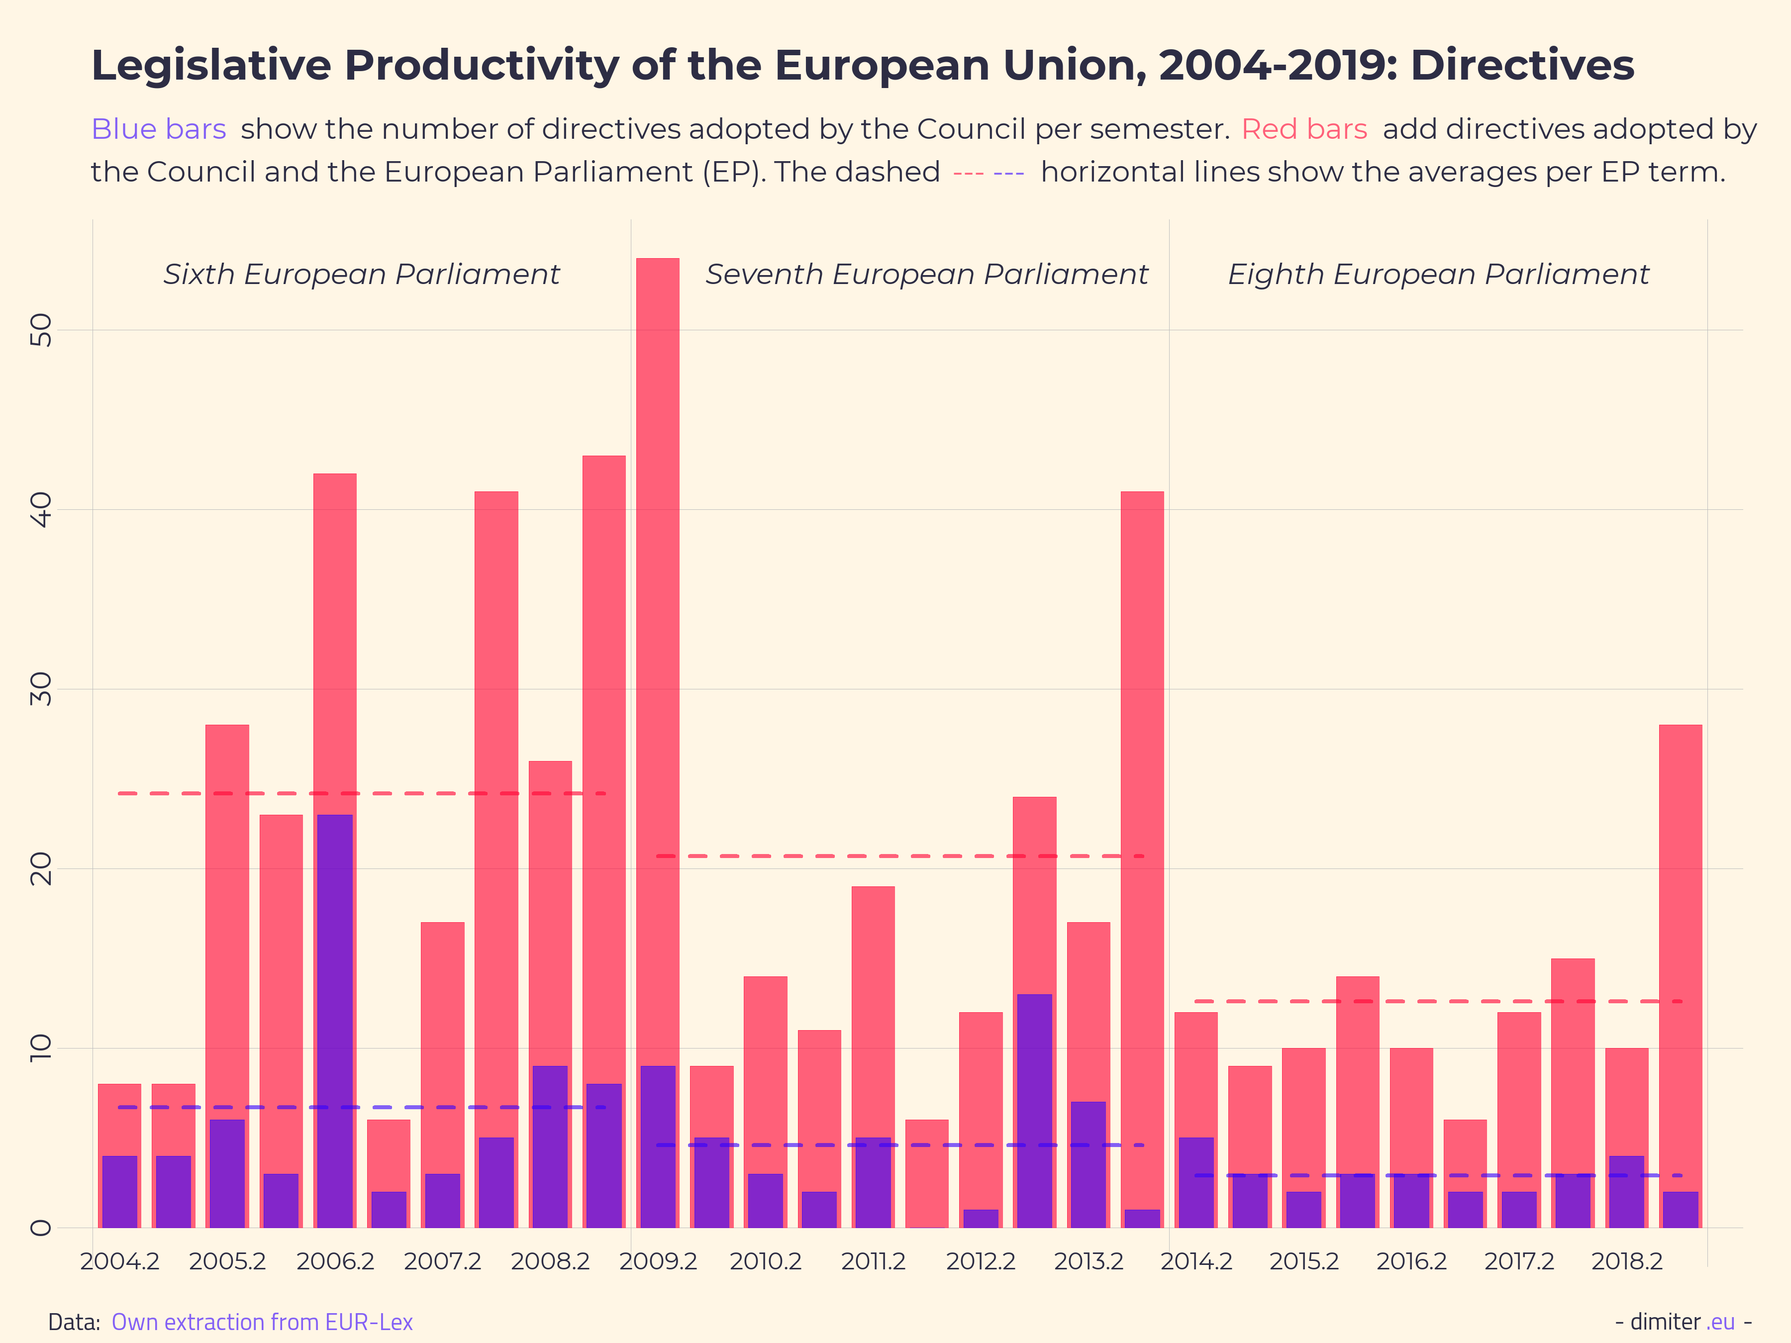
Secondary source of Union law
Legal acts – statistics
https://eur-lex.europa.eu/statistics/legislative-acts-statistics.html

Slide 9
Secondary source of Union law
A regulation - becomes immediately enforceable as law in all member states simultaneously. Regulations can be distinguished from directives which, at least in principle, need to be transposed into national law. Regulations can be adopted by means of a variety of legislative procedures depending on their subject matter.
A directive - requires member states to achieve a particular result without dictating the means of achieving that result. It can be distinguished from regulations which are self-executing and do not require any implementing measures. Directives normally leave member states with a certain amount of leeway as to the exact rules to be adopted. Directives can be adopted by means of a variety of legislative procedures depending on their subject matter.

Slide 10
Secondary source of Union law
A decision - is binding on the person or entity to which it is addressed. Decisions may be addressed to member states or individuals. The Council of the European Union can delegate power to make decisions to the European Commission.
A recommendation - are without legal force but are negotiated and voted on according to the appropriate procedure. Though without legal force, they do have a political weight. The Recommendation is an instrument of indirect action aiming at preparation of legislation in Member States, differing from the Directive only by the absence of obligatory power.

Slide 11
Direct effect
EU law covers a broad range which is comparable to that of the legal systems of the Member States themselves. Both the provisions of the Treaties, and EU regulations are said to have "direct effect" horizontally. This means private citizens can rely on the rights granted to them (and the duties created for them) against one another. For instance, an air hostess could sue her airline employer for sexual discrimination.
Directive have direct effect, but only "vertically". Private citizens may not sue one another on the basis of an EU directive, since these are addressed to the Member States. Directives allow some choice for Member States in the way they translate (or 'transpose') a directive into national law - usually this is done by passing one or more legislative acts, such as an Act of Parliament. Once this has happened citizens may rely on the law that has been implemented. They may only sue the government "vertically" for failing to implement a directive correctly. An example of a directive is the Product liability Directive, which makes companies liable for dangerous and defective products that harm consumers.

Slide 12
Supremacy of the EU law
It has been ruled many times by the Court of Justice that EU law is superior to national laws.
Where a conflict arises between EU law and the law of a Member State, EU law takes precedence, so that the law of a Member State must be disapplied.
This doctrine, known as the supremacy of EU law, emerged from the Court of Justice in Costa v ENEL.

Slide 13
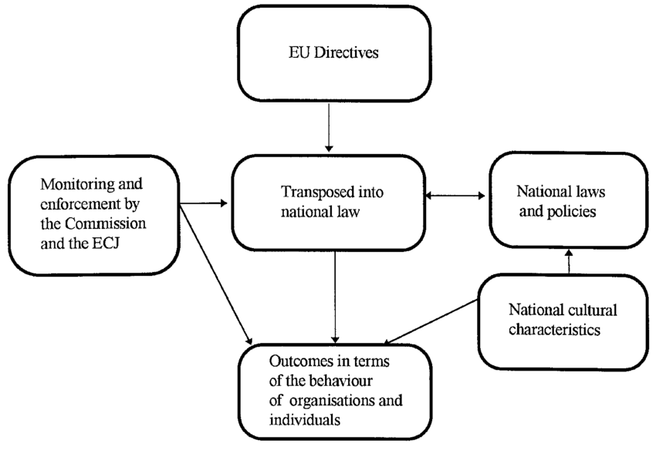
Interrelationships between EU laws and national systems

Slide 14
Policy Making in the EU - New (Soft) Modes of Governance
Open Method of Coordination (OMC)
not legislation, but recommendations, advice on best practice, and guidelines.
characteristics of new modes of governance: participation,multi-level, subsidiarity, deliberation, flexibility, knowledge creation.

Slide 15
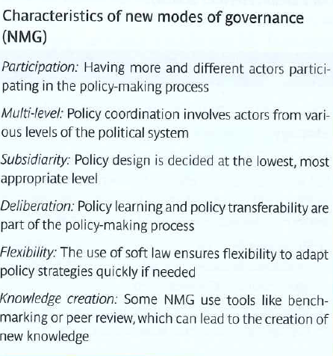
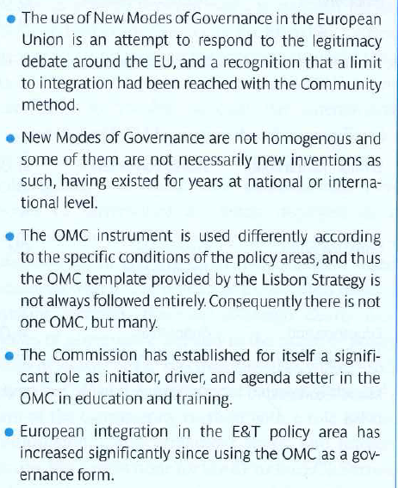

Slide 16
Legislative procedures according to Lisbon Treaty
The ordinary legislative procedure shall consist in the joint adoption by the European Parliament and the Council of a regulation, directive or decision on a proposal from the Commission. This procedure is defined in Article 294.
In the specific cases provided for by the Treaties, the adoption of a regulation, directive or decision by the European Parliament with the participation of the Council, or by the latter with the participation of the European Parliament, shall constitute a special legislative procedure.

Slide 17
The ordinary legislative procedure
Where reference is made in the Treaties to the ordinary legislative procedure for the adoption of an act, the following procedure shall apply.
The Commission shall submit a proposal to the European Parliament and the Council. They use codecision procedure.
Read more: http://www.epgencms.europarl.europa.eu/cmsdata/upload/10fc26a9-7f3e-4d8a-a46d-51bdadc9661c/handbook-olp-en.pdf

Slide 18
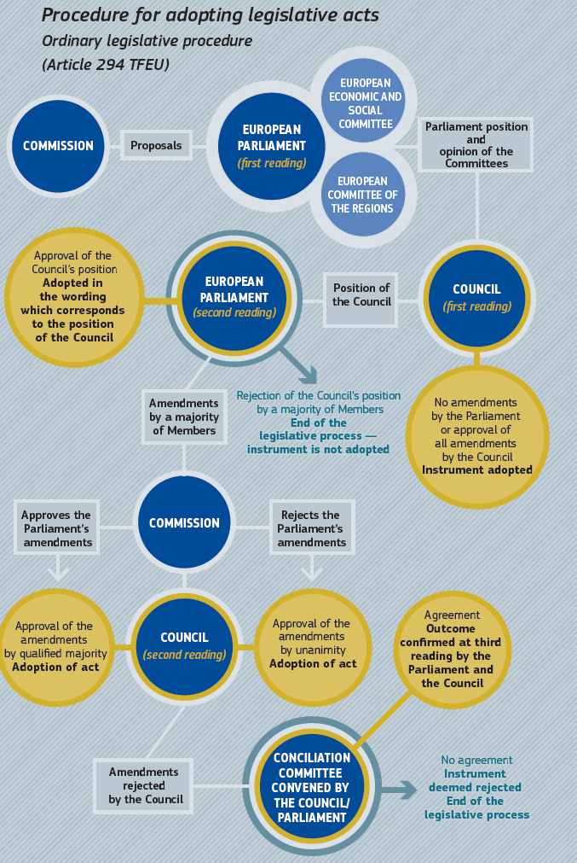

Slide 19
The special legislative procedure
The special legislative procedure is usually characterised by the Council, acting unanimously on a proposal from the Commission and after consulting the European Parliament, taking a decision or by the European Parliament adopting a legal act after obtaining the approval of the Council.
Taking a decision on the budget (Article 314 TFEU): the procedure has detailed rules and largely corresponds to the ordinary legislative procedure.
The Council takes a decision by majority on a proposal of the Commission and after consulting the European Parliament (or other EU institutions and consultative bodies); this was originally the consultation procedure that was initially the standard legislative procedure at EU level but is now used only in isolated cases as a special legislative procedure.
The Council takes a decision without the participation of the European Parliament. This constitutes a rare exception, however, and — other than in the area of the common foreign and security policy, where the Parliament is informed by Council decisions— only takes place in very isolated cases (e.g. Article 31 TFEU: fixing a Common Customs Tariff; Article 301(2) TFEU: composition of the European Economic and Social Committee).

Slide 20
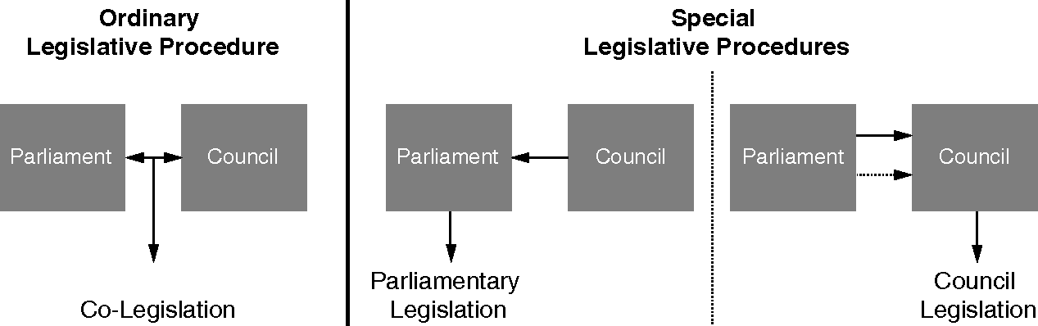
The ordinary and special legislative procedure

Slide 21
THANK YOU FOR YOUR ATTENTION

