Slide 2
EU Budget, Multiannual Financial Framework (MMF)
Radomír Kaňa
Department of International Economic Relations

Slide 3
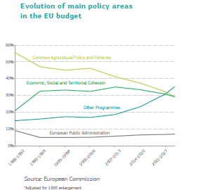
EU Budget History
As expenditure increased in the 1970s and 80s, there was increased tension on the financing side, as the British were dissatisfied with their budgetary imbalance. In 1984 the British were allocated a permanent “correction”. Later, this led to the development of smaller “corrections” for other Member States.
As the internal market programme was launched in 1987, more investment would be needed and therefore a larger budget. Multiannual financial planning (or perspectives) removed some of the tension from the annual processes.
The first long-term financial perspective started in 1988. These were renamed as the Multiannual Financial Frameworks (MFF) in 2009 by the Lisbon Treaty, when the concept of the MFF was included in the treaties under Article 312 TFEU.

Slide 4
The multiannual financial framework (MFF)
The multiannual financial framework (MFF) is the EU's long-term budget. It sets the limits for EU spending - as a whole and also for different areas of activity - over a period of at least five years. Recent MFFs usually covered seven years.
The purpose of the MFF is to:
  align EU spending with its political priorities
  ensure EU budgetary discipline
  make adoption of the annual EU budget easier
  add predictability to EU finances
The MFF's long-term approach to funding helps make the EU’s policies and programmes more effective. Potential co-financers and beneficiaries also gain from its predictability.
The MFF breaks EU expenditure down into broad categories - ‘headings’ - which correspond to the EU’s priorities and areas of action.
For each year covered by the MFF there are fixed limits of expenditure, or ‘ceilings’.
SEE more: https://www.consilium.europa.eu/en/policies/the-eu-budget/#long%20term%20budget/

Slide 5
The EU budget – Myths and facts
At some €186.6 billion (2023 figure), the EU budget is in fact smaller than the budgets of Austria or Belgium.
This is a tiny fraction (2%) of the combined national budgets of all 27 EU countries
National governments in the EU spend more than 50 times what the EU does through its budget;
EU spending represents less than 1% of the total value of the EU economy (Gross National Income of all EU Member States);
By contrast, an average national budget in the EU is 30-40% of the value of its economy.
Unlike national budgets, which are mainly used to provide public services and fund social security systems, the EU budget is primarily used for investment.
The average EU citizen pays €240 per year towards the EU budget (2018 figures) – less than the price of an average cup of coffee per day.

Slide 6
Budgetary principles
Community budgetary law obeys general principles which are largely based on those that apply in national budgetary law.
They are enshrined in the Treaty establishing the European Community (EC) and are developed, adapted and, in some cases, relaxed in Council Regulation No 1605/2002 of 25 June 2002 on the Financial Regulation applicable to the general budget of the European Communities.
The principles in question are those of unity, universality, annuality and specification — seen as the four main traditional budgetary principles — plus the principles of equilibrium, unit of account, budget accuracy, sound financial management and transparency.

Slide 7
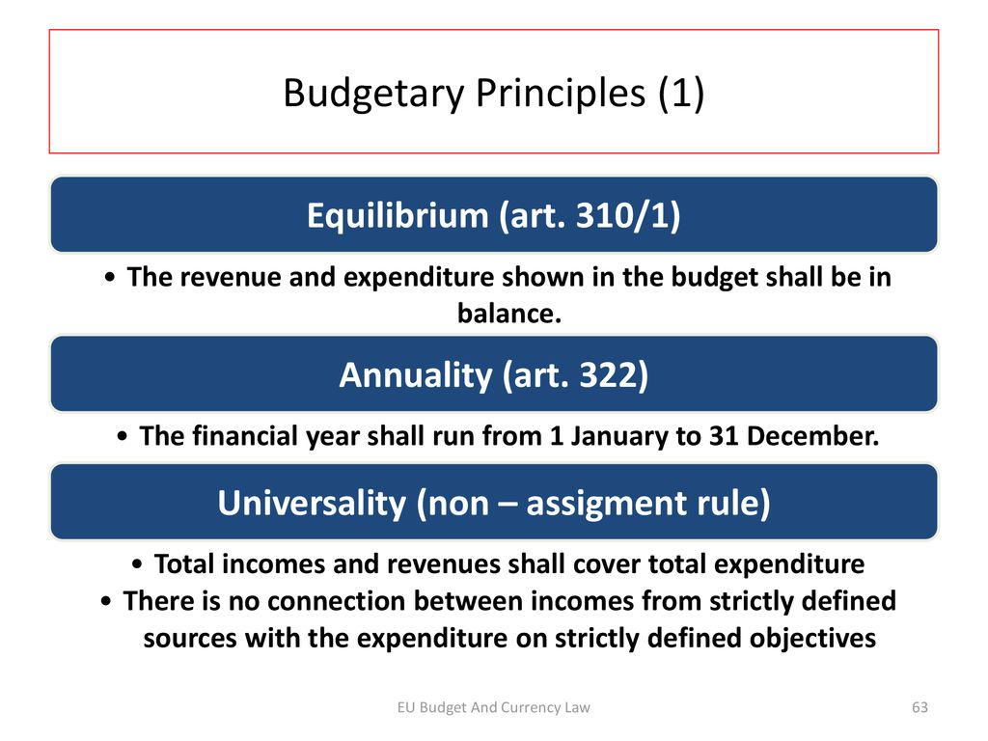
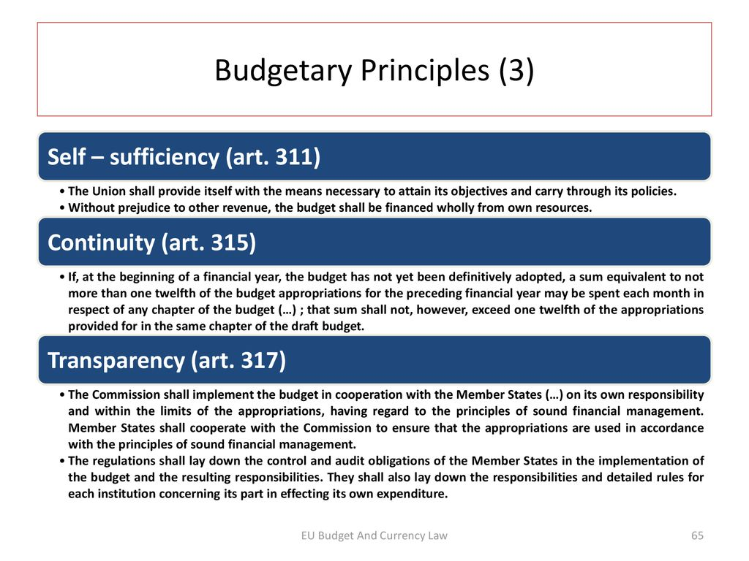
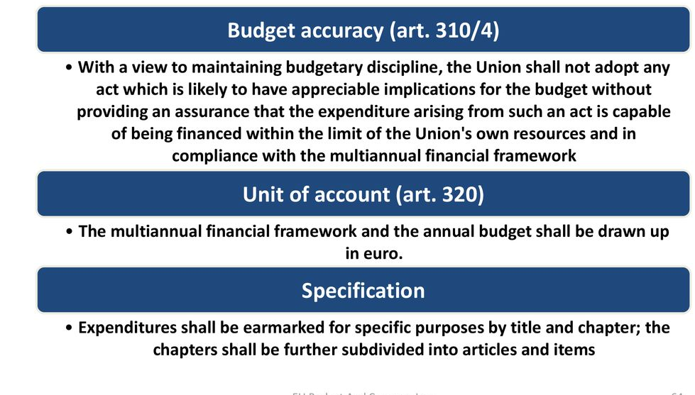
Budgetary principles

Slide 8
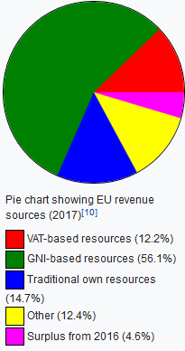
Where does the money come from? How is the budget financed?
The EU budget:
is funded chiefly (99%) from the EU's own resources, supplemented by other sources of revenue,
is based on the principle that expenditure must be matched by revenue
has in-built schemes to compensate certain EU countries.
Own resources account for 99% of the budget. They are not allowed to exceed 1.23% of the EU's gross national income (GNI). The remaining 1% of budget revenue comes from other sources of income.

Slide 9
Resources
There are three kinds of own resources:
  mainly customs duties on imports from outside the EU and sugar levies.
  EU governments keep 25 % to cover the cost of collection.
  own resource from value added tax (VAT)
    A standard percentage is levied on the harmonised VAT base of each EU country.
    The VAT resource accounts for around €14bn. The VAT base to be taxed is capped at 50% of GNI for each country. This rule is intended to prevent less prosperous
    countries having to pay a disproportionate amount (in such countries consumption – and so VAT – tend to account for a higher percentage of national income).
  own resource based on gross national income (GNI) - A standard percentage is levied on the GNI of each EU country. It is used to balance revenue and expenditure, i.e. to fund the part of the budget not covered by other sources of income. Although designed simply as a balancing system, this has become the largest source of revenue.
  The budget also has other sources of revenue, e.g.: taxes on EU staff salaries, contributions from non-EU countries to certain programmes, fines on companies for breaching competition laws, etc.

Slide 10
Expenditure ceilings
Expenditure ceilings
The EU budget has 2 types of amounts:
commitments – commitments to pay out funds to specific initiatives (legally binding promises to spend money which will not necessarily be paid out in the same year but may be disbursed over several financial years
payments – payments forecast for the period covered by the budget (the actual amounts authorized for disbursement in a given year)

Slide 11
How is the budget decided?
Based on the multiannual financial framework in force and the budget guidelines for the coming year, the European Commission prepares the draft budget, and submits it to the Council and Parliament. The budgetary authority, comprised of the Council and the Parliament, amends and adopts the draft budget.
In case of disagreement between Parliament and Council a specific Conciliation Committee is convened with the task of reaching agreement on a joint text within a period of 21 days, subject to the approval of both arms of the budgetary authority. If the joint text is rejected by the Council, the European Parliament has the right to ultimately approve the budget.

Slide 12
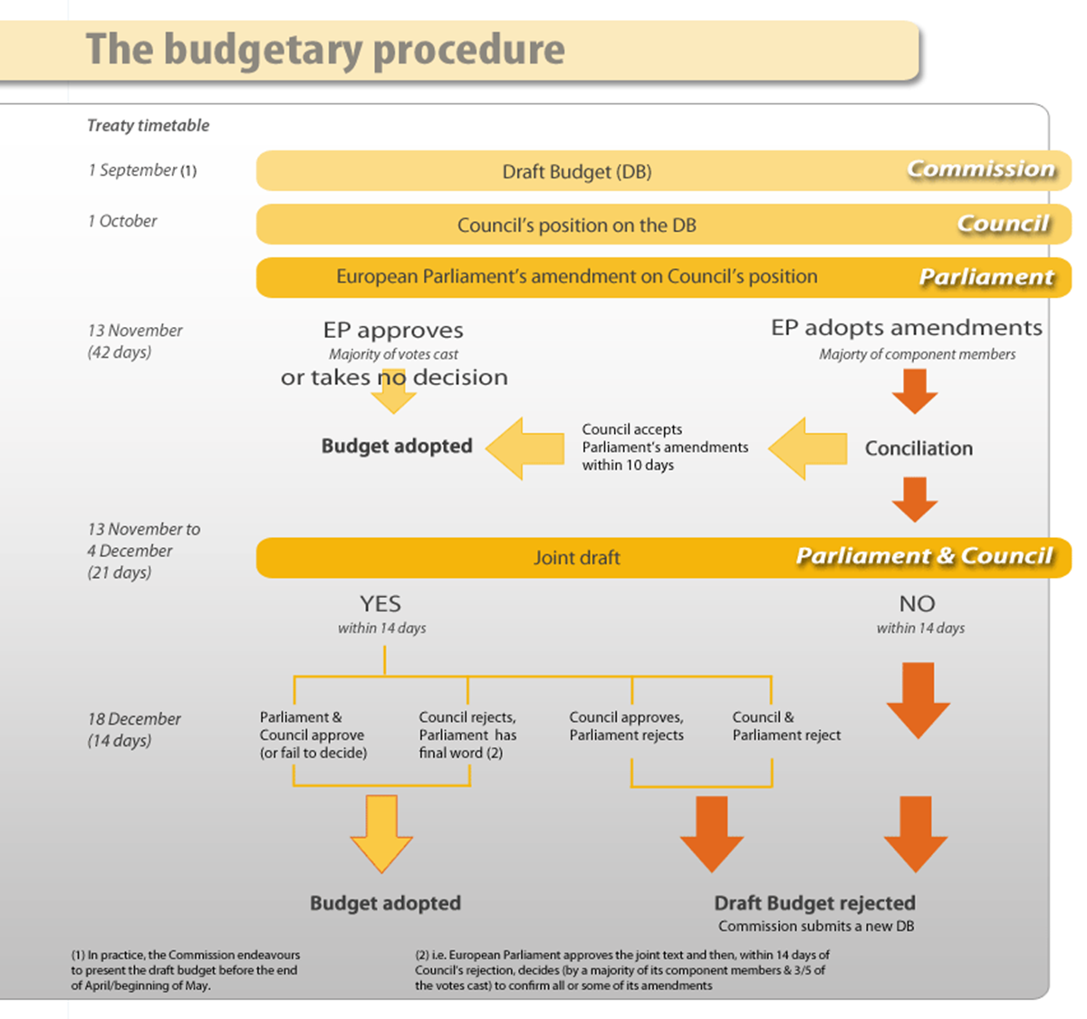
The annual EU budget is agreed by the Council and the European Parliament. The draft budget is proposed by the Commission.
1. The Council and the European Parliament decide on an equal footing.
First, the Council adopts its position on the draft annual EU budget. The European Parliament can then adopt amendments to the Council's position. If their views diverge, a Conciliation Committee is convened to find a compromise within three weeks.
2. After an agreement is reached, the Council and the European Parliament have 14 days to formally approve it.
3. If the Council and the European Parliament do not reach an agreement, the Commission has to present a new draft annual budget.
4. If the annual budget is still not adopted at the beginning of the year to which it refers, the system of provisional twelfths applies. This means that not more than one twelfth of the budget appropriations for the previous year or of the draft budget proposed by the Commission - whichever is smaller - may be spent each month for any chapter of the budget.

Slide 13
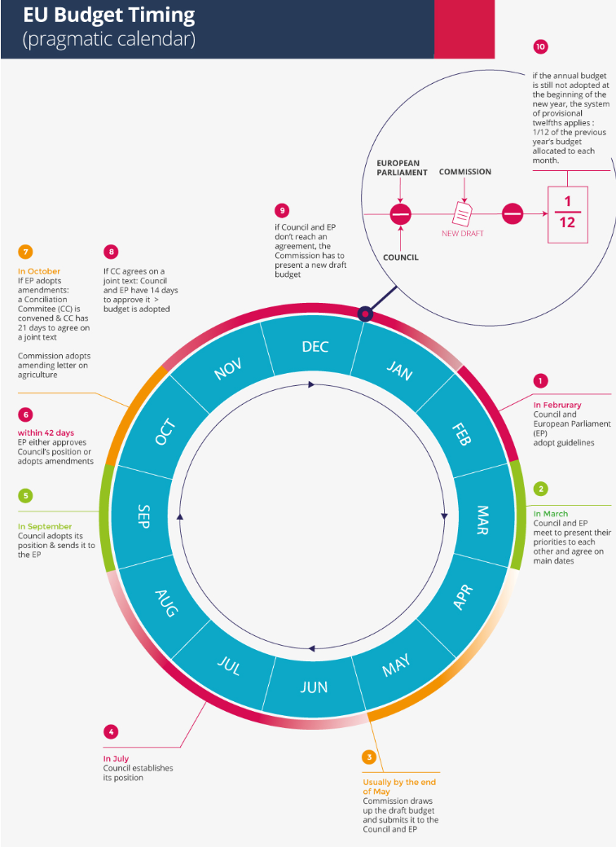

Slide 14
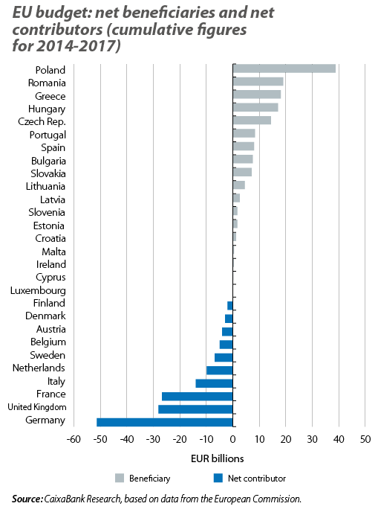
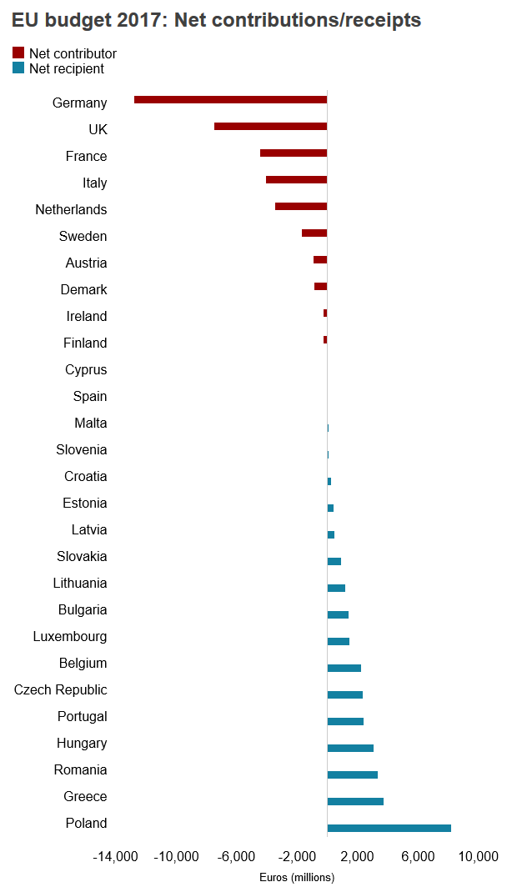

Slide 15
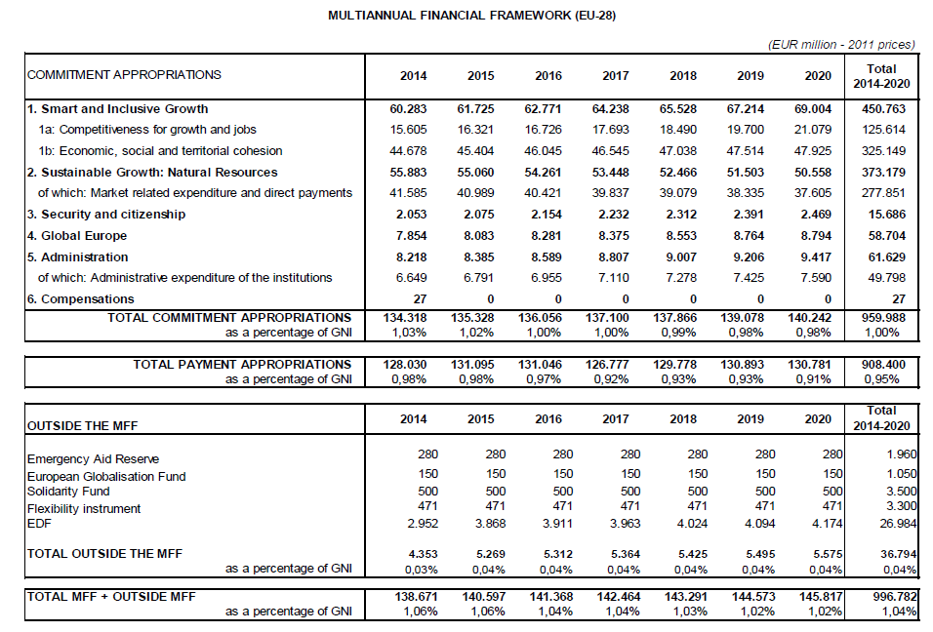
Multiannual Financial Framework 2014-2020

Slide 16
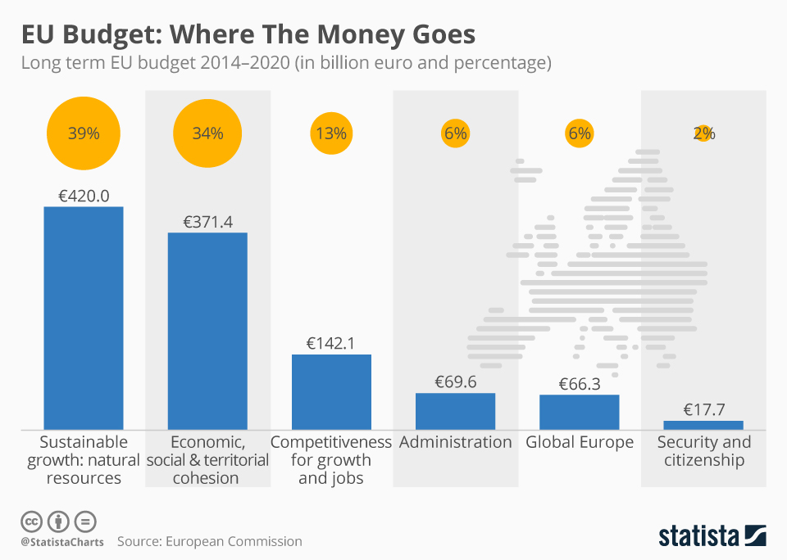
Multiannual Financial Framework 2014-2020

Slide 17
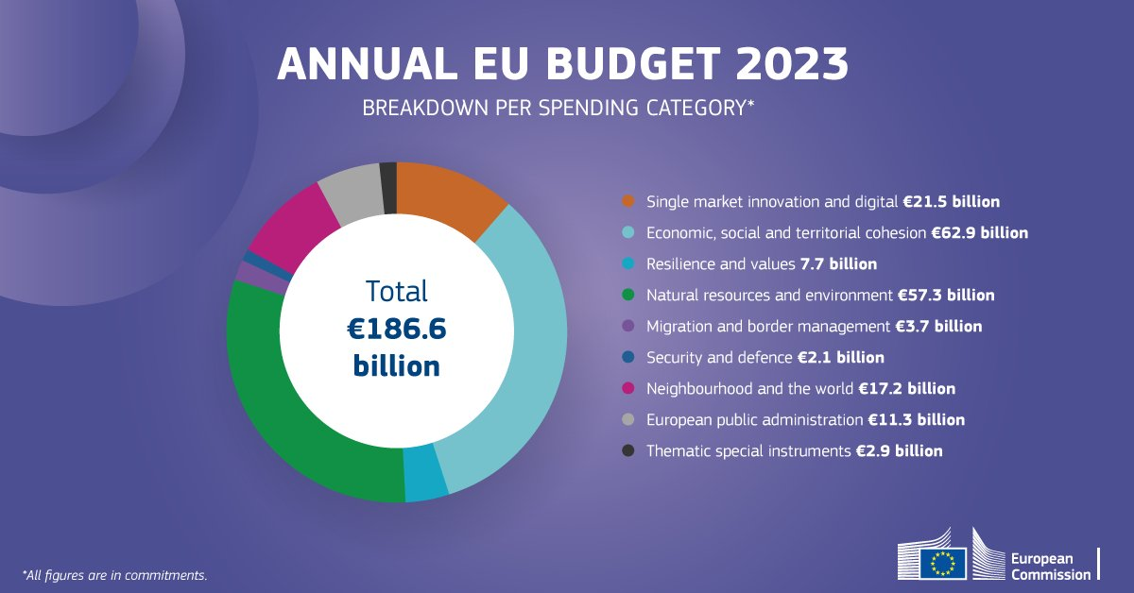
EU annual budget 2023

Slide 18
MFF 2021-2027 - A MODERN EU BUDGET FOR A UNION THAT PROTECTS, EMPOWERS AND DEFENDS
The next long-term budget, starting on 1 January 2021, is the first for the European Union of 27.
The Commission proposes a new, modern and focused long-term budget, tightly geared to the political priorities — bringing to life the positive agenda set out by President Juncker in the State of the Union Address on 14 September 2016 and agreed by the leaders of the 27 Member States in Bratislava on 16 September 2016 and in the Rome Declaration of 25 March 2017.
The proposed budget combines new instruments with modernised programmes to deliver efficiently on the European Union’s priorities and to rise to new challenges.

Slide 19
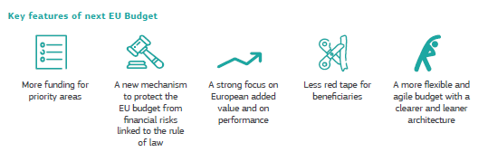
MFF 2021-2027 - A MODERN EU BUDGET FOR A UNION THAT PROTECTS, EMPOWERS AND DEFENDS

Slide 20
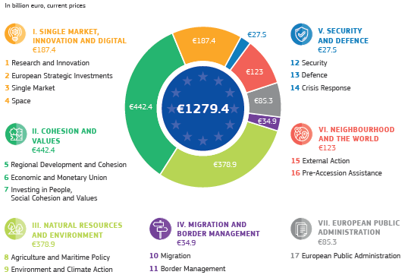
MFF 2021-2027 - A MODERN EU BUDGET FOR A UNION THAT PROTECTS, EMPOWERS AND DEFENDS

Slide 21
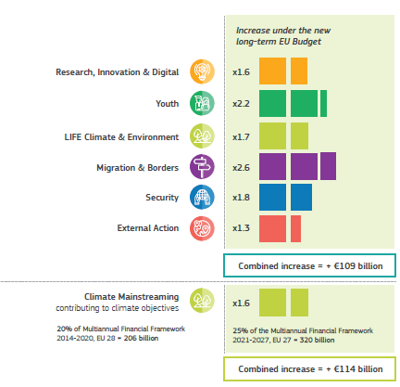
MFF 2021-2027
the Commission proposes a pragmatic approach, providing appropriate support for new and existing priorities while also addressing the shortfall in national contributions resulting from the United Kingdom’s withdrawal from the EU.

Slide 22
MFF 2021-2027

Slide 23
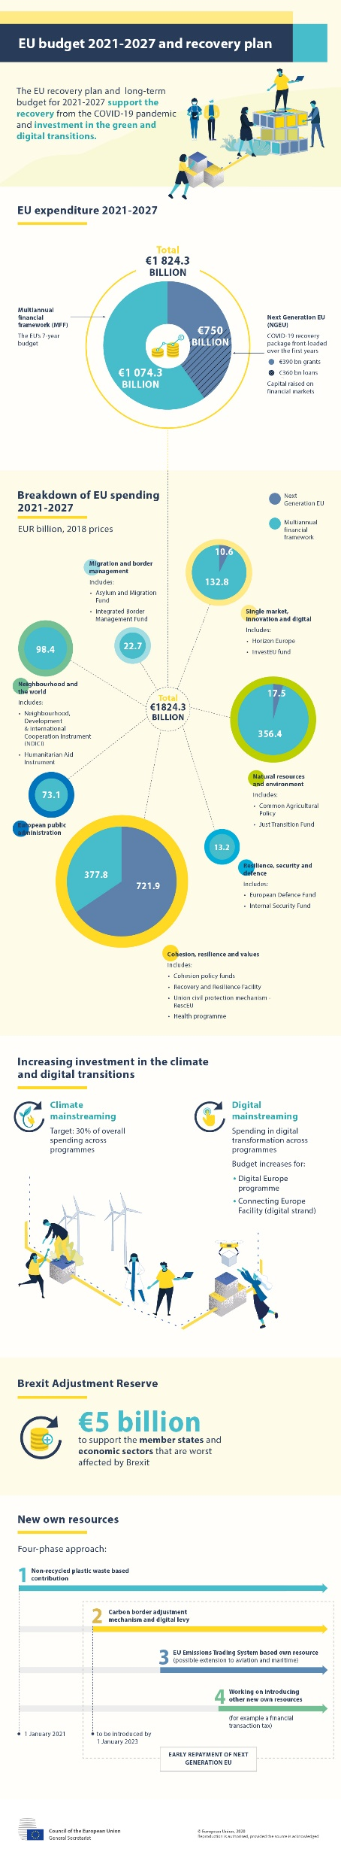
MFF 2021-2027 – new proposal July 2020 - EU recovery plan

Slide 24
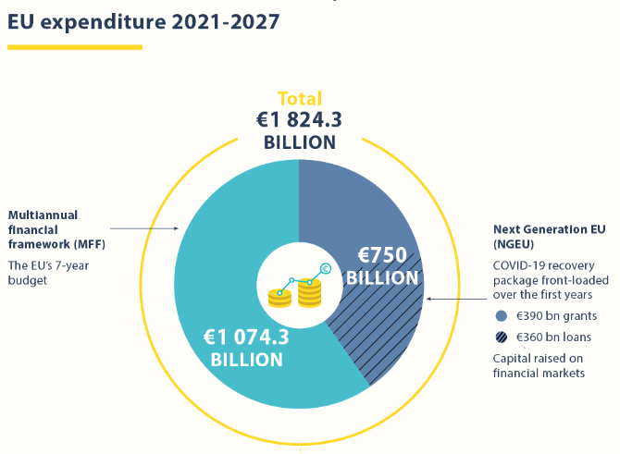
MFF 2021-2027 – new proposal July 2020 - EU recovery plan
On 21 July 2020, the EU leaders reached a historic agreement on the next long-term budget and Next Generation EU. EU leaders have responded quickly with a massive coronavirus recovery plan of €1.824 trillion. It combines the long-term EU budget with an extraordinary, €750 billion recovery effort destined to tackle the effects of an unprecedented crisis in the best interest of the EU.
https://commission.europa.eu/strategy-and-policy/eu-budget/long-term-eu-budget/2021-2027_en
https://www.consilium.europa.eu/en/eu-budget-story/

Slide 25
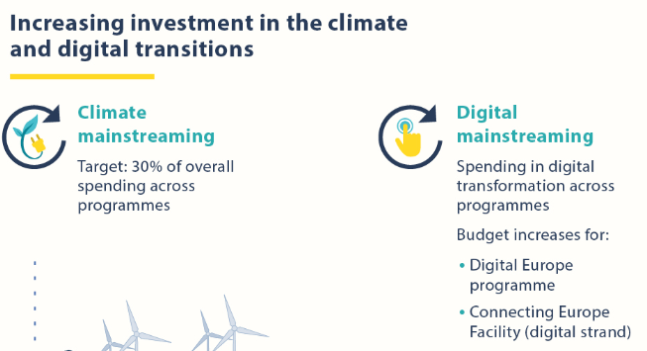

MFF 2021-2027 – new proposal July 2020 - EU recovery plan

Slide 26
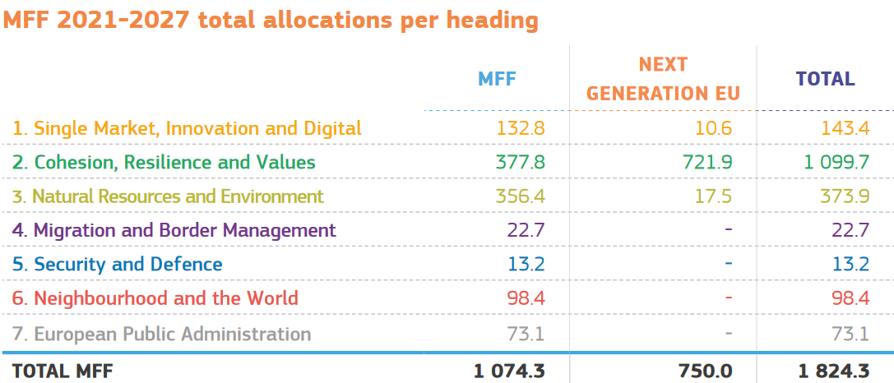
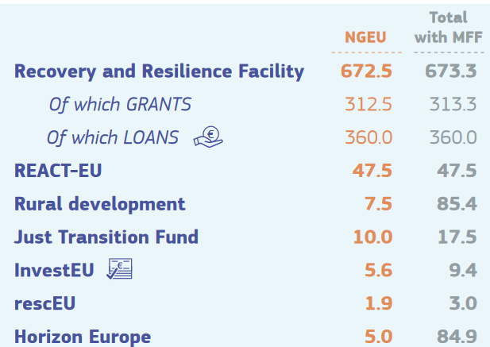
MFF 2021-2027 – new proposal July 2020 - EU recovery plan
Political agreement on 10 November 2020 between the European Parliament and the Council is based on the Commission proposal from 27 May 2020.
A reinforcement of priority programmes of €15 billion compared to the 21 July agreement.
https://www.consilium.europa.eu/en/infographics/mff2021-2027-ngeu-final/

Slide 27
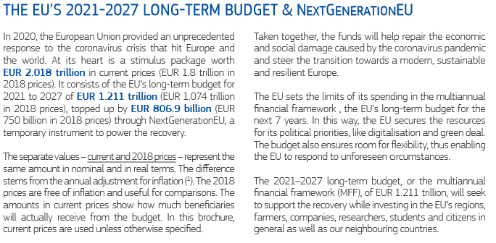
MFF 2021-2027 – 2020 prices

Slide 28
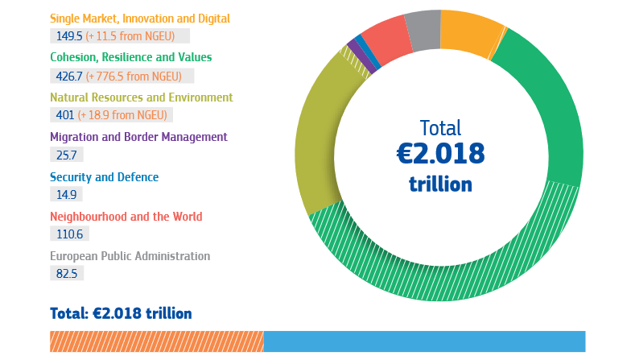
MFF 2021-2027 – 2020 prices

Slide 29
THANK YOU FOR YOUR ATTENTION

