Slide 2
Single European Market
Radomír Kaňa
Department of International Economic Relations

Slide 3

Stages of economic integration
Free Trade Area: reduces tarifs, to zero between members
Customs Union: … + establishes a common external tarrif
Common Market/Single Market: … + establishes a free flow of factors of production (labour and capital), as well as goods and services
Economic Union: … + involves an agreement to harmonize economic policies
Political Union

Slide 4
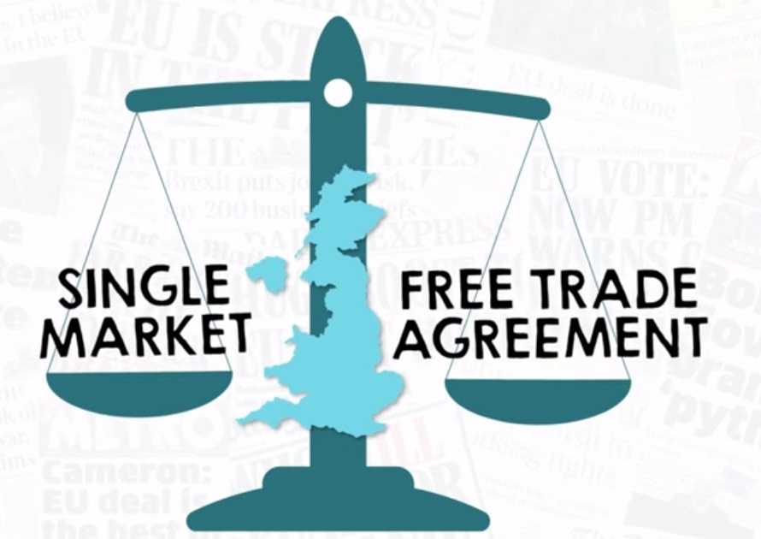
What's the difference between a single market and a free trade agreement
Let’s watch a video – Case of Brexit
https://fullfact.org/europe/whats-difference-between-single-market-and-free-trade-agreement/
https://www.youtube.com/watch?v=7Bg3Php6_Tc

Slide 5
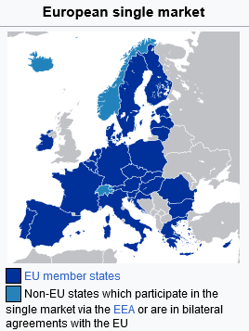
The European single market, internal market or common market is a single market comprising the 27 member states of the European Union (EU) as well as – with certain exceptions – Iceland, Liechtenstein, and Norway through the Agreement on the European Economic Area, and Switzerland through sectoral treaties… 31
The single market seeks to guarantee the free movement of goods, capital, services, and people, known collectively as the "four freedoms".This is achieved through common rules and standards that all the EU member states are legally committed to following.

Slide 6
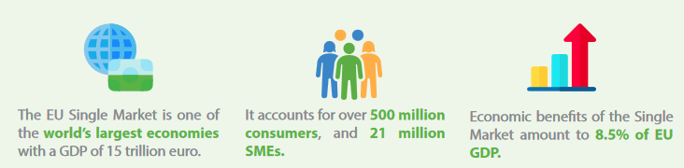
The EU Single Market is one of the world´s largest economies (larger in size than the US or Japan)
The economic benefits of the single market amount to 8.5% of the EU’s GDP.
People, goods, services and capital move freely across the EU single market.
Citizens are free to live, work, study and do business anywhere in the single market.
For businesses, the single market acts as an extensive domestic market.

Slide 7
Three milestones in the history of the single market
The decision to create a single market goes back to 1986.
The single market was launched in January 1993.
April 2011 and October 2012: the European Commission presented two extensive packages of measures to boost the single market. Some of the priority actions: digital single market, mobility of citizens, and financing for small and medium-sized enterprises.
2017: 25 years of Single Market
March 2019: the European Council called for further extensive development of the single market.
Let’s watch a video – 2012: 20x20 - Europe's Single Market is 20 Years Old
https://www.youtube.com/watch?v=cIZayHDuV84
Let’s watch a video
https://www.politico.eu/event/single-market/ … almost an hour☺

Slide 8
Historical background
1955 (Mesina) – 1956 (Venice) – idea of economic unification
Spaak Report = blueprint for a Single Market in Western Europe
3 main elements
  normal standards of competition (eliminate protective barriers)
  reduce state intervention, monopolistic conditions
  prevent distortion of competition
1957: The Treaty of Rome
4 freedoms: Free movement of goods, services, capital, labour
1958: elimination of customs duties + quantitative restrictions + non-tariff bariers
1968: introduction of common external tariff

Slide 9
The clash between laissez faire and interventionist ideologies
The implied commitment to free market economy, stressing the advantages of competition and greater efficiencies through specialization and economies of scale, was balanced by an acceptance of dirigisme and intervention by state agencies and nationalized monopolies.
This tension was framed as a difference between ´regulated capitalism´ and ´neo-liberalism.
Regulated capitalism
government intervention in market
emphasis on welfare state and distributive politics
increased regulation at the EU level
Supporter – Jacques Delors, social democratic and christian parties
Neo-liberalism
market liberalization
regulatory competion among member states
rejection of greater regulatory power for institutions at EU level
supporters – conservative political parties, multinationals and industry associations and financial institutions

Slide 10
Historical background
1960s – 1970s: Politics of Harmonization
Factors for the limited success:
  Unanimous decision-making
  Rising protectionism
  Lack of political will
  The example of Dutch spread jam
MUTUAL RECOGNITION allows member states to recognize regulations as equivalent
1970s – 1980s: Neoliberalism
Business engaged in extensive lobby for Single Market
1985 Single European Act (SEA) - set a deadline to complete the EU single market by the end of 1992
Mutual recognition – a key concept in trade liberalization, promoting mutual reciprocity of standards rather than harmonization.
Examples: Italian pasta, German beer purity, Belgian margarine
1974 Dassonville Case
1979 Cassis de Dijon - ´there was not valid reason why products produced an marketed in one member state could not be introduced into another member state´ see video: https://www.youtube.com/watch?v=T__OuYtFZJo
1993 Keck case
2007 Viking case , Laval and Ruffert case

Slide 11
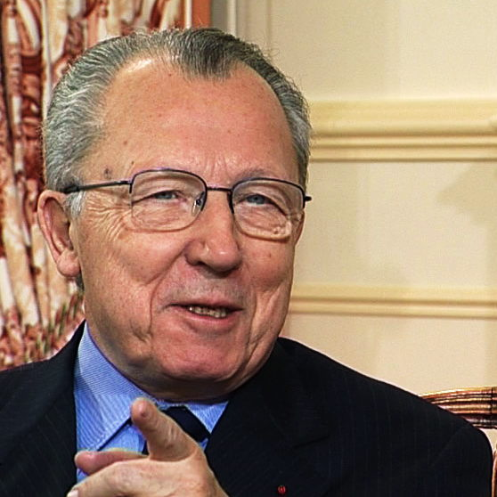
1992 Single Market Programme
Adopted in 1985 by the European Commission as “The White Paper: Completing the Internal Market” called „1992 Programme“
Package of measures to liberalize trade
Main objective = remove:
    Physical barriers
    Technical barriers
    Fiscal barriers
Jacques Lucien Jean DELORS
A French economist and politician, the eighth President of the European Commission and the first person to serve two terms in that office (between January 1985 and December 1994)

Slide 12

1992 Single Market Programme
Other proposals:
The liberalization of public procurement
A common market for services (transport, banking, insurance, information marketing)
Free movement of capital
The removal of legal restraints on the formation of EC-wide companies
The adoption of a Community trademark system
1988 The Cecchini Report
Named after an economist who issued 16 volumes of forecasts for the Internal Market before 1987.
Report:
established the main barriers that were to be removed by implementing Article 13 of the Single European Act: physical barriers, technical barriers and fiscal barriers
it was bassed on a survey of 11 000 industrialists and econometric modelling
it estimated that the EU GDP will rase with 4.5 % in the next 5 years

Slide 13
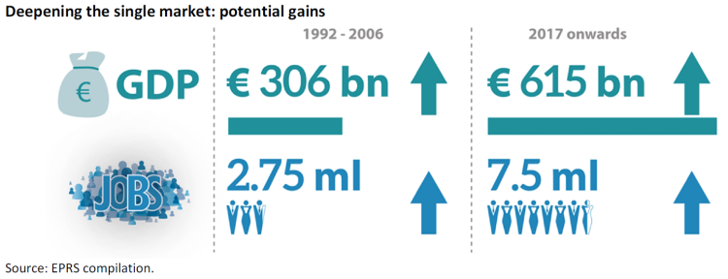
Current State of Single Market
Although a lot was achieved between 1986 and 1992, the single market was never completed as such.
Some of the 3 500 single-market measures so far adopted, mainly to establish common or minimum standards, still need to be implemented or effectively enforced.
In 2014, it was estimated that there were also still significant ‘missing links’ in the single market.
Action on four fronts – full implementation of the Services Directive, further integration of the energy and financial services sectors, and further progress in opening up public procurement – could add an additional 3 % to EU GDP by 2020.
Completing the single market would trigger economic gains ranging from €651 billion to €1.1 trillion per year, equivalent to a range of 5 % – 8.63 % of EU GDP.

Slide 14

Current State of Single Market - Single Market Strategy
On 28 October 2015, the European Commission presented a new Single Market Strategy.
The Commission has decided to give the Single Market an important boost by taking measures that will:
  Enable the balanced development of the collaborative economy
  Help SMEs and start-ups to grow
  Improve the opportunities for businesses and professionals to move across borders
  Address restrictions in the retail sector
  Prevent discrimination against consumers based on nationality or place of residence
  Modernise our standards system
  Create more transparent, efficient and accountable public procurement
  Consolidate Europe’s intellectual property framework
  Ensure a culture of compliance and smart enforcement to help deliver a true Single Market

Slide 15
Current State of Single Market - Time to renew the commitment to the Single Market (March 2019)
Today, deeper integration requires more political courage than 25 years ago and greater efforts to close the gap between rhetoric and delivery.
Over the last four years, the Commission has put forward an ambitious set of measures to deepen the Single Market and make it fairer.
In particular, with the Single Market Strategy, Capital Markets Union and Digital Single Market Strategy, the Commission has presented 67 proposals, out of which 20 still have to be adopted.
The Commission has also presented other key proposals in areas like services, data economy, circular and sustainable development as well as proposed safeguards in the fields of employment, taxation and company law.

Slide 16
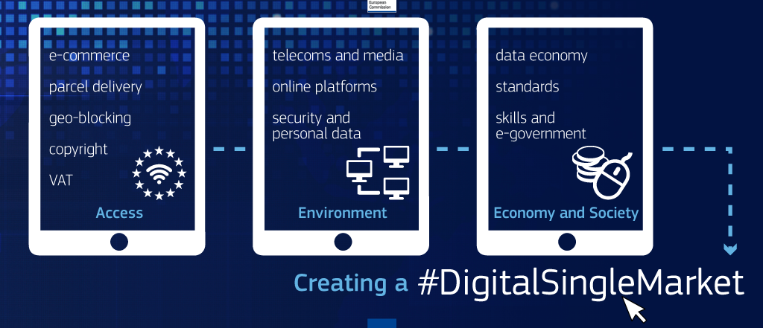
Digital Single Market
28 May 2015 - priorities for the digital single market
Competitiveness ministers emphasised fit-for-purpose copyright rules, updating e-commerce rules, and boosting consumer confidence, awareness and protection.
The ministers also insisted on the need for action to
Priorities:
  creating the right conditions for small and medium-sized businesses, especially start-ups
  promoting the digitisation of European industry
  applying and extending e-governance in public administrations
  increasing investments in digital infrastructure and networks
  assessing the impact of fiscal rules on digital tools (reinforce data protection rules)
  considering the 'digital by default' principles for all new EU legislation.

Slide 17
Adapt the Single Market to a changing world
20 June 2019 - EU leaders acknowledged the single market as a key element in developing the economic base of the European Union. This is one of the four main priorities of the newly adopted strategic agenda for 2019-2024.
The European Council asked for a more integrated approach connecting all relevant policies and dimensions:
  deepening and strengthening the single market and its four freedoms
  designing an industrial policy fit for the future
  addressing the digital revolution
  ensuring fair and effective taxation

Slide 18
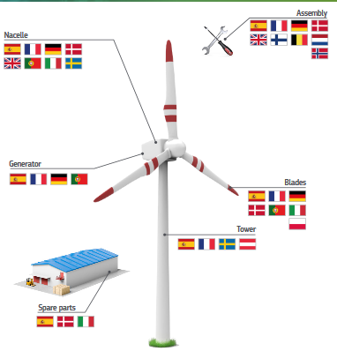
The Single Market: a driver of competitivenes
The Single Market makes it possible for businesses to connect and integrate with each other in a way that allows creating new products and to market them across Europe free from customs or technical barriers.

Slide 19
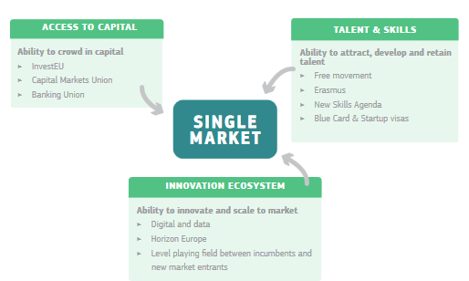
The Single Market: a driver of competitiveness
The EU supports the Single Market by improving the investment environment and enhancing the availability and access to capital, talent, infrastructure and business support across the EU.

Slide 20
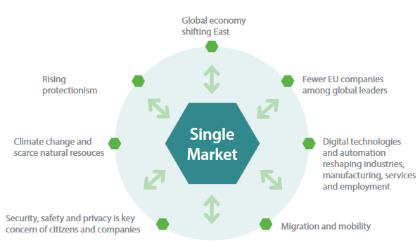
Adapt the Single Market to a changing world
Single Market to remain a source of growth and opportunities, it must continue to adapt to new developments and challenges.
There is significant potential for further economic integration in the areas of services, products, taxation and network industries.
Ambition will also be required to tackle new challenges and avoid emerging barriers in strategic sectors for the future such as digital, artificial intelligence or the circular and low carbon economy.

Slide 21
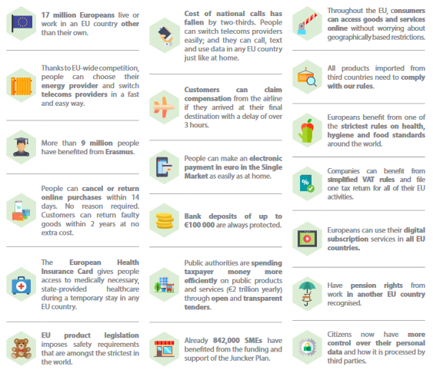
The Single Market: What does it do for you?

Slide 22
The Single Market: What does it do for you?

Slide 23

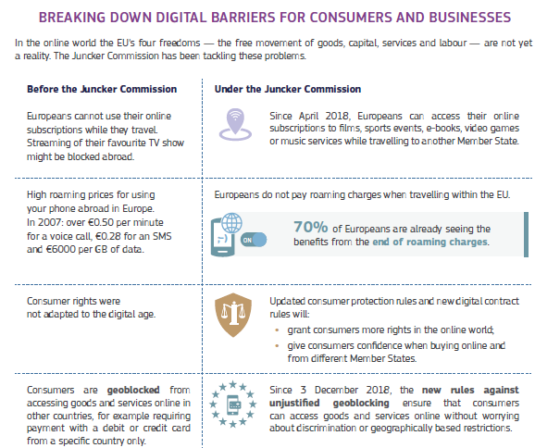
Digital Single Market - achievements
Other results see:
file:///C:/Users/kan03/Downloads/a_digital_single_market_benefit_all_europeans_en_20191128_FB67F35C-08CC-A658-BFEFEB0A086BFA49_53056-5.pdf

Slide 24
The Single Market: main benefits
The single market enabled European consumers to enjoy a greater variety of products.
From 1992 to 2006, the single market increased EU GDP by 2.2 %, representing €233 billion, or around €500 per citizen.
From 1992 to 2006, the single market created 2.75 million jobs, representing a 1.4% increase in total employment.
The single market increased intra-EU trade by 9 %.
In the absence of the single market, per capita European incomes would be 12 % lower today.
Between 1992 and 2012, intra-EU trade intensity rose from about 12 % to 22 % of GDP – and higher benefits from existing trade flows.
Between 1992 and 2016, exports of goods and services as a share of EU GDP rose from 5 to 43 %.
Growth, employment and social indicators¨- 2021
In 2021 the EU industry and services sectors recovered quickly (industry 7.3%, service 4.7%) from the fall driven by the pandemic containment measures in 2020. They grew faster than in the last decade, although slower than in China (+8.2% for both sectors in 2021). The increase in value added occurred across all business sizes.
EU employment grew by 0.7% in 2021. This was stronger than in Japan and the UK, but far below the growth experienced in the USA. Detailed benefits of SEM in 2021 -
https://single-market-scoreboard.ec.europa.eu/competitiveness_en

Slide 25
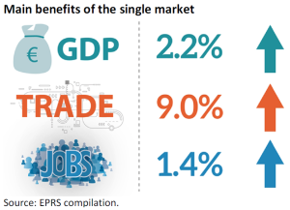
The Single Market: main benefits (2017)
Free movement of goods
The single market has increased competition in the manufacturing sector, which has led to convergence of prices and spurred innovation.
From 1994 to 2015, intra-EU trade in goods more than quadrupled, from €800 billion to €3 063 billion per year, in part due to successive enlargements of the EU.
The single market boosted bilateral exports and imports of goods by Member States by about 8 %, resulting in a 2%-3 % higher per capita income throughout the Member States.
Since 1992, intra-EU exports have risen from 9 to 21 % of EU GDP.
Integration of goods and services – 2021
Single market integration, as measured by trade within the EU, has been growing after the effects of the COVID-19 containment measures in 2020 and remains well above the value of trade with the rest of the world. In June 2022 trade within the EU amounted to more than €360 bn and represented 60% of overall EU trade. In 2019 about 16% of EU SMEs in the industry sector reported sales to another EU country.
In addition, the drop in price dispersion across Member States (from 44.6% in 1996 to 24.4% in 2021) confirms the expectations of the single market leading to price convergence over time.
Detailed benefits of SEM in 2021 -
https://single-market-scoreboard.ec.europa.eu/competitiveness_en

Slide 26
The Single Market: main benefits (2017)
Free movement of people, services and capital
22 of the 27 EU Member States (plus Iceland, Norway, Switzerland and Liechtenstein) participate in the Schengen Agreement, which allows passport-free travel for over 400 million citizens, who make over 4 million trips as tourists in another EU Member State every year.
The number of students studying in an EU Member State other than their own has increased from 3 000 in 1988 to 272 000 in 2014. Since 1987, over 3.3 million students and 470 000 teaching staff have taken part in the EU’s Erasmus programme.
Trade in services is 9 % higher between EU Member States than would have been the case in a free trade area (without tariffs, but with other barriers remaining).
There has been an increase in trade in services across Europe since 1992 – between 1992 and 2013, intra-EU trade in services rose from €215 billion to €685 billion – although it is unclear whether or not the single market is the only driver.
The breaking down of barriers in the EU telecommunications market has improved efficiency in the economy. Consumers saved €9.6 billion between 2009 and 2013, thanks to lower roaming charges.
The annual flow of inward foreign direct investment (FDI) into the EU rose from €64 billion in 1992 to €280 billion in 2016, peaking at €730 billion in 2007, before the 2008 economic crisis.

Slide 27
THANK YOU FOR YOUR ATTENTION

