Slide 2
Economic policy areas of the EU, common and coordinated policies.
Radomír Kaňa
Department of International Economic Relations

Slide 3
EU policies
The EU member countries have transferred some of their law-making authority to the EU in certain policy areas, such as agriculture and fisheries. In other areas, such as culture, policy-making is shared between the EU and national governments
The European Union acts in a wide range of policy areas — economic, social, regulatory and financial — where its action is beneficial to the member states
Common policies – agriculture,trade (commercial),transport, fishery, monetary
Coordinated – regional (economic and social cohesion), social, environmental,r&d, energy, industrial, foreign and security, security and defence…

Slide 4
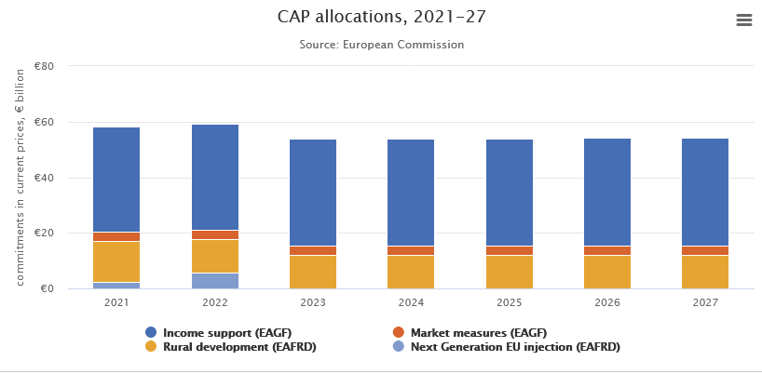
Common Agricultural Policy
The Common Agricultural Policy (CAP) is a system of European Union agricultural subsidies and programmes.
It represented about 39% of the EU's budget, … (total – „SUSTAINABLE GROWTH: NATURAL RESOURCES“)
The CAP combines a direct subsidy payment for crops and land which may be cultivated with price support mechanisms, including guaranteed minimum prices, import tariffs and quotas on certain goods from outside the EU.
Reforms are currently underway reducing import controls and transferring subsidy to land stewardship rather than specific crop production (phased from 2004 to 2012). Detailed implementation of the scheme varies in different EU member countries.
The EU’s multiannual financial framework (MFF) for 2021-27, adopted on 17 December 2020, amounts to €1.21 trillion (in current prices) with an additional €808 billion from the next generation EU recovery instrument. The total allocation for the common agricultural policy (CAP) amounts to €386.6 billion, divided between two funds (often referred to as the “two pillars” of the CAP

Slide 5
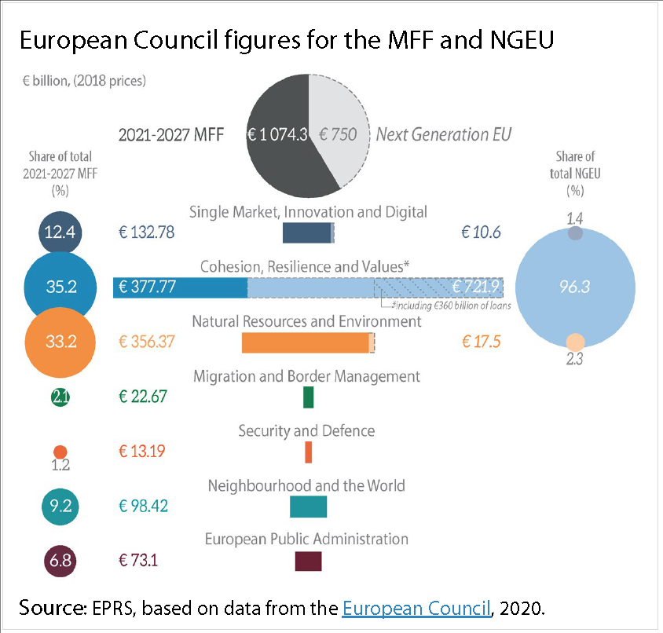
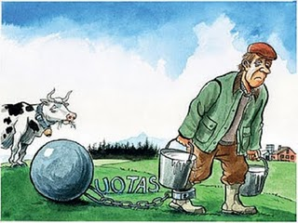
Common Agricultural Policy
… the share of traditional CAP spending is projected to decrease significantly to cca 30 - 32%, following a decrease in real terms in the current financing period.
In contrast, the amounts for the EU's Regional Policy represented 17% of the EU budget in 1988. They will more than double to reach almost 36% in 2013
The aim of the CAP is to provide farmers with a reasonable standard of living, consumers with quality food at fair prices and to preserve rural heritage. However, there has been considerable criticism of CAP.

Slide 6
Common Agricultural Policy
The Treaty of Rome signed in 1957, established the Common Market, it also defined the general objectives of a CAP. The principles of the CAP were set out at the Stresa Conference in July 1958.
The creation of a common agricultural policy was proposed in 1960 by the European Commission and the CAP mechanisms were adopted by the six founding Member States. In 1962, the CAP came into force.
The six member states individually strongly intervened in their agricultural sectors, in particular with regard to what was produced, maintaining prices for goods and how farming was organised. This intervention posed an obstacle to free trade in goods while the rules continued to differ from state to state, since freedom of trade would interfere with the intervention policies.
For details see:
https://agriculture.ec.europa.eu/common-agricultural-policy_en
https://agriculture.ec.europa.eu/common-agricultural-policy/cap-overview/cap-2023-27_en

Slide 7
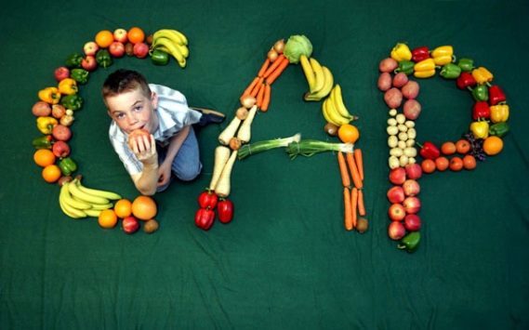
Common Agricultural Policy
Some Member States, in particular France, and all farming professional organisations wanted to maintain strong state intervention in agriculture. This could therefore only be achieved if policies were harmonised and transferred to the European Community level.
By 1962, three major principles had been established to guide the CAP: market unity, community preference and financial solidarity. Since then, the CAP has been a central element in the European institutional system.
The initial objectives were set out in Article 39 of the Treaty of Rome:
  to increase productivity, by promoting technical progress and ensuring the optimum use of the factors of production, in particular labour;
  to ensure a fair standard of living for the agricultural Community;
  to stabilize markets;
  to secure availability of supplies;
  to provide consumers with food at reasonable prices.

Slide 8
Common Agricultural Policy
CAP is an integrated system of measures which works by maintaining commodity price levels within the EU and by subsidising production. There are a number of mechanisms:
Import tariffs are applied to specified goods imported into the EU.
  These are set at a level to raise the World market price up to the EU target price. The target price is chosen as the maximum desirable price for those goods within the EU.
Import quotas are used as a means of restricting the amount of food being imported into the EU.
An internal intervention price
Direct subsidies are paid to farmers
  originally intended to encourage farmers to choose to grow those crops attracting subsidies and maintain home-grown supplies
  subsidies were generally paid on the area of land growing a particular crop
  reforms implemented from 2005 are phasing out specific subsidies in favour of flat-rate payments based only on the area of land in cultivation, and for adopting environmentally beneficial farming methods
Production quotas and 'set-aside' payments
  to prevent overproduction of some foods (for example, milk, grain, wine) that attracted subsidies well in excess of market prices.

Slide 9
Common Agricultural Policy
The CAP was funded by the European Agricultural Guidance and Guarantee Fund (EAGGF) of the EU – till 2006
From 2007……
EAGF - European Agriculture Guarantee Fund
EAFRD – European Agriculture Fund for Rural Development
Attempts at reforms
The Mansholt Plan - 1960s idea that sought to remove small farmers from the land and to consolidate farming into a larger, more efficient industry.
In 1992, the MacSharry reforms - created to limit rising production, while at the same time adjusting to the trend toward a more free agricultural market.
The reforms reduced levels of support by 29% for cereals and 15% for beef. They also created „set-aside“ payments to withdraw land from production, payments to limit stocking levels, and introduced measures to encourage retirement and forestation.

Slide 10
Common Agricultural Policy
The „Agenda 2000“ reforms divided the CAP into two „Pillars“:
  production support – single farm payments and rural development.
Decoupling (2003) - „decoupling“ subsidies from particular crops - Member States may choose to maintain a limited amount of specific subsidy
EU expansion (2004) - increased the number of farmers from 7 to 11 million, direct payments will be phased in over 10 years (2004-2013)
Sugar regime reform (2005-2006)
Proposed direct subsidy limits (2007)
In 2008 the CAP Health Check was launched.
It aims to modernize the policy and provide assistance when answering to new challenges such as climate change. The EU 27 also agreed to further cut direct subsidies to farmers, for the benefit of rural development policy, and to abolish milk production quotas.
The discussion of the CAP’s future beyond 2010 in context of the general reform of EU budget has started in 2010. The first contribution to the discussion from European Commission stressed that agriculture must do more to mitigate climate change and consider the option to established third pillar of the CAP focusing on this issue.

Slide 11
Common Agricultural Policy
Based on the wide-ranging public debate, on 18 November 2010, the Commission presented a Communication on „The CAP towards 2020“
On 12 October 2011 the Commission presented a set of legal proposals to reform the Common Agricultural Policy (CAP)
Its stated aim is to guarantee European citizens healthy and quality food production, whilst preserving the environment
According to the proposal, the three broad objectives of the future CAP are: „Viable food production“, „Sustainable management of natural resources“ and „Balanced territorial development“, which respond directly to the economic, environmental and territorial balance challenges identified in the Communication.
The ten key objectives
For the period 2023-27, the common agricultural policy (CAP) will be built around ten key objectives. Focused on social, environmental and economic goals, these objectives will be the basis upon which EU countries design their CAP strategic plans.
DOOR database
Protected Designation of Origin (PDO) , Protected Geographical Indication (PGI), Traditional Speciality Guaranteed (TSG).

Slide 12
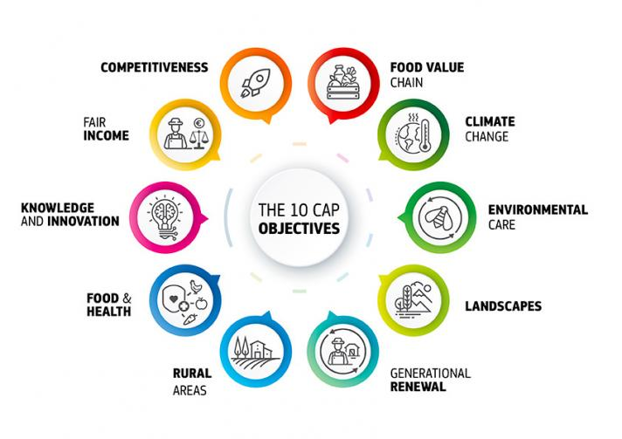
For the period 2023-27, the common agricultural policy (CAP) will be built around ten key objectives

Slide 13
Common Agricultural Policy – for and against
For
The EU must look after its farmers because they help protect the countryside… + quality of production
The free market is unstable. Without intervention prices would fluctuate and farmers would not be able to respond to consumer demand.
Against
Resources are best allocated through a free market: CAP makes food more expensive in the EU than it need be.
The CAP increases poverty in poor countries by competing unfairly with local farmers.
The CAP demands far too high a budgetary contribution to support only a small minority of EU businesses.
Processing farmers' CAP payments is expensive.

Slide 14
EU Trade – Commercial - Policy
The common commercial (trade) policy is one of the main pillars of the European Union's relations with the rest of the world (Article 207 of the Treaty on the Functioning of the European Union – TFEU). It is an integral area of exclusive Union competence (Article 3 of the TFEU). It is the counterpart to the creation of a customs union between the Member States.
The common commercial policy implies uniform conduct of trade relations with third countries, in particular by means of a common customs tariff and common import and export regimes. The Treaty of Lisbon also widens the common commercial policy to include direct foreign investments.
The Union supports the abolition of trade and customs barriers. To defend the European market, it has at its disposal tools such as anti-dumping and anti-subsidy measures, the Trade Barriers Regulation and safeguard measures.
For detailed info see: https://eur-lex.europa.eu/summary/chapter/external_trade.html?root_default=SUM_1_CODED%3D07&locale=en

Slide 15
The main objectives of the commercial policy
First, to appreciate trade with other nations.
Second, to protect domestic market prevailing in the country.
Third, to increase the export of particular product which will help in expanding domestic market.
Fourth, to prevent the imports of particular goods for giving protection to infant industries or developing key industry or saving foreign exchange, etc.
Fifth, to encourage the imports of capital goods for speeding up the economic development of the country.
Sixth to restrict the imports of goods which create unfavourable balance of payments.
Seventh, to assist or prevent the export or import of goods and services for achieving the desired rate of exchange.
Eighth, to enter into trade agreements with foreign nations for stabilizing the foreign trade.

Slide 16
EU Trade Policy
EU and its 27 EU Member States act as one single jurisdiction in all trade-related matters.
The European Commission acts as the leading voice in trade policy.
  It is responsible both for conducting trade negotiations and for enforcing trade agreements: making sure that third countries comply with the rules and accords reached.
The Council acts as the decision maker.
EU trade policy is developed through two main channels:
Multilateral level - this is the level of the World Trade Organisation (WTO), where the EU plays a crucial role.
Bilateral agreements - in addition to multilateral negotiations taking place in the WTO, the EU concludes bilateral agreements with regions and third (non-EU) countries.

Slide 17
EU Trade Policy
Trade policy can involve various complex types of actions … such as the elimination of quantitative restrictions or the reduction of tariffs.
According to a geographic dimension, there is unilateral, bilateral, regional, and multilateral liberalization.
According to the depth of a bilateral or regional reform, there may be „free trade areas“ (wherein partners eliminate trade barriers with respect to each other), „custom unions“ (whereby partners eliminate reciprocal barriers and agree on a common level of barriers against no partners), and „free economic areas“ (or deep integration as in, for example, the European Union, where not only trade but also the movement of factors has been liberalized, where a common currency has been instituted, and where other forms of integration and harmonization have been established).

Slide 18
The most common trade barriers
Tariffs
Taxes levied on products that are traded across borders are called tariffs. However, governments impose tariffs essentially on imports and not on exports. Two most popular types of tariffs are:
• Ad valorem: This tariff involves a set percentage of the price of the imported goods.
• Specific: This refers to a specific amount charged by the government on import of goods.
Quotas
Import quotas are the trade limits set by the government to restrict the quantity of imports during a specified period of time.
Subsidies
Subsidies work to foster export by providing financial assistance to locally-manufactured goods. Subsidies help to either sustain economic activities that face losses or reduce the net price of production.
Embargo
This is an extreme form of trade barrier. Embargoes prohibit import from a particular country as a part of the foreign policy. In the modern world, embargoes are imposed during wartimes or due to severe failure of diplomatic relations

Slide 19
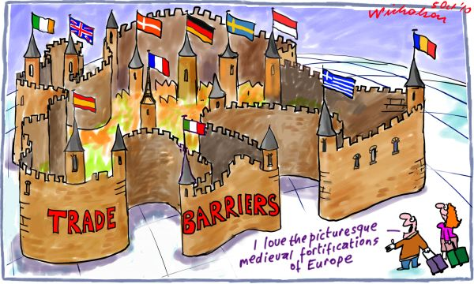
The most common trade barriers
A voluntary export restraint
Is a restriction set by a government on the quantity of goods that can be exported out of a country during a specified period of time. Often the word voluntary is placed in quotes because these restraints are typically implemented upon the insistence of the importing nations.

Slide 20
EU Trade Policy
The most important aspects of the EU trade policy is that the EU is a customs union
  The same import duties are charged on imports from third countries regardless of the country of entry.
  The main principles of customs law are regulated at EU level, although the customs authorities of the EU Member States are in charge of their application.
  Trade remedies against unfair trade practices (i.e. anti-dumping and countervailing measures) and safeguards are adopted by the EU and imposed on the imports concerned regardless of the country of origin.
  Import regulations and export controls are also applicable EU-wide.

Slide 21
EU Trade Policy
The EU's Common Commercial Policy covers all the main measures affecting trade in goods and services and almost all trade-related issues
Trade-related areas partially covered by the common trade policy include: company law, indirect taxation, standards and other technical regulations, and enforcement of intellectual property rights
EU position in world trade - https://policy.trade.ec.europa.eu/eu-trade-relationships-country-and-region/eu-position-world-trade_cs
EU Top trading partners - file:///C:/Users/kan03/Downloads/Overview%20of%20top%20trading%20partners.pdf

Slide 22
EU Top trading partners

Slide 23
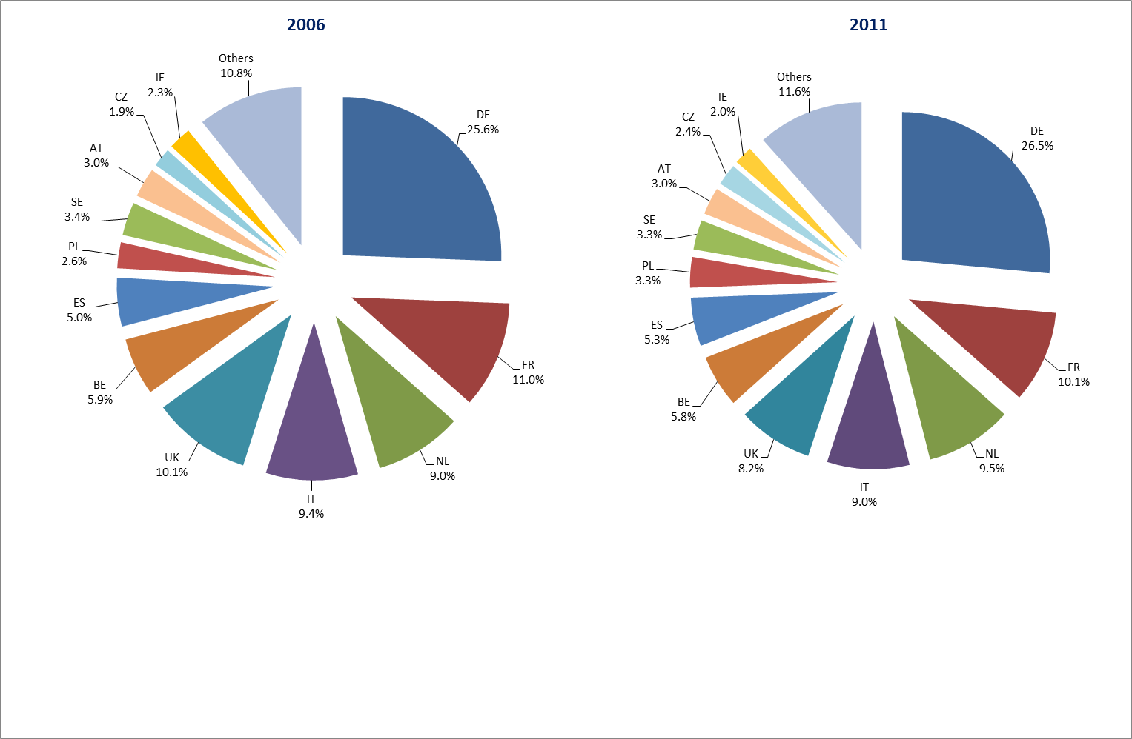
Country share of EU exports of goods

Slide 24
Common transport policy
Transport is fundamental to our societies and our economy– vital for growth and job creation.
The transport industry directly employs around 10 million people and accounts for about 5% of GDP.
Effective transport systems are key to European companies' ability to compete in the world economy. Logistics such as transport and storage account for 10–15% of the cost of a finished product for European companies.
The quality of transport services has a major impact on people's quality of life. The average household spends 13.2% of its budget on transport goods and services.
EU transport policy – details: https://eur-lex.europa.eu/summary/chapter/transport.html?root_default=SUM_1_CODED%3D32%2CSUM_2_CODED%3D3201&locale=en

Slide 25
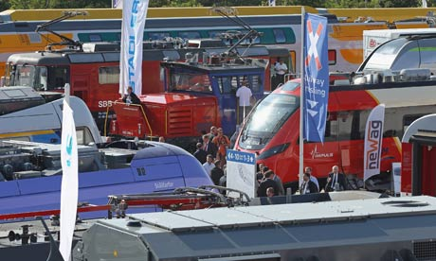
Common transport policy
The Treaty of Rome, made provision for a common European transport policy.
During 1982-83 the European Parliament brought a case against the Council
in 1985 the European Court of Justice (ECJ) ruled in the European Parliament's favour.
The goal of the common transport policy is to remove obstacles at the borders between Member States so as to facilitate the free movement of persons and goods.
Prime objectives
  To complete the internal market for transport, ensure sustainable development, manage funding programmes and spatial planning, improve safety and develop international cooperation.
  It is also concerned with laying down the conditions under which non-resident carriers may operate transport services within a Member State.
Since the Amsterdam Treaty entered into force, decisions have been taken under the codecision procedure, following consultation of the European Economic and Social Committee and the Committee of the Regions.

Slide 26
Common transport policy
TRANS-EUROPEAN NETWORK – TRANSPORT (TEN, TEN-T)
  The trans-European transport network is the name given by the Commission to a programme for the construction, modernisation and interconnection of Europe’s major transport infrastructures.
  In 1996 the EU adopted guidelines for the development of the trans-European transport network and identified 14 priority projects, a number of the 14 priority projects have now been completed and the Commission proposes the addition of six new projects
EU Commission published a White Paper „European Transport Policy for 2010: Time to decide“ on 12 September 2001.
  This set out the framework for all EU level transport policy
  Including 60 specific measures to be taken at a European level
  An action programme for the period until 2010
In 2011, the EU Commission announced anew White Paper, which detailed plans across 25 policy areas. These included: moving away from a reliance on fossil fuels; making more journeys available by rail; ensuring at least 40% of aviation fuel comes from low carbon sources by 2050. The paper also set out plans for a single market in transport
Strategic plan 2020-2024 – Mobility and Transport - https://commission.europa.eu/system/files/2020-10/move_sp_2020-2024_en.pdf

Slide 27
Common fisheries policy
The common fisheries policy (CFP) shares certain Treaty provisions with the Common Agricultural Policy
General objectives:
to increase productivity;
to ensure a fair standard of living for the agricultural community;
to stabilise markets;
to assure the availability of supplies;
to ensure that supplies reach consumers at reasonable prices.
The first common rules in the fisheries sector date back to 1970.
1983 - the Council defined the basis for a Community Fisheries Policy
1992 - regulation establishing a Community system for fisheries and aquaculture
  provides the basis for modernising policy on the conservation and management of fishery resources
1993 - the creation of the Financial Instrument for Fisheries Guidance (FIFG) .
2007 - the FIFG was replaced by the European Fisheries Fund (EFF) which will run to 2013.
from 2014 - European Maritime and Fisheries Fund (EMFF) - one of the five European Structural and Investment (ESI) Funds ….

Slide 28
Common fisheries policy (maritime and fisheries)
The different legal instruments governing fisheries are adopted following a consultation procedure
The Council adopts Community legislation acting on a Commission proposal and after consulting the European Parliament.
June 2006 - Green Paper on an integrated EU Maritime Policy
On 13 July 2011, the European Commission presented its proposals for the reform of the EU common fisheries policy…… ordinary legislative procedure…………….. and, on 2 December 2011, it proposed a new fund for the EU's maritime and fisheries policies for the period 2014-2020 and 2021 - 2027: the European maritime and fisheries fund (EMFF). www pages - https://oceans-and-fisheries.ec.europa.eu/index_en
See☺ - European Atlas of the Seas… map

Slide 29
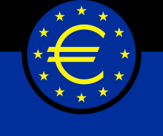
Economic and monetary union, ECB, eurozone …
The Economic and Monetary Union (EMU) represents a major step in the integration of EU economies. Launched in 1992, EMU involves the coordination of economic and fiscal policies, a common monetary policy, and a common currency - the euro
The decision to form an Economic and Monetary Union was taken by the European Council in the Dutch city of Maastricht in December 1991, and was later enshrined in the Treaty on European Union (the Maastricht Treaty). Economic and Monetary Union takes the EU one step further in its process of economic integration, which started in 1957 when it was founded.
Economic integration brings the benefits of greater size, internal efficiency and robustness to the EU economy as a whole and to the economies of the individual Member States. This, in turn, offers opportunities for economic stability, higher growth and more employment - outcomes of direct benefit to EU citizens.

Slide 30
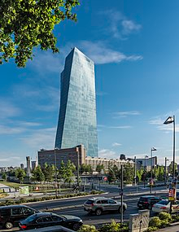
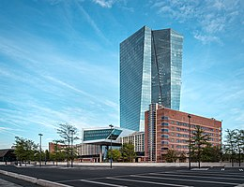
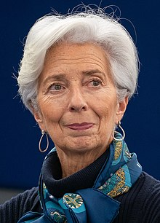
Economic and monetary union, ECB, eurozone …
In practical terms, EMU means:
Coordination of economic policy-making between Member States
Coordination of fiscal policies, notably through limits on government debt and deficit
An independent monetary policy run by the European Central Bank (ECB)
Single rules and supervision of financial Institutions within the euro area
The single currency and the euro area
Christine Lagarde – President of the European Central Bank

Slide 31
Economic and monetary union, ECB, eurozone …
The euro area,commonly called eurozone, is a currency union of 20 member states of the European Union that have adopted the euro (€) as their primary currency and sole legal tender, and have thus fully implemented EMU policies.
The Eurosystem is the monetary authority of the eurozone, the Eurogroup is an informal body of finance ministers that makes fiscal policy for the currency union, and the European System of Central Banks is responsible for fiscal and monetary cooperation between eurozone and non-eurozone EU members. The European Central Bank (ECB) makes monetary policy for the eurozone, sets its base interest rate, and issues euro banknotes and coins.
The European Central Bank (ECB) is the prime component of the Eurosystem and the European System of Central Banks (ESCB) as well as one of seven institutions of the European Union.It is one of the world's most important central banks.
The ECB was established by the Treaty of Amsterdam in May 1999 with the purpose of guaranteeing and maintaining price stability. On 1 December 2009, the Treaty of Lisbon became effective and the bank gained the official status of an EU institution. https://www.ecb.europa.eu/mopo/html/index.en.html ... See more about ECB and monetary policy

Slide 32
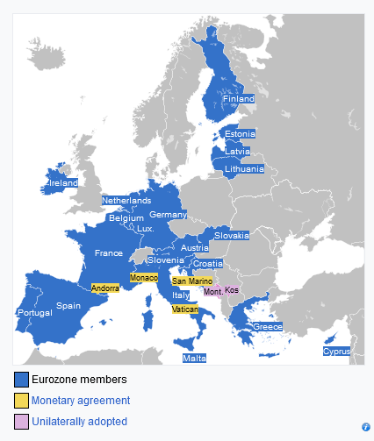
The 20 eurozone members are Austria, Belgium, Croatia, Cyprus, Estonia, Finland, France, Germany, Greece, Ireland, Italy, Latvia, Lithuania, Luxembourg, Malta, the Netherlands, Portugal, Slovakia, Slovenia, and Spain.
The seven non-eurozone members of the EU are Bulgaria, Czech Republic, Denmark, Hungary, Poland, Romania, and Sweden. They continue to use their own national currencies, although all but Denmark are obliged to join once they meet the euro convergence criteria.
Among non-EU member states, Andorra, Monaco, San Marino, and Vatican City have formal agreements with the EU to use the euro as their official currency and issue their own coins.
In addition, Kosovo and Montenegro have adopted the euro unilaterally - these countries, however, have no representation in any eurozone institution.

Slide 33
Regional policy of the European Union
The regional policy of the European Union (EU), also referred as Cohesion Policy, is a policy with the stated aim of improving the economic well-being of regions in the European Union and also to avoid regional disparities.
More than one third of the EU's budget is devoted to this policy, which aims to remove economic, social and territorial disparities across the EU, restructure declining industrial areas and diversify rural areas which have declining agriculture.
EU regional policy is geared towards making regions more competitive, fostering economic growth and creating new jobs. The policy also has a role to play in wider challenges for the future, including climate change, energy supply and globalisation.
The EU's regional policy covers all European regions, although regions across the EU fall in different categories (so-called objectives), depending mostly on their economic situation.
The policy constitutes the main investment policy of the EU, and is due to account for around of third of its budget, or EUR 392 billion over the period of 2021-2027

Slide 34
Territorial cohesion
Territorial cohesion is a European Union concept which builds on the European Spatial Development Perspective (ESDP)
The main aim of the territorial cohesion policy is to contribute to a balanced distribution of economic and social resources among the European regions with the priority on the territorial dimension. This means that resources and opportunities should be equally distributed among the regions and their populations.
The main resource of EU's territorial cohesion policy is EU's structural funds. There are two structural funds available to all EU regions: the European Regional Development Fund (ERDF)and the European Social Fund (ESF).
Regional policy projects in less developed regions are supported by specific European funds: the European Regional Development Fund (ERDF), the European Social Fund Plus (ESF+), the Cohesion Fund and the Just Transition Fund (JTF) FUNDS:https://ec.europa.eu/regional_policy/funding_en … https://ec.europa.eu/regional_policy/policy/what/investment-policy_en
The European Spatial Development Perspective (ESDP) is a document approved by the Informal Council of Ministers of Spatial Planning of European Commission in Potsdam in 1999. It is a legally non-binding document forming a policy framework with 60 policy options for all tiers of administration with a planning responsibility. The strategic aim is to achieve a balanced and sustainable spatial development strategy.

Slide 35
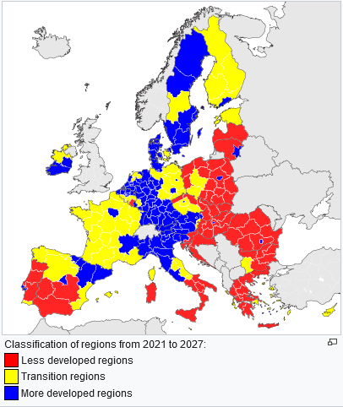
New Cohesion Policy
Cohesion policy – Regional development and cohesion
In 2021-2027 EU cohesion policy has set a shorter, modern menu of 5 policy objectives supporting growth for the period 2021-2027.
The Joint Action Plan includes actions on:
1. a more competitive and smarter Europe
2. a greener, low carbon transitioning towards a net zero carbon economy
3. a more connected Europe by enhancing mobility
4. a more social and inclusive Europe
5. Europe closer to citizens by fostering the sustainable and integrated development of all types of territories
For details see: https://ec.europa.eu/regional_policy/2021-2027_en

Slide 36
THANK YOU FOR YOUR ATTENTION

