Slide 2
Global security and Common Security and Defense policy of European Union.
Radomír Kaňa
Department of International Economic Relations

Slide 3
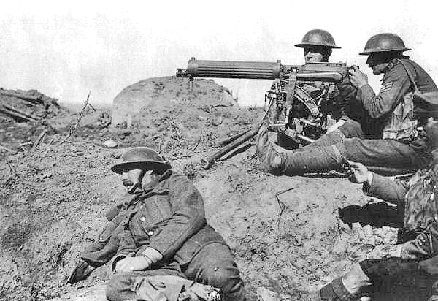
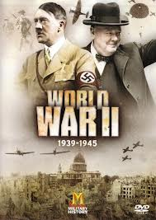
The European continent in 20th century has become the scene of two most destructive global military conflicts in human history, despite the efforts of a number of politicians for intergovernmental (and possibly supranational) cooperation.
The idea of European integration, with an emphasis on security (the beginnings of which could be found in the 15th century) got the chance after 1945, when the recovery process opened opportunities for its gradual implementation after the Second World War.

Slide 4
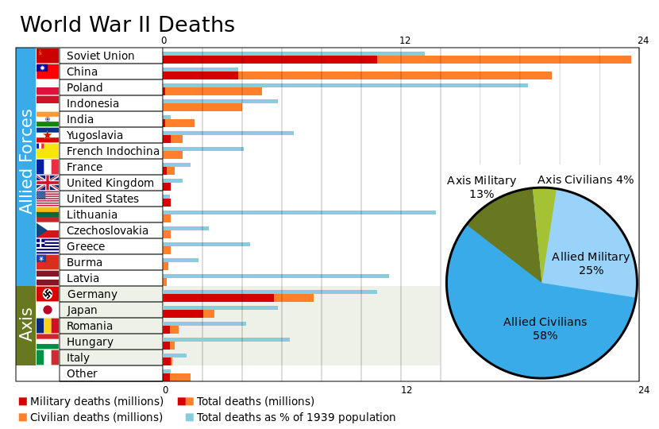

Slide 5
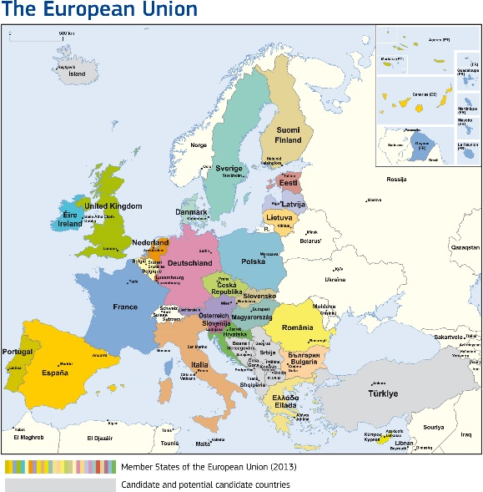
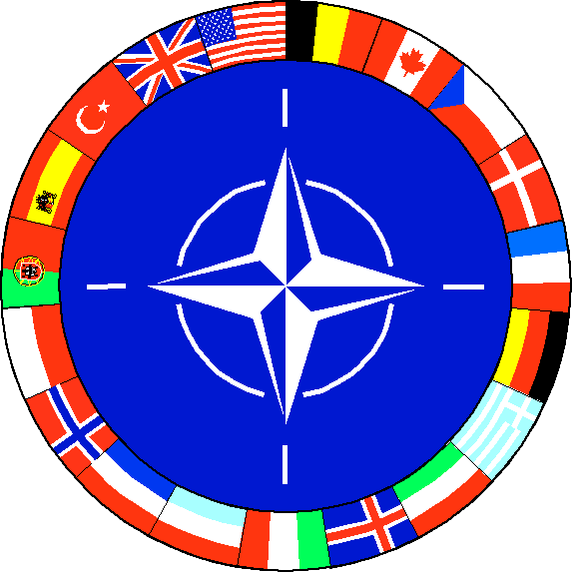

Negative experiences of Europeans with militant policy leading to two global wars, were transformed in efforts to build integration structures and other international organizations (NATO, Western European Union) ….to ensure regional and global security
… the effort from the beginning to implement certain security features within the Community - all these led present European Union member states to create a contemporary form of a CFSP and the CSDP within its framework.

Slide 6
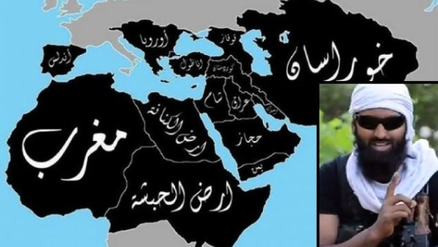
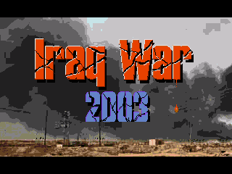
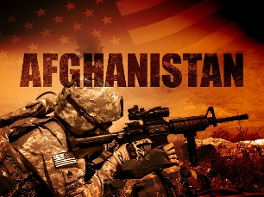
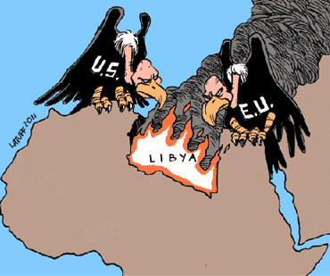
… the end of the bipolar division of the world in the nineties of the twenty century
has significantly reduced the likelihood of a global war,
but that the current world situation is not free of safety hazards
the current multipolarity brings new threats…

Slide 7
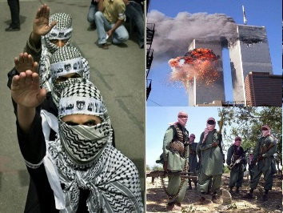
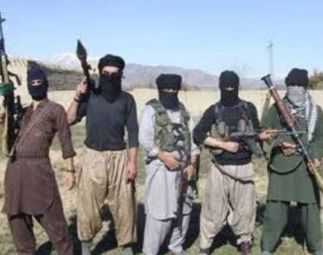
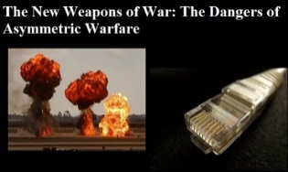
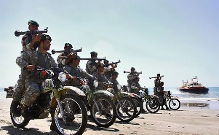
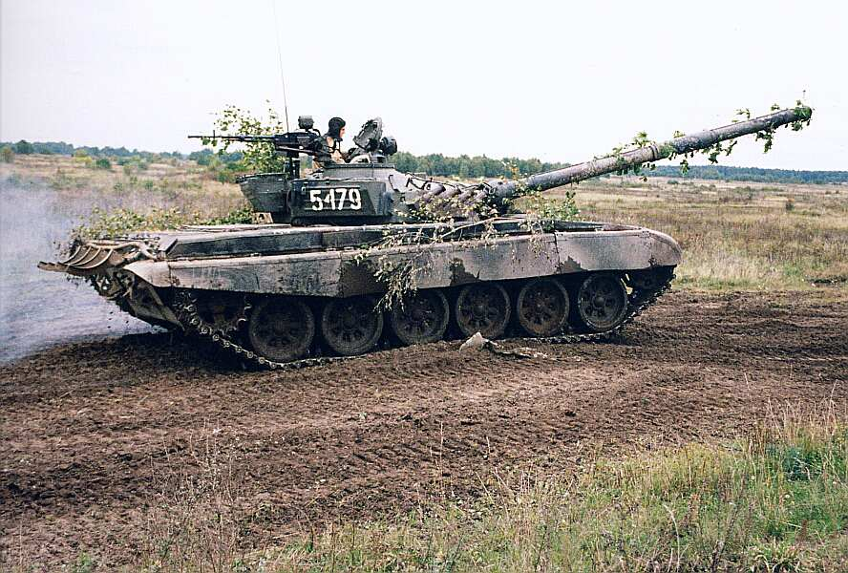
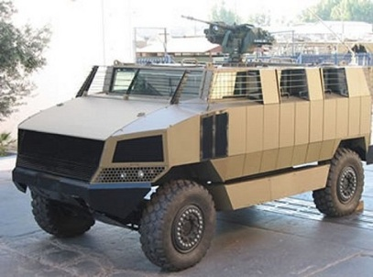
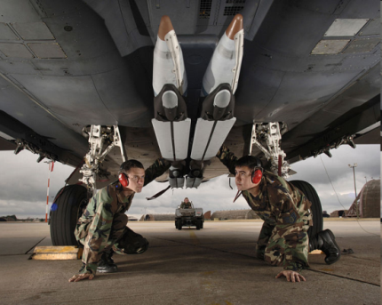
new threats
global security situation at the turn of the millennium
…the importance of other hazards
escalation of a series of regional conflicts …with assymetric warfare
transnational terrorism … proliferation of weapons of mass destruction… failure states … organized crime… illegal immigration
….different approaches … procedures …

Slide 8
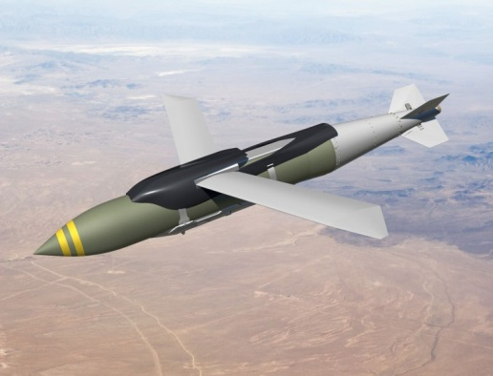
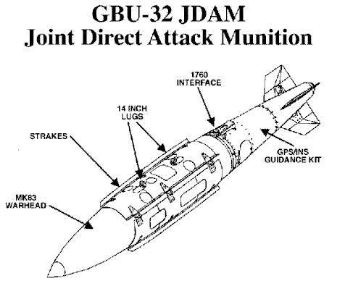
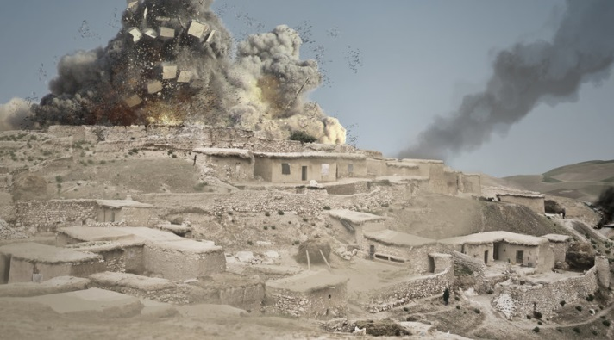
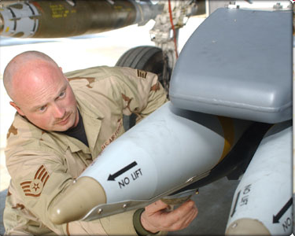

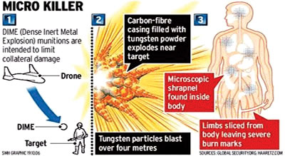
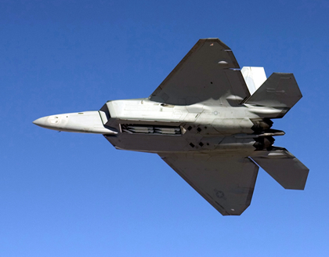
new methods, instruments, technology ...
JDAM - Joint Direct Attack Munition
Small Diameter Bomb (SDB) System, …. DIME (Dense Inert Metal Explosive)

Slide 9
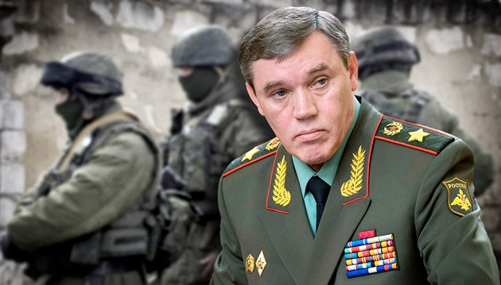
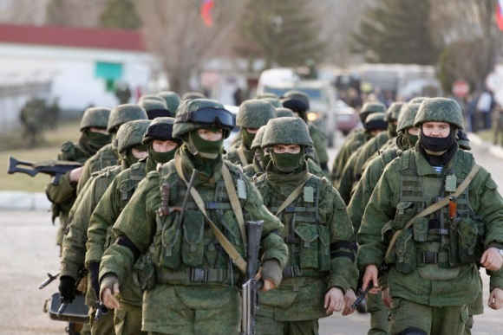
Hybrid War
... Strategic concept, introduced by American researcher Frank G. Hoffman in 2007
It is a state of permanent war, when you can not say exactly whether direct intervention takes place or not.
It is seen as a mix of political, economic and social events, which is followed by military action. These include support for opposition forces in the foreign country, the funding of non-governmental organizations promoting specific interests or sending instructors to train allied forces.
… for Gerasimov hybrid war is not just a concept, but a reality ...
Valerij Gerasimov – since 2012 Chief of the General Staff of the Armed Forces of Russia

Slide 10
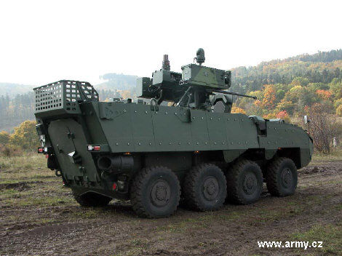
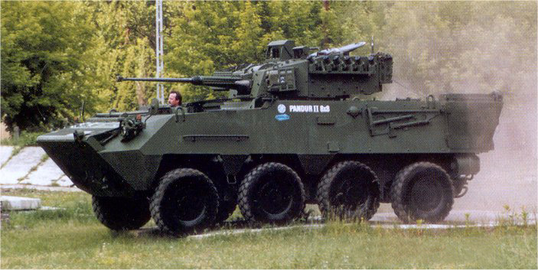
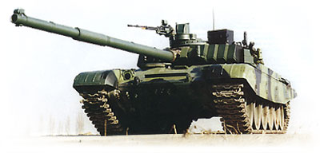
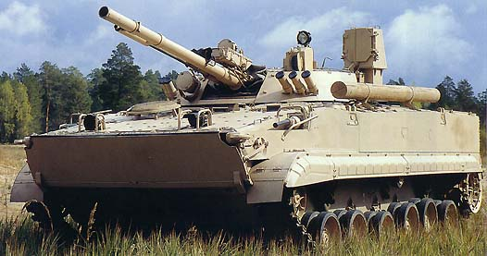
military equipment …“old“

Slide 11
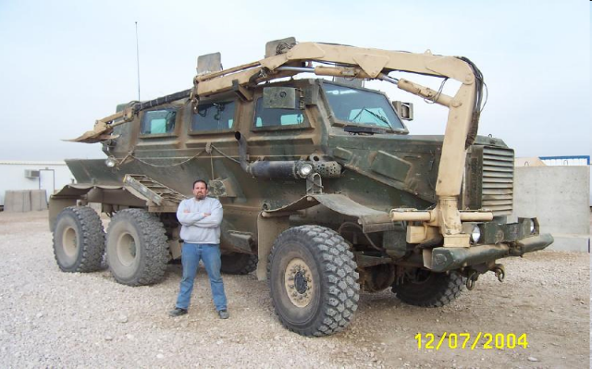
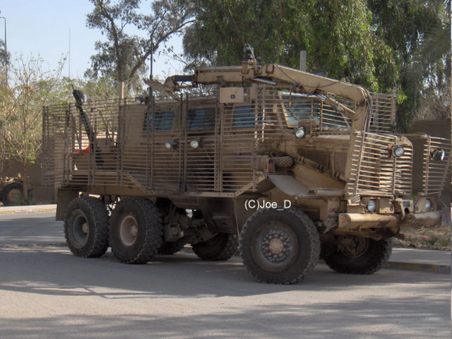

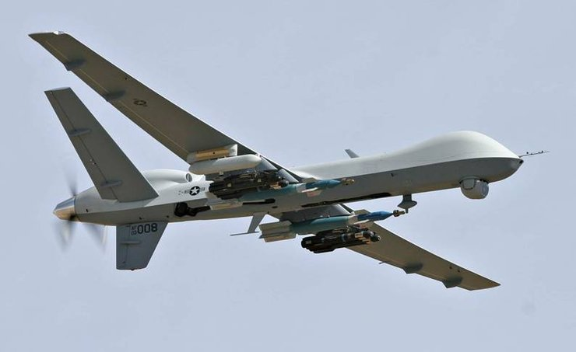
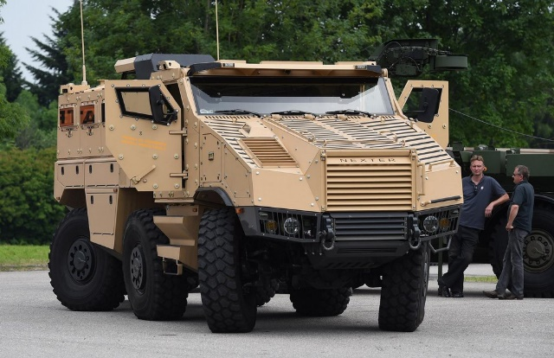
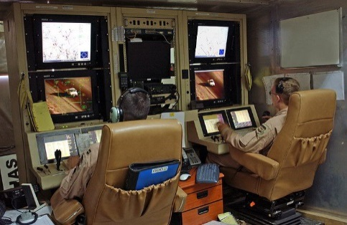
military equipment …new

Slide 12
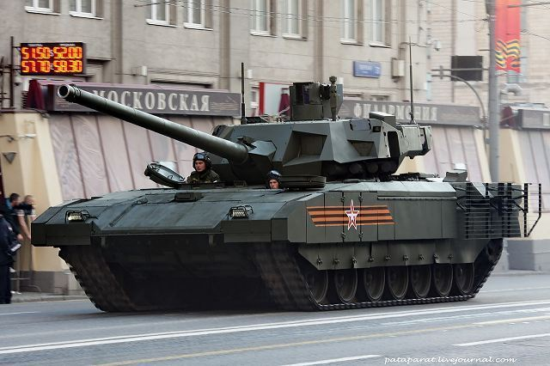
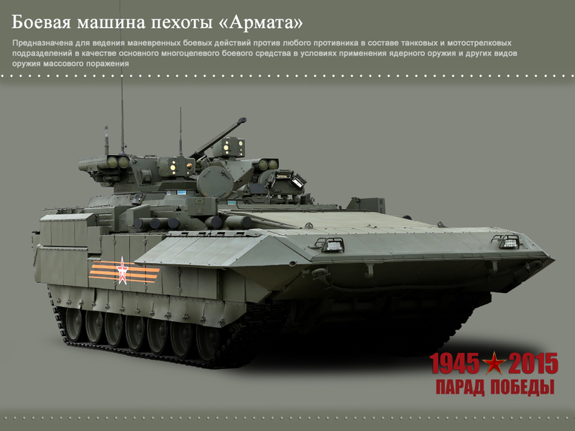
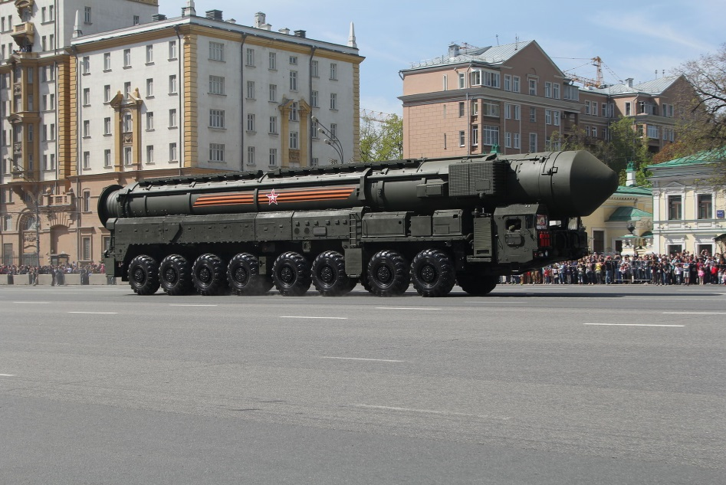
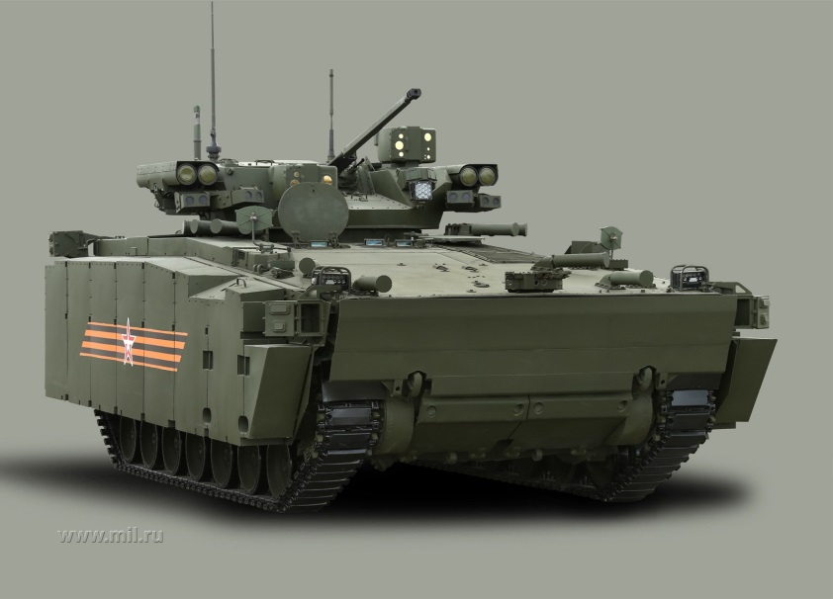
9th May 2015 in Moscow … a return to the „old order“ ???

Slide 13
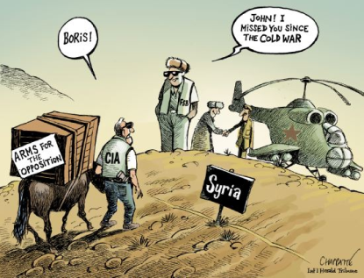

Slide 14
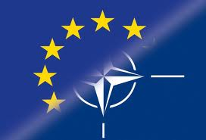
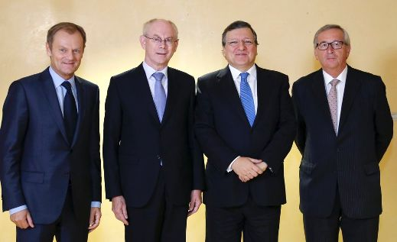
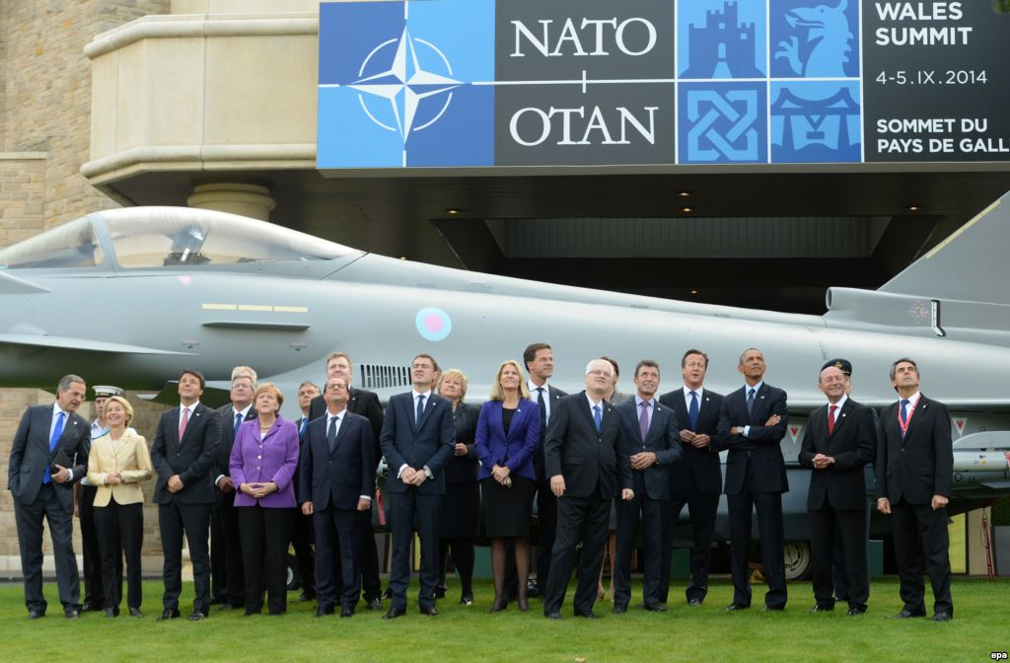
The European Union together with other global security actors, such as NATO and the U.S. has to assume its share of responsibility in this area …
The importance of the Union on the financial, economic and trade areas is unquestionable and it certainly ranks among the world powers
With regard to this position in the world economy, comes the need to adopt an adequate role on the international political scene

Slide 15
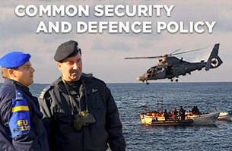
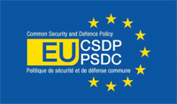
CSDP…a perspective area for the deepening of the European integration process
The Common Security and Defence Policy (CSDP)… formerly known as the European Security and Defence Policy (ESDP) - is a major element of the Common Foreign and Security Policy of the European Union
The aim of the CSDP is to give to the EU a politico-military capability for purely European operations where the US and/or NATO do not want to be involved
The Common Security and Defence Policy enables the Union to take a leading role in peace-keeping operations, conflict prevention and in the strengthening of the international security. It is an integral part of the EU's comprehensive approach towards crisis management, drawing on civilian and military assets …
The Common Security and Defence Policy
https://www.eeas.europa.eu/eeas/common-security-and-defence-policy_en

Slide 16
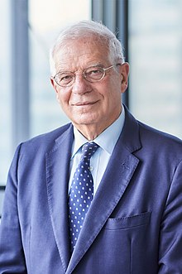
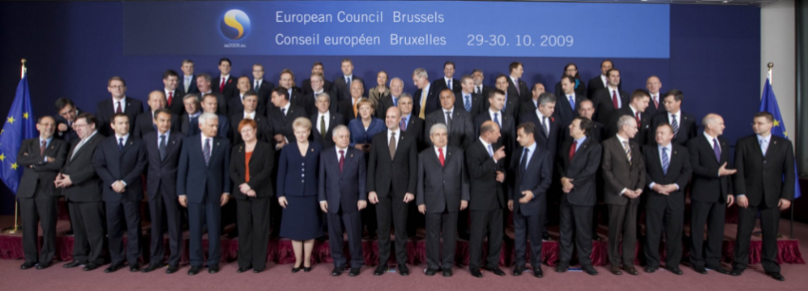
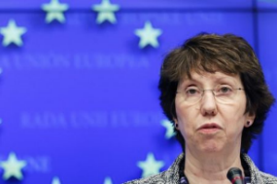
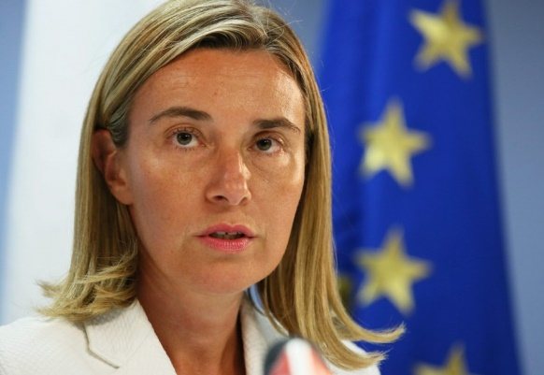
CSDP
Formally, the CSDP is the domain of the The European Council. …the heads of member states
the Union High Representative now – Josep Borrell Fontelles plays a significant role… as Chairman of the external relations configuration of the Council (FAC)… she prepares and examines decisions to be made before they are brought to the Council
The CSDP is furthermore strongly facilitated by the European External Action Service
Complete timeline - EU cooperation on security and defence
https://www.consilium.europa.eu/en/policies/defence-security/defence-security-timeline/
Josep Borrell Fontelles - High Representative of the Union for Foreign Affairs and Security Policy and Vice-President of theEuropean Commission… since 1 December 2019

Slide 17
CSDP - political and military structures
Nice, December 2000 … decided to establish permanent political and military structures
The Political and Security Committee (PSC)
The European Union Military Committee (EUMC)
The European Union Military Staff (EUMS)
The Civilian Planning and Conduct Capability (CPCC)
https://www.eeas.europa.eu/eeas/csdp-structure-instruments-and-agencies_en

Slide 18
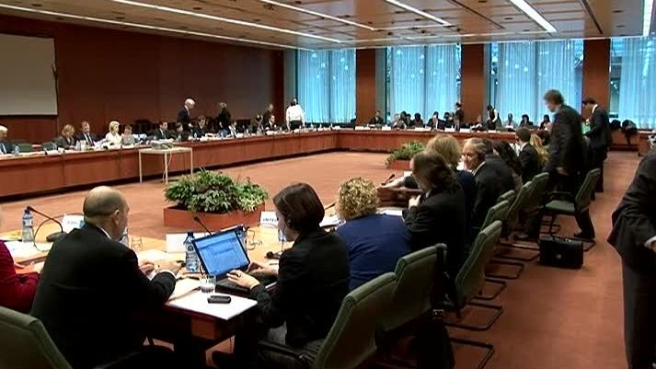
The Political and Security Committee (PSC)
PSC meets in Brussels at the ambassadorial level
permanent preparatory body for the Council
keeping track of the international situation, and helping to define policies within the Common Foreign and Security Policy including the CSDP
chaired by EEAS official
advised by a Committee for Civilian Aspects of Crisis Management (CIVCOM) and EUMC

Slide 19
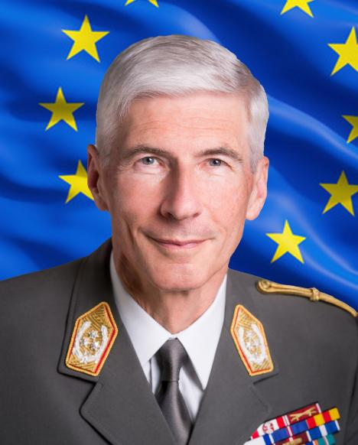
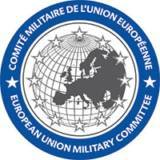
The European Union Military Committee (EUMC)
the highest military body …within the Council
composed of the Chiefs of Defence of the Member States…. permanent military representatives
provides the PSC with advice and recommendations on all military matters within the EU
permanent Chairman
The current Chairman is Gen. Robert BRIEGER (Austria), leads the works of the (EUMC), … the military adviser to the High Representative of the Union for Foreign Affairs and Security Policy on all military matters… the primary point of contact with the Operation Commanders of the EU's military operations.
Gen. Robert BRIEGER

Slide 20



The European Union Military Staff
It is the only permanent integrated military structure of the European Union - military and civilian experts
Established on 11 June 2001, the EU Military Staff receives taskings from the EU Military Committee The EUMS was transferred from the Council General Secretariat to the European External Action Service (EEAS) on 1 January 2011.
provides in-house military expertise for the High Representative … performs early warning; strategic planning; situation assessment
The EUMS is led by the Director General (DGEUMS, a three-star general) who is assisted by the Deputy Director General and the Chef of Staff (DDG/COS, a two-star general/Rear Admiral)
Admiral
Hervé Bléjean

Slide 21

The Civilian Planning and Conduct Capability (CPCC)
part of the Council Secretariat - the permanent structure responsible for an autonomous operational conduct of civilian CSDP operations.
under the political control and strategic direction of the Political and Security Committee and the overall authority of the High Representative
ensures the effective planning and conduct of civilian CSDP crisis management operations
There are examples of civilian CSDP missions supervised and supported by CPCC:
EUPOL COPPS and EUBAM Rafah in the Palestinian Territories, EUBAM LIBYA, EUPOL AFGHANISTAN, EULEX Kosovo, EUMM Georgia, EUCAP NESTOR (Horn of Africa and Western Indian Ocean), EUCAP SAHEL Niger, EUCAP SAHEL Mali and EUAM Ukraine

Slide 22


EU operations and missions as a key instrument of CDSP
European Union missions and operations carried out within the CSDP are considered the most important instrument of the EU to ensure its own security and contribution to the stability not only in the European region, but in the global world too
This is the present peak of the existing efforts of the Union's CSDP
All Member States are not obviously involved in foreign operations equally, it is always about the participation of individual countries under the heading of the Union.
Around 4,000 EU military and civilian staff are currently deployed in CSDP missions and operations in three continents, working for a more stable world and contributing to a safer Europe

Slide 23


EU operations and missions as a key instrument of CDSP
The first of these operations (missions) has been launched in 2003. Missions take place not only in Europe but in Africa and Asia too.
They include political dialogue, development and humanitarian assistance, as well as military intervention. Several operations have been successfully completed, the next are still ongoing.
EU distinguishes three types of these operations - military, police and missions in support of the rule of law.

Slide 24
EU operations and missions as a key instrument of CDSP
Because of the multinational character of the missions, there are two basic concepts - the framework nation and the lead nation.
The term lead nation means a country, which appears in a specific time period as chief of command and control of the military operation. The most used is the so-called principle of a rotating command within multinational structures.
Framework nation principle (mostly used by EU), differs from the lead nation, that for the entire operation are used command, communication and control structures of only one state.

Slide 25



Completed EU missions and operations
Since the first CSDP missions and operations were launched back in 2003, the EU has undertaken over 37 overseas operations, using civilian and military missions and operations in several countries in Europe, Africa and Asia.
As of today (2022), there are 22 ongoing CSDP missions and operations, 12 of which are civilian, and 9/10 military.

Slide 26

Completed EU Missions and Operations … 19 (2022)
For details see: https://www.eeas.europa.eu/eeas/missions-and-operations_en#11930

Slide 27

Ongoing EU Missions and Operations… 22 (2022)

Slide 28

The Battlegroups (EU BG)
Headline Goal 2010… rapid reaction units … composed of joint battle groups.
proposal was put forward by France, Germany and the United Kingdom … February 2004… …deal with … Petersberg Tasks and the tasks from the European Security Strategy
The groups are intended to be deployed on the ground within 5-10 days of approval from the Council … ….sustainable for at least 30 days…could be extended to 120 days
composed of approximately 1500 troops; plus command and support services… 18 BG - two of which are ready for deployment at all times
reached full operational capacity on 1st January 2007

Slide 29



Military Expenditures - 2022, SIPRI

Slide 30


Slide 31


Slide 32


Slide 33
Conclusion….
… according to the official communiqué of the Council of the European Union but also in other EU institutions …the above-mentioned EU missions and operations are considered to be successful - especially those completed.
Of course, the views of independent experts may be more critical …

Slide 34



Conclusion….
CSDP played in addition to those foreign missions important role in the case of major events, known as the so-called Arab Spring that took place during the year 2011.
But an inconsistent position of the EU member countries has been showed here, especially in the case of civil war in Syria (the question of unified position regarding the arms embargo). Even today, there is little clear consensus on EU sanctions against Russia in the due to the events in Ukraine.

Slide 35
Conclusion….
The possibilities for EU military operations … are quite wide….
Despite the gradual strengthening of the role of the Union in the field of international relations and in diplomatic activities in resolving many conflicts:
its military capabilities (mainly due to limited military expenditures) are not yet able to provide, maintain and successfully solve a really large-scale operations outside the territory of the EU member states …
…cooperation with NATO/USA … to ensure adequate and mutual cooperation… very important

Slide 36
THANK YOU FOR YOUR ATTENTION

