Slide 2
European Union and NATO.
Radomír Kaňa
Department of International Economic Relations

Slide 3
EU and NATO
In an increasingly volatile and unstable geopolitical context, cooperation between the European Union and the North Atlantic Treaty Organisation (NATO) is essential.
Sharing strategic interests and facing the same challenges, NATO and the European Union cooperate on issues of common interest and are working side by side in crisis management, capability development and political consultations, as well as providing support to their common partners in the east and south. The EU is a unique and essential partner for NATO.
The security of EU and NATO are inter-connected: not only are 21 EU Member States also NATO Allies; together, they can also mobilise a broad range of tools and make the most efficient use of resources to address those challenges and enhance the security of their citizens.

Slide 4
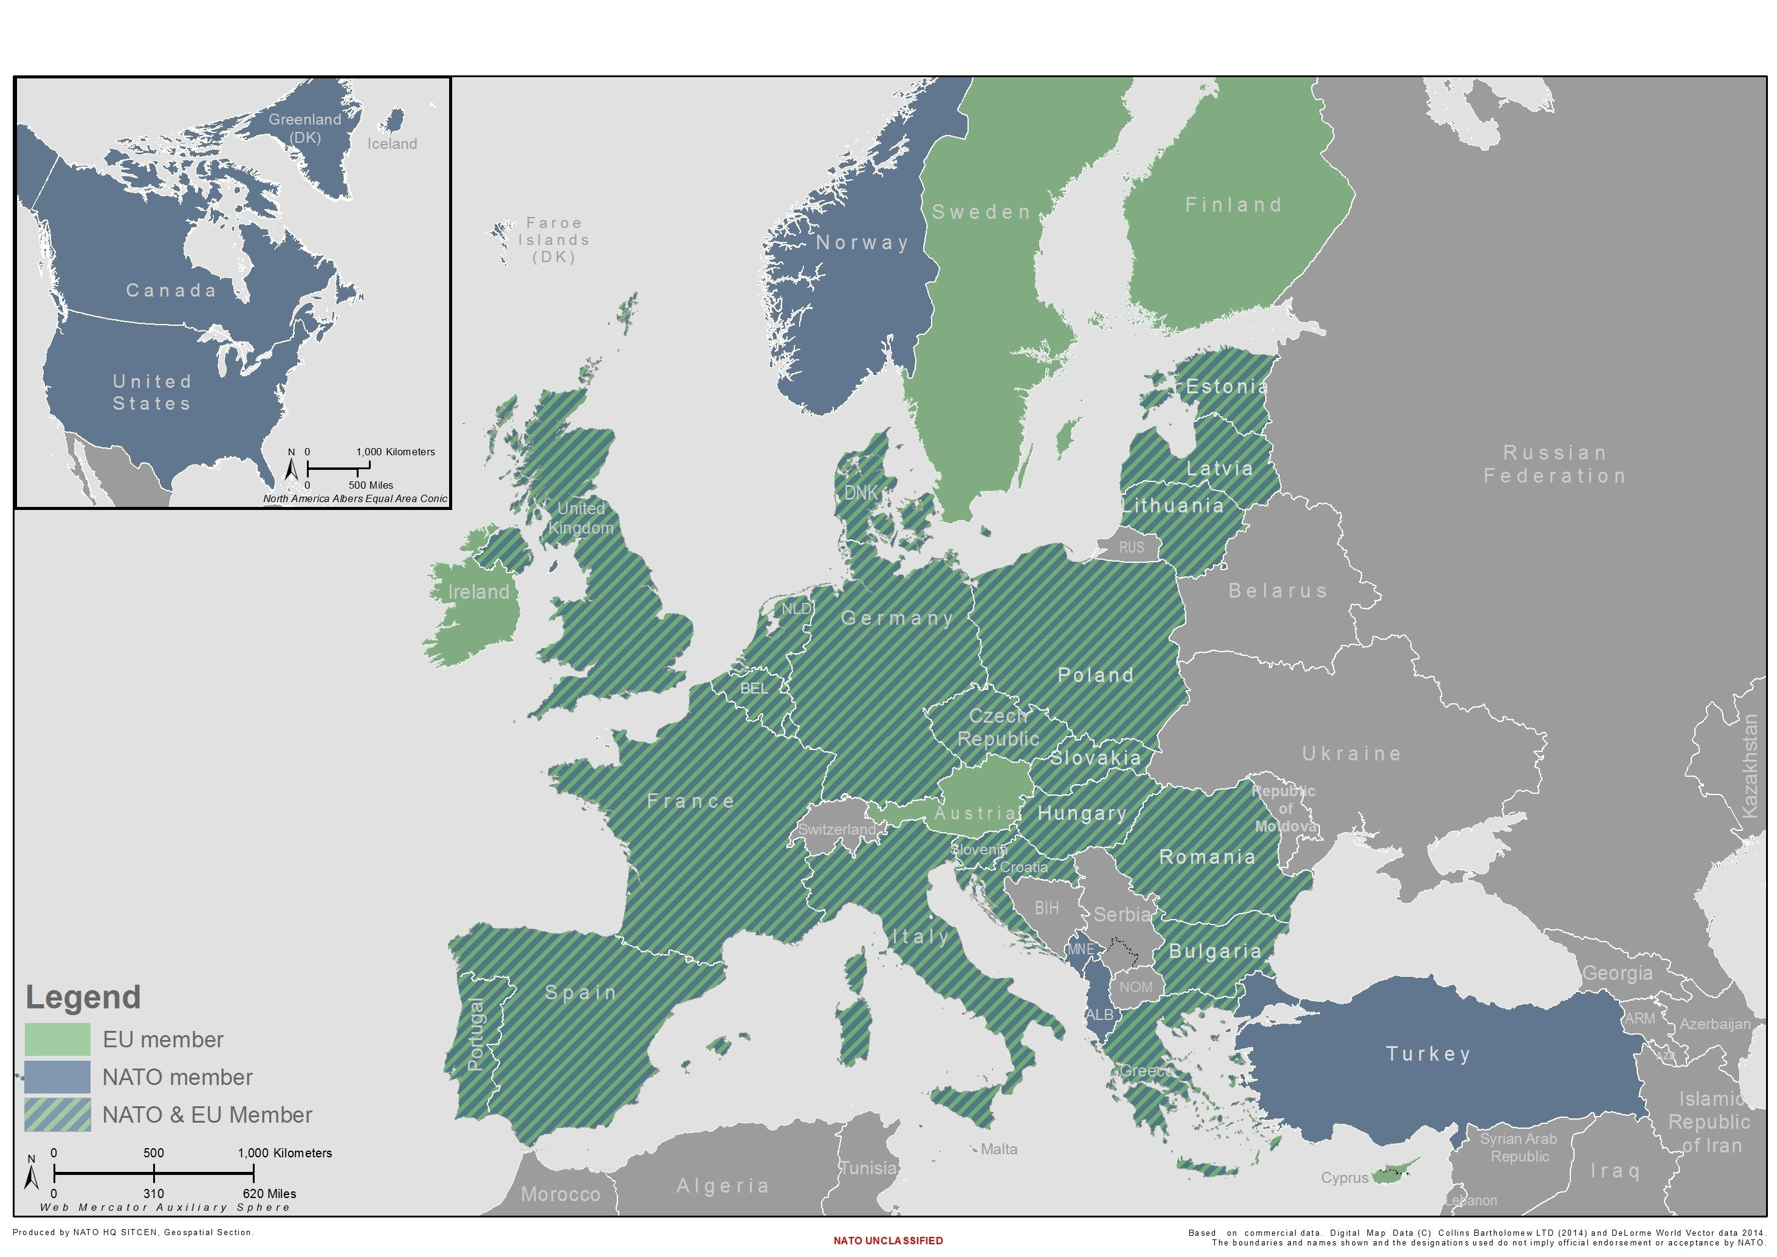

Slide 5
Framework for cooperation
An exchange of letters between the NATO Secretary General and the EU Presidency in January 2001 defined the scope of cooperation and modalities of consultation on security issues between the two organisations.
Cooperation further developed with the signing of the NATO-EU Declaration on ESDP in December 2002 and the agreement, in March 2003, of a framework for cooperation.
NATO-EU Declaration on ESDP: The NATO-EU Declaration on ESDP, agreed on 16 December 2002, reaffirmed the EU assured access to NATO’s planning capabilities for its own military operations and reiterated the political principles of the strategic partnership: effective mutual consultation; equality and due regard for the decision-making autonomy of the EU and NATO; respect for the interests of EU and NATO member states; respect for the principles of the Charter of the United Nations; and coherent, transparent and mutually reinforcing development of the military capability requirements common to the two organisations.

Slide 6
Framework for cooperation
The “Berlin Plus” arrangements:
As part of the framework for cooperation adopted on 17 March 2003, the so-called “Berlin Plus” arrangements provide the basis for NATO-EU cooperation in crisis management in the context of EU-led operations that make use of NATO's collective assets and capabilities, including command arrangements and assistance in operational planning.
In effect, they allow the Alliance to support EU-led operations in which NATO as a whole is not engaged.
NATO and the EU meet on a regular basis to discuss issues of common interest. Meetings take place at different levels including at the level of foreign ministers, ambassadors, military representatives and defence advisors. There are regular staff-to-staff talks at all levels between NATO’s International Staff and International Military Staff, and their respective EU interlocutors (the European External Action Service, the European Defence Agency, the European Commission and the European Parliament).

Slide 7
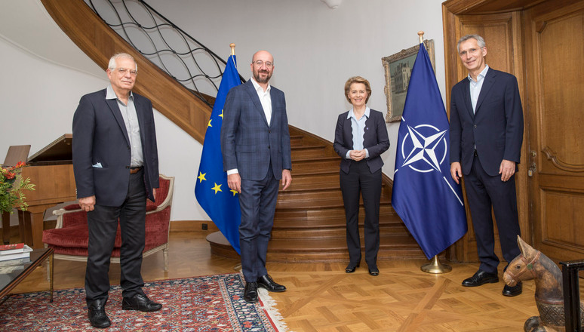
Framework for cooperation
Permanent military liaison arrangements have been established to facilitate cooperation at the operational level.
A NATO Permanent Liaison Team has been operating at the EU Military Staff since November 2005 and an EU Cell was set up at SHAPE (NATO’s strategic command for operations in Mons, Belgium) in March 2006.

Slide 8
A NEW ERA OF INTERACTION
On 8 July 2016, the President of the European Council and the President of the European Commission, together with the Secretary General of the North Atlantic Treaty Organization signed a Joint Declaration in Warsaw with a view to giving new impetus and new substance to the EU-NATO strategic partnership.
It outlined seven concrete areas where cooperation between the two organisations should be enhanced:
countering hybrid threats;
operational cooperation including at sea and on migration;
cyber security and defence;
defence capabilities;
defence industry and research;
exercises;
supporting Eastern and Southern partners’ capacity-building efforts.

Slide 9
EU-NATO relations - history
February 1992: The EU adopts the Maastricht Treaty, which envisages an intergovernmental Common Foreign and Security Policy (CFSP) and the eventual framing of a common defence policy (European Security and Defence Policy - ESDP) with the Western European Union (WEU) as the EU's defence component - Close cooperation is established between NATO and the WEU.
June 1992: In Oslo, NATO foreign ministers support the objective of developing the WEU as a means of strengthening the European pillar of the Alliance and as the defence component of the EU, that would also cover the “Petersberg tasks” (humanitarian search and rescue tasks, peacekeeping tasks, crisis-management tasks including peace enforcement and environmental protection).
January 1994: Allied leaders agree to make collective assets of the Alliance available, on the basis of consultations in the North Atlantic Council, for WEU operations undertaken by the European Allies in pursuit of their CFSP. NATO endorses the concept of Combined Joint Task Forces, which provides for “separable but not separate” deployable headquarters that could be used for European-led operations and is the conceptual basis for future operations involving NATO and other non-NATO countries.
June 1996: In Berlin, NATO foreign ministers agree for the first time to build up a European Security and Defence Identity (ESDI) within NATO, with the aim of rebalancing roles and responsibilities between Europe and North America. An essential part of this initiative was to improve European capabilities. They also decide to make Alliance assets available for WEU-led crisis-management operations. These decisions lead to the introduction of the term "Berlin Plus".

Slide 10
EU-NATO relations - history
December 1998: At a summit in St Malo, France and the United Kingdom make a joint statement affirming the EU's determination to establish a European Security and Defence Policy (ESDP).
April 1999: At the Washington Summit, Heads of State and Government decide to develop the “Berlin Plus” arrangements.
June 1999: A European Council meeting in Cologne, Germany decides "to give the European Union the necessary means and capabilities to assume its responsibilities regarding a common European policy on security and defence".
December 1999: At the Helsinki Council meeting, EU members establish military "headline goals" to allow the EU to deploy up to 60,000 troops by 2003 for ‘Petersberg tasks'. EU members also create political and military structures including a Political and Security Committee, a Military Committee and a Military Staff. The crisis-management role of the WEU is transferred to the EU. The WEU retains residual tasks.
September 2000: The North Atlantic Council and the EU’s interim Political and Security Committee meet for the first time to take stock of progress in NATO-EU relations.
December 2000: Signature of the EU's Treaty of Nice containing amendments reflecting the operative developments of the ESDP as an independent EU policy (entry into force February 2003).

Slide 11
EU-NATO relations - history
January 2001: Beginning of institutionalised relations between NATO and the EU with the establishment of joint meetings, including at the level of foreign ministers and ambassadors. Exchange of letters between the NATO Secretary General and the EU Presidency on the scope of cooperation and modalities for consultation.
May 2001: First formal NATO-EU meeting at the level of foreign ministers in Budapest. The NATO Secretary General and the EU Presidency issue a joint statement on the Western Balkans.
November 2002: At the Prague Summit, NATO members declare their readiness to give the EU access to NATO assets and capabilities for operations in which the Alliance is not engaged militarily.
December 2002: EU-NATO Declaration on ESDP.
March 2003: Agreement on the framework for cooperation. Entry into force of a NATO-EU security of information agreement. Transition from the NATO-led Operation Allied Harmony to the EU-led Operation Concordia in the Republic of North Macedonia (then known as the former Yugoslav Republic of Macedonia).
May 2003: First meeting of the NATO-EU Capability Group.
July 2003: Development of a common strategy for the Western Balkans.
November 2003: First joint NATO-EU crisis-management exercise.

Slide 12
EU-NATO relations - history
February 2004: France, Germany and the United Kingdom launch the idea of EU rapid-reaction units composed of joint battle groups.
December 2004: Beginning of the EU-led Operation Althea in Bosnia and Herzegovina.
September 2005: Transatlantic informal NATO-EU ministerial dinner, New York.
October 2005: Agreement on Military Permanent Arrangements establishing a NATO Permanent Liaison Team at the EU Military Staff and an EU cell at SHAPE.
November 2005: NATO Permanent Liaison Team set up at the EU Military Staff.
March 2006: EU cell set up at SHAPE.
April 2006: Transatlantic informal NATO-EU ministerial dinner, Sofia.
2006 - 2010: Transatlantic informal NATO-EU ministerial dinners are held in New York (Sep. 2006); Brussels (Jan. 2007); Oslo (April 2007); New York (Sep. 2007); Brussels (Dec. 2007); New York (Sep. 2008); Brussels (Dec. 2008); Brussels (March 2009); and New York (Sep. 2010).
November 2010: At the Lisbon Summit, the Allies underline their determination to improve the NATO-EU strategic partnership and welcome recent initiatives from several Allies and ideas proposed by the Secretary General in this regard.

Slide 13
EU-NATO relations - history
September 2011: Transatlantic informal NATO-EU ministerial dinner, New York.
September 2012: Transatlantic informal NATO-EU ministerial dinner, New York.
11 February 2013: President of the European Commission José Manuel Barroso visits NATO Headquarters.
May 2013: The NATO Secretary General addresses the European Parliament’s Committee on Foreign Affairs and Subcommittee on Security and Defence.
June 2013: The NATO Secretary General participates in an informal meeting of EU foreign ministers.
December 2013: The NATO Secretary General addresses the European Council in Brussels.
5 March 2014: NATO and EU Political and Security Committee (PSC) ambassadors hold informal talks on Ukraine.
10 June 2014: NATO and EU PSC ambassadors hold more informal talks on Ukraine.
10 February 2016: A Technical Arrangement on Cyber Defence was concluded between the NATO Computer Incident Response Capability (NCIRC) and the Computer Emergency Response Team of the European Union (CERT-EU), providing a framework for exchanging information and sharing best practices between emergency response teams.

Slide 14
EU-NATO relations - history
11 February 2016: At the request of Germany, Greece and Türkiye, NATO defence ministers agree that the Alliance should join international efforts to stem illegal trafficking and illegal migration in the Aegean Sea, cooperating with the European Union's border management agency, Frontex.
10 March 2016: Visiting the European Commission to meet Commission President Jean-Claude Juncker, NATO Secretary General Jens Stoltenberg stresses the vital importance of the NATO-EU relationship and welcomes the organisations’ deepening ties.
12-13 May 2016: An informal EU-NATO Directors General Conference takes place at NATO Headquarters to enhance staff-to-staff interaction between the organisations’ respective military staffs on topics of current relevance and common interest related to security and defence.
20 May 2016: High Representative Federica Mogherini visits NATO Headquarters for a meeting with NATO foreign ministers to discuss areas for expanded NATO-EU cooperation ahead of upcoming EU and NATO summit meetings.
24 June 2016: In a statement on the outcome of the British referendum on membership of the EU, the NATO Secretary General underlines his confidence that the United Kingdom's position in NATO will remain unchanged and that the country – a strong and committed NATO Ally – will continue to play its leading role in the Alliance.

Slide 15
EU-NATO relations - history
July 2016: In Warsaw, a Joint Declaration expresses the determination to give new impetus and new substance to the NATO-EU strategic partnership in light of common challenges. Areas for strengthened cooperation include: countering hybrid threats; operational cooperation including at sea; cyber security and defence; defence capabilities; defence industrial cooperation; exercises; and building the defence capabilities of partners to the east and south.
27 October 2016: NATO defence ministers meet with EU High Representative Federica Mogherini and the defence ministers of Finland and Sweden to discuss ways to deepen NATO-EU cooperation in the areas of countering hybrid threats, cyber defence, coordinated exercises and supporting partners. Ministers agree to extend NATO’s deployment in the Aegean Sea in support of the efforts of Greece, Türkiye and the EU’s border agency Frontex to break the lines of human trafficking. They also decide that NATO’s new Operation Sea Guardian will support the EU’s Operation Sophia in the Central Mediterranean with NATO ships and planes, ready to help increase the EU’s situational awareness and provide logistical support.
15 November 2016: NATO Secretary General Jens Stoltenberg meets with EU defence ministers for talks on European defence and closer NATO-EU cooperation. He stresses that efforts to strengthen European defence can contribute to a stronger NATO, through better defence capabilities and higher defence spending in Europe.
25 November 2016: Senior officials from NATO and the EU meet to discuss the next practical steps in NATO-EU cooperation on cyber defence.

Slide 16
EU-NATO relations - history
7 December 2016: NATO foreign ministers approve a series of more than 40 measures to advance how NATO and the EU work together including on countering hybrid threats, cyber defence, and making their common neighbourhood more stable and secure.
15 December 2016: NATO Secretary General Jens Stoltenberg meets with EU leaders for talks on European defence and closer NATO-EU cooperation. He stresses that closer cooperation between NATO and the EU is important today because of new security threats.
10 February 2017: NATO convenes an informal workshop on how to reinforce security dialogue in the Euro-Atlantic region, focusing on the importance of NATO, the European Union and the Organization for Security and Co-operation in Europe (OSCE).
24 March 2017: The North Atlantic Council and the EU’s Political and Security Committee meet to discuss NATO-EU cooperation, in particular the implementation of the Joint Declaration signed in Warsaw in July 2016, which led to a common set of proposals endorsed by the respective Councils of both organisations in December 2016.
19 June 2017: A first progress report on NATO-EU cooperation – authored jointly by NATO Secretary General Jens Stoltenberg and EU High Representative / Vice-President of the European Commission Federica Mogherini – concludes that the two organisations are making substantial progress in complementing each other’s work since the agreement in Warsaw in July 2016 to work more closely together in areas ranging from resilience to hybrid threats, through greater coherence on capability development to helping build the defence capacities of partner countries.

Slide 17
EU-NATO relations - history
5 December 2017: In a meeting with EU High Representative Federica Mogherini, NATO foreign ministers agree to step up NATO’s cooperation with the European Union through an additional common set of 32 new proposals on the implementation of the Joint Declaration signed by the President of the European Council, the President of the European Commission and the Secretary General of NATO. Joint work will include three new areas: military mobility, information-sharing in the fight against terrorism, and promoting women’s role in peace and security. A second progress report on NATO-EU cooperation is issued.
8 June 2018: A third progress report on NATO-EU cooperation is released to the public and highlights the qualitative and quantitative increase in cooperation between NATO and the EU.
10 July 2018: In a second Joint Declaration on EU-NATO Cooperation, the President of the European Council, the President of the European Commission and the NATO Secretary General underline the importance of continued EU-NATO cooperation to address multiple and evolving security challenges as well as steps being taken by both organisations to strengthen capabilities in defence and security.
11 July 2018: At the Brussels Summit, Allied leaders underline that the European Union remains a unique and essential partner for NATO. They welcome tangible progress made in a range of areas as well as the second Joint Declaration about taking further steps to implement the common set of 74 proposals, emphasising the importance of the commitment to improve military mobility.

Slide 18
EU-NATO relations - history
17 June 2019: A fourth progress report on NATO-EU cooperation is published.
16 June 2020: A fifth progress report on NATO-EU cooperation is published.
3 June 2021: A sixth progress report on NATO-EU cooperation is published.
14 June 2021: At the Brussels Summit, Allied leaders emphasise unprecedented levels of NATO-EU strategic cooperation that includes addressing challenges such as resilience issues, emerging and disruptive technologies, the security implications of climate change, disinformation and the growing geostrategic competition. They reaffirm their commitment to the full implementation of the common set of 74 proposals and highlight the importance of the development of coherent, complementary and interoperable defence capabilities.
3 February 2022: NATO and EU PSC Ambassadors hold and informal meeting to discuss Russia’s military build-up in and around Ukraine and the implications for European and international security.
24-25 February 2022: Secretary General Jens Stoltenberg meets with the President of the European Commission, Ursula von der Leyen, and the President of the European Council, Charles Michel, to discuss Russia’s unprovoked invasion of Ukraine. NATO and the EU stand united in condemning Russia’s actions, and in supporting Ukraine’s sovereignty, territorial integrity and right to self-defence. On 25 February, EU Council President Michel and EU Commission President von der Leyen take part in an extraordinary virtual summit of Heads of State and Government of NATO Allies, plus Finland and Sweden.

Slide 19
EU-NATO relations - history
20 June 2022: A seventh progress report on NATO-EU cooperation is published.
29-30 June 2022: President of the European Council Charles Michel and President of the European Commission Ursula von der Leyen participate in talks at the NATO Summit in Madrid, as well as at the transatlantic dinner hosted by the Spanish government and with the participation of NATO and EU Heads of State and Government. NATO and the EU underline the importance of further strengthening their essential strategic partnership, and reaffirm their common resolve in responding to Russia’s war against Ukraine.
10 January 2023: Secretary General Jens Stoltenberg, President of the European Council Charles Michel and President of the European Commission Ursula von der Leyen meet at NATO Headquarters to sign the third Joint Declaration on EU-NATO Cooperation. The meeting underlines the importance of NATO-EU cooperation in the context of the changed security environment following Russia’s invasion of Ukraine, and the increase in shared members following the impending accessions of Finland and Sweden to NATO.
Infographic - EU-NATO: a cooperation through the years
https://www.consilium.europa.eu/en/infographics/eu-nato-a-cooperation-through-the-years/

Slide 20
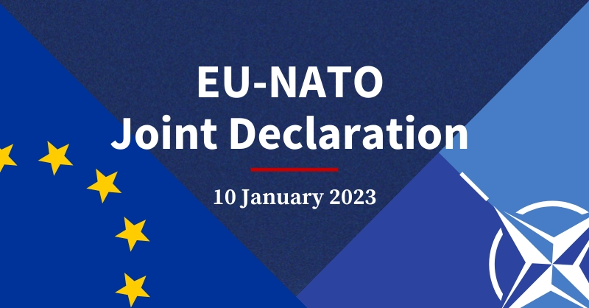
EU response to Russia's invasion of Ukraine
Since the first day of Russia’s invasion of Ukraine, the EU and NATO, EU member states and NATO Allies have intensified their work and cooperation, demonstrating full unity and common resolve in condemning Russia’s war of aggression and supporting Ukraine defend itself and protect its population.
EU-NATO joint declaration 2023
On 10 January 2023, the EU and NATO signed a joint declaration (third) in Brussels. They condemned in the strongest possible terms Russia’s aggression against Ukraine and reiterated their unwavering support to the country.
The declaration also sets out a shared vision of how the EU and NATO will act together against common security threats.

Slide 21
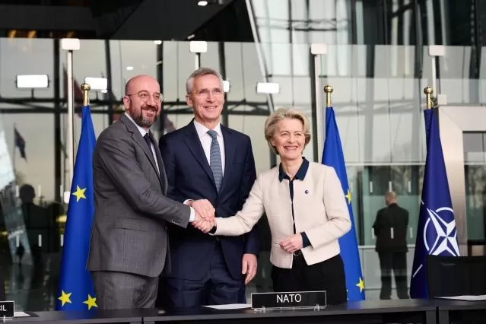
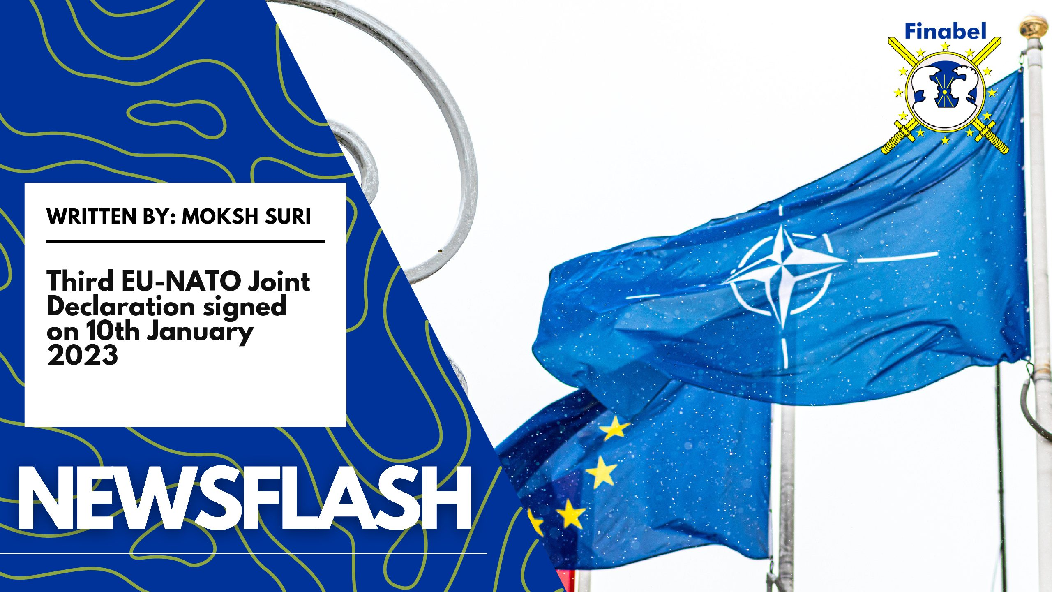
EU response to Russia's invasion of Ukraine
The EU and NATO will expand and deepen their cooperation on areas such as:
the growing geostrategic competition
resilience and the protection of critical infrastructure
emerging and disruptive technologies
space
the security implications of climate change
foreign information manipulation and interference
Joint Declaration on EU-NATO Cooperation
https://www.nato.int/cps/en/natohq/official_texts_210549.htm

Slide 22
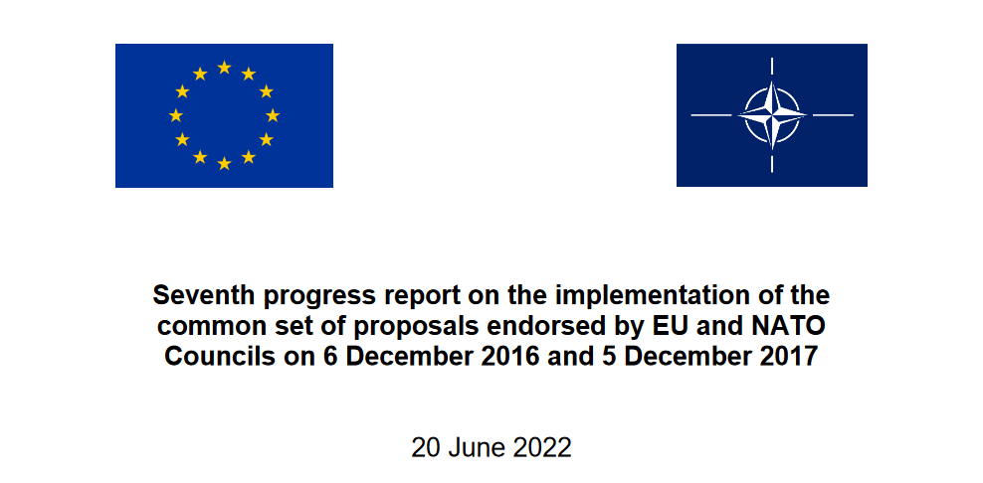
EU response to Russia's invasion of Ukraine
Seventh progress report
On 20 June 2022, the Council took note of the report which elaborates on the progress achieved between June 2021 and May 2022 by demonstrating tangible deliverables in all areas of cooperation.
The EU-NATO strategic partnership is more robust and relevant than ever at this critical moment for Euro-Atlantic security.
The report underlines in particular progress in:
political dialogue
political consultations
cooperation work strands
https://www.consilium.europa.eu/media/57184/eu-nato-progress-report.pdf

Slide 23
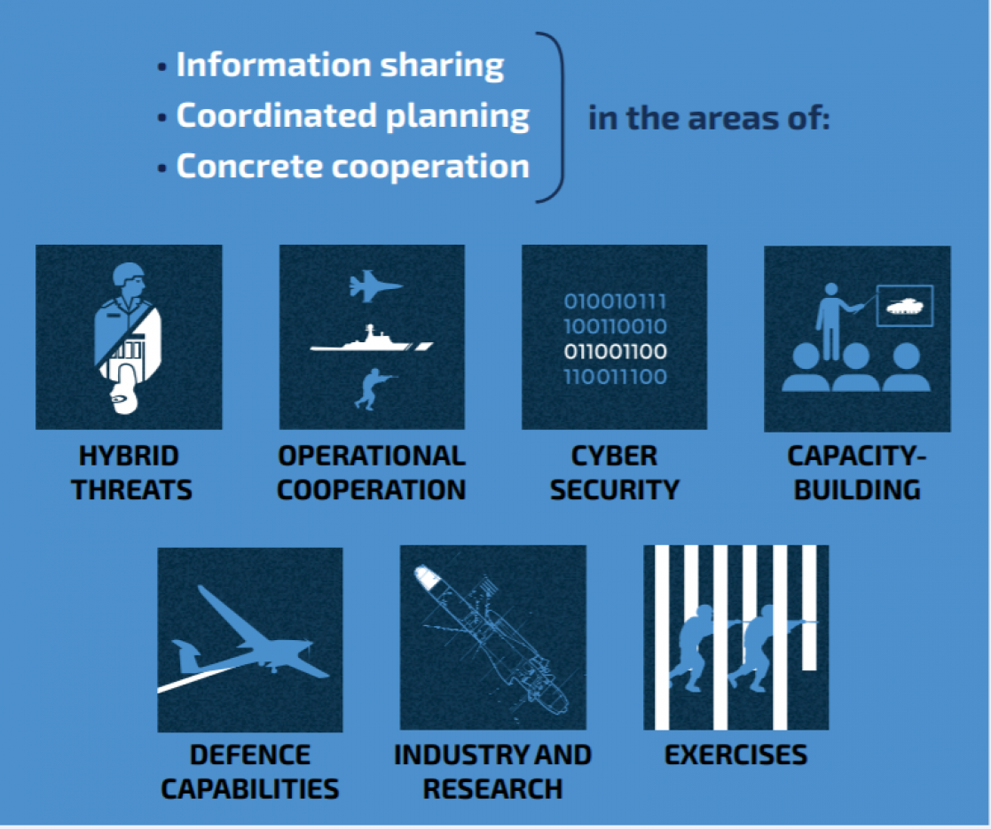
Cooperation between the EU and NATO is now the established norm and daily practice and continues to take place on the basis of key guiding principles: openness, transparency, inclusiveness and reciprocity, in full respect of the decision-making autonomy and procedures of both organisations without prejudice to the specific character of the security and defence policy of any Member State.

Slide 24
THANK YOU FOR YOUR ATTENTION

