Slide 2
Business Valuation
Introduction

Slide 3


Teaching staff
Jozef Glova
Alena Andrejovská

Slide 4
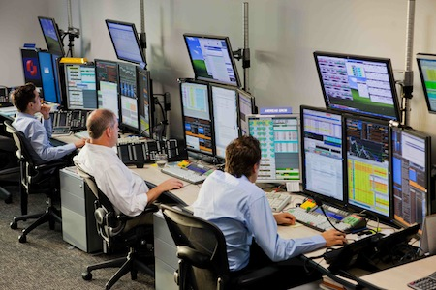



Our background
Business Valuation, incl. Projects Assessment
Portfolio Management
Market Risk Analysis and Management
Accounting and Reporting
Tax and Taxation Policy
Investment Analysis

Slide 5
Business Valuation Structure
Topic 1: Financial statements and intro to financial analysis.
Topic 2: Financial reporting standards.
Topic 3: The present value and financial figures behind.
Topic 4: The basic principles of valuation.
Topic 5: The Cost of Capital
Topic 6: Building your first Excel valuation model
Final Assessment & Course Evaluation

Slide 6
Contacts
Welcome on board! ☺ I hope you will enjoy it.
Our contacts are
Jozef Glova | Jozef.Glova@tuke.sk
Alena Andrejovská | Alena.Andrejovska@tuke.sk

