Slide 2
Business Valuation: An Introduction

Slide 3
Structure
Cash Flow determination
Time value of money
Discount rate or cost of capital determination
Comparable valuation

Slide 4
Valuation
Valuation is the analytical process of determining the current or projected worth of an asset or a company.
Valuation is a quantitative process of determining the fair value of an asset, investment, or firm.
There are several methods and techniques for arriving at a valuation. In this part of seminar, we will go through basic valuation principles of income approach – determining cash flows, time value of money, determining the discount rate and comparable valuation.

Slide 5
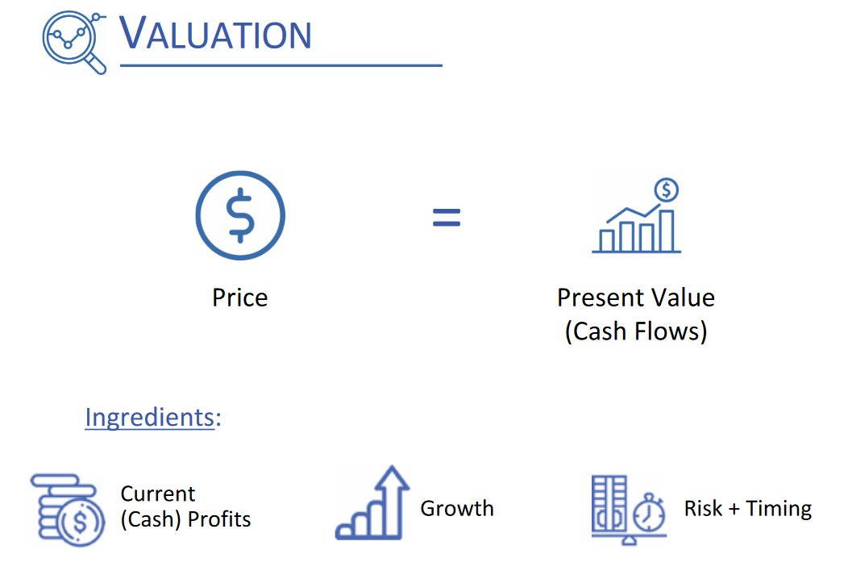

Slide 6


Slide 7
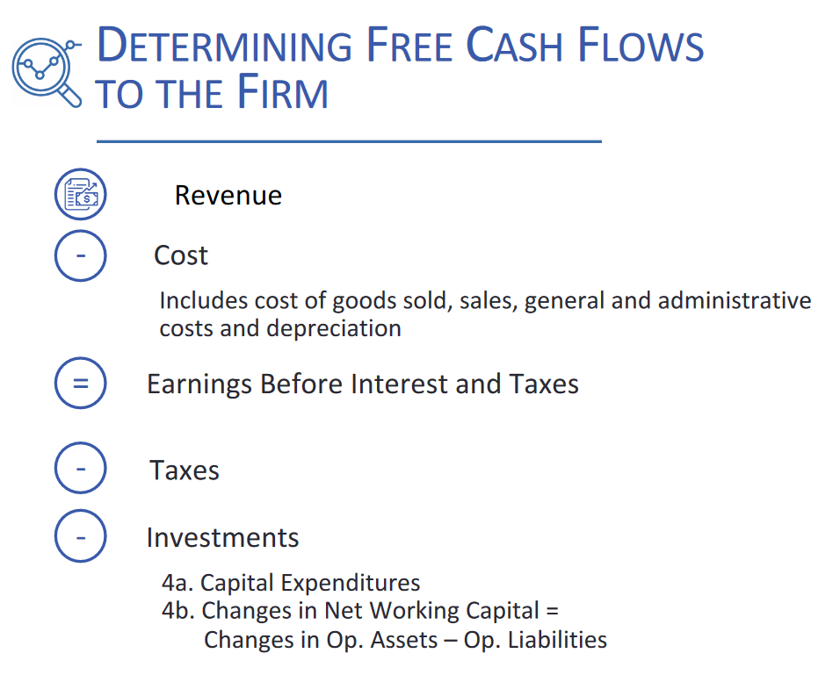

Slide 8
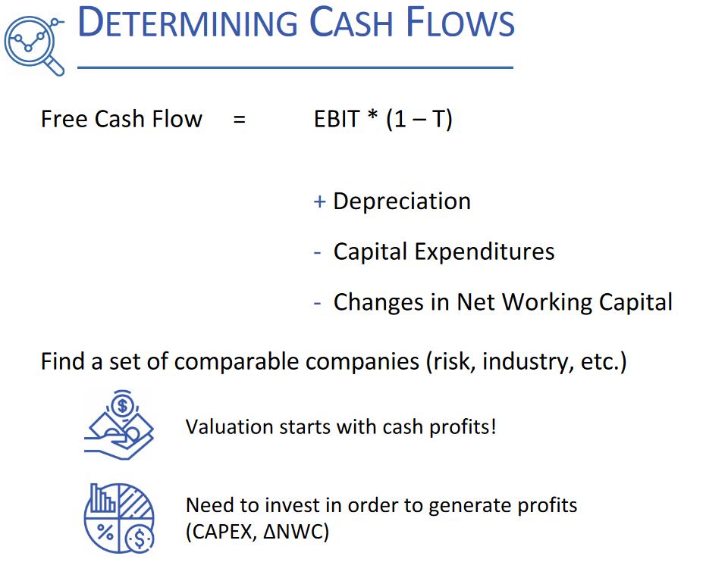

Slide 9
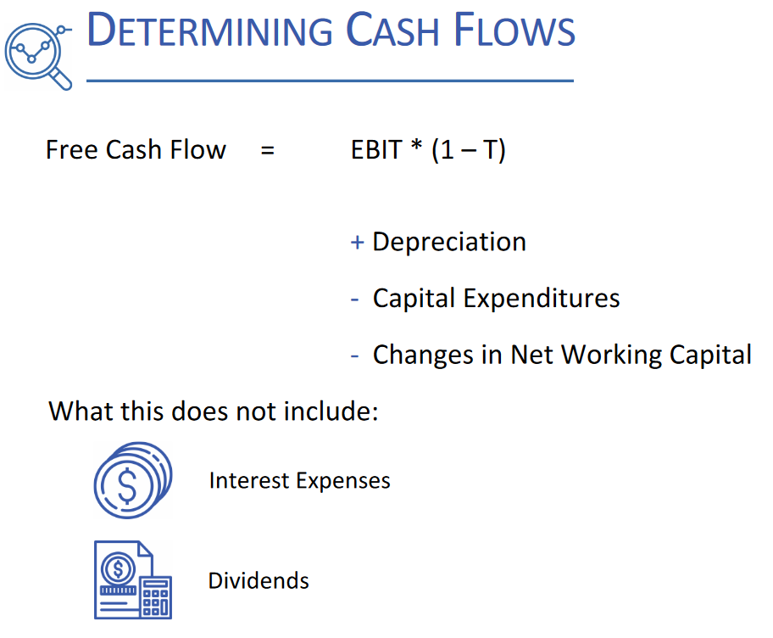

Slide 10


Slide 11
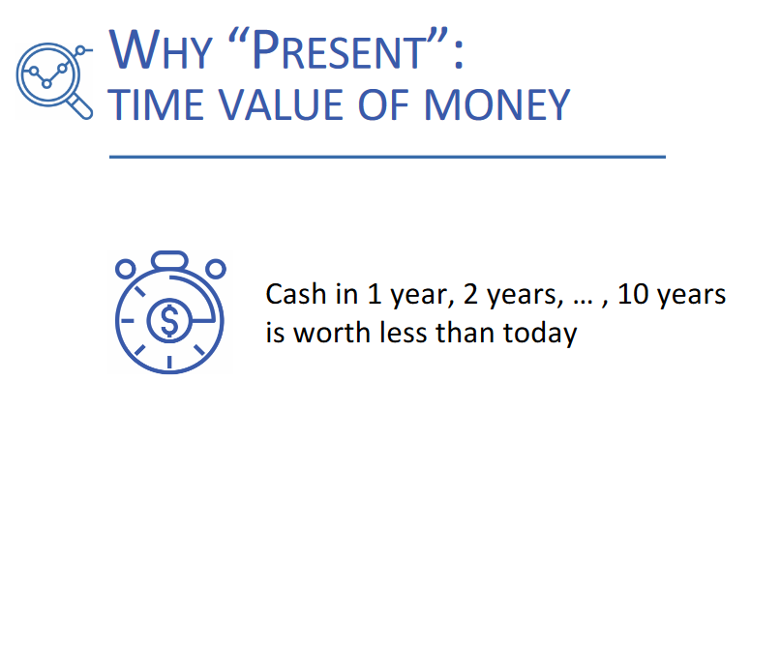

Slide 12
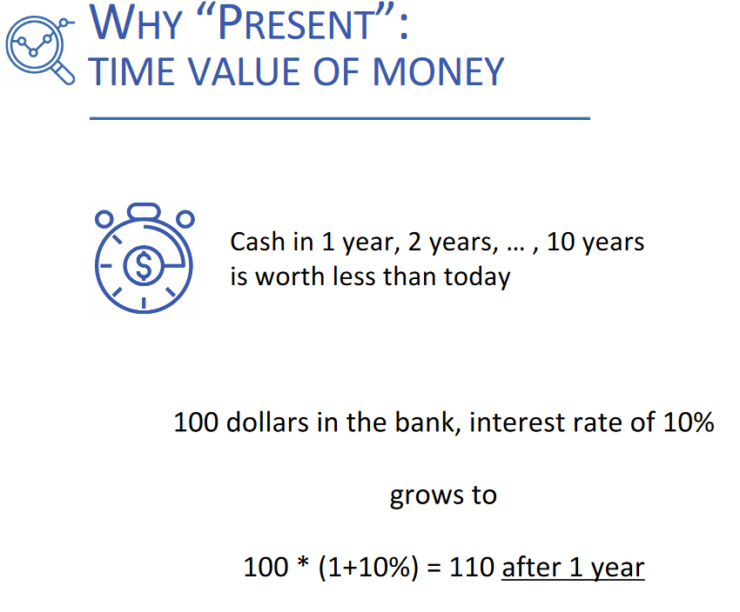

Slide 13
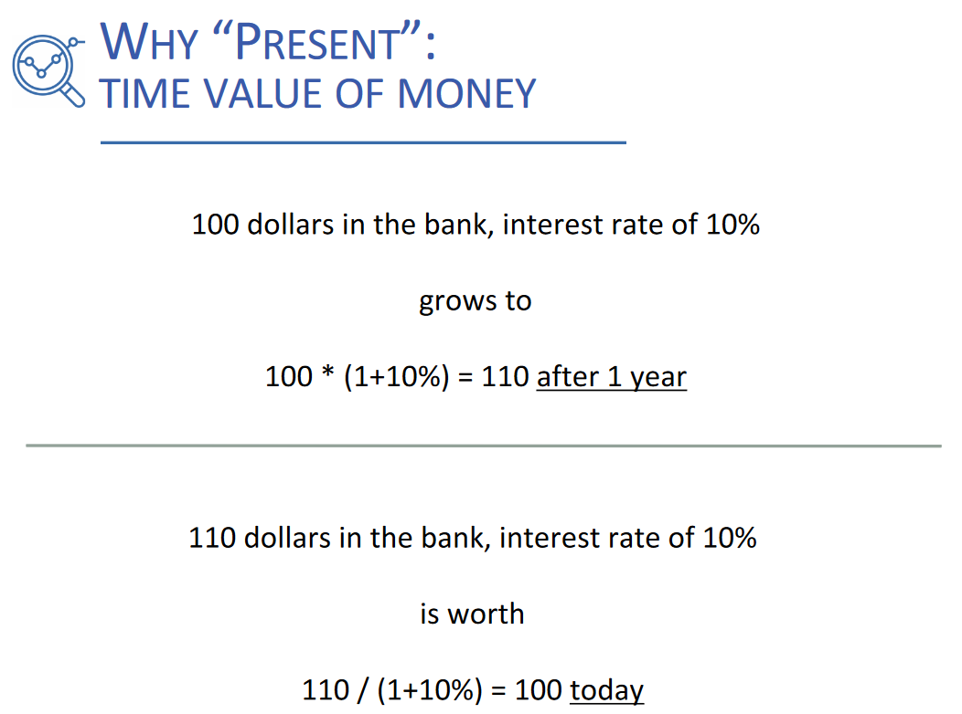

Slide 14
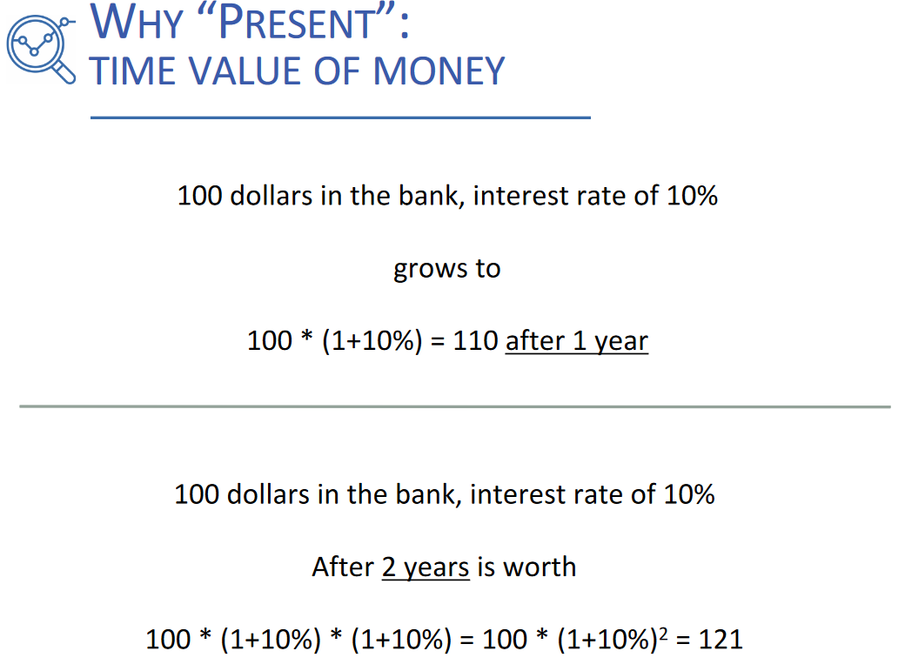

Slide 15
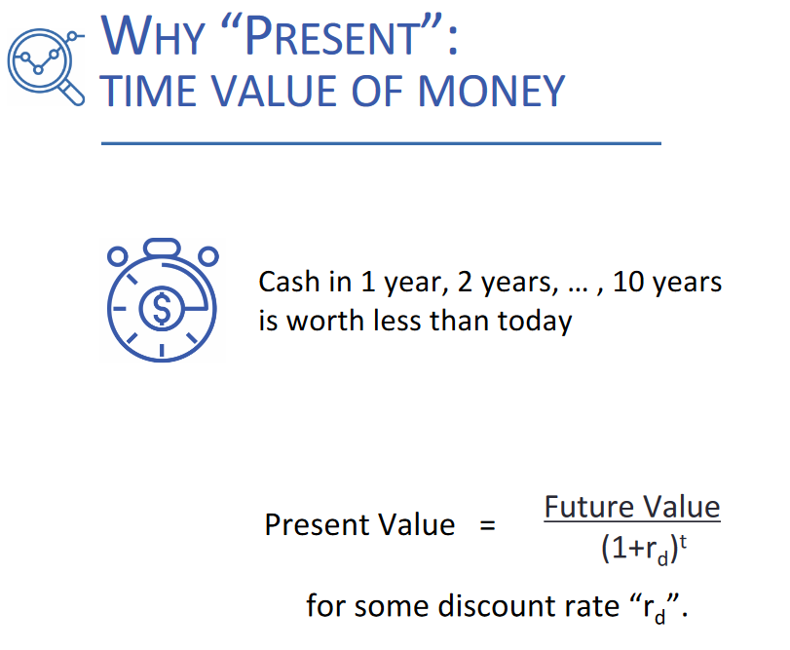

Slide 16
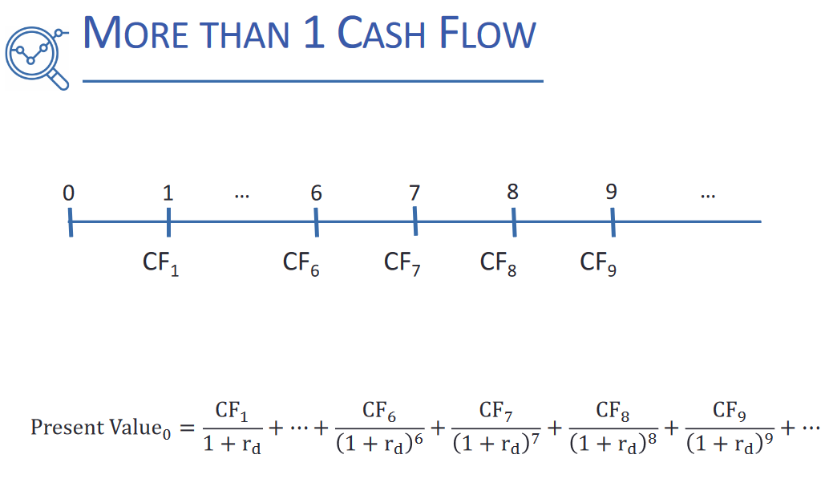

Slide 17
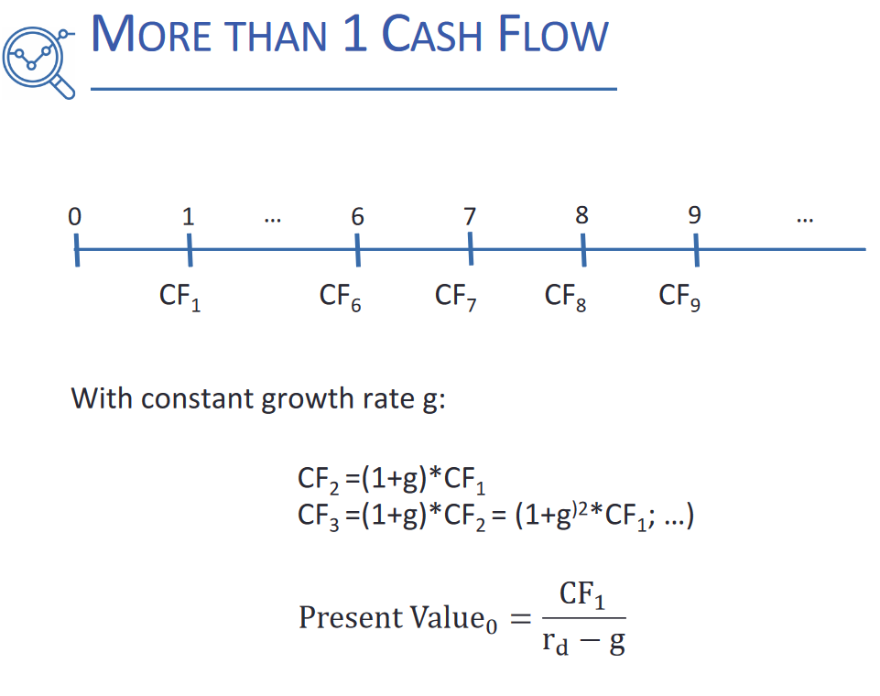

Slide 19
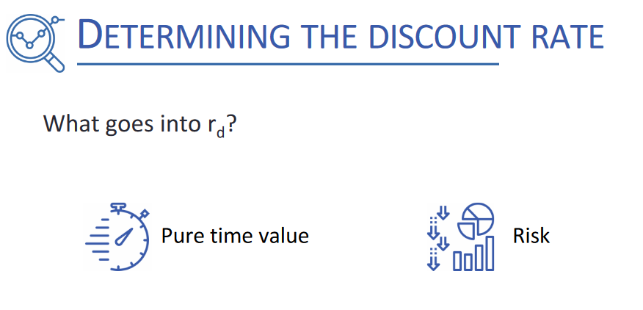

Slide 20
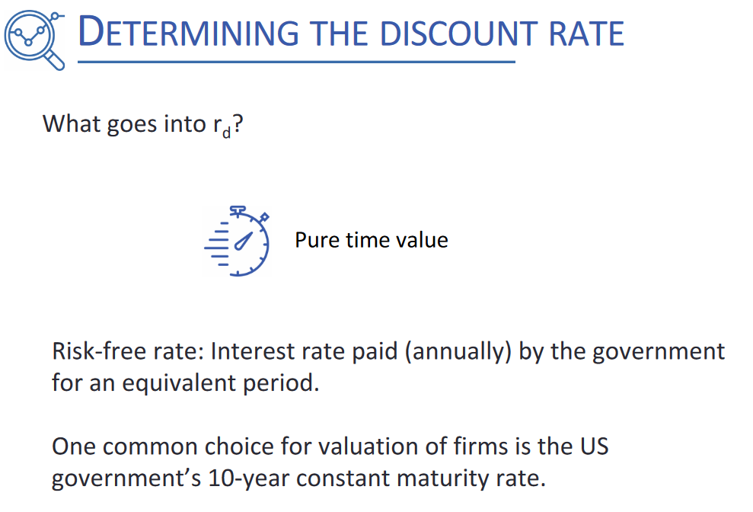

Slide 21
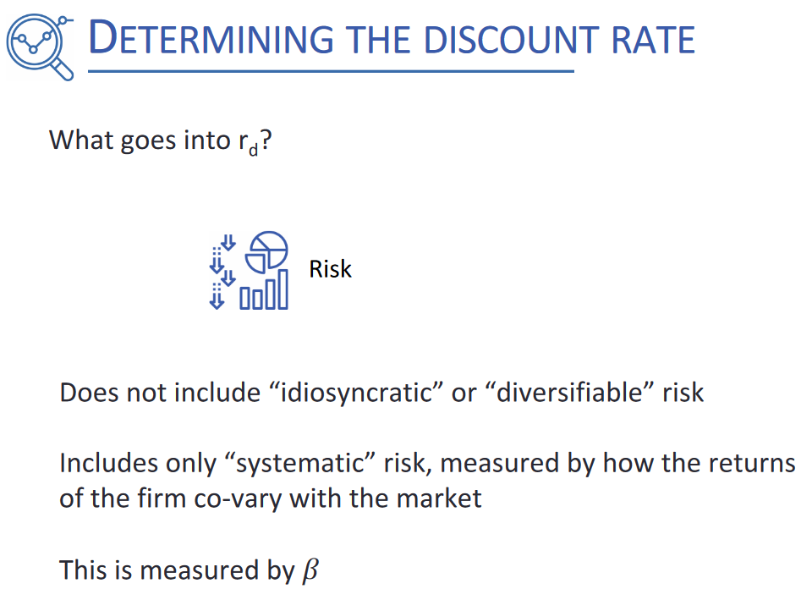

Slide 22
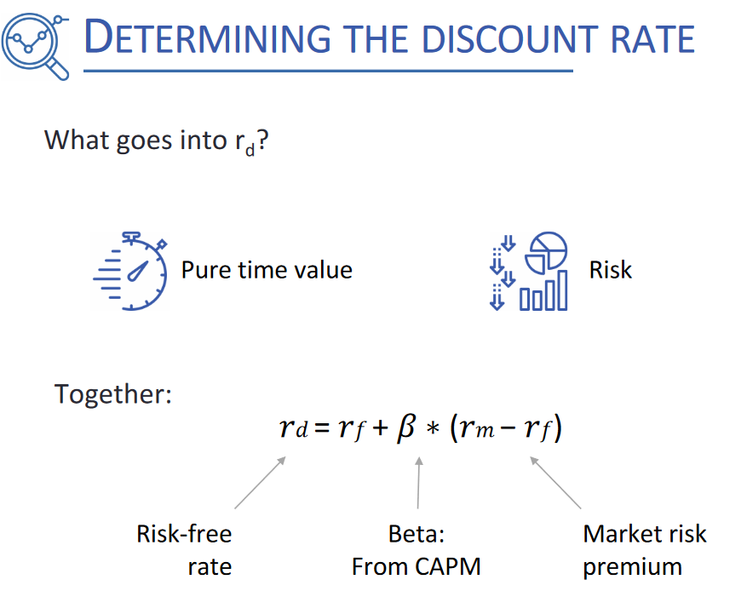

Slide 23


Slide 24
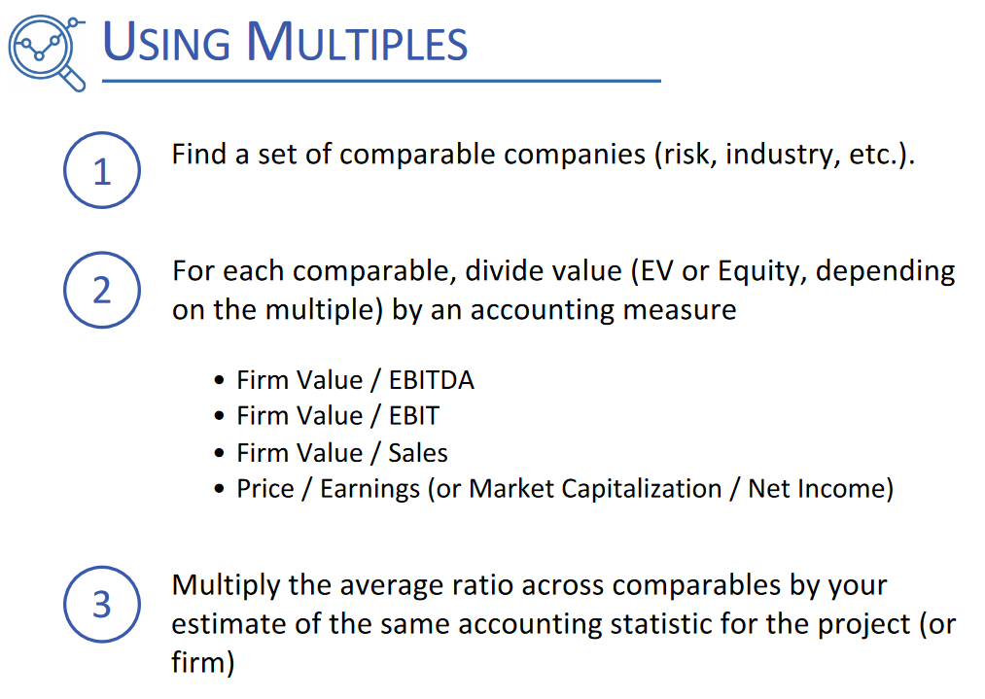

Slide 25
THANK YOU FOR YOUR ATTENTION!
Any questions?

