Slide 2
Cost of Capital

Slide 3
Cost of Capital
The cost of capital is the rate of return that the suppliers of capital—bondholders and owners—require as compensation for their contribution of capital.
A company typically has several alternatives for raising capital, including issuing equity, debt, and instruments that share characteristics of debt and equity.
Because we are using the cost of capital in the evaluation of investment opportunities, we are dealing with a marginal cost—what it would cost to raise additional funds for the potential investment project.
The cost of capital of a company is the required rate of return that investors demand for the average-risk investment of a company.
The most common way to estimate this required rate of return is to calculate the marginal cost of each of the various sources of capital and then calculate a weighted average of these costs.

Slide 4
Weighted average cost of capital (WACC)
The cost that a business incurs for additional capital is known as the WACC or the marginal cost of capital (MCC).
The weights used to calculate this weighted average represent the proportions of the various funding sources that the business uses to fund its investment program.
If debt, common stock, and preferred stock make up the sources of capital as well as the possibility that interest payments may be tax deductible in some states.

Slide 5
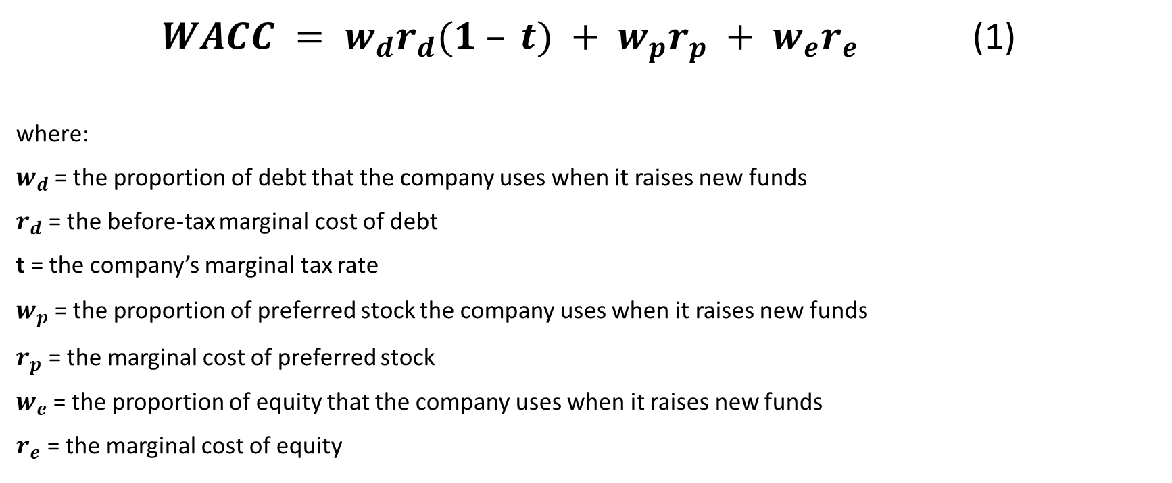
Weighted average cost of capital (WACC)
$WACC = w_{d}r_{d}(1 – t) + w_{p}r_{p} + w_{e}r_{e}$ (1)
where:
$w_{d}$= the proportion of debt that the company uses when it raises new funds
$r_{d}$ = the before-tax marginal cost of debt
t = the company’s marginal tax rate
$w_{p}$ = the proportion of preferred stock the company uses when it raises new funds
$r_{p}$ = the marginal cost of preferred stock
$w_{e}$ = the proportion of equity that the company uses when it raises new funds
$r_{e}$ = the marginal cost of equity

Slide 6
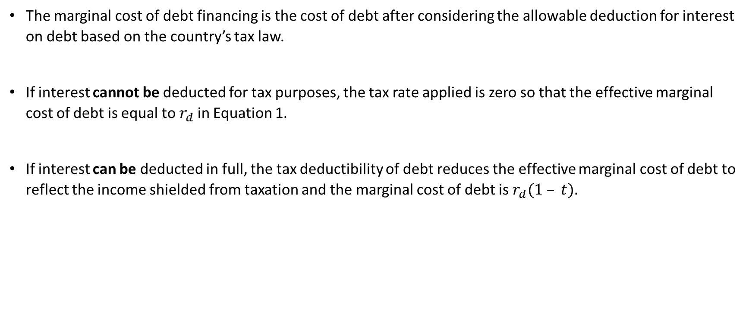
Taxes and the Cost of Capital
The marginal cost of debt financing is the cost of debt after considering the allowable deduction for interest on debt based on the country’s tax law.
If interest cannot be deducted for tax purposes, the tax rate applied is zero so that the effective marginal cost of debt is equal to $r_{d}$ in Equation 1.
If interest can be deducted in full, the tax deductibility of debt reduces the effective marginal cost of debt to reflect the income shielded from taxation and the marginal cost of debt is $r_{d}(1 – t).$

Slide 7
Example of taxes and the cost of capital
A company pays €1 million in interest on its €10 million of debt.
The cost of this debt is not €1 million because this interest expense reduces taxable income by €1 million, resulting in a lower tax.
If the company has a marginal tax rate of 40 percent, this €1 million of interest costs the company (€1 million)(1 − 0.4) = €0.6 million because the interest reduces the company’s tax bill by €0.4 million.
In this case, the before tax cost of debt is 10 percent, whereas the after-tax cost of debt is (€0.6 million)/(€10 million) = 6 percent, which can also be calculated as 10%(1 – 0.4).

Slide 8
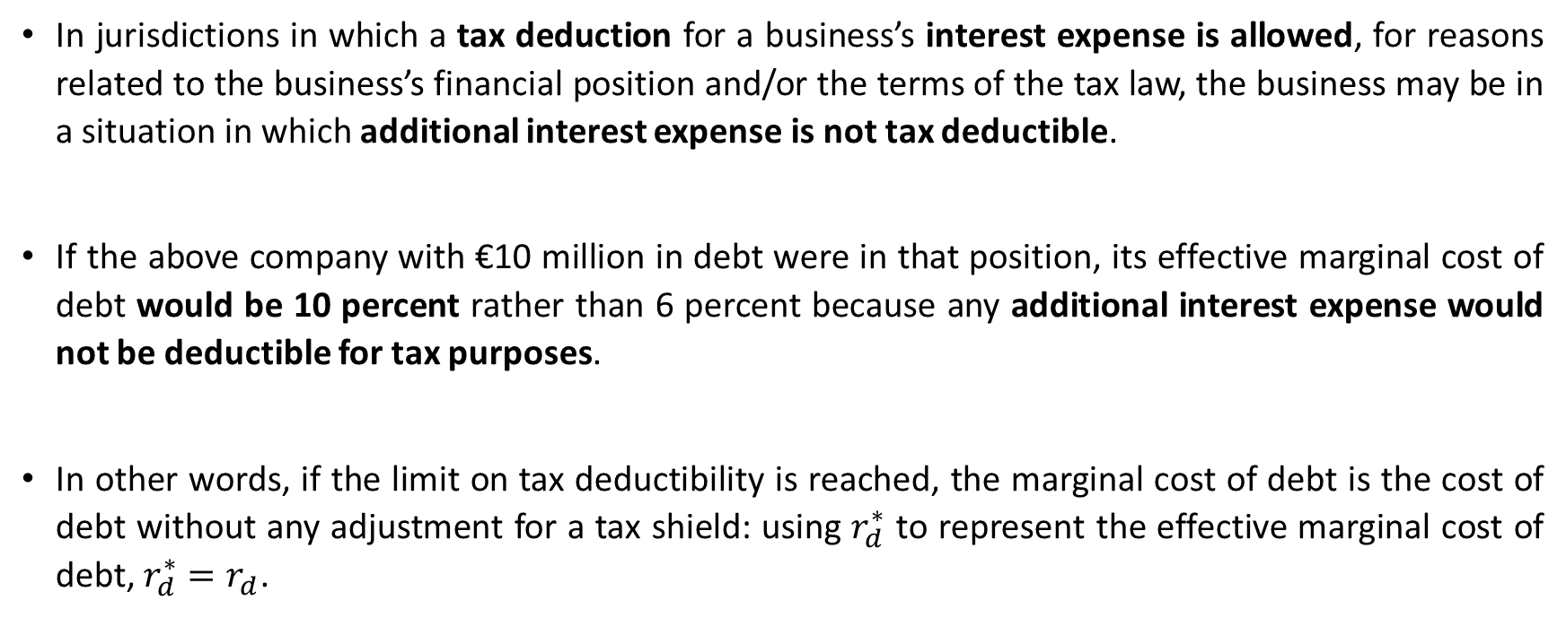
Tax deduction
In jurisdictions in which a tax deduction for a business’s interest expense is allowed, for reasons related to the business’s financial position and/or the terms of the tax law, the business may be in a situation in which additional interest expense is not tax deductible.
If the above company with €10 million in debt were in that position, its effective marginal cost of debt would be 10 percent rather than 6 percent because any additional interest expense would not be deductible for tax purposes.
In other words, if the limit on tax deductibility is reached, the marginal cost of debt is the cost of debt without any adjustment for a tax shield: using $r_{d}^{∗}$ to represent the effective marginal cost of debt, $r_{d}^{∗}=r_{d}$.

Slide 9
Computing the Weighted Average Cost of Capital
Assume that ABC Corporation has the following capital structure:
30 percent debt,
10 percent preferred stock,
60 percent equity.
Also assume that interest expense is tax deductible.
ABC Corporation wishes to maintain these proportions as it raises new funds. Its before-tax cost of debt is 8 percent, its cost of preferred stock is 10 percent, and its cost of equity is 15 percent. If the company’s marginal tax rate is 40 percent, what is ABC’s weighted average cost of capital?
Solution:
The weighted average cost of capital is
WACC = (0.3)(0.08)(1 – 0.40) + (0.1)(0.1) + (0.6)(0.15) = 11.44 percent

Slide 10
Weights of the Weighted Average
How do we determine what weights to use?
If we assume that a company has a target capital structure and raises capital consistent with this target, we should use this target capital structure. The target capital structure is the capital structure that a company is striving to obtain.
Someone outside the company must estimate it using one of several approaches:
  Assume the company’s current capital structure, at market value weights for the components, represents the company’s target capital structure.
  Examine trends in the company’s capital structure or statements by management regarding capital structure policy to infer the target capital structure.
  Use averages of comparable companies’ capital structures as the target capital structure.
NOTE: In the absence of knowledge of a company’s target capital structure, we may take Method 1 as the baseline. In applying Method 3, we use an unweighted, arithmetic average, as is often done for simplicity. An alternative is to calculate a weighted average, which would give more weight to larger companies.

Slide 11
Example: Estimating the Proportions of Capital
Anziell is in the process of estimating the cost of capital of Gewicht GmbH. The following information is provided:
Gewicht GmbH
Market value of debt €50 million
Market value of equity €60 million
Primary competitors and their capital structures (in millions):
Competitor Market Value of Debt Market Value of Equity
A €25 €50
B €101 €190
C £40 £60
What are Gewicht’s proportions of debt and equity that Anziell would use if estimating these proportions using the company’s:
1 current capital structure?
2 competitors’ capital structure?
3 Suppose Gewicht announces that a debt-to-equity ratio of 0.7 reflects its target capital structure. What weights should Anziell use in the cost of capital calculations?

Slide 12

Solution to 1:
Current capital structure
w$d=\frac{€50 million}{€50million + €60 million }=0,4545$
w$e=\frac{€60 million}{€50million + €60 million }=0,5454$

Slide 13
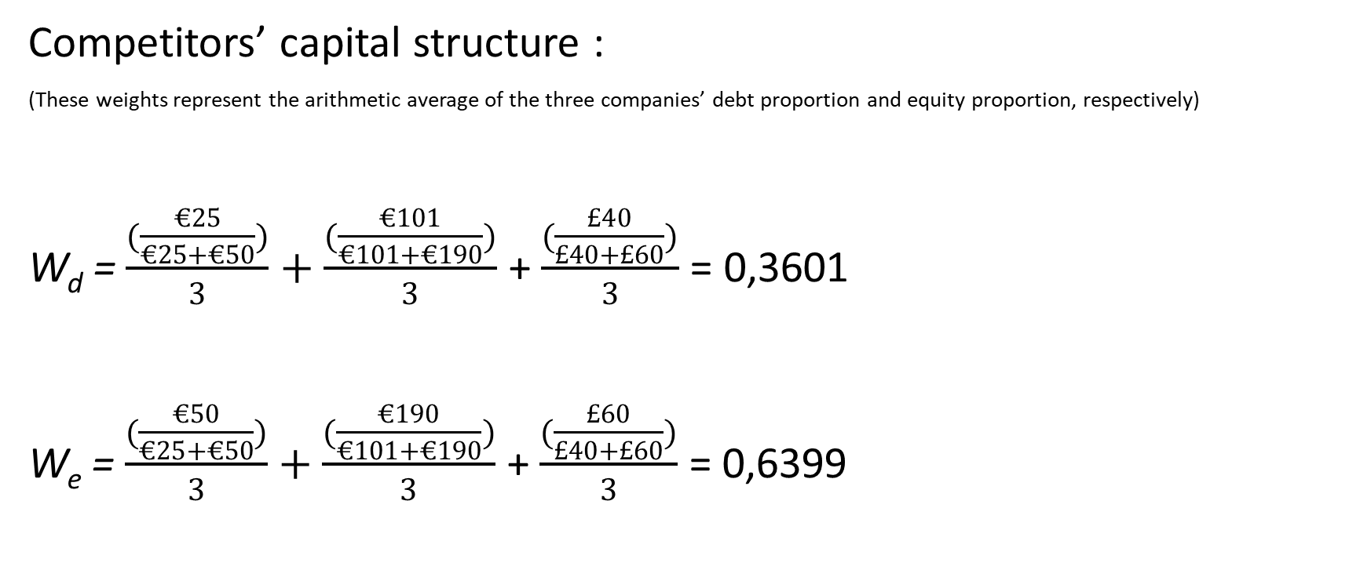
Solution to 2:
Competitors’ capital structure :
(These weights represent the arithmetic average of the three companies’ debt proportion and equity proportion, respectively)
W_{d} = $\frac{(\frac{€25}{€25+€50})}{3}+\frac{(\frac{€101}{€101+€190})}{3}$ + $\frac{(\frac{£40}{£40+£60})}{3}$ = 0,3601
W_{e} = $\frac{(\frac{€50}{€25+€50})}{3}+\frac{(\frac{€190}{€101+€190})}{3}$ + $\frac{(\frac{£60}{£40+£60})}{3}$ = 0,6399

Slide 14
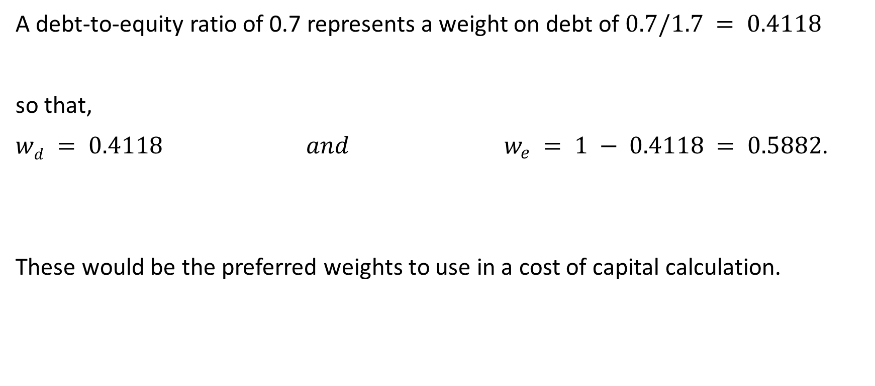
Solution to 3:
A debt-to-equity ratio of 0.7 represents a weight on debt of $0.7/1.7 = 0.4118$
so that,
$wd = 0.4118 and { w}_{e} = 1 − 0.4118 = 0.5882$.
These would be the preferred weights to use in a cost of capital calculation.

Slide 15
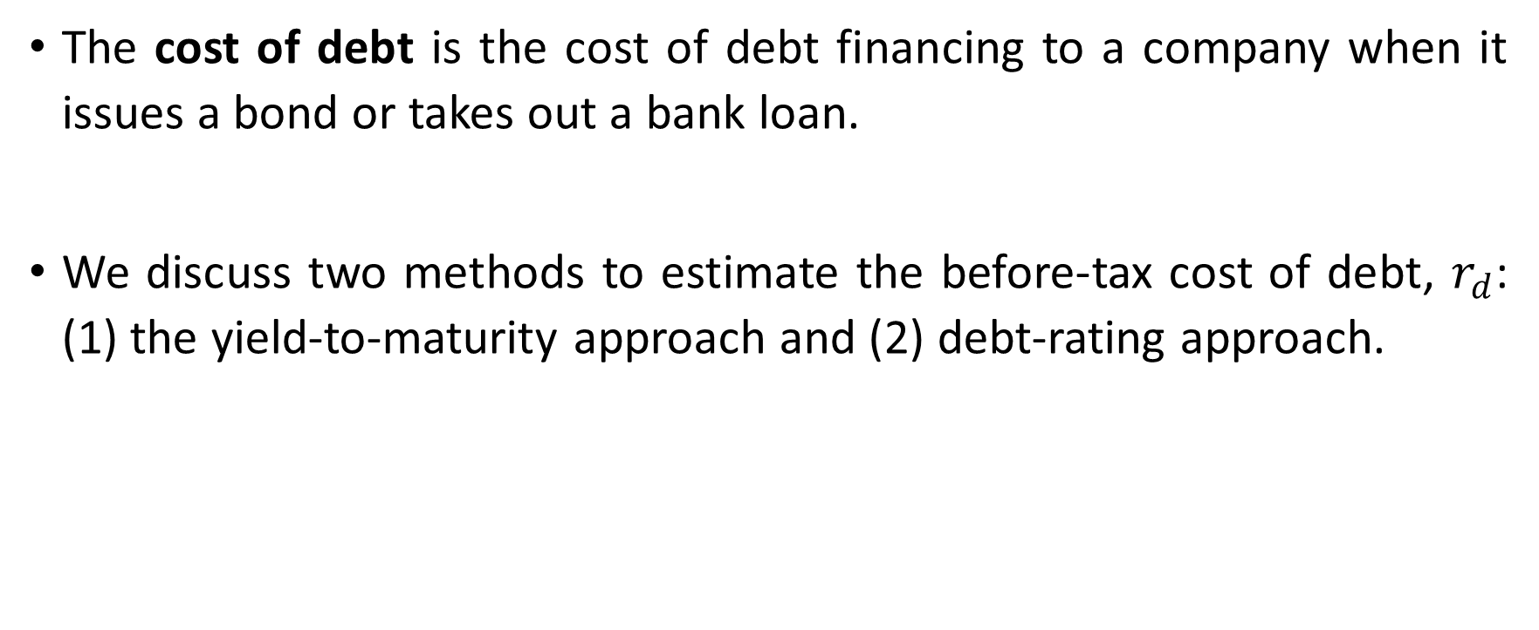
Cost of Debt
The cost of debt is the cost of debt financing to a company when it issues a bond or takes out a bank loan.
We discuss two methods to estimate the before-tax cost of debt, $r_{d}$: (1) the yield-to-maturity approach and (2) debt-rating approach.

Slide 16
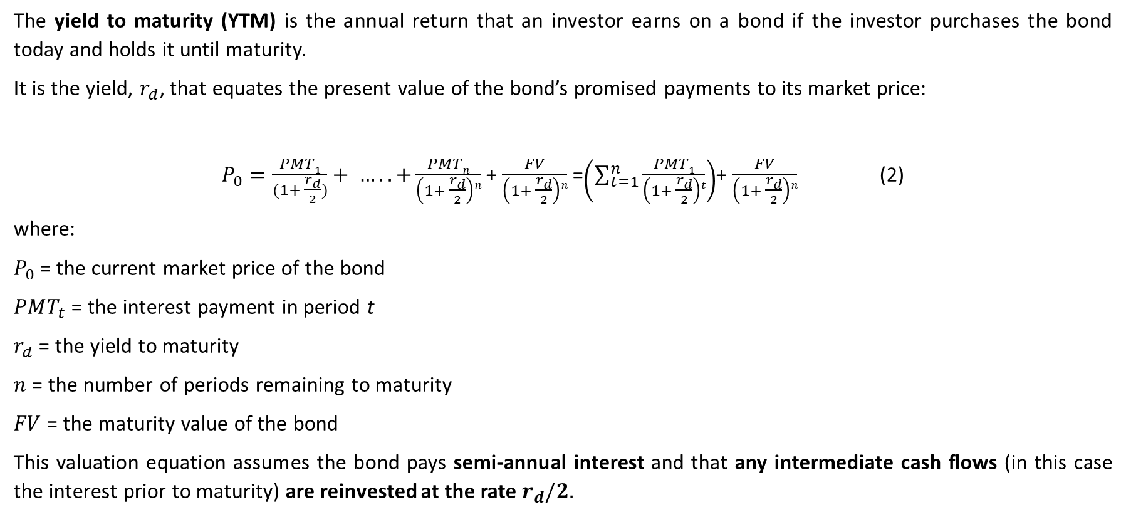
Cost of Debt: Yield-to-Maturity Approach
The yield to maturity (YTM) is the annual return that an investor earns on a bond if the investor purchases the bond today and holds it until maturity.
It is the yield, $r_{d}$, that equates the present value of the bond’s promised payments to its market price:
$P_{0}=\frac{PMT1}{(1+ \frac{r_{d}}{2})}+ …..+\frac{PMTn}{\left(1+ \frac{r_{d}}{2}\right)n}$ + $\frac{FV}{\left(1+ \frac{r_{d}}{2}\right)n}$ =$\left(\sum_{t=1}^{n}{\frac{PMT1}{\left(1+ \frac{r_{d}}{2}\right)t}}\right)$+ $\frac{FV}{\left(1+ \frac{r_{d}}{2}\right)n}$ (2)
where:
$P_{0}$ = the current market price of the bond
$PMT_{t}$ = the interest payment in period t
$r_{d}$ = the yield to maturity
$n$ = the number of periods remaining to maturity
$FV$ = the maturity value of the bond
This valuation equation assumes the bond pays semi-annual interest and that any intermediate cash flows (in this case the interest prior to maturity) are reinvested at the rate $r_{d}/2.$

Slide 17
Example: Calculating the After-Tax Cost of Debt
Valence Industries issues a bond to finance a new project. It offers a 10-year, $1,000 face value, 5 percent semi-annual coupon bond.
Upon issue, the bond sells at $1,025.
What is Valence’s before-tax cost of debt?
If Valence’s marginal tax rate is 35 percent, what is Valence’s after-tax cost of debt?

Slide 18
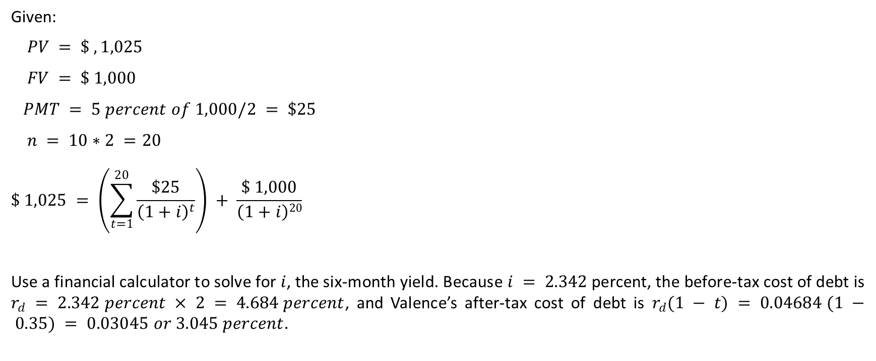
Solution:
Given:
$$PV = \$ ,1,025$$
$$FV = \$ 1,000$$
$$PMT = 5 percent of 1,000/2 = \$25$$
$$n = 10∗2 =20$$
$$\$ 1,025 = \left(\sum_{t=1}^{20}{\frac{\$25}{{\left(1+i\right)}^{t}}}\right) + \frac{\$ 1,000}{\left(1+i\right)20}$$
Use a financial calculator to solve for $i$, the six-month yield. Because $i = 2.342$percent, the before-tax cost of debt is $r_{d} = 2.342 percent × 2 = 4.684 percent$, and Valence’s after-tax cost of debt is $r_{d}(1 − t) = 0.04684 (1 − 0.35) = 0.03045 or 3.045 percent.$

Slide 19
Cost of Debt: Debt-Rating Approach
The debt-rating approach can be used to calculate the before-tax cost of debt in the absence of a reliable current market price for a company's debt. We calculate the before-tax cost of debt based on a company's debt rating by using the yield on bonds with similar ratings and maturities to the existing debt of the company.
When employing this strategy, it is important to keep in mind that debt ratings are assessments of the debt issue itself, with the issuer being only one of several factors. Ratings and yields are also influenced by other factors, such as debt seniority and security, so care must be taken to account for the likely type of debt that the company will issue when determining the comparable debt rating and yield.
The debt-rating approach is a simple example of pricing on the basis of valuation-relevant characteristics, which in bond markets has been known as evaluated pricing or matrix pricing.

Slide 20
Cost of Debt: Issues I/II
Fixed-Rate Debt versus Floating-Rate Debt. Up to now, we have assumed that the interest on debt is a fixed amount each period. We can observe market yields of the company’s existing debt or market yields of debt of similar risk in estimating the before-tax cost of debt. The company may also issue floating-rate debt in which the interest rate adjusts periodically according to a prescribed index, such as the prime rate or Libor, over the life of the instrument. Estimating the cost of a floating-rate security is difficult because the cost of this form of capital over the long term depends not only on the current yields but also on the future yields.
Debt with Optionlike Features. Options affect the value of debt. If the company already has debt outstanding incorporating optionlike features that the analyst believes are representative of the future debt issuance of the company, the analyst may simply use the yield to maturity on such debt in estimating the cost of debt. If the analyst believes that the company will add or remove option features in future debt issuance, the analyst can make market value adjustments to the current YTM to reflect the value of such additions and/or deletions.

Slide 21
Cost of Debt: Issues II/II
Nonrated Debt. If a company does not have any debt outstanding or if the yields on the company’s existing debt are not available, the analyst may not always be able to use the yield on similarly rated debt securities. It may be the case that the company does not have rated bonds.
Leases. A lease is a contractual obligation that can substitute for other forms of borrowing. This is true whether the lease is an operating lease or a finance lease (capital lease). If the company uses leasing as a source of capital, the cost of these leases should be included in the cost of capital. The cost of this form of borrowing is similar to that of the company’s other long-term borrowing.

Slide 22
Cost of Preferred Stock
The cost of preferred stock is the cost that a company has committed to pay preferred stockholders as a preferred dividend when it issues preferred stock.
In the case of nonconvertible, noncallable preferred stock that has a fixed dividend rate and no maturity date (fixed rate perpetual preferred stock).

Slide 23

Cost of Preferred Stock
Cost of preferred stock can be calculated as:
$$r_{p}=\frac{D_{p}}{P_{p}} (3)$$
where:
$r_{p}$= the cost of preferred stock
$D_{p}$= the preferred stock dividend per share
$P_{p}$= the current preferred stock price per share

Slide 24
Cost of Preferred Stock and Taxes
The dividend on preferred stock is not tax-deductible by the company; therefore, there is no adjustment to the cost for taxes.
This is not to be confused, however, with the dividends-received deduction, which reduces the effective tax on intercorporate preferred dividends received.

Slide 25
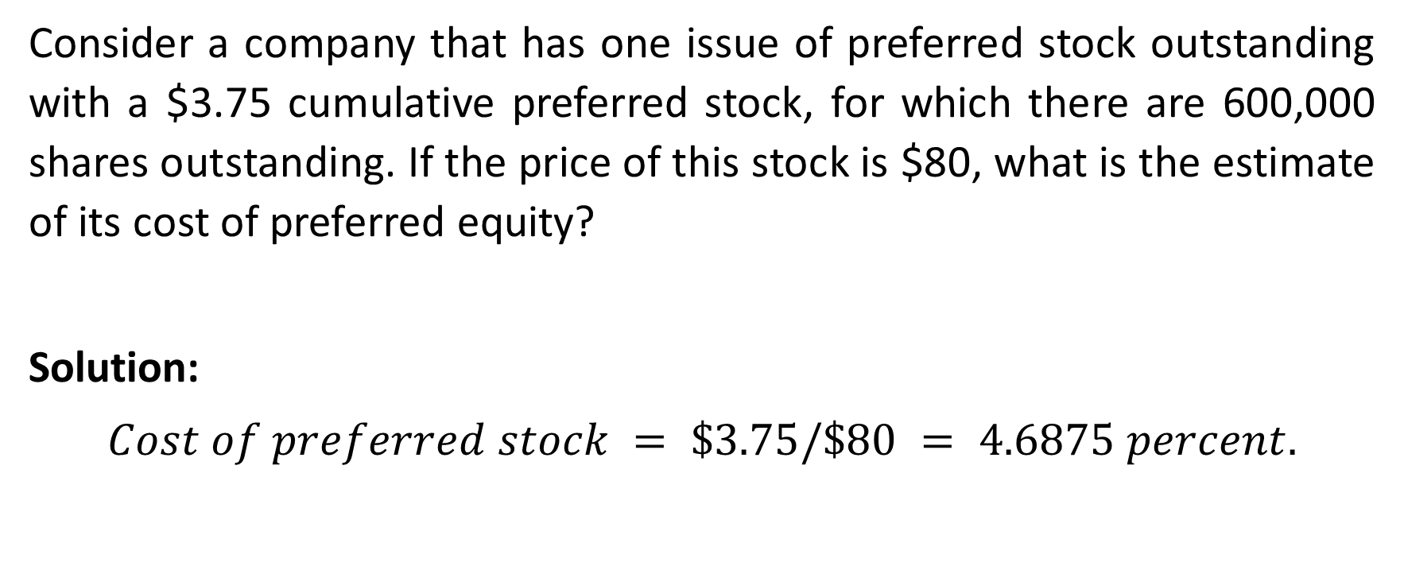
Example: Calculating the Cost of Preferred Equity
Consider a company that has one issue of preferred stock outstanding with a $3.75 cumulative preferred stock, for which there are 600,000 shares outstanding. If the price of this stock is $80, what is the estimate of its cost of preferred equity?
Solution:
$$Cost of preferred stock = \$3.75/\$80 = 4.6875 percent.$$

Slide 26
Cost of Common Equity
The cost of common equity, usually referred to simply as the cost of equity, is the rate of return required by a company’s common shareholders. A company may increase common equity through the reinvestment of earnings—that is, retained earnings—or through the issuance of new shares of stock.
The estimation of the cost of equity is challenging because of the uncertain nature of the future cash flows in terms of the amount and timing. Commonly used approaches for estimating the cost of equity include the capital asset pricing model, the dividend discount model, and the bond yield plus risk premium method.

Slide 27
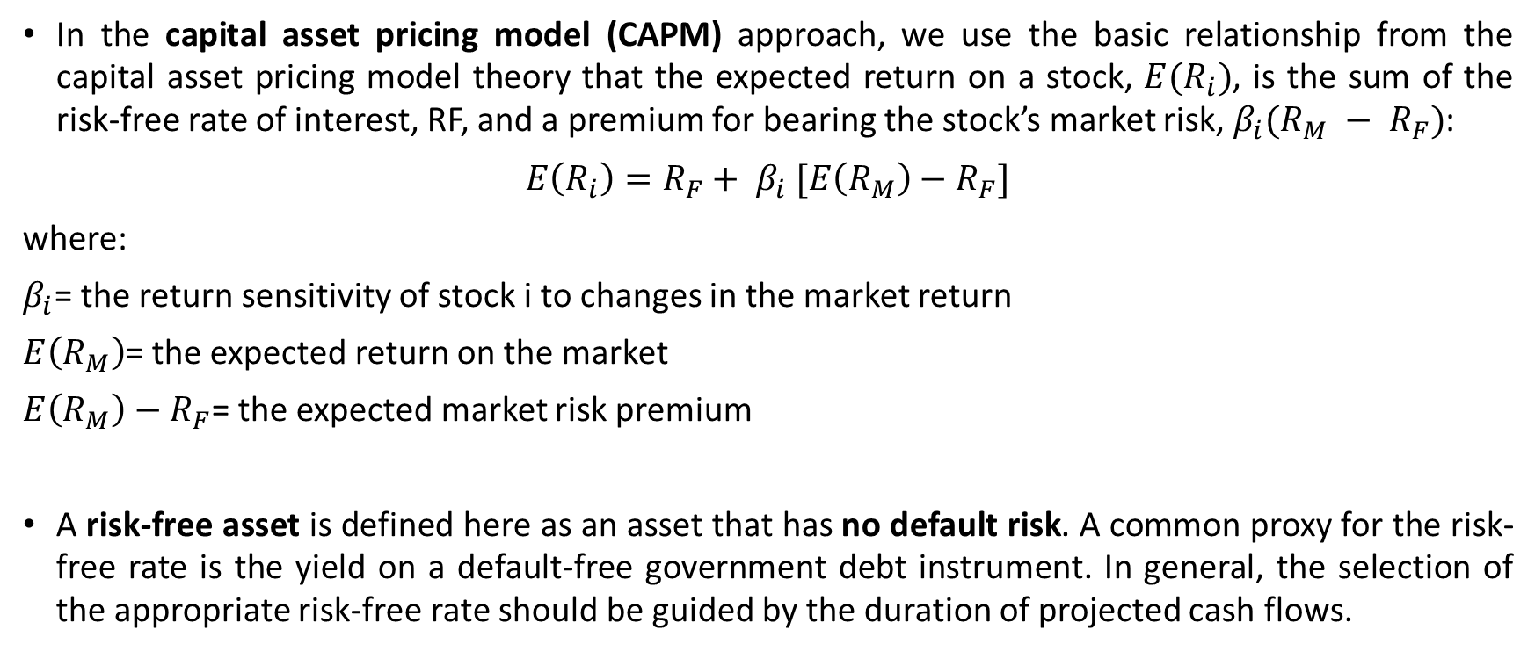
Cost of Common Equity: Capital Asset Pricing Model Approach (CAPM)
In the capital asset pricing model (CAPM) approach, we use the basic relationship from the capital asset pricing model theory that the expected return on a stock, $E(R_{i})$, is the sum of the risk-free rate of interest, RF, and a premium for bearing the stock’s market risk, $β_{i}(R_{M} − R_{F})$:
$$E\left(R_{i}\right)=R_{F}+ β_{i} [E\left(R_{M}\right)−R_{F}]$$
where:
$β_{i}$= the return sensitivity of stock i to changes in the market return
$E\left(R_{M}\right)$= the expected return on the market
$E\left(R_{M}\right)−R_{F}$= the expected market risk premium
A risk-free asset is defined here as an asset that has no default risk. A common proxy for the risk-free rate is the yield on a default-free government debt instrument. In general, the selection of the appropriate risk-free rate should be guided by the duration of projected cash flows.

Slide 28
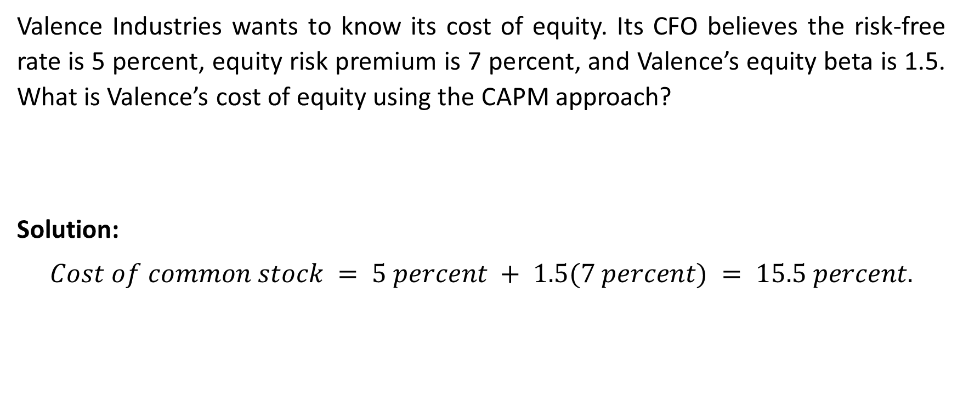
Example: Using the CAPM to Estimate the Cost of Equity
Valence Industries wants to know its cost of equity. Its CFO believes the risk-free rate is 5 percent, equity risk premium is 7 percent, and Valence’s equity beta is 1.5. What is Valence’s cost of equity using the CAPM approach?
Solution:
$$Cost of common stock = 5 percent + 1.5(7 percent) = 15.5 percent.$$

Slide 29
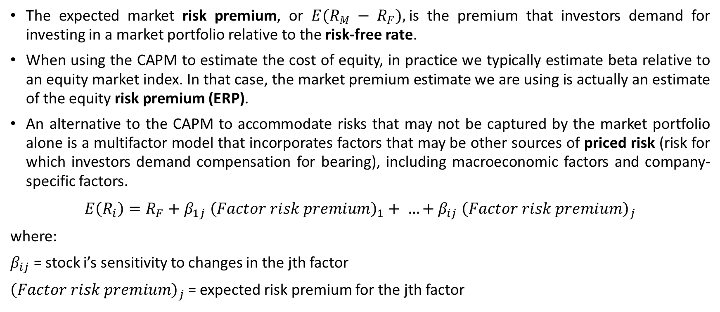
Cost of Common Equity: Capital Asset Pricing Model Approach (CAPM)
The expected market risk premium, or $E(R_{M} − R_{F}),$is the premium that investors demand for investing in a market portfolio relative to the risk-free rate.
When using the CAPM to estimate the cost of equity, in practice we typically estimate beta relative to an equity market index. In that case, the market premium estimate we are using is actually an estimate of the equity risk premium (ERP).
An alternative to the CAPM to accommodate risks that may not be captured by the market portfolio alone is a multifactor model that incorporates factors that may be other sources of priced risk (risk for which investors demand compensation for bearing), including macroeconomic factors and company-specific factors.
$$E\left(R_{i}\right)=R_{F}+β_{1j} {\left(Factor risk premium\right)}_{1}+ …+β_{ij} {\left(Factor risk premium\right)}_{j}$$
where:
$β_{ij}$ = stock i’s sensitivity to changes in the jth factor
${\left(Factor risk premium\right)}_{j}$ = expected risk premium for the jth factor

Slide 30
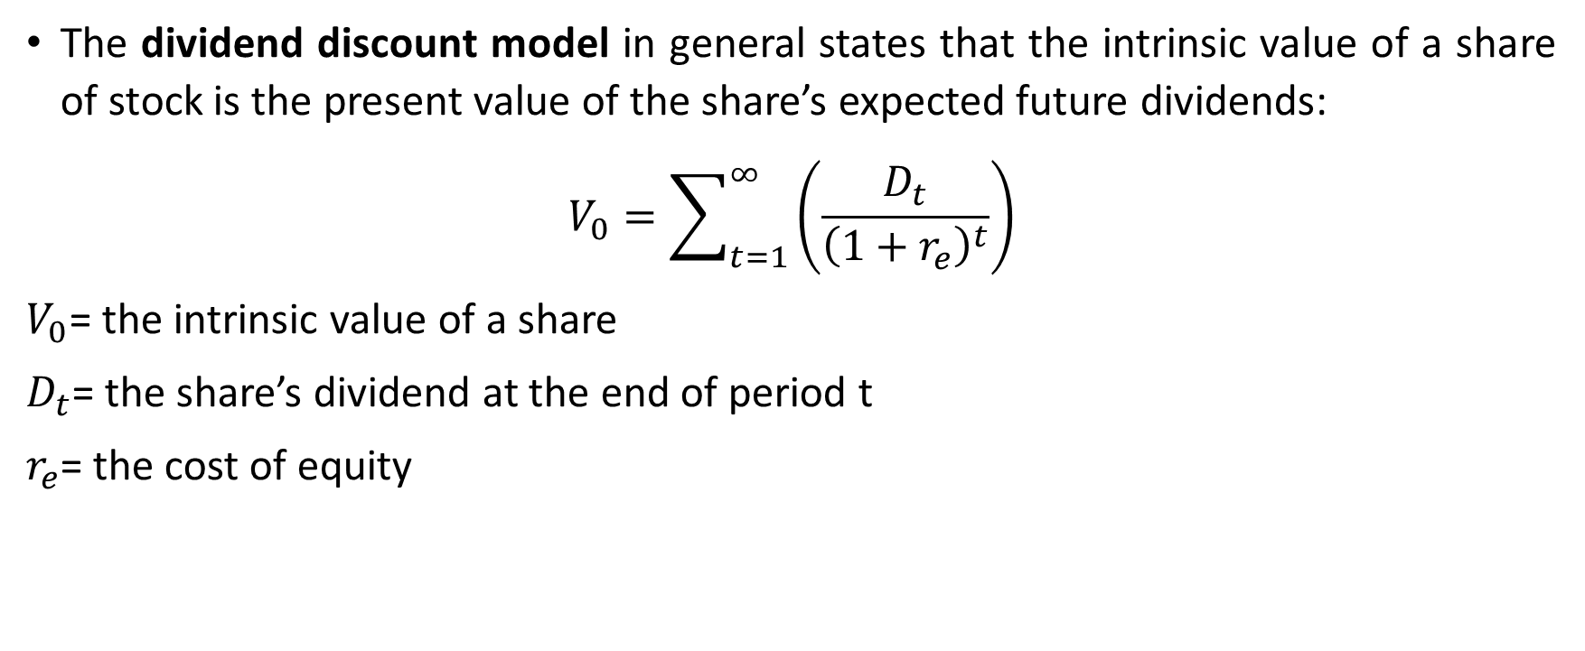
Cost of Common Equity: Dividend Discount Model Approach
The dividend discount model in general states that the intrinsic value of a share of stock is the present value of the share’s expected future dividends:
$$V_{0}=\sum_{t=1}^{∞}{\left(\frac{D_{t}}{{\left(1+r_{e}\right)}^{t}}\right)}$$
$V_{0}$= the intrinsic value of a share
$D_{t}$= the share’s dividend at the end of period t
$r_{e}$= the cost of equity

Slide 31
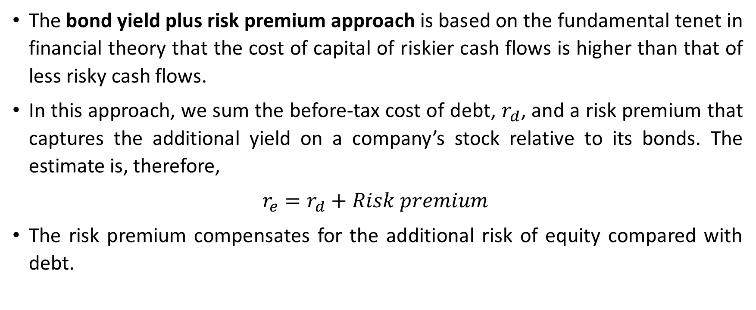
Cost of Common Equity: Bond Yield plus Risk Premium Approach
The bond yield plus risk premium approach is based on the fundamental tenet in financial theory that the cost of capital of riskier cash flows is higher than that of less risky cash flows.
In this approach, we sum the before-tax cost of debt, $r_{d}$, and a risk premium that captures the additional yield on a company’s stock relative to its bonds. The estimate is, therefore,
$$r_{e}=r_{d}+Risk premium$$
The risk premium compensates for the additional risk of equity compared with debt.

Slide 32
Questions
Which alternatives have the company to raise its capital?
  Issue equity, debt
  Only debt
  Only issuing equity
In jurisdictions in which a tax deduction for a business’s interest expense is allowed, the company can be in the situation:
  in which there are no additional interest expense
  in which additional interest expense is not tax deductible
  in which additional interest expenses are tax deductible
Notes:
1 – A
2 - B

Slide 33
Questions
3. What is the cost of debt?
  The cost of debt is the cot of debt financing to a company when it uses external sources.
  The cost of debt is the cost of debt financing to a company when it issues a bond or takes out a bank loan.
  The cost of debt is the cost of debt financing to a company when it uses internal sources.
4. The dividend on preferred stock is not tax-deductible by the company; therefore, there is no adjustment to the cost for taxes:
  TRUE
  FALSE
Notes:
3 – B
4 - TRUE

Slide 34
Questions
5. How is defined risk-free asset in the CAPM approach:
  As an asset that has an average default risk
  As an asset which has a minimum default risk
  As an asset that has no default risk
6. Which approach to the cost of Common Equity is defined as „... is based on the fundamental tenet in financial theory that the cost of capital of riskier cash flows is higher than that of less risky cash flows“?
  Capital Asset Pricing Model Approach
  Bond Yield plus Risk Premium Approach
  Dividend Discount Model Approach
Notes:
5 – C
6 - B

