Slide 1
Chapter 1
Project management
Stefán Guðnason

Slide 2
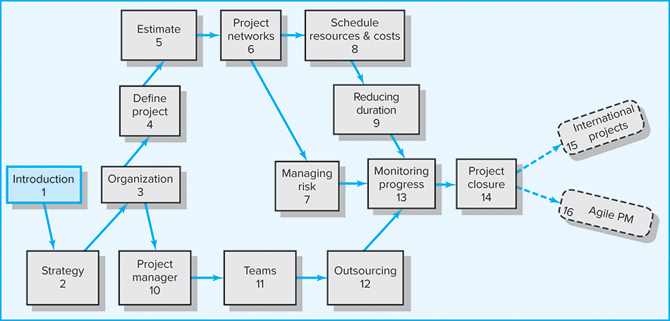
An Overview of Project Management 7th ed

Slide 3
What we hope to gain from this chapter
Understand why project management is crucial in today’s world
Distinguish a project from routine operations
Identify the different stages of project life cycle
Understand the importance of projects in implementing organization strategy
Understand that managing projects involves balancing the technical and sociocultural dimensions of the project

Slide 4
Chapter Outline
1.1 What Is a Project?
1.2 Current Drivers of Project Management
1.3 Project Governance
1.4 Project Management Today—A Socio-Technical Approach

Slide 5
What Is a Project?
Project Defined (according to PMI)
  A temporary endeavor undertaken to create a unique product, service, or result
Major Characteristics of a Project
  Has an established objective
  Has a defined life span with a beginning and an end
  Requires across-the-organizational participation
  Involves doing something never been done before
  Has specific time, cost, and performance requirements

Slide 6
Program versus Project
Program Defined
  A group of related projects designed to accomplish a common goal over an extended period of time
Program Management
  A process of managing a group of ongoing, interdependent, related projects in a coordinated way to achieve strategic objectives
  Examples:
Examples:
- Program: Finish all courses required for a business major.
- Project: Finish the project management course with excelance.

Slide 7
Comparison of Routine Work with Projects
Routine, Repetitive Work
- Taking notes in class
- File management
- Taking meeting notes
- Answering the phone
- Routine manufacturing of phones from Samsung
Projects
- Write a B.S. Thesis
- Setting up a lemonade stand
- Start a new study program
- Write a play
- Design a new phone for Samsung that can keep the charge for at least two days.

Slide 8
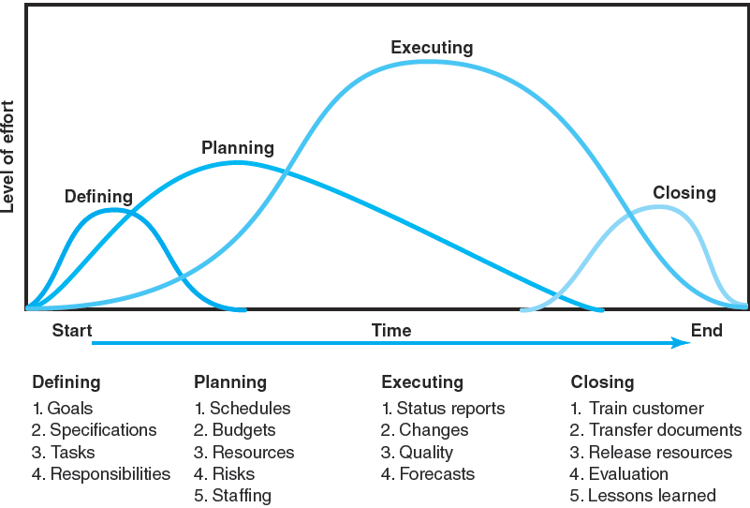
Project Life Cycle

Slide 9
The Challenge of Project Management
The Project Manager
  Manages temporary, non-repetitive activities and frequently acts independently of the formal organization.
    Marshals resources for the project.
    Is linked directly to the customer interface.
    Provides direction, coordination, and integration
    to the project team.
    Is responsible for performance and success of the project.
  Must induce the right people at the right time to address the right issues and make the right decisions.

Slide 10
Current Drivers of Project Management
Factors leading to the increased use of project management:
  Compression of the product life cycle
  Knowledge explosion
  Triple bottom line (planet, people, profit)
  Increased customer focus
  Small projects represent big problems

Slide 11
Project Governance
Integration (or centralization) of project management provides senior management with:
  An overview of all project management activities
  A big picture of how organizational resources are used
  A risk assessment of their portfolio of projects
  A rough metric of the firm’s improvement in managing projects relative to others in the industry
  Linkages of senior management with actual project execution management

Slide 12
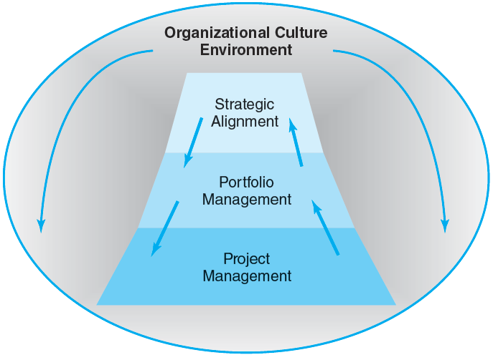
Integrated Management of Projects

Slide 13
Alignment of Projects with
Organizational Strategy
Problems resulting from the uncoordinated project management systems include:
  Projects that do not support the organization’s overall strategic plan and goals.
  Independent managerial decisions that create internal imbalances, conflicts and confusion resulting in dissatisfied customers.
  Failure to prioritize projects results in the waste of resources on non-value-added activities/projects.

Slide 14
A Project Management Today:
A Socio-Technical Approach
The Technical Dimension (The “Science”)
  Consists of the formal, disciplined, purely logical parts of the process.
  Includes planning, scheduling, and controlling projects.
The Sociocultural Dimension (The “Art”)
  Involves contradictory and paradoxical world of implementation.
  Centers on creating a temporary social system within a larger organizational environment that combines the talents of a divergent set of professionals working to complete the project.

Slide 15
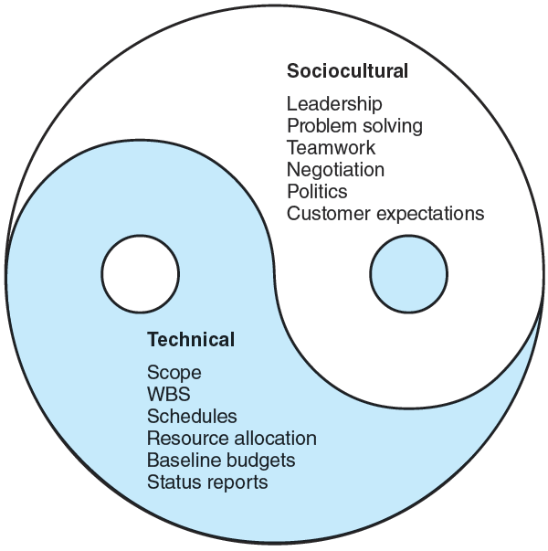
A Socio-Technical Approach to Project Management

Slide 16
Key Terms
Program
Project
Project life cycle
Socio-Technical Approach

