Slide 1
Project management
Organization Strategy and Project Selection

Slide 2
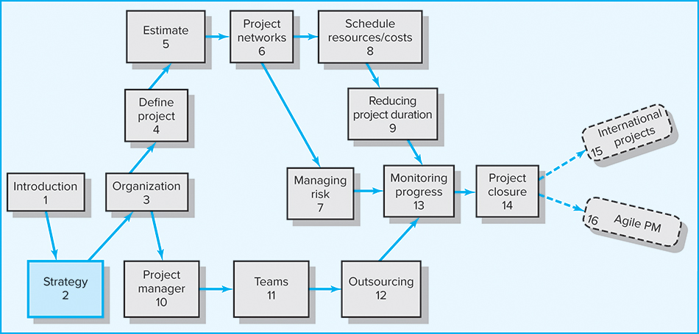

Slide 3
What we hope to learn:
Explain why it is important for project managers to understand their organization’s strategy
Identify the significant role projects contribute to the strategic direction of the organization
Understand the need for a project priority system
Apply financial and nonfinancial criteria to assess the value of projects
Understand how multi-criteria models can be used to select projects
Apply an objective priority system to project selection
Understand the need to manage the project portfolio

Slide 4
Chapter outline
2.1 The Strategic Management Process: An Overview
2.2 The Need for a Project Priority System
2.3 A Portfolio Management System
2.4 Selection Criteria
2.5 Applying a Selection Model
2.6 Managing the Portfolio System

Slide 5
Why Project Managers Need to Understand Strategy
Changes in the organization’s mission and strategy
  Project managers must respond to changes with appropriate decisions about future projects and adjustments to current projects.
  Project managers who understand their organization’s strategy can become effective advocates of projects aligned with the firm’s mission.

Slide 6
The Strategic Management Process:
An Overview
Strategic Management
  Requires every project to be clearly linked to strategy.
  Provides theme and focus of firm’s future direction.
    Responding to changes in the external environment—environmental scanning
    Allocating scarce resources of the firm to improve its competitive position—internal responses to new programs
  Requires strong links among mission, goals, objectives, strategy, and implementation.

Slide 7
Four Activities of the Strategic
Management Process
Review and define the organizational mission
Set long-range goals and objectives
Analyze and formulate strategies to reach objectives
Implement strategies through projects

Slide 8
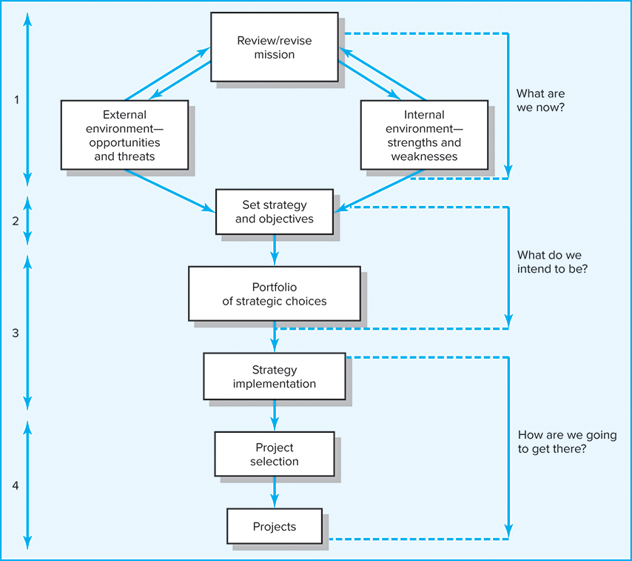
Strategic Management Process

Slide 9
Characteristics of Objectives
S Specific Be specific in targeting an objective
M Measurable Establish a measurable indicator(s) of progress
A Assignable Make the objective assignable to one person
for completion
R Realistic State what can realistically be done with
available resources
T Time related State when the objective can be achieved,
that is, duration

Slide 10
S.M.A.R.T markmið
SMART. Almenn skilyrði sem setja á markmiðum verkefna.
S | Specific | Sértækt | Lýsa ber því sem á að ná fram með verkefninu; því sem stendur ljóslega eftir þegar verkefninu er lokið. Hér ber að forðast ónákvæmt orðalag eins og „þekkja“, „kunna“, rannsaka“ o.s.frv. Beina þarf sjónum að þörf, kröfum og væntingum þeirra sem njóta eiga niðurstöðunnar. Lýsingin þarf að vera skýr og skorinorð, laus við skrúðmælgi og yfirleitt þannig fram sett að allir sem að verkefninu munu koma skilji hvað við er átt, ekki síst þeir sem taka eiga ákvörðun og enn fremur þeir sem njóta eiga niðurstöðunnar.
M | Measurable | Mælanlegt | Setja ber mælikvarða sem hægt er að bera að árangrinum. Hér erum að ræða fjölda, hlutfall, stærð og jafnvel mælanlegt viðhorf eða skoðanir. Við verðum að vita í verkefnislok hvort við höfum í raun náð því markmiði eða þeim markmiðum sem við settum í upphafi með áorðnum breytingum meðan á verkefninu stóð.
A | Achievable | Gerlegt. | Við verðum að gera ráð fyrir því að markmiðinu sé hægt að ná á einhvern hátt. Þess vegna skoðum við eftirfarandi undirforsendur: Við vitum að það er mælanlegt. Aðrir hafa náð svipuðum markmiðum. „Teoretískt“ er hægt að ná því. Raunhæfur möguleiki á að útvega nauðsynleg aðföng. Við höfum hugmynd um takmörk getu okkar (einstaklingar, skipulagseining, skipulagsheild).
R | Realistic | Framkvæmanlegt / Raunhæft | Markmiðið þarf ekki að vera framkvæmanlegt miðað við okkar aðstæður þótt það sé gerlegt að ná því. Hér þurfum við að líta okkur nær. Er t.d. ekki vilji í okkar nánasta umhverfi til að fara út í verkefni af þessu tagi, jafnvel þótt það sé gerlegt? Hér þarf t.d. að taka mismunandi viðhorf manna til áhættu með í reikninginn. Ef andstaða er veruleg getur verkefnið ekki verið raunhæft miðað við núverandi eða fyrirsjáanlegar aðstæður í okkar umhverfi. Óraunhæf markmið leiða af sér andvana fædd verkefni ekki síst vegna þess að gegn þeim er jafnan andstaða frá upphafi. Höfum hugfast að framkvæmanleiki snýst um forgagnsröð, tíma, fé og tækifæri.
T | Time based | Tímasett | Við verðum að setja verkefnum okkar tímamörk. Hér er fyrst og fremst átt við þann tíma sem það mun taka að ná hinu endanlega markmiði en jafnframt getur verið heppilegt að setja vörður inn í verkefnið.

Slide 11
The Need for a Project Priority System
The Implementation Gap
  The lack of understanding and consensus on strategy among top management and middle-level (functional) managers who independently implement the strategy.
Organization Politics
  Project selection is based on the persuasiveness and power of people advocating the projects.
Resource Conflicts and Multitasking
  Multiproject environment creates interdependency relationships of shared resources which results in the starting, stopping, and restarting projects.

Slide 12
Benefits of Project Portfolio Management
Builds discipline into the project selection process
Links project selection to strategic metrics
Prioritizes project proposals across a common set of criteria, rather than on politics or emotion
Allocates resources to projects that align with strategic direction
Balances risk across all projects
Justifies killing projects that do not support strategy
Improves communication and supports agreement on project goals

Slide 13
A Portfolio Management System
Design of a project portfolio system:
  Classification of a project
  Selection criteria depending upon classification
  Sources of proposals
  Evaluating proposals
  Managing the portfolio of projects.

Slide 14
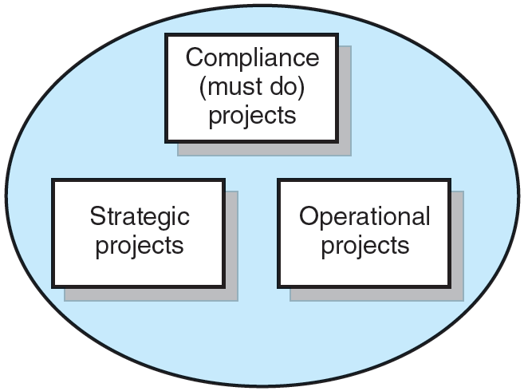
Portfolio of Projects by Type
Compliance
Needed to meet regulatory conditions to operate in a region f.ex.
Operational
Needed to support current operation. Daily business. Need different level of managerial input
Strategic
Directly support the organization’s long run objectives / Strategy New things!

Slide 15
A Portfolio Management System
Selection Criteria
  Financial models: payback, net present value (NPV)
  Non-financial models: projects of strategic importance to the firm
Multi-Criteria Selection Models
  Use several weighted selection criteria to evaluate project proposals.

Slide 16
Financial Models
The Payback Model
  Measures the time the project will take to recover
  the project investment.
  Uses more desirable shorter paybacks.
  Emphasizes cash flows, a key factor in business.
Limitations of Payback:
  Ignores the time value of money.
  Assumes cash inflows for the investment period
  (and not beyond).
  Does not consider profitability.

Slide 17
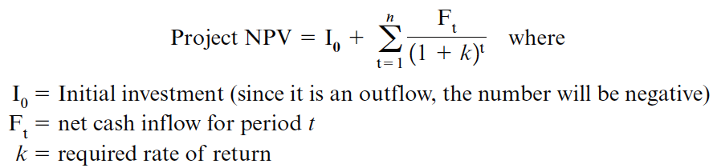
Financial Models (cont’d)
The Net Present Value (NPV) Model
  Uses management’s minimum desired rate-of-return (discount rate) to compute the present value of all net cash inflows.
    Positive NPV: project meets minimum desired rate
    of return and is eligible for further consideration.
    Negative NPV: project is rejected.

Slide 18

Example Comparing Two Projects
Using Payback Method
Project A:
Investment cost $700.000
Revenues $225.000 pr. year for 5 years
Required rate of return 15%
Project B:
Investment cost $400.000
Revenues $110.000 pr. year for 5 years
Required rate of return 15%
Calculate and compare payback and NPV ...

Slide 19
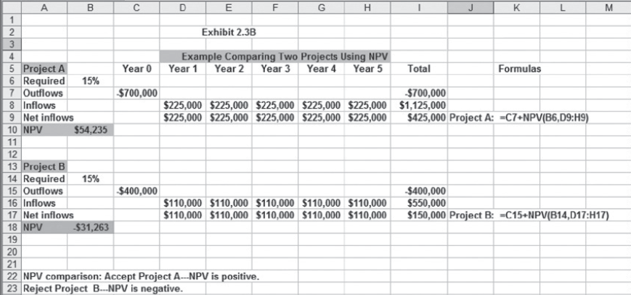
Example Comparing Two Projects
Using Net Present Value Method
EXHIBIT 2.3b

Slide 20
Nonfinancial Strategic Criteria
To capture larger market share
To make it difficult for competitors to enter the market
To develop an enabler product, which by its introduction will increase sales in more profitable products
To develop core technology that will be used in next-generation products
To reduce dependency on unreliable suppliers
To prevent government intervention and regulation
To restore corporate image or enhance brand recognition
To demonstrate its commitment to corporate citizenship and support for community development

Slide 21
Multi-Criteria Selection Models
Checklist Model
  Uses a list of questions to review potential projects and to determine their acceptance or rejection.
  Fails to answer the relative importance or value of a potential project and doesn’t to allow for comparison with other potential projects.
Multi-Weighted Scoring Model
  Uses several weighted qualitative and/or quantitative selection criteria to evaluate project proposals.
  Allows for comparison of projects with other potential projects.

Slide 22
Sample Selection Questions Used in Practice
Topic | Question
Strategy/alignment | What specific strategy does this project align with?
Driver | What business problem does the project solve?
Success metrics | How will we measure success?
Sponsorship | Who is the project sponsor?
Risk | What is the impact of not doing this project?
Risk | What is the project risk to our organization?
Risk | Where does the proposed project fit in our risk profile?
Benefits, value, ROI | What is the value of the project to this organization?
Benefits, value, ROI | When will the project show results?
Objectives | What are the project objectives?
EXHIBIT 2.4

Slide 23
Sample Selection Questions Used in Practice
Topic | Question
Organization culture | Is our organization culture right for this type of project?
Resources | Will internal resources be available for this project?
Approach | Will we build or buy?
Schedule | How long will this project take?
Schedule | Is the time line realistic?
Training/resources | Will staff training be required?
Finance/portfolio | What is the estimated cost of the project?
Portfolio | Is this a new initiative or part of an existing initiative?
Portfolio | How does this project interact with current projects?
Technology | Is the technology available or new?
EXHIBIT 2.4 cont’d

Slide 24
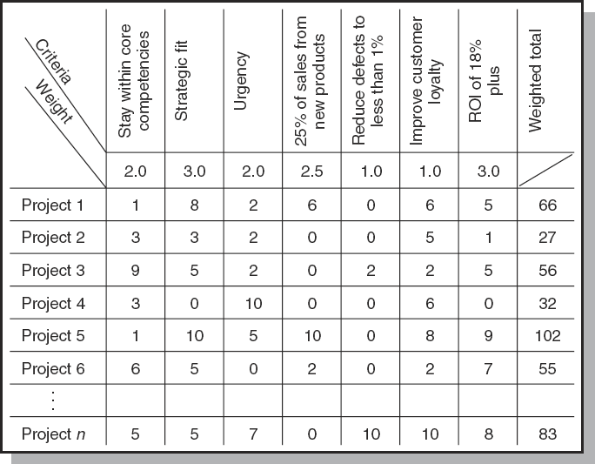
Project Screening Matrix
FIGURE 2.3

Slide 25
Applying a Selection Model
Project Classification
  Deciding how well a strategic or operations project fits the organization’s strategy
Selecting a Model
  Applying a weighted scoring model to align projects closer with the organization’s strategic goals
    Reduces the number of wasteful projects
    Helps identify proper goals for projects
    Helps everyone involved understand how
    and why a project is selected

Slide 26
Applying a Selection Model (cont’d)
Sources and Solicitation of Project Proposals
  Within the organization
  Request for proposal (RFP) from external sources (contractors and vendors)
Ranking Proposals and Selection of Projects
  Prioritizing requires discipline, accountability, responsibility, constraints, reduced flexibility,
  and loss of power
Managing the Portfolio
  Senior management input
  The governance team (project office) responsibilities

Slide 27
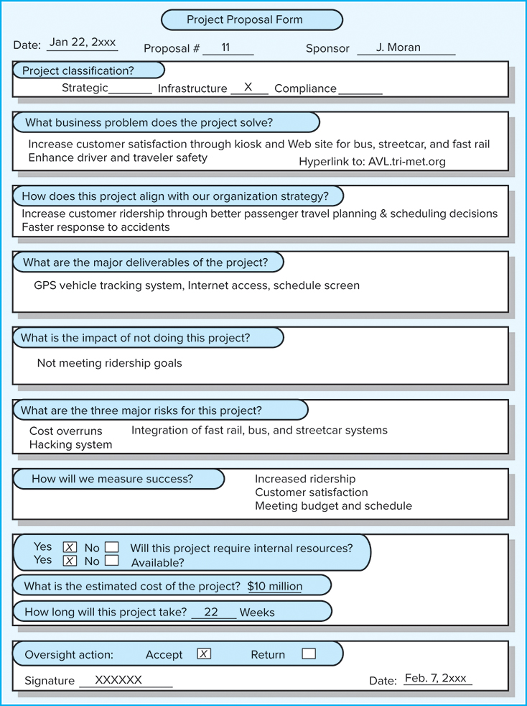
A Proposal Form for an Automatic Vehicular Tracking (AVL) Public
Transportation Project
FIGURE 2.4A

Slide 28
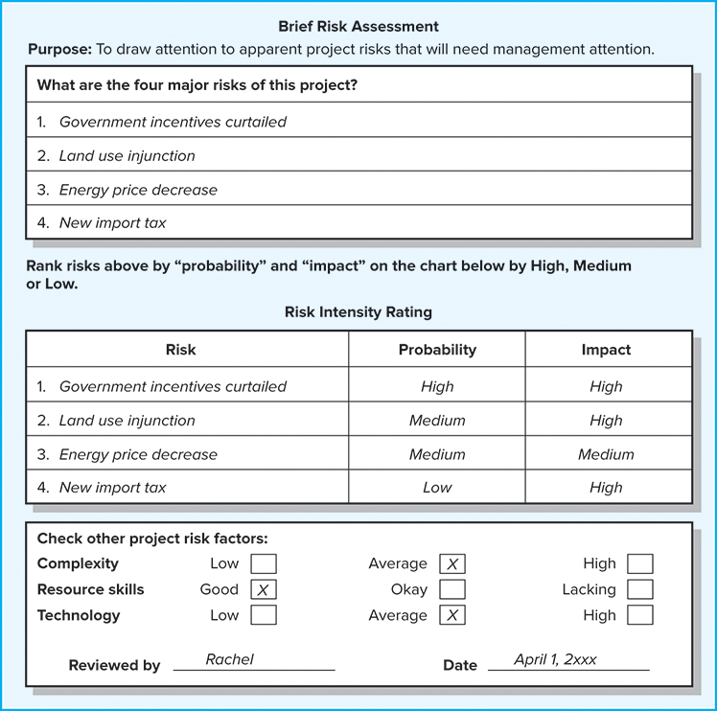
Risk Analysis for
500-Acre Wind Farm
FIGURE 2.4B

Slide 29
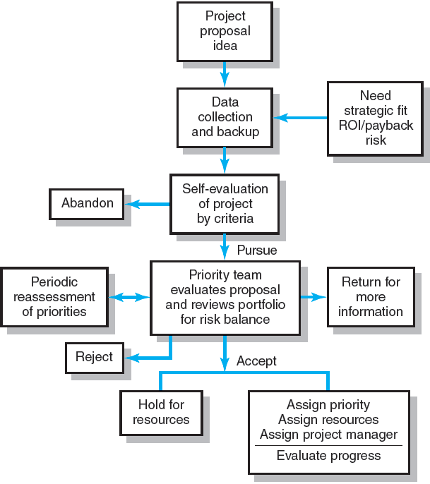
Project
Screening Process
FIGURE 2.5

Slide 30
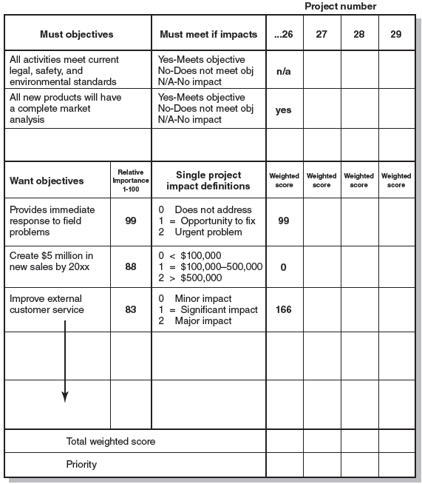
Priority Screening
Analysis
FIGURE 2.6

Slide 31
Managing the Portfolio System
Senior Management Input
  Provide guidance in selecting criteria that are aligned with the organization’s strategic goals.
  Decide how to balance available resources among current projects.
The Governance Team Responsibilities
  Publish the priority of every project.
  Ensure that the project selection process is open and free of power politics.
  Reassess the organization’s goals and priorities.
  Evaluate the progress of current projects.

Slide 32
Balancing the Portfolio for
Risks and Types of Projects
Bread-and-butter Projects
  Involve evolutionary improvements
  to current products and services.
Pearls
  Represent revolutionary commercial opportunities using proven technical advances.
Oysters
  Involve technological breakthroughs
  with high commercial payoffs.
White Elephants
  Showed promise at one time
  but are no longer viable.

Slide 33
How would you classify the following projects?
You manage a hotel resort located on the South Beach on the Island of Kauai in Hawaii. You are shifting the focus of your resort from a traditional fun-in-the-sun destination to eco-tourism. (Eco-tourism focuses on environmental awareness and education.)
a. Convert the pool heating system from electrical to solar power.
b. Build a 4-mile nature hiking trail.
c. Renovate the horse barn.
d. Replace golf shop that burned down after being struck by lightning.
e. Launch a new promotional campaign with Hawaii Airlines.
f. Convert 12 adjacent acres into a wildlife preserve.
g. Update all the bathrooms in condos that are 10 years or older.
h. Change hotel brochures to reflect eco-tourism image.
i. Test and revise disaster response plan.
j. Introduce wireless Internet service in café and lounge areas.
Thorgeir Palsson 2019

Slide 34
You manage a hotel resort located on the South Beach on the Island of Kauai in Hawaii. You are shifting the focus of your resort from a traditional fun-in-the-sun destination to eco-tourism. (Eco-tourism focuses on environmental awareness and education.)
a. Convert the pool heating system from electrical to solar power.
b. Build a 4-mile nature hiking trail.
c. Renovate the horse barn.
d. Replace golf shop that burned down after being struck by lightning.
e. Launch a new promotional campaign with Hawaii Airlines.
f. Convert 12 adjacent acres into a wildlife preserve.
g. Update all the bathrooms in condos that are 10 years or older.
h. Change hotel brochures to reflect eco-tourism image.
i. Test and revise disaster response plan.
j. Introduce wireless Internet service in café and lounge areas.
Compliance, Strategy, Operational
Thorgeir Palsson 2019

