Slide 1
Chapter Three
Organization: Structure and Culture

Slide 2
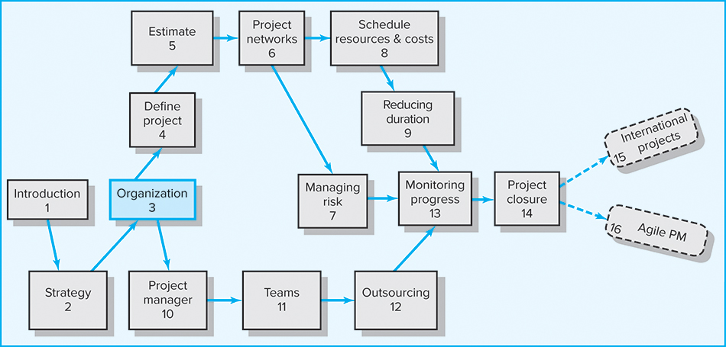
Where We Are Now

Slide 3
Learning Objectives
Identify different project management structures and understand their strengths and weaknesses
Distinguish three different types of matrix structures and understand their strengths and weaknesses
Understand organizational and project considerations that should be considered in choosing an appropriate project management structure
Appreciate the significant role that organizational culture plays in managing projects
Interpret the culture of an organization
Understand the interaction between project management structure and the culture of an organization

Slide 4
Chapter Outline
3.1 Project Management Structures
3.2 What Is the Right Project Management
Structure?
3.3 Organizational Culture
3.4 Implications of Organizational Culture for
Organizing Projects

Slide 5
Project Management Structures
Challenges to Organizing Projects
  The uniqueness and short duration of projects relative to ongoing longer-term organizational activities
  The multidisciplinary and cross-functional nature of projects creates authority and responsibility dilemmas.
Choosing an Appropriate Project Management Structure
  A good system balances
  the needs of the project
  with the needs of the
  organization.

Slide 6
Project Management Structures (cont’d)
Organizing Projects: Functional Organization
  Different segments of the project are delegated
  to respective functional units.
  Coordination is maintained through normal management channels.
  It is used when the interest of one functional area dominates the project or one functional area has
  a dominant interest in the project’s success.

Slide 7

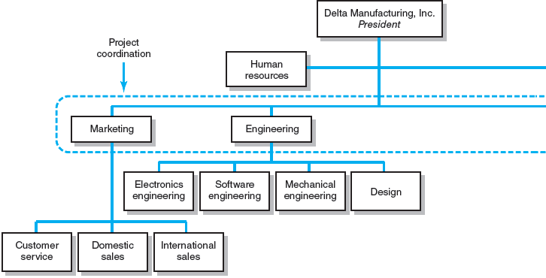
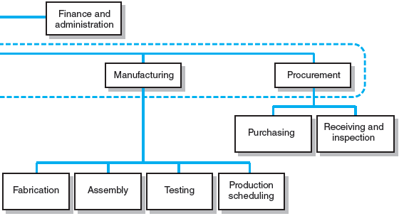
Functional Organizations
FIGURE 3.1

Slide 8
Functional Organization
Advantages
  No structural change
  Flexibility
  In-depth expertise
  Easy post-project transition
Disadvantages
  Lack of focus
  Poor integration
  Slow
  Lack of ownership

Slide 9
Project Management Structures (cont’d)
Organizing Projects: Dedicated Project Teams
  Teams operate as separate units under the leadership of a full-time project manager.
  In a projectized organization where projects are the dominant form of business, functional departments are responsible for providing support for its teams.

Slide 10
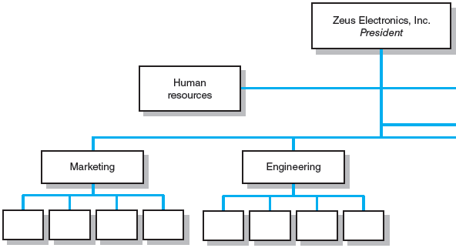
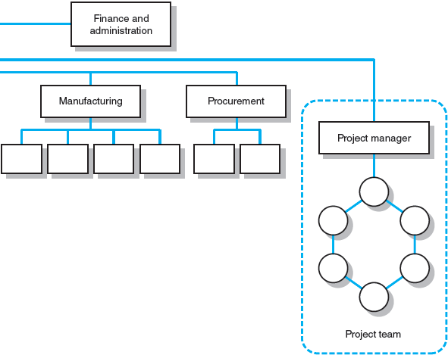
Dedicated Project Team
FIGURE 3.2

Slide 11
Project Organization: Dedicated Team
Advantages
  Simple
  Fast
  Cohesive
  Cross-functional integration
Disadvantages
  Expensive
  Internal strife
  Limited technological expertise
  Difficult post-project transition

Slide 12
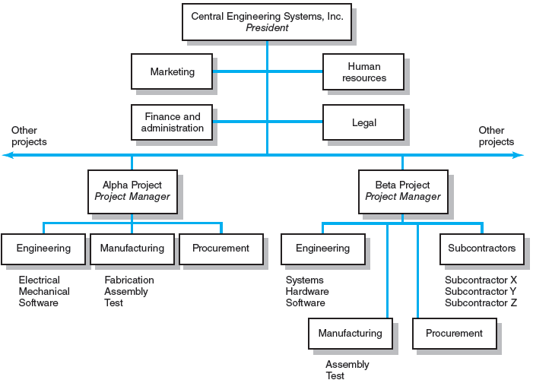
Projectized Organization Structure
FIGURE 3.3

Slide 13
Project Management Structures (cont’d)
Organizing Projects: Matrix Structure
  Hybrid organizational structure (matrix) is overlaid on the normal functional structure.
    Two chains of command (functional and project)
    Project participants report simultaneously to both functional and project managers.
  Matrix structure optimizes the use of resources.
    Allows for participation on multiple projects while performing normal functional duties
    Achieves a greater integration of expertise and project requirements

Slide 14
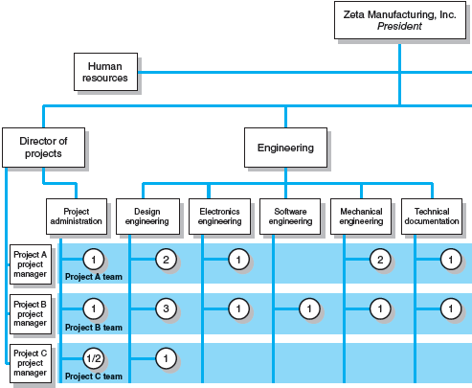
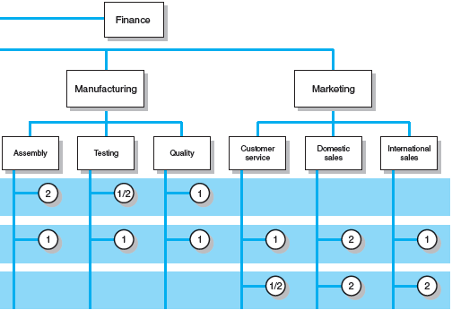
Matrix Organization Structure
FIGURE 3.4

Slide 15
Division of Project Manager and Functional Manager Responsibilities in a Matrix Structure
Project Manager Negotiated Issues Functional Manager
What has to be done? Who will do the task? How will it be done?
When should the task be done? Where will the task be done?
How much money is available Why will the task be done? How will the project involvement
to do the task? impact normal functional activities?
How well has the total project Is the task satisfactorily How well has the functional
been done? completed? input been integrated?
TABLE 3.1

Slide 16
Different Matrix Forms
Weak Form
  The authority of the functional manager predominates and the project manager has indirect authority.
Balanced Form
  The project manager sets the overall plan and the functional manager determines how work to be done.
Strong Form
  The project manager has broader control and functional departments act as subcontractors
  to the project.

Slide 17
Project Organization: Matrix Structure
Advantages
  Efficient
  Strong project focus
  Easier post-project transition
  Flexible
Disadvantages
  Dysfunctional conflict
  Infighting
  Stressful
  Slow

Slide 18
What Is the Right Project
Management Structure?
Organization Considerations
  How important is the project to the firm’s success?
  What percentage of core work involves projects?
  What level of resources (human and physical)
  are available?

Slide 19
What Is the Right Project
Management Structure? (cont’d)
Project Considerations
  Size of project
  Strategic importance
  Novelty and need for innovation
  Need for integration (number of departments involved)
  Environmental complexity (number of external interfaces)
  Budget and time constraints
  Stability of resource requirements

Slide 20
Organizational Culture
Organizational Culture Defined
  A system of shared norms, beliefs, values, and assumptions which binds people together, thereby creating shared meanings.
  The “personality” of the organization that sets it
  apart from other organizations.
    Provides a sense of identity to its members
    Helps legitimize the management system of the organization
    Clarifies and reinforces standards of behavior
    Helps create social order

Slide 21
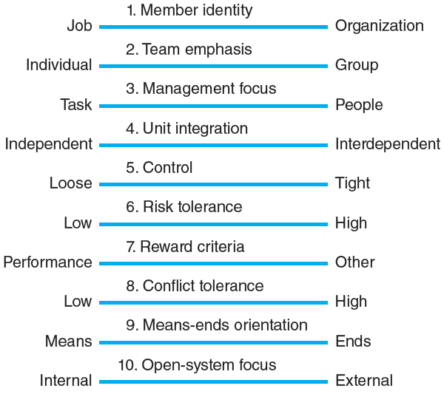
Key Dimensions Defining an Organization’s Culture
FIGURE 3.5

Slide 22
Identifying Cultural Characteristics
Study the physical characteristics
of an organization
Read about the organization
Observe how people interact
within the organization
Interpret stories and folklore
surrounding the organization

Slide 23
Organizational Culture Diagnosis Worksheet
Power Corp.
I. Physical Characteristics:
Architecture, office layout, décor, attire
Corporate HQ is 20 Story modern building—president on top floor. Offices are bigger in the top floors than lower floors. Formal business attire (white shirts, ties, power suits, . . . ) Power appears to increase the higher up you are.
II. Public Documents:
Annual reports, internal newsletters, vision statements
At the heart of the Power Corp. Way is our vision . . . to be the global energy company most admired for its people, partnership and performance. Integrity. We are honest with others and ourselves. We meet the highest ethical standards in all business dealings. We do what we say we will do.
III. Behavior:
Pace, language, meetings, issues discussed, decision-making style, communication patterns, rituals
Hierarchical decision-making, pace brisk but orderly, meetings start on time and end on time, subordinates choose their words very carefully when talking to superiors, people rarely work past 6:00 P.M., president takes top performing unit on a boat cruise each year . . .
IV. Folklore:
Stories, anecdotes, heroines, heroes, villains
Young project manager was fired after going over his boss’s head to ask for additional funds.
Stephanie C. considered a hero for taking complete responsibility for a technical error.
Jack S. was labeled a traitor for joining chief competitor after working for Power Corp. for 15 years.
FIGURE 3.6

Slide 24
Implications of Organizational Culture for Organizing Projects
Challenges for Project Managers
in Navigating Organizational Cultures
  Interacting with the culture and subcultures
  of the parent organization
  Interacting with the project’s clients
  or customer organizations
  Interacting with other organizations
  connected to the project

Slide 25
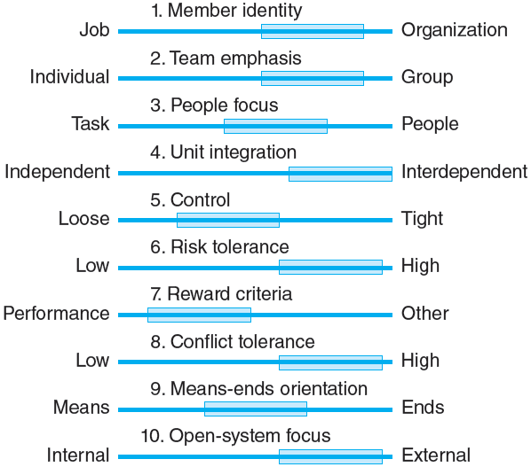
Cultural Dimensions of an Organization Supportive of Project Management
FIGURE 3.7

Slide 26
Key Terms
Balanced matrix
Dedicated project team
Matrix
Organizational culture
Projectized organization
Project Office (PO)
Strong matrix
Weak matrix

