Slide 1
Chapter four- defining the project
Stefan gudnason

Slide 2
Learning Objectives
Identify key elements of a project scope statement and understand why a complete scope statement is crucial to project success
Understand why it is important to establish project priorities in terms of cost, time, and performance
Demonstrate the importance of a work breakdown structure (WBS) to the management of projects and how it serves as a data base for planning and control
Demonstrate how the organization breakdown structure (OBS) establishes accountability to organizational units
Describe a process breakdown structure (PBS) and when to use it
Create responsibility matrices for small projects
Create a communication plan for a project

Slide 3
Defining the Project
Step 1: Defining the Project Scope
Step 2: Establishing Project Priorities
Step 3: Creating the Work Breakdown Structure
Step 4: Integrating the WBS with the Organization
Step 5: Coding the WBS for the Information System

Slide 4
Step 1: Defining the Project Scope
Project Scope
  A definition of the end result or mission of the project—a product or service for the client/customer
Purposes of the Project Scope Statement
  To clearly define the deliverable(s) for the end user.
  To focus the project on successful completion
  of its goals.
  To be used by the project owner and participants
  as a planning tool and for measuring project success

Slide 5
Project Scope Checklist
Project objective
Deliverables
Milestones
Technical requirements
Limits and exclusions
Reviews with customer

Slide 6
Project Scope: Terms and Definitions
Scope Statements
  Also called statements of work (SOW)
Project Charter
  Can contain an expanded version of scope statement.
  A document authorizing the project manager to initiate and lead the project
Scope Creep
  The tendency for the project scope to expand over time due to changing requirements, specifications, and priorities

Slide 7
Step 2: Establishing Project Priorities
Causes of Project Trade-offs
  Shifts in the relative importance of criterions related
  to cost, time, and performance parameters
    Budget–Cost
    Schedule–Time
    Performance–Scope
Managing the Priorities of Project Trade-offs
  Constrain: original parameter is a fixed requirement.
  Enhance: optimizing a criterion over others
  Accept: reducing (or not meeting) a criterion requirement

Slide 8
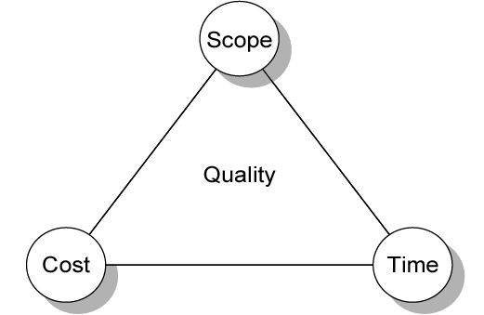
Project Management Trade-offs
FIGURE 4.1

Slide 9

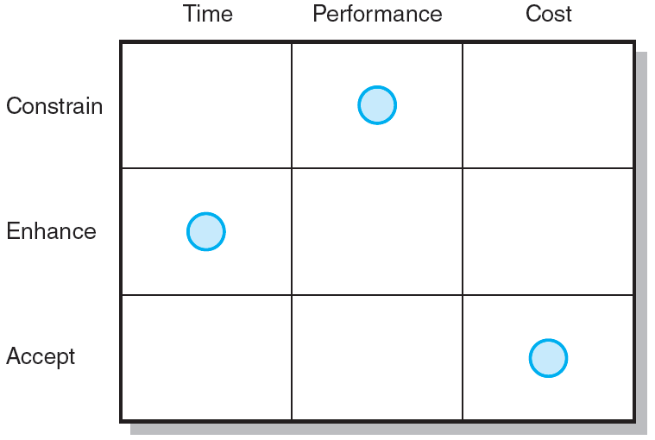
Project Priority Matrix
FIGURE 4.2

Slide 10
Step 3: Creating the Work Breakdown Structure
Work Breakdown Structure (WBS)
  A hierarchical outline (map) that identifies the products and work elements involved in a project
  Defines the relationship of the final deliverable
  (the project) to its subdeliverables, and in turn,
  their relationships to work packages.
  Best suited for design and build projects that have tangible outcomes rather than process-oriented projects

Slide 11
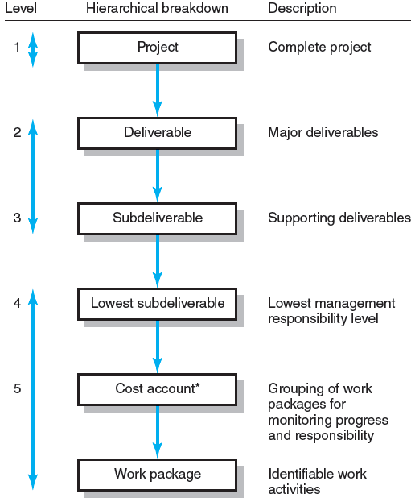
Hierarchical Breakdown of the WBS
* This breakdown groups work packages by type of work within a deliverable and allows assignment of responsibility to an organizational unit. This extra step facilitates a system for monitoring project progress (discussed in Chapter 13).
FIGURE 4.3

Slide 12
How WBS Helps the Project Manager
WBS
  Facilitates evaluation of cost, time, and technical performance of the organization on a project.
  Provides management with information appropriate
  to each organizational level.
  Helps in the development of the organization breakdown structure (OBS), which assigns project responsibilities to organizational units and individuals
  Helps manage plan, schedule, and budget.
  Defines communication channels and assists
  in coordinating the various project elements.

Slide 13
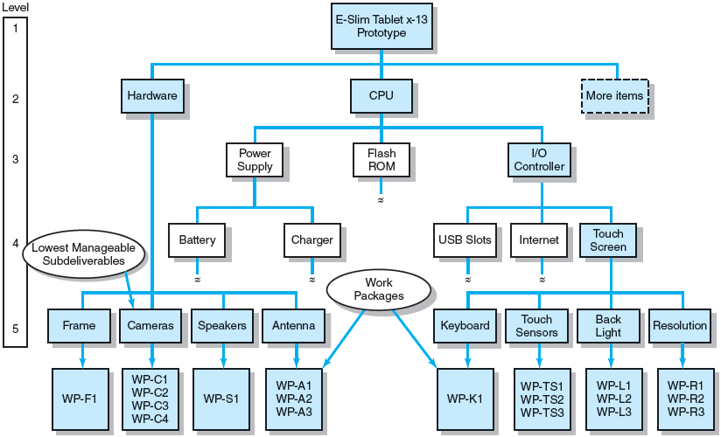
Work Breakdown Structure
FIGURE 4.4

Slide 14
Work Packages
A work package is the lowest level of the WBS.
  It is output-oriented in that it:
    Defines work (what).
    Identifies time to complete a work package (how long).
    Identifies a time-phased budget to complete
    a work package (cost).
    Identifies resources needed to complete
    a work package (how much).
    Identifies a person responsible for units of work (who).
    Identifies monitoring points for measuring success (how well).

Slide 15
Step 4: Integrating the WBS with the Organization
Organizational Breakdown Structure (OBS)
  Depicts how the firm is organized to discharge its work responsibility for a project.
    Provides a framework to summarize
    organization unit work performance.
    Identifies organization units responsible
    for work packages.
    Ties organizational units to cost control accounts.

Slide 16
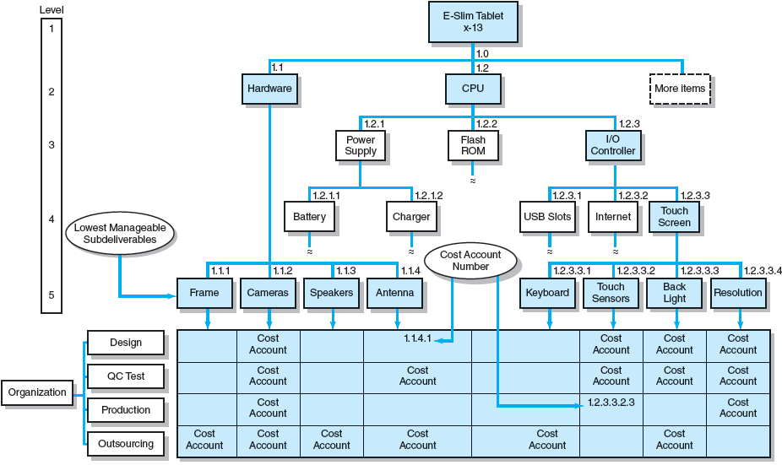
Integration of
WBS and OBS
FIGURE 4.5

Slide 17
Step 5: Coding the WBS for the Information System
WBS Coding System
  Defines:
    Levels and elements of the WBS
    Organization elements
    Work packages
    Budget and cost information
  Allows reports to be consolidated at any level in the organization structure
WBS Dictionary
  Provides detailed information about each element in the WBS.

Slide 18
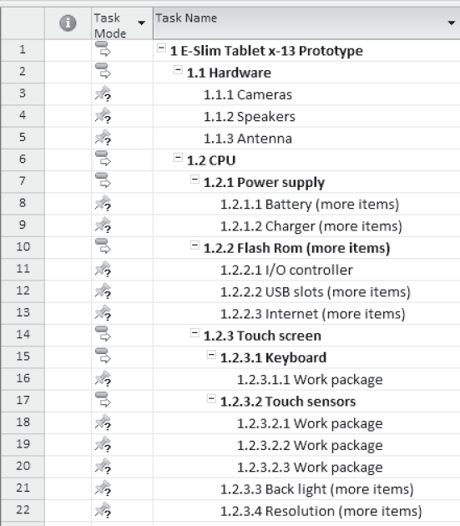
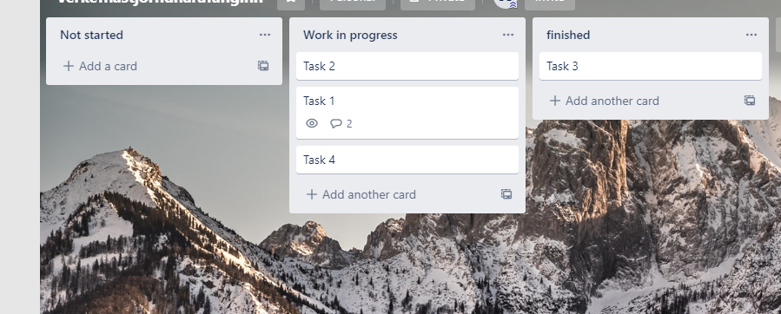
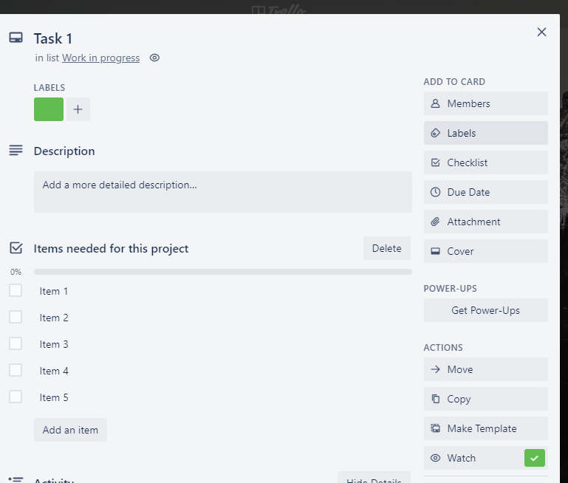
Coding
the WBS
EXHIBIT 4.1

Slide 19
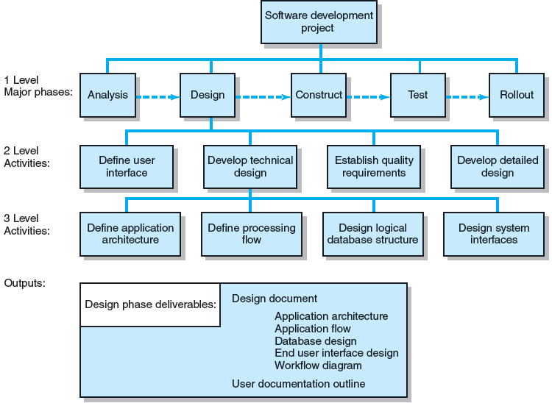
Process Breakdown Structure (PBS) for
Software Development Project
FIGURE 4.6

Slide 20
Responsibility Matrices
Responsibility Matrix (RM)
  Also called a linear responsibility chart
  Summarizes the tasks to be accomplished and who is responsible for what on the project.
    Lists project activities and participants responsible for each activity.
    Clarifies critical interfaces between units
    and individuals that need coordination.
    Provide a means for all participants to view their responsibilities and agree on their assignments.
    Clarifies the extent or type of authority that
    can be exercised by each participant.

Slide 21
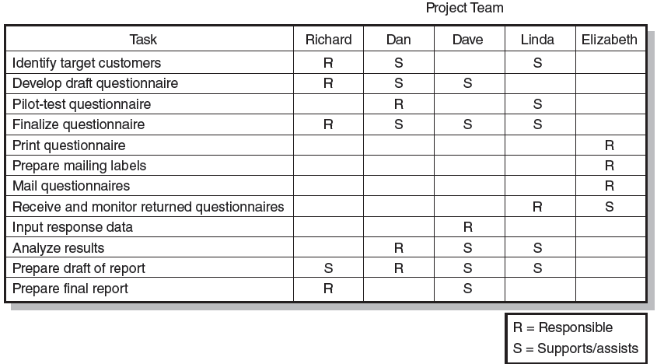
Responsibility Matrix for a Market Research Project
FIGURE 4.7

Slide 22
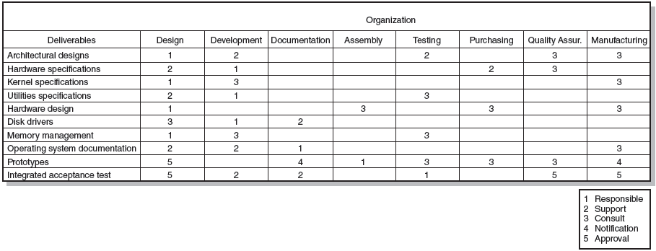
Responsibility Matrix for the Conveyor Belt Project
FIGURE 4.8

Slide 23
Project Communication Plan
What information needs to be collected
and when?
Who will receive the information?
What methods will be used to gather
and store information?
What are the limits, if any, on who has access to certain kinds of information?
When will the information be communicated?
How will it be communicated?

Slide 24
Developing a Communication Plan
Stakeholder analysis
Information needs
Sources of information
Dissemination modes
Responsibility and timing

Slide 25
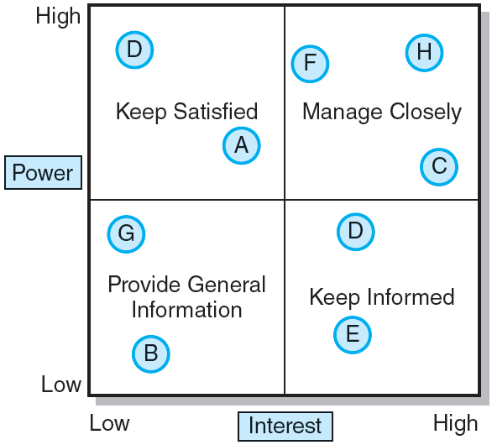
Stakeholder Communications
FIGURE 4.9

Slide 26
Information Needs
Project status reports
Deliverable issues
Changes in scope
Team status meetings
Gating decisions
Accepted request changes
Action items
Milestone reports

Slide 27
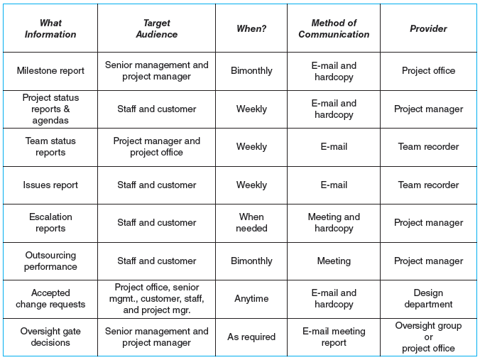
Shale Oil Research Project Communication Plan
FIGURE 4.10

Slide 28
Key Terms
Cost account
Milestone
Organization breakdown structure (OBS)
Priority matrix
Process breakdown structure (PBS)
Project charter
Responsibility matrix
Scope creep
Scope statement
WBS dictionary
Work breakdown structure (WBS)
Work package

