Slide 1
Project Management - Chapter 5, Estimating Project time and costs
Stefan guðnason

Slide 2
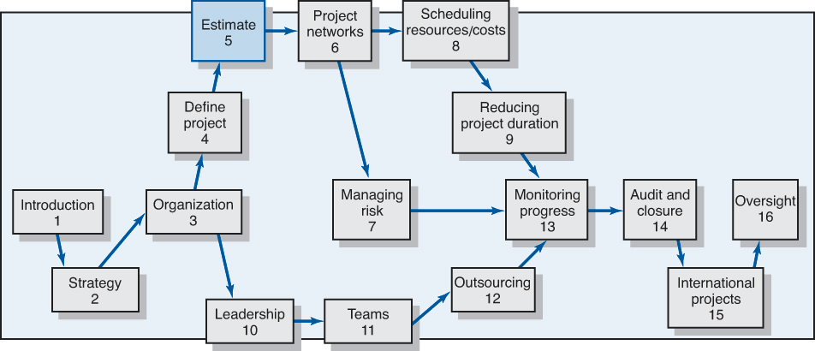
Where are we now?

Slide 3
Learning Objectives
Understand estimating project times and costs are the foundation for project planning and control
Describe guidelines for estimating time, cost, and resources
Describe the methods, uses, and advantages and disadvantages of top-down and bottom-up estimating methods
Distinguish different kinds of costs associated with a project
Suggest a scheme for developing an estimating database for future projects
Understand the challenge of estimating mega projects and describe steps that lead to better informed decisions
Define a “white elephant” in project management and provide examples

Slide 4
Estimating Projects
Estimating
  The process of forecasting or approximating the time and cost of completing project deliverables
  The task of balancing expectations of stakeholders and need for control while the project is implemented
Types of Estimates
  Top-down (macro) estimates: analogy, group consensus, or mathematical relationships
  Bottom-up (micro) estimates: estimates of elements
  of the work breakdown structure

Slide 5
Why Estimating Time and Cost Is Important
To support good decisions
To schedule work
To determine how long the project should take and its cost
To determine whether the project is worth doing
To develop cash flow needs
To determine how well the project is progressing

Slide 6
Factors Influencing the Quality of Estimates
Planning Horizon
Other (Nonproject)
Factors
Project
Complexity
Quality of Estimates
Organization
Culture
People
Padding
Estimates
Project Structure and Organization

Slide 7
Estimating Guidelines for Times,
Costs, and Resources
Have people familiar with the tasks make the estimate
Use several people to make estimates
Base estimates on normal conditions, efficient methods, and a normal level of resources
Use consistent time units in estimating task times
Treat each task as independent, don’t aggregate
Do not make allowances for contingencies.
Add a risk assessment to avoid surprises to stakeholders

Slide 8
Developing Work Package Estimates
Use people familiar with
the tasks
Include a risk assessment
Use several people to make estimates
Preparing Initial Estimates
Make no allowance for contingencies
Assume normal conditions
Assume tasks are independent
Use consistent time units

Slide 9
Top-Down versus Bottom-Up Estimating
Top-Down Estimates
  Are usually derived from someone who uses experience and/or information to determine the project duration and total cost.
  Are sometimes made by top managers who have little knowledge of the processes used to complete the project.
Bottom-Up Approach
  Can serve as a check on cost elements in the WBS
  by rolling up the work packages and associated cost accounts to major deliverables at the work package level.

Slide 10
Top-Down versus Bottom-Up Estimating
Conditions for Preferring Top-Down or
Bottom-up Time and Cost Estimates
Top-down Bottom-up
Condition Estimates Estimates
- Strategic decision making X
- Cost and time important X
- High uncertainty X
- Internal, small project X
- Fixed-price contract X
- Customer wants details X
- Unstable scope X
TABLE 5.1

Slide 11
Estimating Projects: Preferred Approach
Make rough top-down estimates
Develop the WBS/OBS
Make bottom-up estimates
Develop schedules and budgets
Reconcile differences between top-down
and bottom-up estimates

Slide 12
Top-Down Approaches for Estimating Project Times and Costs
Consensus methods
Ratio methods (sometimes called parametric)
Apportion method
Function point methods for software and system projects
Learning curves
Project Estimate
Times
Costs

Slide 13

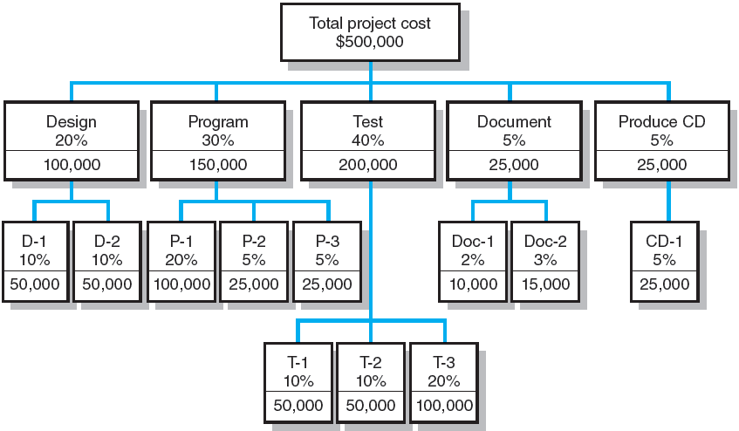
Apportion Method of Allocating Project Costs Using the Work Breakdown Structure
FIGURE 5.1

Slide 14
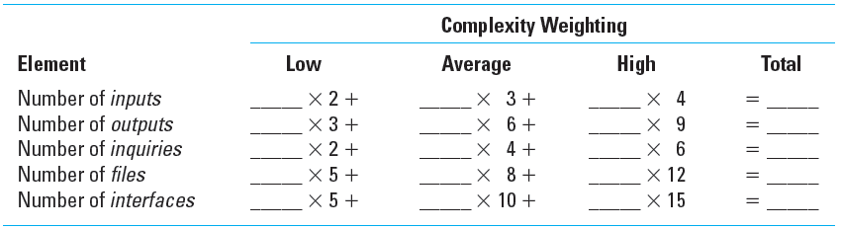
Simplified Basic Function Point Count Process for a Prospective Project or Deliverable
TABLE 5.2

Slide 15
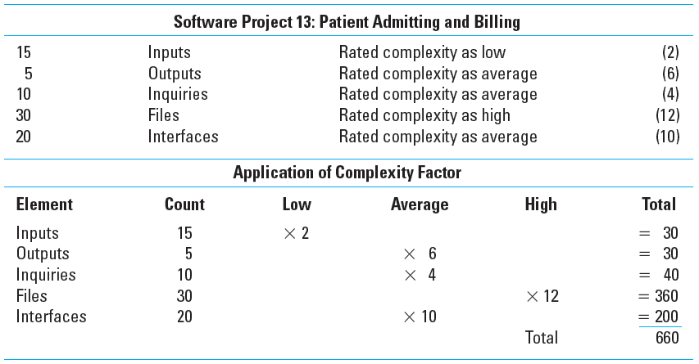
Example: Function Point Count Method
TABLE 5.3

Slide 16
Bottom-Up Approaches for Estimating Project Times and Costs
Template methods
Parametric procedures applied to specific tasks
Range estimates for
the WBS work packages
Phase estimating: A hybrid

Slide 17
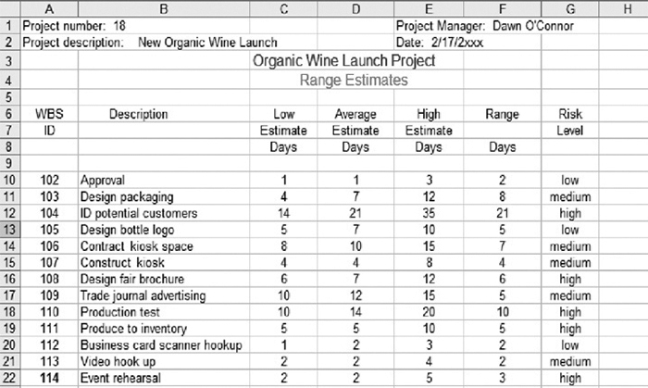
Range Estimating Template
FIGURE 5.2

Slide 18
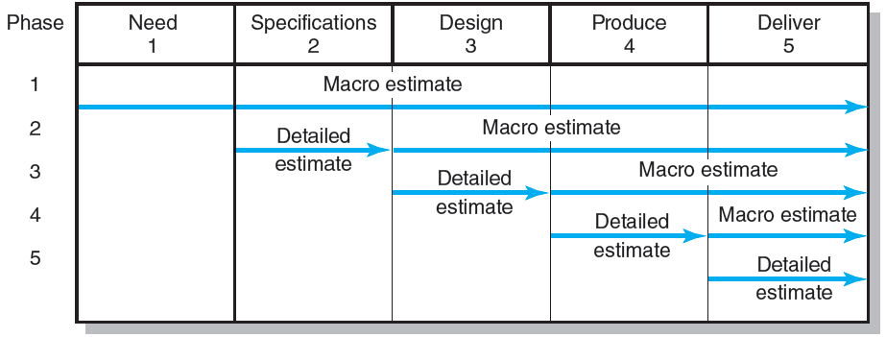
Phase Estimating over Product Life Cycle
FIGURE 5.3

Slide 19
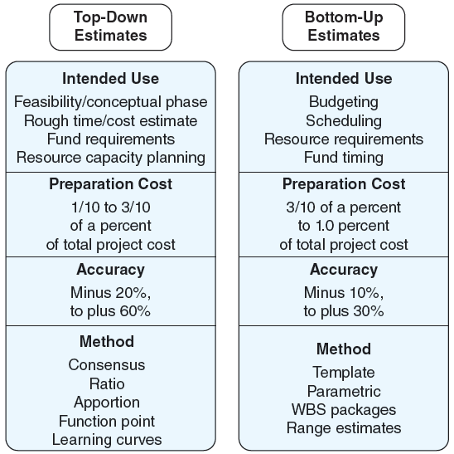
Top-Down and Bottom-Up Estimates
FIGURE 5.4

Slide 20
Level of Detail
Level of detail in the WBS varies with the complexity of the project, the need for control, the project size, cost, duration, and other factors.
Excessive detail is costly.
  Fosters a focus on departmental outcomes rather than on deliverable outcomes
  Creates unproductive paperwork
Insufficient detail is costly.
  Lack of focus on goals
  Wasted effort on nonessential activities

Slide 21
Types of Costs
Direct Costs
  Costs that are clearly chargeable to a specific work package.
    Labor, materials, equipment, and other
Direct (Project) Overhead Costs
  Costs incurred that are directly tied to project deliverables or work packages.
    Salary, rents, supplies, specialized machinery
General and Administrative Overhead Costs
  Organization costs indirectly linked to a specific package that are apportioned to the project.

Slide 22
Contract Bid Summary Costs
Direct costs
$80,000
Direct overhead
$20,000
Total direct costs
$100,000
G&A overhead (20%)
$20,000
Total costs
$120,000
Profit (20%)
$24,000
Total bid
$144,000

Slide 23
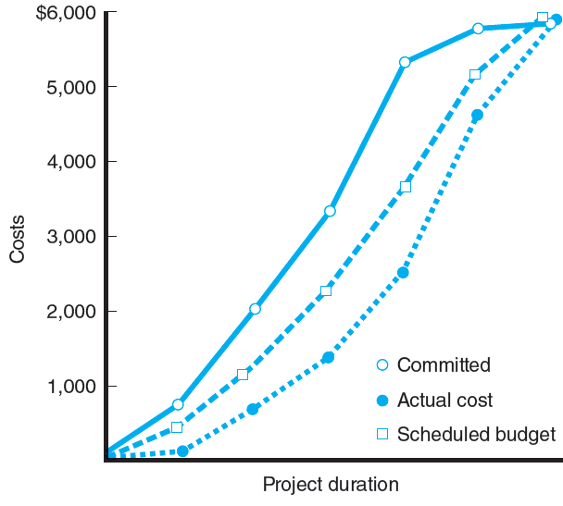
Three Views of Cost
FIGURE 5.6

Slide 24
Refining Estimates
Reasons for Adjusting Estimates
  Interaction costs are hidden in estimates.
  Normal conditions do not apply.
  Things go wrong on projects.
  Changes in project scope and plans
  Overly optimistic
  Strategic misrepresentation
Adjusting Estimates
  Time and cost estimates of specific activities are adjusted as the risks, resources, and situation particulars become more clearly defined.

Slide 25
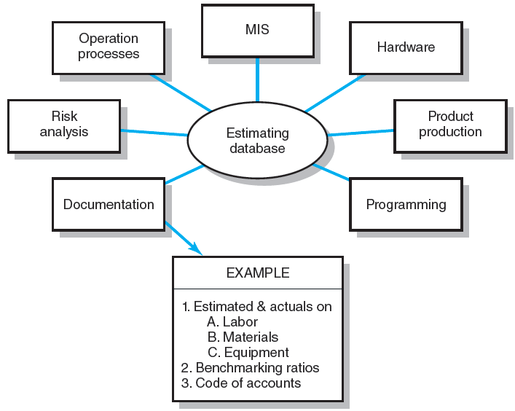
Estimating Database Templates
FIGURE 5.7

Slide 26
Mega Projects: A Special Case
Mega Projects
  Are large-scale, complex ventures that typically cost $1 billion or more, take many years to complete, and involve multiple private and public stakeholders.
    High-speed rail lines, airports, healthcare reform, the Olympics, development of new aircraft
  Often involve a double whammy.
    Cost much more than expected but underdelivered on benefits they were to provide.
  Are sometimes called “White Elephants”
    Over budget, under value, high cost of maintaining (exceeds the benefits received)

Slide 27
Three Steps of the Reference Class Forecasting (RCF) Process
Select a reference class of projects similar to your potential projects.
Collect and arrange outcome data as a distribution. Create a distribution of cost overruns as a percentage of the original project estimate.
Use the distribution data to arrive at a realistic forecast. Compare the original cost estimate for the project with the reference class projects.

Slide 28
Key Terms
Apportionment
Bottom-up estimates
Delphi method
Direct costs
Function points
Learning curves
Overhead costs
Padding estimates
Phase estimating
Range estimating
Ratio methods
Reference class forecasting (RCF)
Template method
Time and cost databases
Top-down estimates
White elephant

