Slide 1
Project Management - Chapter 6, Developing a Project Plan
Stefan guðnason

Slide 2
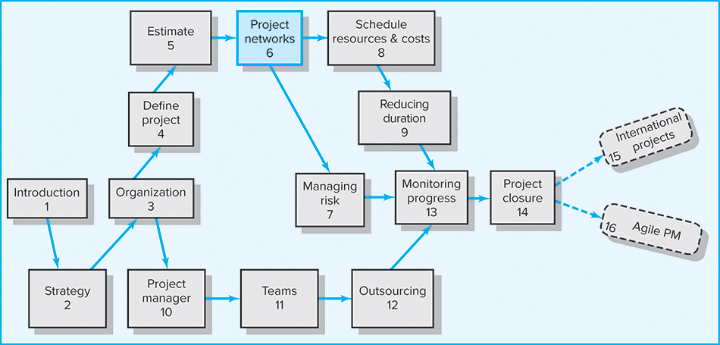
Where are we now?

Slide 3
Learning Objectives
Understand the linkage between WBS and the project network
Diagram a project network using AON methods
Calculate early, late, and slack activities times
Identify and understand the importance of managing the critical path
Distinguish free slack from total slack
Demonstrate understanding and application of lags in compressing projects or constraining the start or finish of an activity

Slide 4
Developing the Project Network
The Project Network
  A flow chart that graphically depicts the logical sequences, interdependencies, and start and finish times of the project activities along with the longest path(s) through the network—the critical path
    Provides the basis for scheduling labor and equipment.
    Enhances communication among project participants.
    Provides an estimate of the project’s duration.
    Provides a basis for budgeting cash flow.
    Identifies activities that are critical.
    Highlights activities that are “critical” and should not be delayed.
    Help managers get and stay on plan.

Slide 5
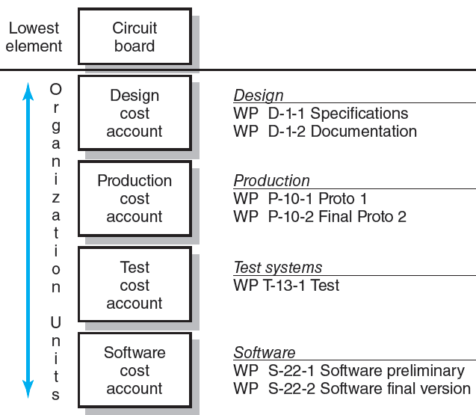
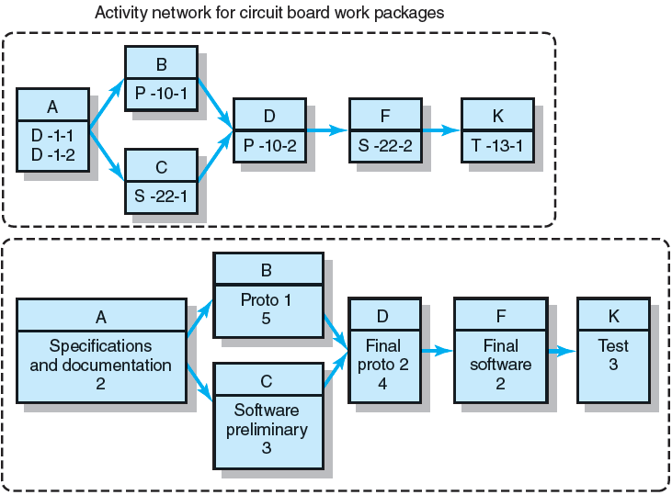
From WBS/Work Package to Network
FIGURE 6.1

Slide 6
Constructing a Project Network
Terminology
  Activity: an element of the project that requires time but may not require resources
  Merge Activity: an activity that has two or more preceding activities on which it depends (more than one dependency arrow flowing into it)
  Parallel Activities: Activities that can occur independently and, if desired, not at the same time
A
B
D
C

Slide 7
Constructing a Project Network (cont’d)
Terminology
  Path: a sequence of connected, dependent activities
  Critical Path:
    The longest path through the activity network that allows for the completion of all project-related activities
    The shortest expected time in which the entire project can be completed.
    Delays on the critical path will delay completion of the entire project.
C
A
B
D

Slide 8
Constructing a Project Network (cont’d)
Terminology
  Burst Activity: an activity that has more than one activity immediately following it (more than one dependency arrow flowing from it)
Two Approaches
  Activity-on-Node (AON)
    Uses a node to depict an activity.
  Activity-on-Arrow (AOA)
    Uses an arrow to depict an activity.
B
A
C
D

Slide 9
Basic Rules to Follow in Developing
Project Networks
Networks typically flow from left to right.
An activity cannot begin until all preceding connected activities are complete.
Arrows indicate precedence and flow and can cross over each other.
Each activity must have a unique identify number.
An activity identification number must be greater than that of any predecessor activities.
Looping is not allowed.
Conditional statements are not allowed.
Use common start and stop nodes.

Slide 10

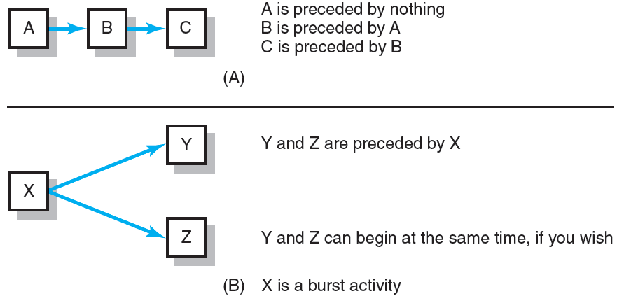
Activity-on-Node Fundamentals
FIGURE 6.2

Slide 11
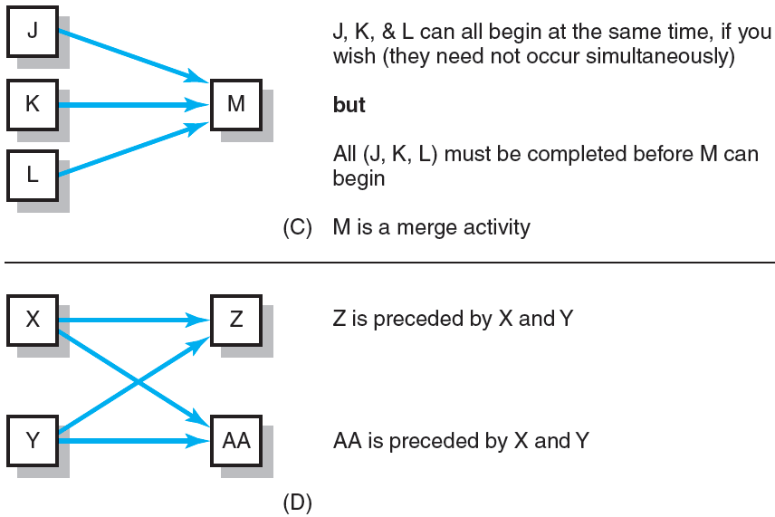
Activity-on-Node Fundamentals (cont’d)
FIGURE 6.2 (cont’d)

Slide 12
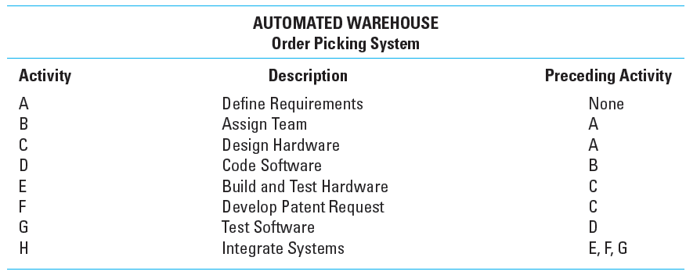
Network Information
TABLE 6.1

Slide 13
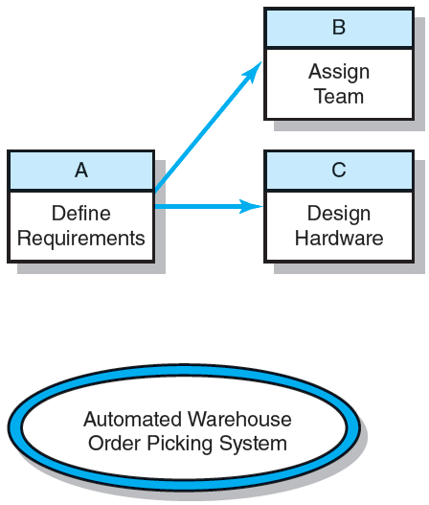
Automated Warehouse—Partial Network
FIGURE 6.3

Slide 14
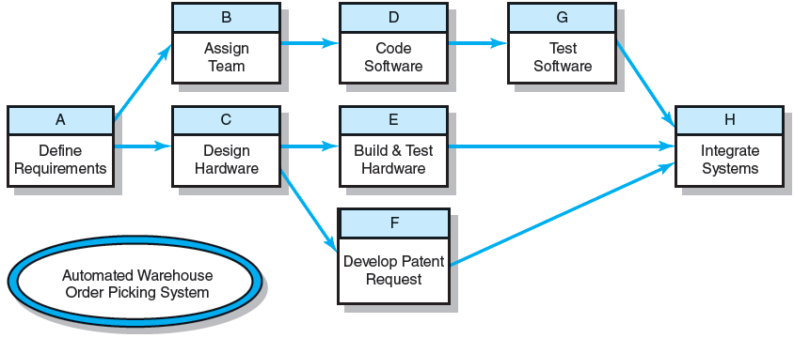
Automated Warehouse—Complete Network
FIGURE 6.4

Slide 15
Network Computation Process
Forward Pass—Earliest Times
  How soon can the activity start? (early start—ES)
  How soon can the activity finish? (early finish—EF)
  How soon can the project finish? (expected time—TE)
Backward Pass—Latest Times
  How late can the activity start? (late start—LS)
  How late can the activity finish? (late finish—LF)
  Which activities represent the critical path?
  How long can the activity be delayed? (slack or float—SL)

Slide 16
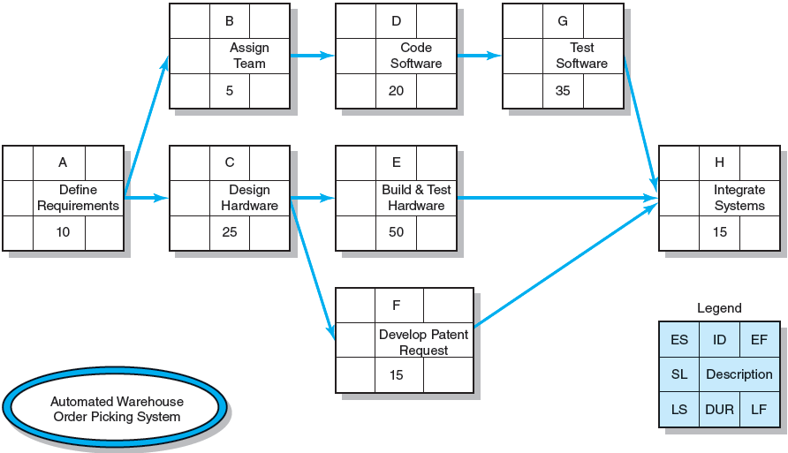
Activity-on-Node Network
FIGURE 6.5

Slide 17
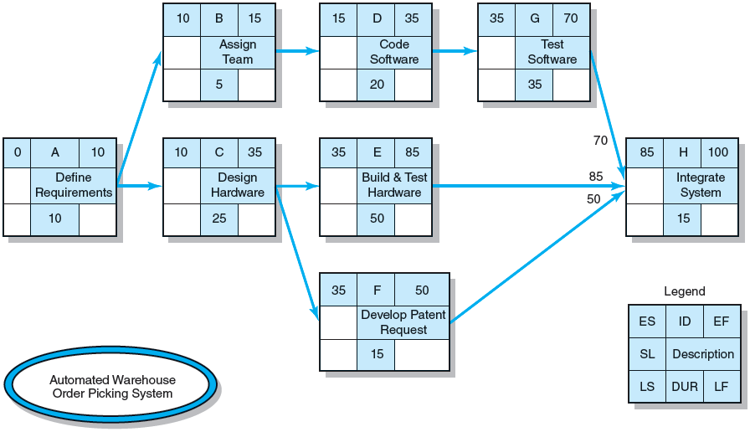
Activity-on-Node Network Forward Pass
FIGURE 6.6

Slide 18
Forward Pass Computation
Add activity times along each path in the network (ES + Duration = EF).
Carry the early finish (EF) to the next activity where it becomes its early start (ES) unless…
The next succeeding activity is a merge activity, in which case the largest early finish (EF) number of all its immediate predecessor activities is selected.

Slide 19
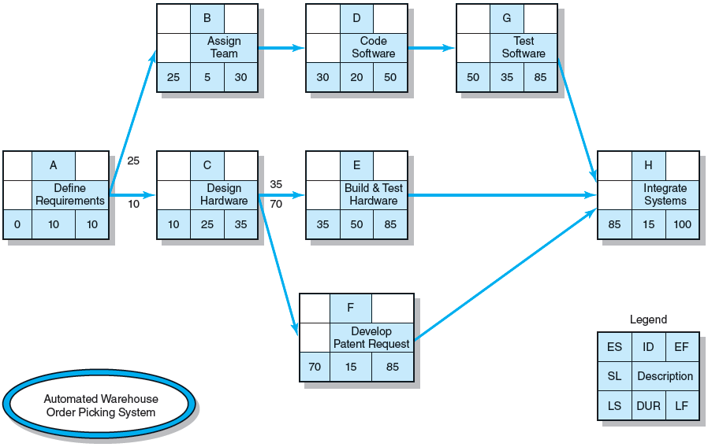
Activity-on-Node Network Backward Pass
FIGURE 6.7

Slide 20
Backward Pass Computation
Subtract activity times along each path starting with the project end activity (LF - Duration = LS).
Carry the late start (LS) to the next preceding activity where it becomes its late finish (LF) unless…
The next succeeding activity is a burst activity, in which case the smallest late start (LS) number of all its immediate successor activities is selected.

Slide 21
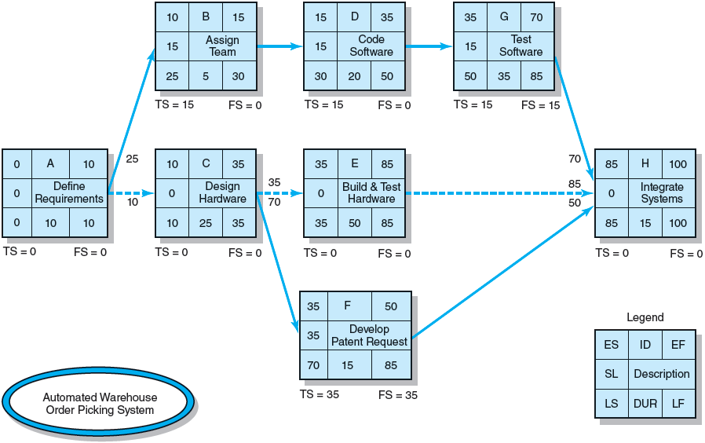
Forward and Backward Passes Completed with Slack Times
FIGURE 6.8

Slide 22
Determining Total Slack (TS)
Total Slack (or Float)
  Tells us the amount of time an activity can be delayed and not delayed the project.
  Is how long an activity can exceed its early finish date without affecting the project end date or an imposed completion date.
  Is simply the difference between the LS and ES (LS – ES = SL) or between LF and EF (LF – EF = SL).

Slide 23
Determining Free Slack (FS)
Free Slack (or Float)
  Is the amount of time an activity can be delayed after the start of a longer parallel activity or activities.
  Is how long an activity can exceed its early finish date without affecting early start dates of any successor(s).
  Allows flexibility in scheduling scarce resources.
  Only activities that occur at the end of a chain of activities, where you have a merge activity, can have free slack.

Slide 24
The Critical Path
  Is the network path(s) that has (have) the least slack in common.
  Is the longest path through the activity network.
  Is the shortest expected time in which the entire project can be completed.
  Is important because it impacts completion time.
  Is where you put best people on.
  Is where you pay extra extension when doing risk assessment.
  Is where you look when other managers asking to ‘borrow’ people or equipment.
  Is where you look when you don’t have time to monitor all activities.

Slide 25
Network Sensitivity
  The likelihood the original critical path(s) will change once the project is initiated.
  A network schedule that has only one critical path and noncritical activities that enjoy significant slack would be labeled ‘insensitive’.

Slide 26
Practical Considerations
Network Logic Errors
Activity Numbering
Use of Computers to Develop Networks (and Gantt Chart)
Calendar Dates
Multiple Starts and Multiple Projects

Slide 27
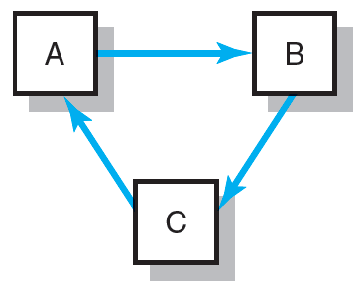
Network Logic Errors: Illogical Loop
FIGURE 6.9

Slide 28
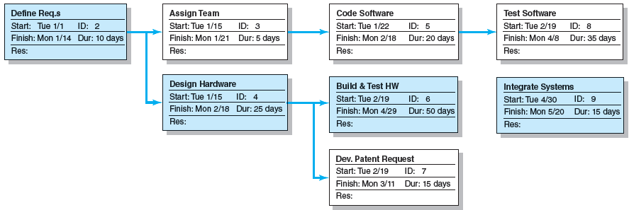
Automated Warehouse Order Picking System Network
FIGURE 6.10

Slide 29
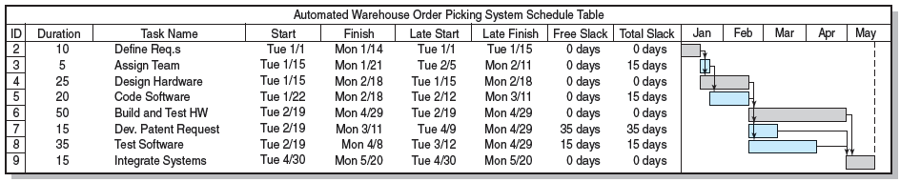
Automated Order Warehouse Picking System Bar Chart
FIGURE 6.11

Slide 30
Extended Network Techniques to Come Close to Reality
Laddering
  Activities are broken into segments so the following activity can begin sooner and not delay the work.
Lags
  The minimum amount of time a dependent activity must be delayed to begin or end.
    Lengthy activities are broken down to reduce the delay
    in the start of successor activities.
    Lags can be used to constrain finish-to-start, start-to-start, finish-to-finish, start-to-finish, or combination relationships.

Slide 31
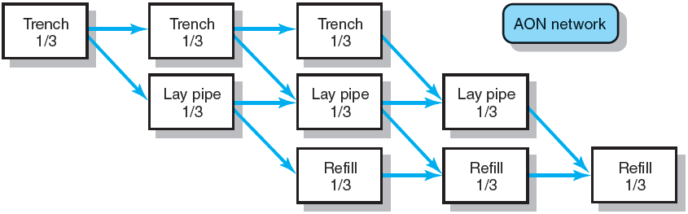
Example of Laddering Using
Finish-to-Start Relationship
FIGURE 6.12

Slide 32

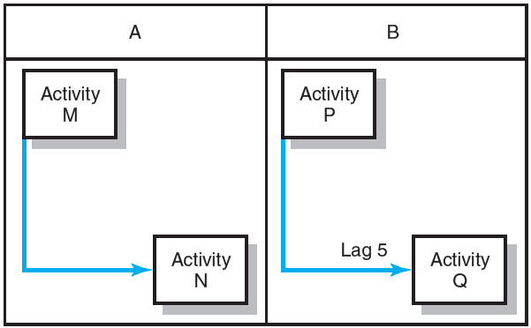
Use of Lags
Finish-to-Start Relationship
FIGURE 6.13
Start-to-Start Relationship
FIGURE 6.14

Slide 33
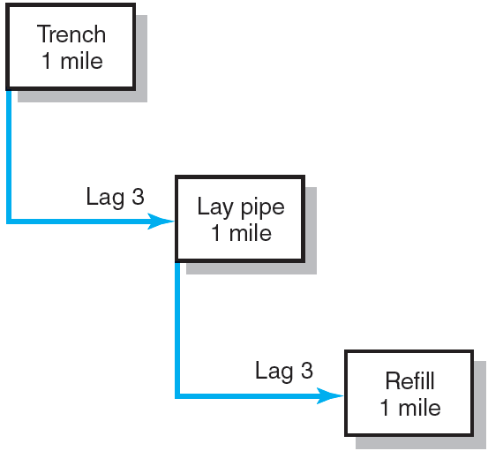
Use of Lags (cont’d)
Use of Lags to Reduce Schedule Detail and Project Duration
FIGURE 6.15

Slide 34
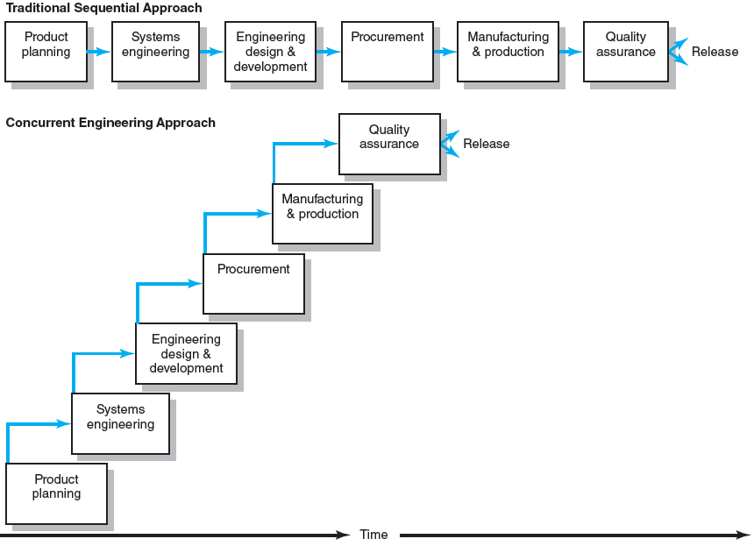
New Product Development Process
FIGURE 6.16

Slide 35
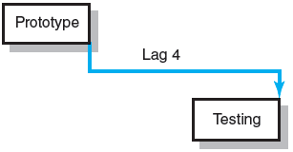
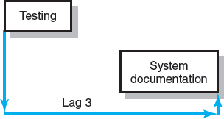
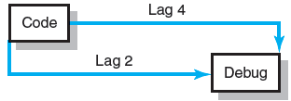
Use of Lags (cont’d)
Finish-to-Finish
Relationship
FIGURE 6.17
Start-to-Finish
Relationship
FIGURE 6.18
Combination
Relationships
FIGURE 6.19

Slide 36
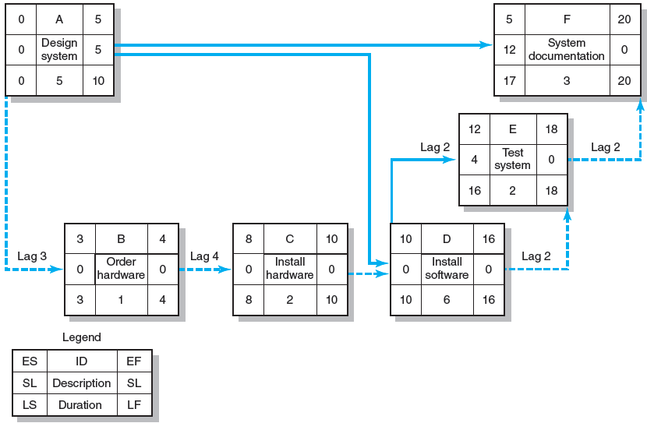
Network Using Lags
FIGURE 6.20

Slide 37
Hammock Activities
Hammock Activity
  Spans over a segment of a project.
  Has a duration that is determined after the network plan is drawn.
  Is very useful in assigning and controlling indirect project costs.
  Is used to aggregate sections of the project to facilitate getting the right level of detail for specific sections of a project.

Slide 38
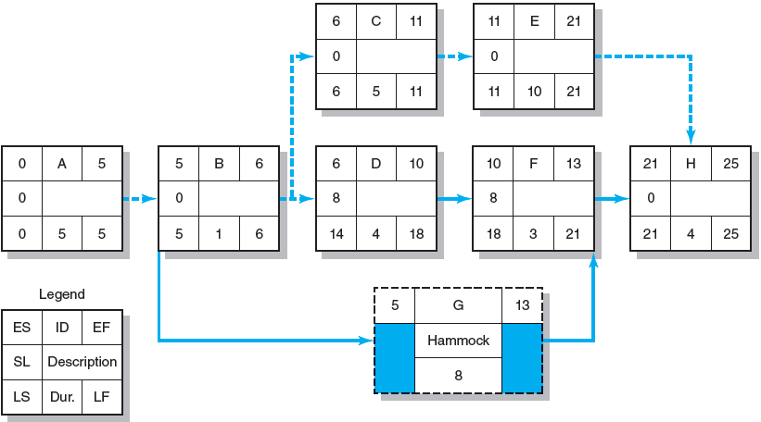
Hammock Activity Example
FIGURE 6.21

Slide 39
Key Terms
Activity
Activity-on-arrow (AOA)
Activity-on-node (AON)
Burst activity
Concurrent engineering
Critical path
Early time
Free slack
Gantt chart
Hammock activity
Lag relationship
Late time
Merge activity
Parallel activity
Sensitivity
Total slack

