Slide 1
Chapter seven – Managing risk.
Stefán Guðnason

Slide 2
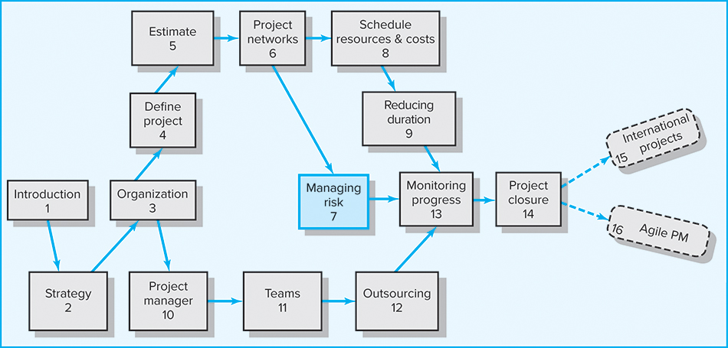
Where We Are Now

Slide 3
Learning Objectives
Describe the risk management process
Understand how to identify project risks
Assess the significance of different project risks
Describe the four different responses to managing risks
Understand the role contingency plans play in risk management process
Understand opportunity management and describe the four different approaches to responding to opportunities in a project
Understand how contingency funds and time buffers are used to manage risks on a project
Recognize the need for risk management being an ongoing activity
Describe the change control process

Slide 4
Chapter Outline
7.1 Risk Management Process
7.2 Step 1: Risk Identification
7.3 Step 2: Risk Assessment
7.4 Step 3: Risk Response Development
7.5 Contingency Planning
7.6 Opportunity Management
7.7 Contingency Funding and Time Buffers
7.8 Step 4: Risk Response Control
7.9 Change Control Management

Slide 5
Risk Management Process
Risk
  Uncertain or chance events that planning cannot overcome or control
Risk Management
  An attempt to recognize and manage potential and unforeseen trouble spots that may occur when the project is implemented
    What can go wrong (risk event)
    How to minimize the risk event’s impact (consequences)
    What can be done before an event occurs (anticipation)
    What to do when an event occurs (contingency plans)

Slide 6

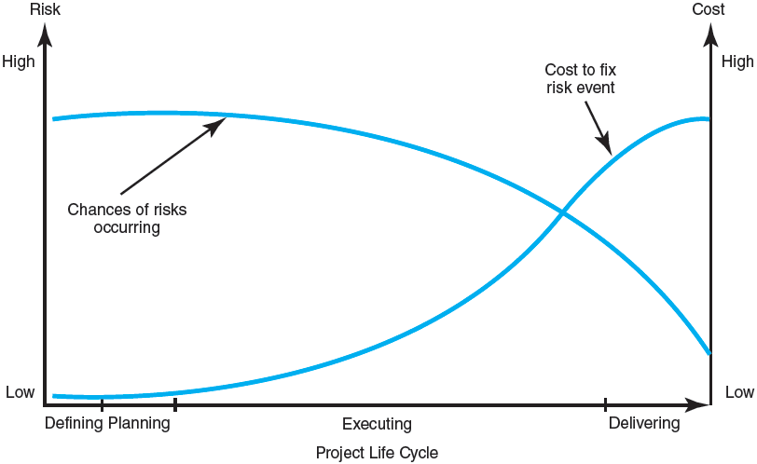
The Risk Event Graph
FIGURE 7.1

Slide 7
Risk Management’s Benefits
A proactive rather than reactive approach
Reduces surprises and negative consequences
Prepares the project manager to take advantage
of appropriate risks
Provides better control over the future
Improves chances of reaching project performance objectives within budget and on time

Slide 8
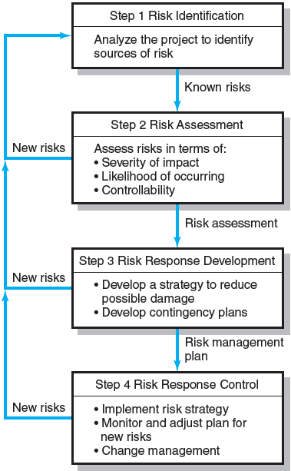
The Risk Management Process
FIGURE 7.2

Slide 9
Managing Risk
Step 1: Risk Identification
  Generate a list of possible risks through brainstorming, problem identification and risk profiling
  Use risk breakdown structure (RBS) in conjunction with work breakdown structure (WBS) to identify and analyze risks
    Macro risks first, then specific events
  Risk profile is a list of questions addressing additional areas of uncertainty on a project.

Slide 10
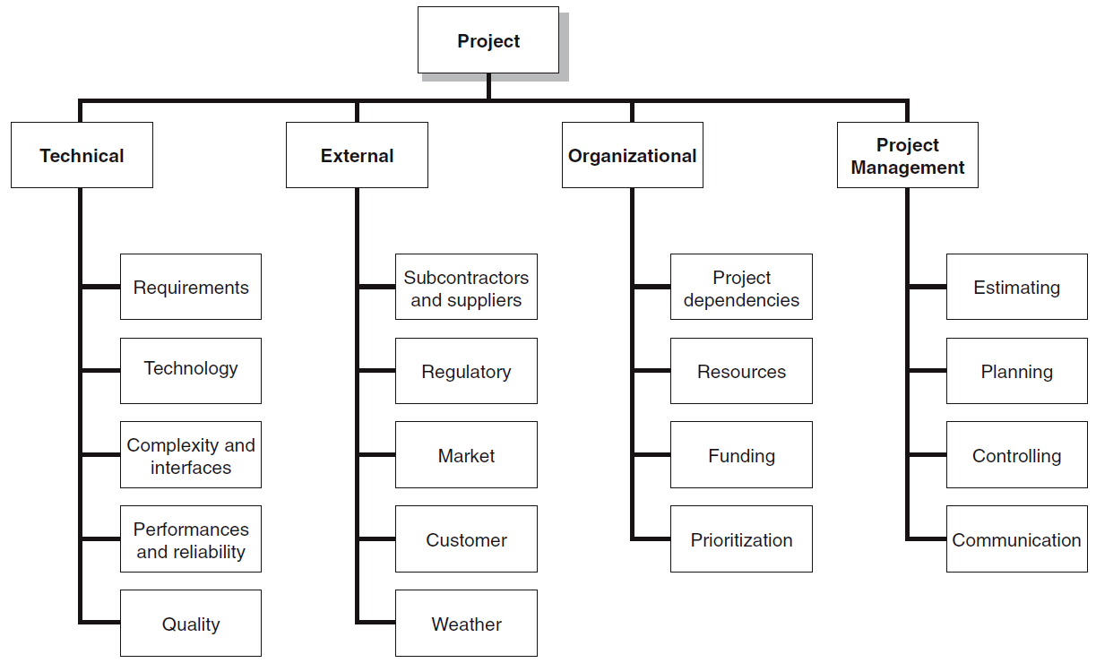
The Risk Breakdown Structure (RBS)
FIGURE 7.3

Slide 11
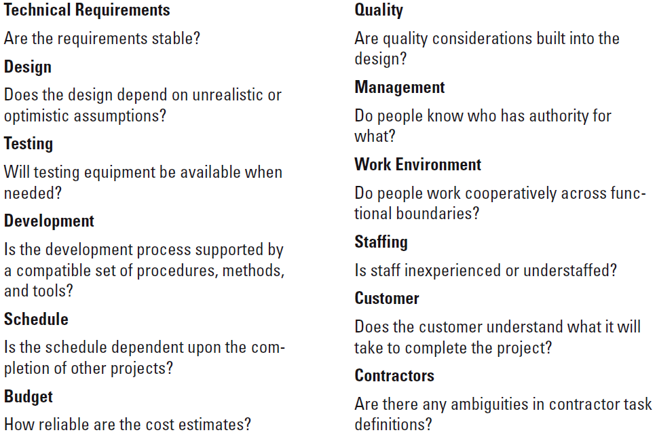
Partial Risk Profile for Product Development Project
FIGURE 7.4

Slide 12
Managing Risk
Step 2: Risk Assessment
  Scenario analysis for event probability and impact
  Risk assessment form
  Risk severity matrix
    Failure Mode and Effects Analysis (FMEA)
      Risk Value = Impact x Probability x Detection
  Probability analysis
    Decision trees, NPV, and PERT

Slide 13
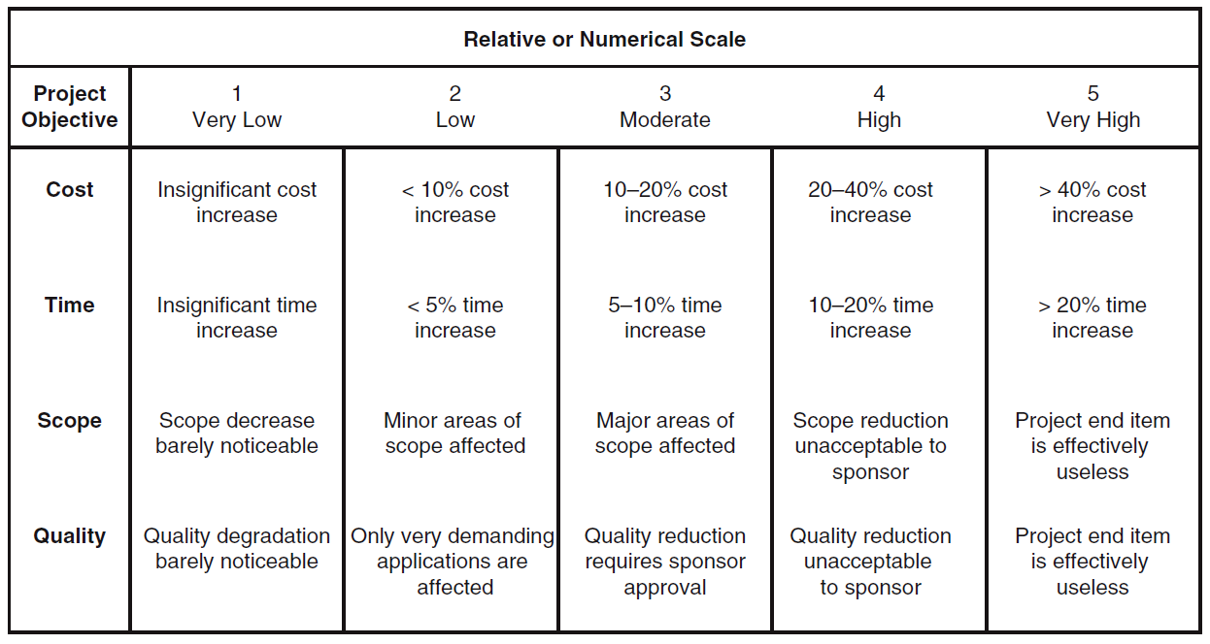
Defined Conditions for Impact Scales of a Risk on Major Project Objectives (Examples for negative impacts only)
FIGURE 7.5

Slide 14
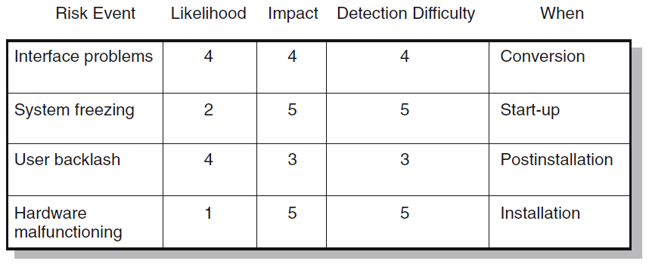
Risk Assessment Form
FIGURE 7.6

Slide 15
Risk Severity Matrix
Failure Mode and Effects Analysis (FMEA)
Impact × Probability × Detection = Risk Value
 |  | User Backlash | Interface problems
 |  |  |  | System freezing
 |  |  |  | Hardware malfunc-tioning
5
4
Red zone (major risk)
Yellow zone (moderate risk)
Green zone (minor risk)
Likelihood
3
2
1
1
2
3
4
5
FIGURE 7.7
Impact

Slide 16
PERT - Program Evaluation Review Technique
Assumes each activity duration has a range that statistically follows a beta distribution.
PERT uses three time estimates for each activity: optimistic, pessimistic, and a weighted average to represent activity durations.
Knowing the weighted average and variances for each activity allows the project planner to compute the probability of meeting different project durations.

Slide 17
Managing Risk (cont’d)
Step 3: Risk Response Development
  Mitigating Risk
    Reducing the likelihood an adverse event will occur
    Reducing the impact of an adverse event
  Avoiding Risk
    Changing the project plan to eliminate the risk or condition
  Transferring Risk
    Paying a premium to pass the risk to another party
    Requiring Build-Own-Operate-Transfer (BOOT) provisions
  Accepting Risk
    Making a conscious decision to accept the risk

Slide 18
Contingency Planning
Contingency Plan
  An alternative plan that will be used if a possible foreseen risk event actually occurs
  A plan of actions that will reduce or mitigate the negative impact (consequences) of a risk event
Risks of Not Having a Contingency Plan
  Having no plan may slow managerial response
  Decisions made under pressure can be potentially dangerous and costly

Slide 19
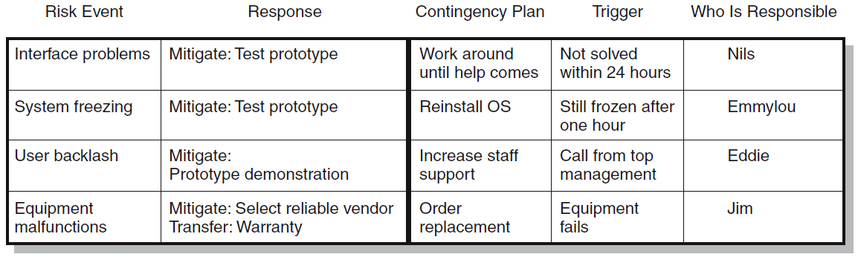
Risk Response Matrix
FIGURE 7.8

Slide 20
Risk and Contingency Planning
Technical Risks
  Backup strategies if chosen technology fails
  Assessing whether technical uncertainties can be resolved
Schedule Risks
  Use of slack increases the risk of a late project finish
  Imposed duration dates (absolute project finish date)
  Compression of project schedules due to a shortened project duration date

Slide 21
Risk and Contingency Planning (cont’d)
Cost Risks
  Time/cost dependency links: costs increase when problems take longer to solve than expected.
  Price protection risks (a rise in input costs) increase if the duration of a project is increased.
Funding Risks
  Changes in the supply of funds for the project can dramatically affect the likelihood of implementation or successful completion of a project.

Slide 22
Opportunity Management
Exploit
  Seeking to eliminate the uncertainty associated with an opportunity to ensure that it definitely happens
Share
  Allocating some or all of the ownership of an opportunity to another party who is best able to capture the opportunity for the benefit of the project
Enhance
  Taking action to increase the probability and/or the positive impact of an opportunity
Accept
  Being willing to take advantage of an opportunity if it occurs, but not taking action to pursue it

Slide 23
Contingency Funding and Time Buffers
Contingency Funds
  Funds to cover project risks—identified and unknown
    Size of funds reflects overall risk of a project.
  Budget reserves
    Are linked to the identified risks of specific work packages.
  Management reserves
    Are large funds to be used to cover major unforeseen risks (e.g., change in project scope) of the total project.
Time Buffers
  Amounts of time used to compensate for unplanned delays in the project schedule
    Severe risk, merge, noncritical, and scarce resource activities

Slide 24
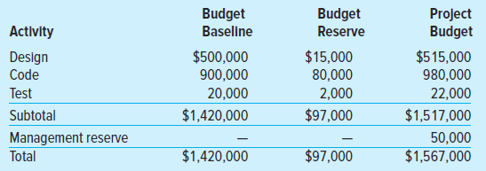
Contingency Fund Estimate
TABLE 7.1

Slide 25
Managing Risk (cont’d)
Step 4: Risk Response Control
  Risk control
    Execution of the risk response strategy
    Monitoring of triggering events
    Initiating contingency plans
    Watching for new risks
  Establishing a Change Management System
    Monitoring, tracking, and reporting risk
    Fostering an open organization environment
    Repeating risk identification/assessment exercises
    Assigning and documenting responsibility for managing risk

Slide 26
Change Control Management
Sources of Change
  Project scope changes
  Implementation of contingency plans
  Improvement changes

Slide 27
Change Management Systems
Identify proposed changes
List expected effects of proposed changes on schedule and budget
Review, evaluate, and approve or disapprove of changes formally
Negotiate and resolve conflicts of change, condition, and cost
Communicate changes to parties affected
Assign responsibility for implementing change
Adjust master schedule and budget
Track all changes that are to be implemented

Slide 28
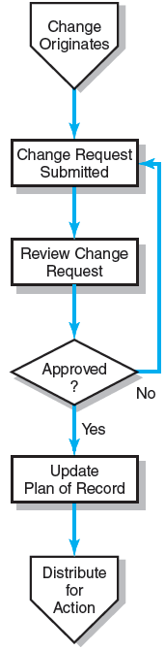
The Change
Control Process
FIGURE 7.9

Slide 29
Benefits of a Change Control System
Inconsequential changes are discouraged by the formal process.
Costs of changes are maintained in a log.
Integrity of the WBS and performance measures is maintained.
Allocation and use of budget and management reserve funds are tracked.
Responsibility for implementation is clarified.
Effect of changes is visible to all parties involved.
Implementation of change is monitored.
Scope changes will be quickly reflected in baseline and performance measures.

Slide 30
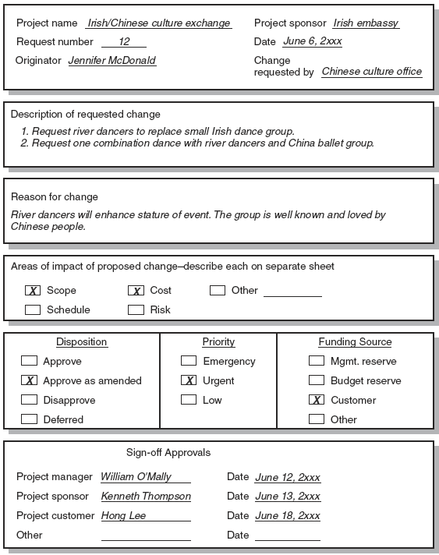
Sample Change Request
FIGURE 7.10

Slide 31
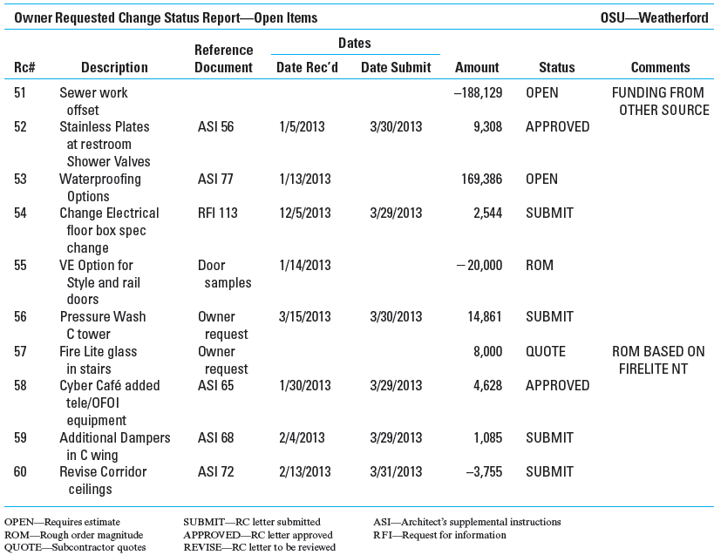
Change Request Log
FIGURE 7.11

Slide 32
Key Terms
Accept risk
Avoiding risk
Budget reserve
Change management system
Contingency plan
Management reserve
Mitigating risk
Opportunity
Risk
Risk breakdown structure (RBS)
Risk profile
Risk register
Risk severity matrix
Scenario analysis
Time buffer
Transferring risk

