Slide 1
Chapter eleven – Managing project teams
Stefán Guðnason

Slide 2
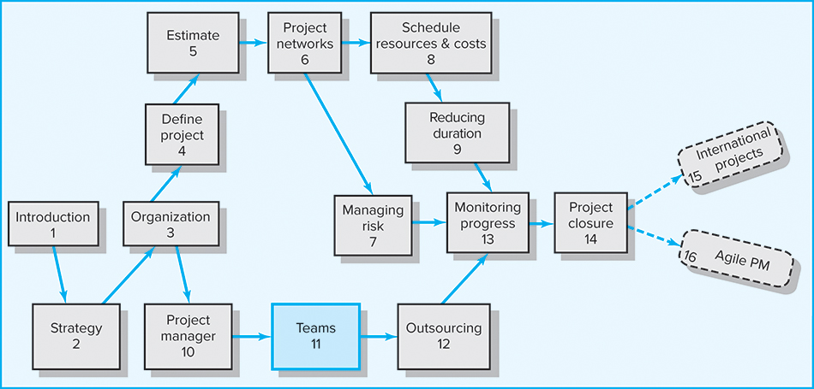
Where We Are Now
Copyright © 2018 McGraw-Hill Education. All rights reserved. No reproduction or distribution without the prior written consent of McGraw-Hill Education.

Slide 3
Learning Objectives
Identify key characteristics of a high-performance project team
Distinguish the different stages of team development
Understand the impact situational factors have on project team development
Identify strategies for developing a high-performance project team
Distinguish functional conflict from dysfunctional conflict and describe strategies for encouraging functional conflict and discouraging dysfunctional conflict
Understand the challenges of managing virtual project teams
Recognize the different pitfalls that can occur in a project team

Slide 4
Chapter Outline
11.1 The Five-Stage Team Development Model
11.2 Situational Factors Affecting Team
Development
11.3 Building High-Performance Project Teams
11.4 Managing Virtual Project Teams
11.5 Project Team Pitfalls

Slide 5
High-Performing Teams
Synergy
  1 + 1 + 1 = 10 (positive synergy)
  1 + 1 + 1 = 2 (negative synergy)
Characteristics of High-performing Teams
    Share a sense of common purpose
    Make effective use of individual talents and expertise
    Have balanced and shared roles
    Maintain a problem solving focus
    Accept differences of opinion and expression
    Encourage risk taking and creativity
    Set high personal performance standards
    Identify with the team

Slide 6

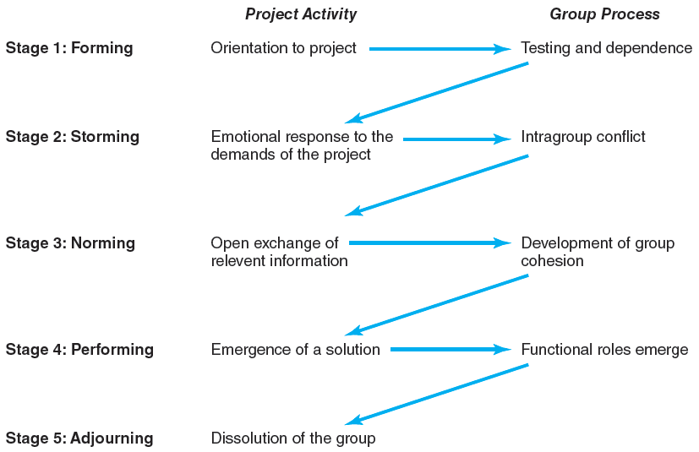
The Five-Stage Team Development Model
FIGURE 11.1
Copyright © 2018 McGraw-Hill Education. All rights reserved. No reproduction or distribution without the prior written consent of McGraw-Hill Education.

Slide 7
Conditions Favoring Development of
High Performance Project Teams
Members report solely to the project manager
All relevant functional areas are represented on the team
The project involves a compelling objective
Members are in close communication with each other
Ten or fewer team members
Voluntary team membership
Continuous service on the team
Full-time assignment to the team
An organization culture of cooperation and trust
Copyright © 2018 McGraw-Hill Education. All rights reserved. No reproduction or distribution without the prior written consent of McGraw-Hill Education.

Slide 8
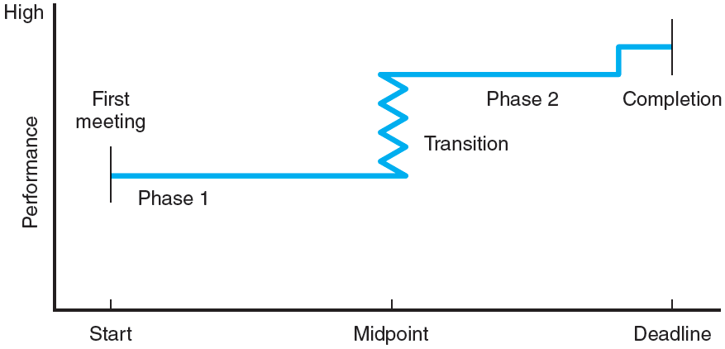
The Punctuated Equilibrium Model of Group Development
FIGURE 11.2
Copyright © 2018 McGraw-Hill Education. All rights reserved. No reproduction or distribution without the prior written consent of McGraw-Hill Education.

Slide 9
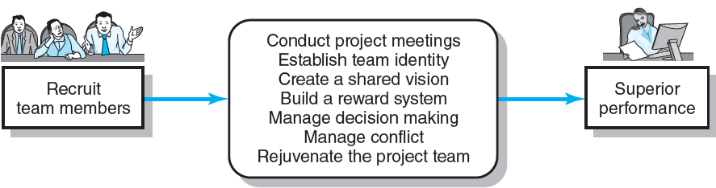
Creating a High-Performance Project Team
FIGURE 11.3
Copyright © 2018 McGraw-Hill Education. All rights reserved. No reproduction or distribution without the prior written consent of McGraw-Hill Education.

Slide 10
Building High-Performance Project Teams
Recruiting Project Members
  Factors affecting recruiting
    Importance of the project
    Management structure used to complete the project
  How to recruit?
    Ask for volunteers
  Who to recruit?
    Problem-solving ability
    Availability
    Technological expertise
    Credibility
    Political connections
    Ambition, initiative, and energy
    Familiarity

Slide 11
Project Team Meetings
Managing
Subsequent Meetings
Establishing Ground Rules
Establishing Team Norms
Conducting Project Meetings
Planning Decisions
Relationship Decisions
Tracking Decisions
Managing Change Decisions
Copyright © 2018 McGraw-Hill Education. All rights reserved. No reproduction or distribution without the prior written consent of McGraw-Hill Education.

Slide 12
Norms of High-performance Teams
Confidentiality is maintained; no information is shared outside the team unless all agree to it.
It is acceptable to be in trouble, but it is not acceptable to surprise others. Tell others immediately when deadlines or milestones will not be reached.
There is zero tolerance for bulling a way through a problem or an issue.
Agree to disagree, but when a decision has been made, regardless of personal feelings, move forward.
Respect outsiders, and do not flaunt one’s position on the project team.
Hard work does not get in the way of having fun.

Slide 13
Establishing a Team Identity
Effective Use
of Meetings
Co-location of
team members
Creation of project
team name
Get the team to do
something together
Team rituals
Copyright © 2018 McGraw-Hill Education. All rights reserved. No reproduction or distribution without the prior written consent of McGraw-Hill Education.

Slide 14
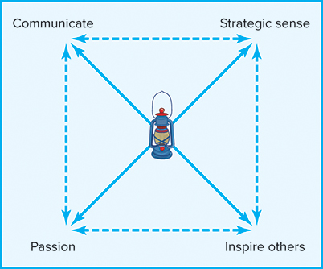
Requirements for an Effective Project Vision
FIGURE 11.4
Copyright © 2018 McGraw-Hill Education. All rights reserved. No reproduction or distribution without the prior written consent of McGraw-Hill Education.

Slide 15
Managing Project Reward Systems
Group Rewards
  Who gets what as an individual reward?
  How to make the reward have lasting significance?
  How to recognize individual performance?
    Letters of commendation
    Public recognition for outstanding work
    Desirable job assignments
    Increased personal flexibility

Slide 16
Orchestrating the Decision-Making Process
Problem Identification
Generating Alternatives
Reaching a Decision
Follow-up
Copyright © 2018 McGraw-Hill Education. All rights reserved. No reproduction or distribution without the prior written consent of McGraw-Hill Education.

Slide 17
Managing Conflict within the Project Team
Encouraging Functional Conflict
  Encourage dissent by asking tough questions
  Bring in people with different points of view
  Designate someone to be a devil’s advocate
  Ask the team to consider an unthinkable alternative
Managing Dysfunctional Conflict
  Mediate the conflict
  Arbitrate the conflict
  Control the conflict
  Accept the conflict
  Eliminate the conflict

Slide 18
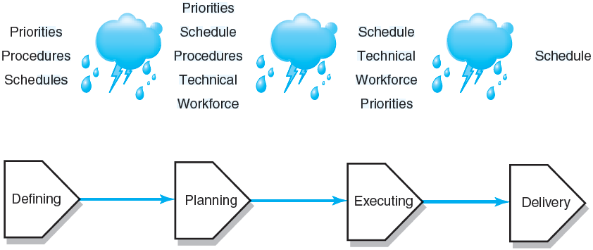
Sources of Conflict over the Project Life Cycle
FIGURE 11.5
Copyright © 2018 McGraw-Hill Education. All rights reserved. No reproduction or distribution without the prior written consent of McGraw-Hill Education.

Slide 19
Rejuvenating the Project Team
Informal Techniques
  Institute new rituals
  Take an off-site break as a team from the project
  View an inspiration message or movie
  Have the project sponsor give a pep talk
Formal Techniques
  Hold a team building session facilitated by an outsider to clarify ownership issues affecting performance
  Engage in an outside activity that provides an intense common experience to promote social development of the team

Slide 20
Managing Virtual Project Teams
Challenges:
  Developing trust
    Exchange of social information
    Set clear roles for each team member
  Developing effective patterns of communication
    Don’t let team members vanish
    Establish a code of conduct to avoid delays
    Establish clear norms and protocols for surfacing assumptions and conflicts
    Use electronic video technology to verify work
    Share the pain

Slide 21
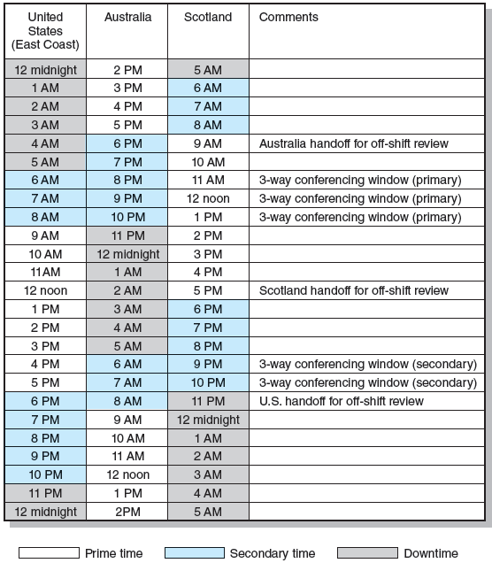
24-Hour Global Clock
FIGURE 11.6
Copyright © 2018 McGraw-Hill Education. All rights reserved. No reproduction or distribution without the prior written consent of McGraw-Hill Education.

Slide 22
Project Team Pitfalls
Groupthink
Bureaucratic
Bypass Syndrome
Going Native
Team Spirit Becomes
Team Infatuation
Copyright © 2018 McGraw-Hill Education. All rights reserved. No reproduction or distribution without the prior written consent of McGraw-Hill Education.

Slide 23
Key Terms
Brainstorming
Dysfunctional conflict
Functional conflict
Groupthink
Nominal group technique (NGT)
Positive synergy
Project kickoff meeting
Project vision
Team building
Team rituals
Virtual project team
Copyright © 2018 McGraw-Hill Education. All rights reserved. No reproduction or distribution without the prior written consent of McGraw-Hill Education.

Slide 24
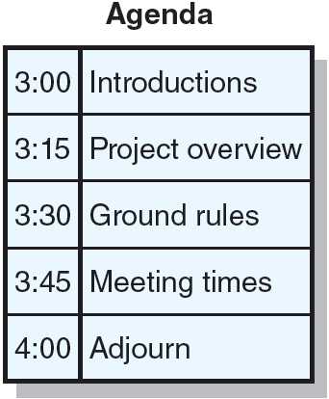
Celebration Task Force Agenda
FIGURE C11.1
Copyright © 2018 McGraw-Hill Education. All rights reserved. No reproduction or distribution without the prior written consent of McGraw-Hill Education.

