Slide 1
Chapter twelve - Outsourcing: Managing Interorganizational Relations
Stefán Guðnason

Slide 2
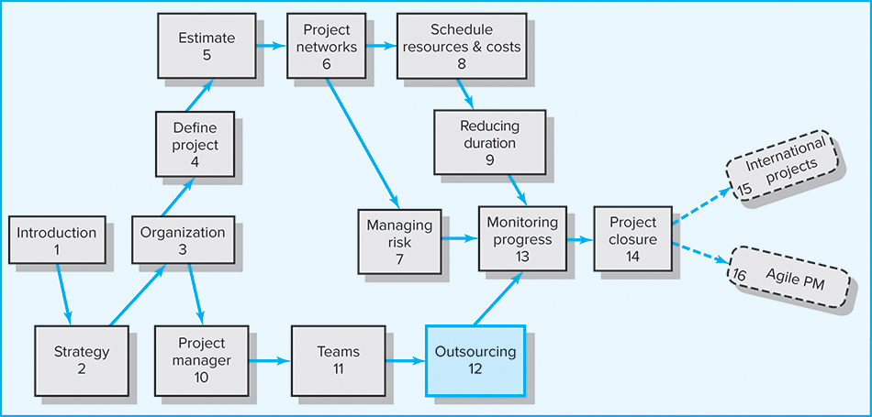
Where We Are Now

Slide 3
Learning Objectives
Understand the advantages and disadvantages of outsourcing project work
Describe the basic elements of a Request for Proposal (RFP)
Identify best practices for outsourcing project work
Practice principled negotiation
Describe the met-expectations model of customer satisfaction and its implications for working with customers on projects

Slide 4
Chapter Outline
12.1 Outsourcing Project Work
12.2 Request for Proposal (RFP)
12.3 Best Practices in Outsourcing Project Work
12.4 The Art of Negotiating
12.5 A Note on Managing Customer Relations

Slide 5
Outsourcing Project Work
Outsourcing
  The process of transferring of business functions or processes (e.g., customer support, IT, accounting) to other, often foreign companies
  Being applied to contracting significant chunks of project work
  Being applied to the creation of new products and services

Slide 6

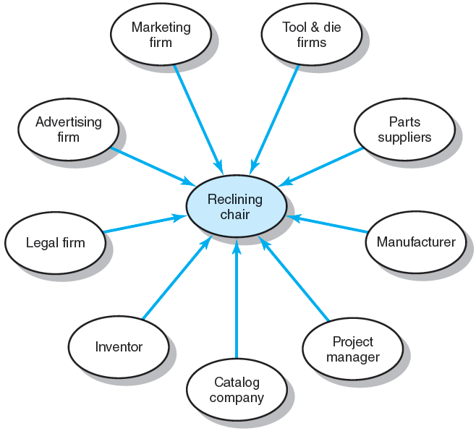
Reclining Chair Project
FIGURE 12.1

Slide 7
Outsourcing Project Work
Advantages
  Cost reduction
  Faster project completion
  High level of expertise
  Flexibility
Disadvantages
  Coordination breakdowns
  Loss of control
  Conflict
  Security issues
  Political hot potato

Slide 8
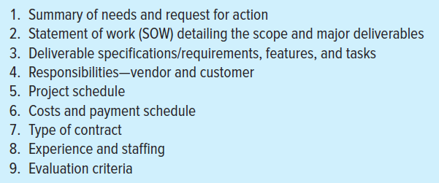
Request for Proposal (RFP)
Be announced to external contractors/vendors with adequate experience to implement the project
Development steps:
FIGURE 12.2

Slide 9
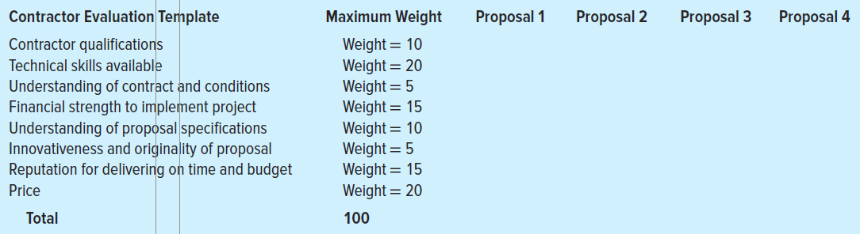
Contractor Evaluation Template
FIGURE 12.3

Slide 10
Best Practices in Outsourcing Project Work
Well-defined requirements and procedures
Extensive training and team-building activities
Well-established conflict management processes in place
Frequent review and status updates
Co-location when needed
Fair and incentive-laden contracts
Long-term outsourcing relationships
FIGURE 12.2

Slide 11
Key Differences Between Partnering and Traditional Approaches to Managing Contracted Relationships
Partnering Approach
Mutual trust forms the basis for strong working relationships.
Shared goals and objectives ensure common direction.
Joint project team exists with
high level of interaction.
Open communications avoid misdirection and bolster effective working relationships.
Long-term commitment provides the opportunity to attain continuous improvement.
Traditional Approach
Suspicion and distrust; each party is wary of the motives of the other.
Each party’s goals and objectives, while similar, are geared to what is best for them.
Independent project teams; teams are spatially separated with managed interactions.
Communications are structured
and guarded.
Single project contracting is normal.
TABLE 12.1

Slide 12
Key Differences Between Partnering and
Traditional Approaches …(cont’d)
Partnering Approach
Objective critique is geared to candid assessment of performance.
Access to each other’s organization resources is available.
Total company involvement requires commitment from CEO to team members.
Integration of administrative systems equipment takes place.
Risk is shared jointly among the partners, encouraging innovation and continuous improvement.
Traditional Approach
Objectivity is limited due to fear of reprisal and lack of continuous improvement opportunity.
Access is limited with structured procedures and self-preservation
taking priority over total optimization.
Involvement is normally limited to project-level personnel.
Duplication and/or translation takes place with attendant costs and delays.
Risk is transferred to the other party.
TABLE 12.1 (cont’d)

Slide 13
Strategies for Communicating with Outsourcers
STRATEGY 1: Recognize cultural differences
STRATEGY 2: Choose the right words
STRATEGY 3: Confirm your requirements
STRATEGY 4: Set deadlines

Slide 14
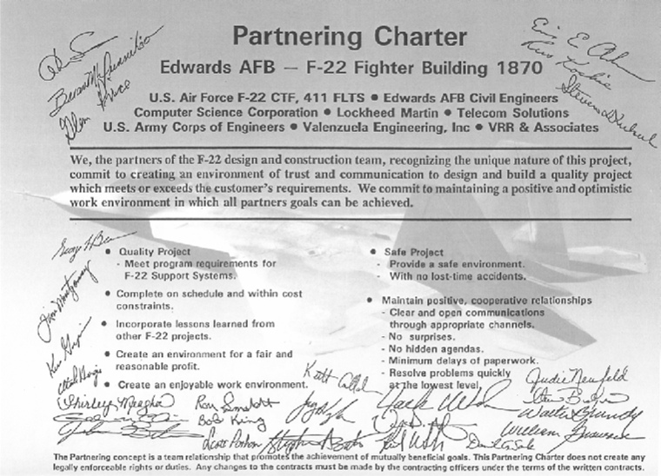
Project Partnering Charter
FIGURE 12.2

Slide 15
Preproject Activities—Setting the Stage for Successful Partnering
Selecting a Partner(s)
  Voluntary, experienced, willing, with committed top management
Team Building: The Project Managers
  Build a collaborative relationship among the project managers
Team Building: The Stakeholders
  Expand the partnership commitment to include other key managers and specialists

Slide 16
Project Implementation—Sustaining Collaborative Relationships
Establish a “we” as opposed to “us and them” attitude toward the project
  Co-location: employees from different organizations work together at the same location
Establish mechanisms that will ensure the relationship withstands problems and setbacks
  Problem resolution
  Continuous improvement
  Joint evaluation
  Persistent leadership

Slide 17
Project Completion—Celebrating Success
Conduct a joint review of accomplishments
and disappointments
Hold a celebration for all project participants
Recognize special contributions

Slide 18
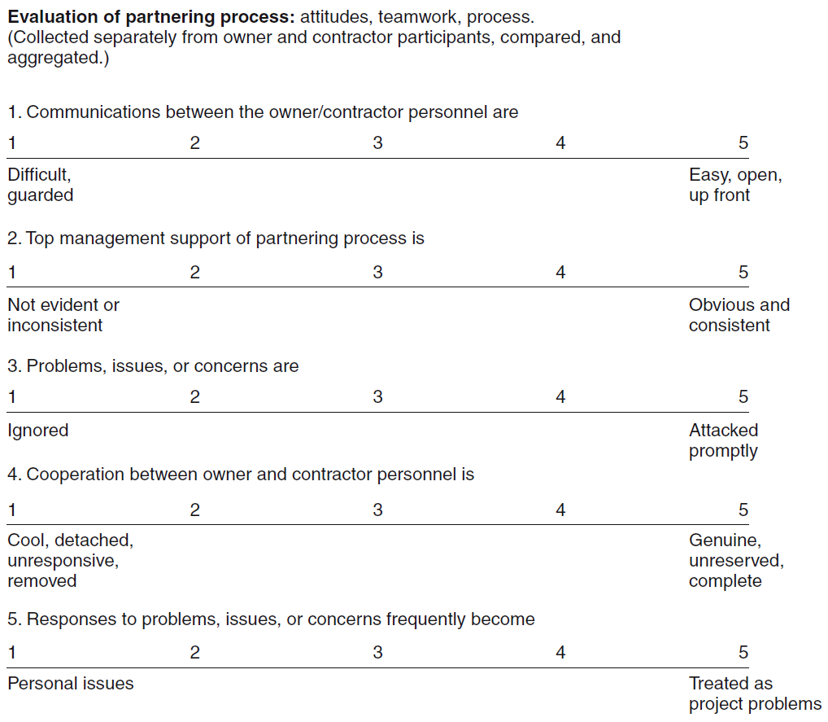
Sample Online Partnering Survey
FIGURE 12.6

Slide 19
Advantages of Long-term Partnerships
Reduced administrative costs
More efficient utilization of resources
Improved communication
Improved innovation
Improved performance

Slide 20
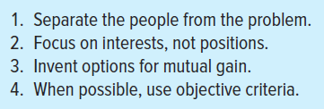
The Art of Negotiating
Project management is NOT a contest.
  Everyone is on the same side—OURS.
  Everyone is bound by the success of the project.
  Everyone has to continue to work together.
Principled Negotiations
TABLE 12.2

Slide 21
The Art of Negotiating (cont’d)
Dealing with Unreasonable People
  If pushed, don’t push back.
  Ask questions instead of making statements
  Use silence as a response to unreasonable demands
  Ask for advice and encourage others to criticize your ideas and positions
  Use Fisher and Ury’s best alternative to a negotiated agreement (BATNA) concept to work toward a win/win scenario

Slide 22
Managing Customer Relations
Customer Satisfaction
  The negative effect of dissatisfied customers on a firm’s reputation is far greater than the positive effect of satisfied customers.
  Every customer has a unique set of performance expectations and met-performance perceptions.
  Satisfaction is a perceptual relationship:
  Perceived performance
  Expected performance
  Project managers must be skilled at managing both customer expectations and perceptions.

Slide 23
The Met-Expectations Model of Customer Satisfaction
0.90 | = | Perceived performance | = | 1.10
Dissatisfied |  | Expected performance |  | Very satisfied
If performance falls short of expectations (ratio < 1), the customer is dissatisfied.
If the performance matches expectations (ratio = 1), the customer is satisfied.
If the performance exceeds expectations (ratio > 1), the customer is very satisfied or even delighted.
FIGURE 12.7

Slide 24
Managing Customer Relations (cont’d)
Managing Customer Expectations
  Don’t oversell the project; better to undersell.
  Develop a well-defined project scope statement
  Share significant problems and risks
  Keep everyone informed about the project’s progress
  Involve customers early in decisions about project development changes
  Handle customer relationships and problems in an expeditious, competent, and professional manner
  Speak with one voice
  Speak the language of the customer

Slide 25
Project Roles, Challenges, and Strategies
Project Manager Roles | Challenges | Strategies
Entrepreneur | Navigate unfamiliar surroundings | Use persuasion to influence others
Politician | Understand two diverse cultures (parent and client organization) | Align with the powerful individuals
Friend | Determine the important relationships to build and sustain outside the team itself | Identify common interests and experiences to bridge a friendship with the client
Marketer | Understand the strategic objectives of the client organization | Align new ideas/proposals with the strategic objectives of the client organization
Coach | Motivate client team members without formal authority | Provide challenging tasks to build the skills of the team members
TABLE 12.3

Slide 26
Key Terms
Best alternative to a negotiated agreement (BATNA)
Co-location
Escalation
Met-expectations model
Outsourcing
Partnering charter
Principled negotiation

Slide 27
Contract Management

Slide 28
Procurement Management Process
Planning purchases and acquisitions
Planning contracting
Requesting seller responses
Selecting sellers
Administering the contract
Closing the contract

Slide 29
Contract
A formal agreement between two parties wherein the contractor obligates itself to perform a service and the client obligates itself to do something in return.
  Defines the responsibilities of the parties, spells out the conditions of its operations
  Defines the rights of the parties to each other
  Grants remedies to a party if the other party breaches its transactional obligations

Slide 30
Types of Contracts
Fixed-Price (FP) Contract or Lump-sum Agreement
  The contractor with the lowest bid agrees to perform all work specified in the contract at a fixed price
  The disadvantage for owners is that it is more difficult and more costly to prepare.
  The primary disadvantage for contractors is the risk of underestimating project costs.
  Contract adjustments:
    Redetermination provisions
    Performance incentives

Slide 31
Types of Contracts (cont’d)
Cost-Plus Contracts
  The contractor is reimbursed for all direct allowable costs (materials, labor, travel) plus an additional prior-negotiated fee (set as a percentage of the total costs) to cover overhead and profit.
  Risk to client is in relying on the contractor’s best efforts to contain costs.
  Controls on contractors:
    Performance and schedule incentives
    Costs-sharing clauses

Slide 32
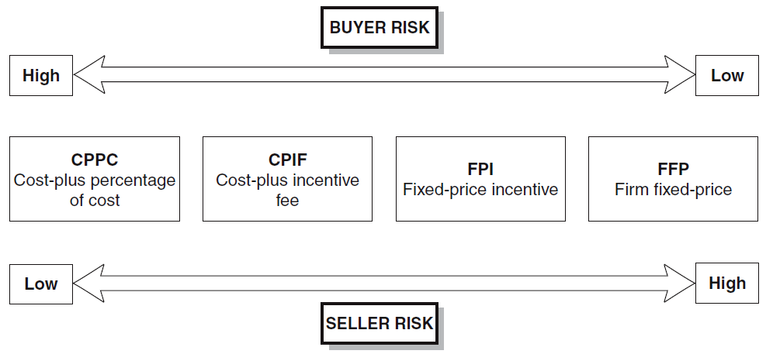
Contract Type versus Risk
FIGURE A12.1

Slide 33
Contract Changes
Contract Change Control System
  Defines the process by which a contract’s authorized scope (costs and activities) may be modified:
    Paperwork
    Tracking systems
    Dispute resolution procedures
    Approval levels necessary for authorizing changes
  Best practice is the inclusion of change control system provisions in the original contract.

