Slide 1
Chapter Eight – Scheduling Resources and Costs
Stefan guðnason

Slide 2
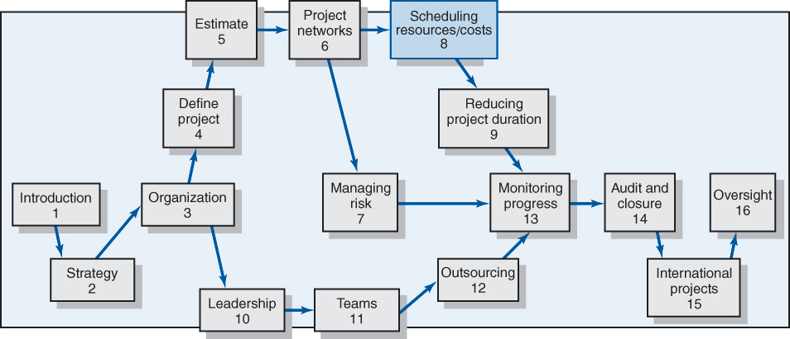
You are here

Slide 3
Learning Objectives
Understand the differences between time-constrained and resource-constrained schedules
Identify different types of resource constraints
Describe how the smoothing approach is used on time-constrained projects
Describe how leveling approach is used for resource-constrained projects
Understand how project management software creates resource-constrained schedules
Understand when and why splitting tasks should be avoided
Identify general guidelines for assigning people to specific tasks
Identify common problems with multiproject resource scheduling
Explain why a time-phased budget baseline is needed
Create a time-phased project budget baseline

Slide 4
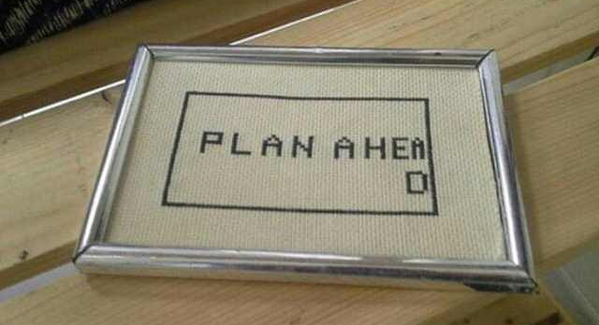
Project contraints
Plan is nothing … planning is everything
Up-front planning is essential

Slide 5
Remember …
Project network times are not a schedule, until resources have been assigned!
Cost estimates are not a budget, until they have been time-phased!
To finish your plan, you need to include: cost and resources!
This helps you to make realistic judgments of resource availability and project duration
Chapters so far have predicted a perfect world situation.

Slide 6
The Resource Problem
Resource Scheduling Problems:
  The implicit assumption is that resources will be available in the required amounts when needed.
  If resources are adequate, but demands varies = even out resources by delaying noncritical activities (using slak) to lower peak demand and increase resource utilization = resource smoothing
  If resources are not adequate to meet peak demand; then the late start of activities must be delayed and the project duration increased = Resource-Constrained Scheduling
  Resource utilization and availability through Resource Leveling and Resource Constrained Scheduling

Slide 7
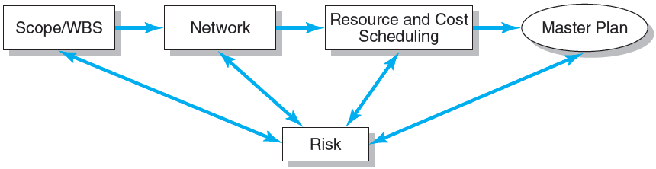
Project Planning Process
FIGURE 8.1

Slide 8
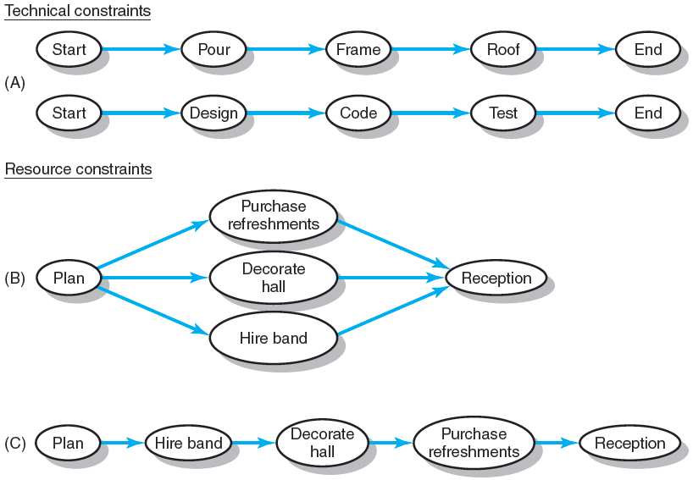
Effects of resource constraints

Slide 9
Type of resource constraints
People
Materials
Equipment

Slide 10
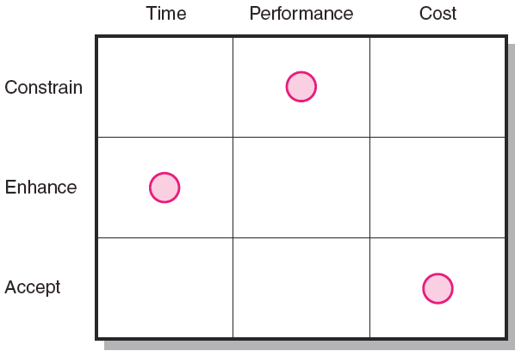
Classification of a
Scheduling Problem
Classification of Problem
Using a priority matrix will help determine if the project is time or resource constrained
Time Constrained Project
A project that must be completed by an imposed date
Time is fixed, resources are flexible: additional resources are required to ensure project meets schedule.
Resource Constrained Project
A project in which the level of resources available cannot be exceeded
Resources are fixed, time is flexible: inadequate resources will delay the project.

Slide 11
Resource Allocation Methods
Limiting Assumptions
Splitting activities is not allowed—once an activity is start, it is carried to completion.
Level of resource used for an activity cannot be changed.
Activities with the most slack pose the least risk.
Reduction of flexibility does not increase risk.
The nature of an activity (easy, complex) doesn’t increase risk.

Slide 12
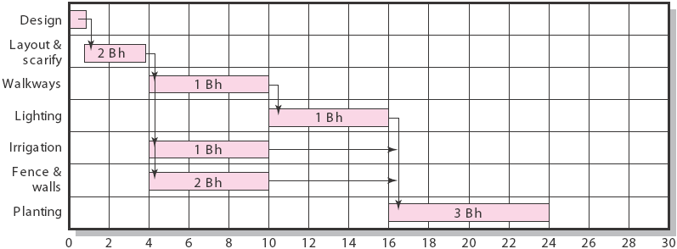
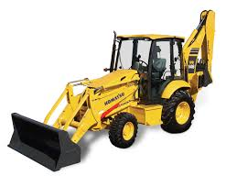
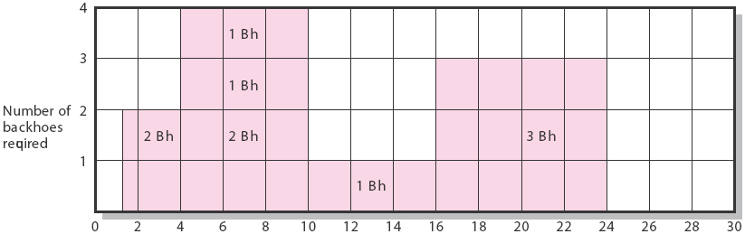
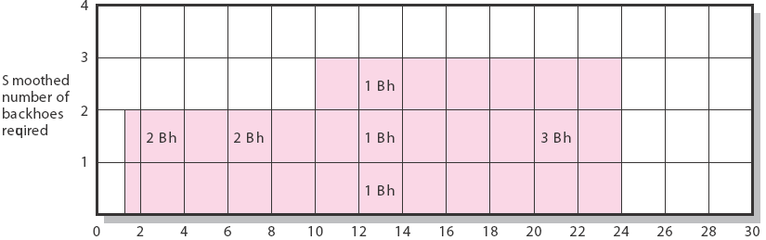
Example
Slack
Botanical Garden

Slide 13
Resource Allocation Methods (cont’d)
Resource Demand Leveling Techniques for Time-Constrained Projects. Delay noncritical activities by using positive slack to reduce peak demand and fill in the valleys for resources.
Advantages
Peak resource demands are reduced (smoothened)
Resources over the life of the project are reduced (from 4 -> 3)
Fluctuation in resource demand is minimized.
Disadvantages
Loss of flexibility that occurs from reducing slack
Increases in the criticality of all activities

Slide 14
Resource-Constrained Projects
Resource-Constrained Projects
Projects that involve resources that are limited in quantity or by their availability
Scheduling of activities requires the use of heuristics (rules-of-thumb) that focus on:
  Minimum slack
  Smallest (least) duration
  Lowest activity identification number
The parallel method is used to apply heuristics.
An iterative process that starts at the first time period of the project and schedules period-by-period any activities scheduled to start using the three priority rules

Slide 15
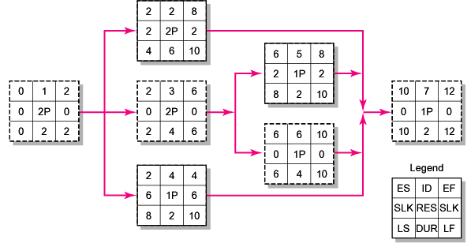
Resource-Constrained Schedule through Period 2–3

Slide 16
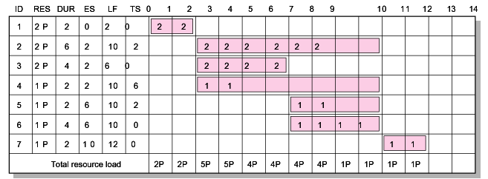
Resource-Constrained Schedule through Period 2–3
ES resource load chart
3 programmers max!
FIGURE 8.3 (cont’d)

Slide 17
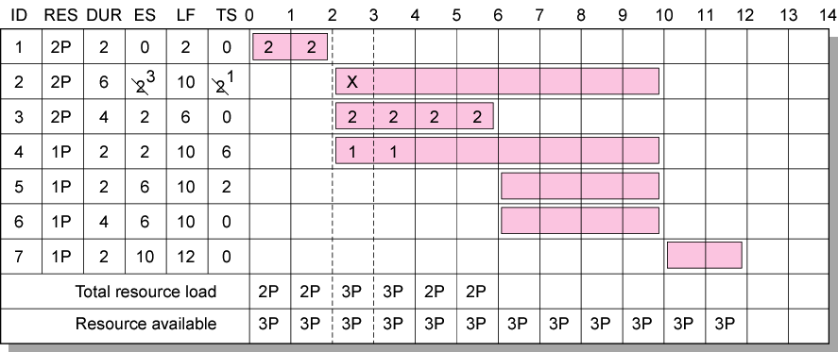
Resource-Constrained Schedule through Period 2–3
Resource-constrained schedule through period 2–3
FIGURE 8.3 (cont’d)

Slide 18
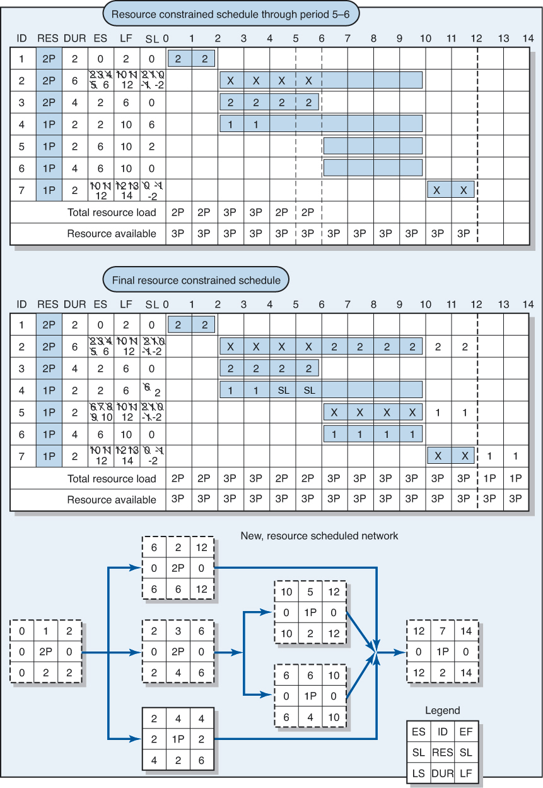
Resource-Constrained Schedule through Period 5–6
Resource-constrained schedule through period 5–6
FIGURE 8.4

Slide 19
Resource-Constrained Schedule through Period 5–6
Final resource-constrained schedule
FIGURE 8.4 (cont’d)

Slide 20
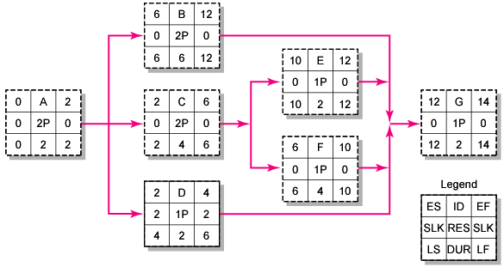
Resource-Constrained Schedule through Period 5–6
New, resource-constrained network

Slide 21
What has changed?
Reduced slack
New, resource-constrained network

Slide 22
Impacts of resource-constrained scheduling
Reduces delay but reduces flexibility
Increases sensitivity of the network
Increases scheduling complexity
May make traditional critical path no longer meaningful
Can break sequence of events
May cause parallel activities to become sequential and critical activities with slack to become noncritical

Slide 23
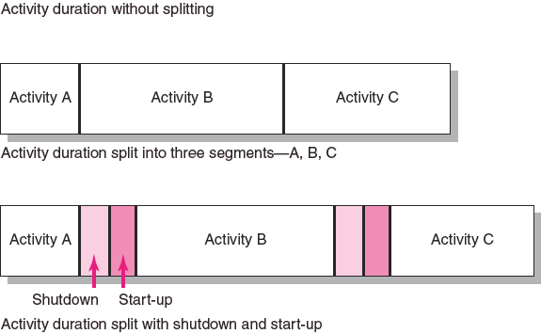
Splitting/multitasking
    Is considered the major reason why projects fail to meet schedule

Slide 24
Benefits of Scheduling Resources
If resources are truly limited and and activity time estimates are accurate = the resource constrained schedule will materialize not the time constrained schedule
Important to prepare before the project begins = will give time for considering alternatives => cost/time trade offs can be considered
Recourse scheduling provides information to prepare time-phased work package budgets with dates (better planning)
Recourse scheduling allows PM’s to access more flexibility over resources.

Slide 25
Assigning people to projects
Don’t always pick the same people for the toughest assignments. = balance task performance!
Choose people with an eye to fostering their development through participation on the project.
Pick people with compatible work habits and personalities but who complement each other.
Team-up veterans with new hires to share experience and socialize newcomers into the organization.
Select people who may need to learn to work together at later stages of the project or other projects.

Slide 26
Managing multi-project scheduling
In the real world, we are not only working with one project!
Resource allocation therefore generally occurs in a multi-project environment, where demands of one project have to be reconciled with the needs of other projects.

Slide 27
Problems in managing multi-project scheduling
Overall schedule slippage: Because of shared resources; delay in one delays the other
Inefficient resource utilization: Different scheduling, different peaks and valleys
Resource bottlenecks: Lack of equipment etc …. Competition for the use of tools and equipment's.
=> Create project offices or departments to oversee the scheduling of resources across projects.
=> Use a project priority queuing system: first come, first served for resources.
=> Centralize project management: treat all projects as a part of a “mega-project.”
=> Outsource projects to reduce the number of projects handled internally.

Slide 28
Time-phased budget
Planned cost vs actual cost. What does it tell you mid way through the project period?
A budget schedule over the life of the project
Connects costs and progress ... This will tell you!
Necessary for effective cost control.

Slide 29
Time-phased budget
Why?
=> you can time-phase work packages and assign them to their respective scheduled activities to develop a budget over the life of the project
Why do we need a time-phased budget baseline?
=> example:
  Total budget 4 million
  Time 10 weeks
  Cost per/week 400.00 US$
  Mid way through: Planned cost 2m but actual cost 2,4m.
  Good or bad? Is this 400.000 overrun?
  Or: planned cost 2m and actual 1,7$M? Under budget?
  = We don’t know how much work has been accomplished for the money spent! = Hence: time-phased cost match is needed!

Slide 30
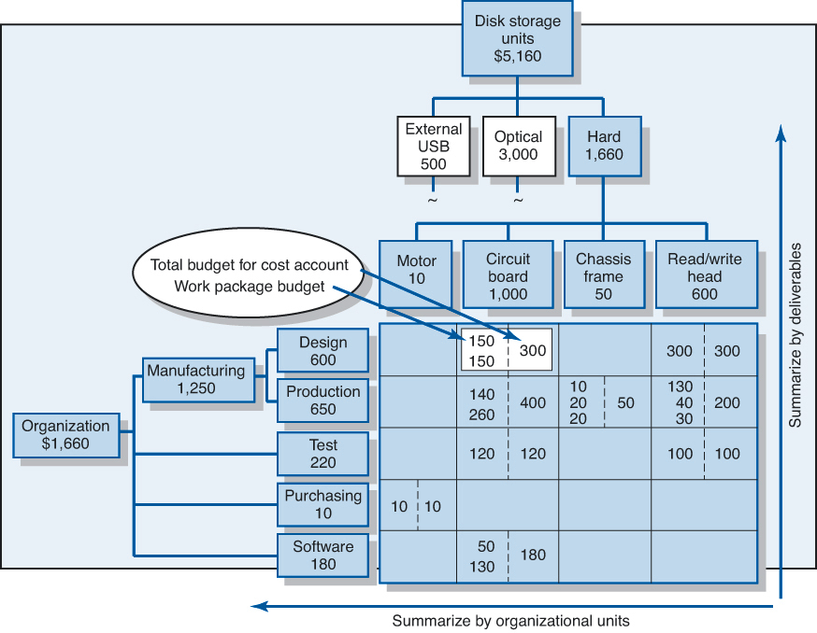
Connect WBS and organization

Slide 31
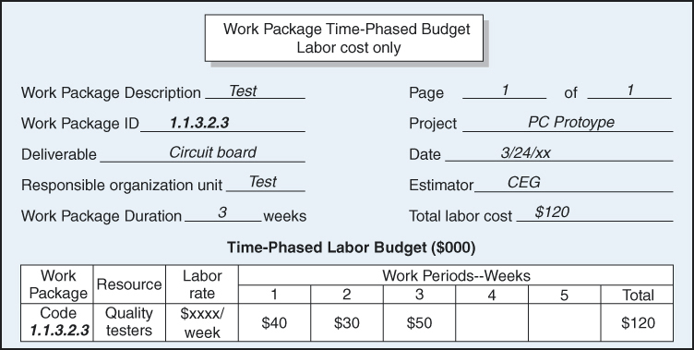
Time-phase work packages

Slide 32
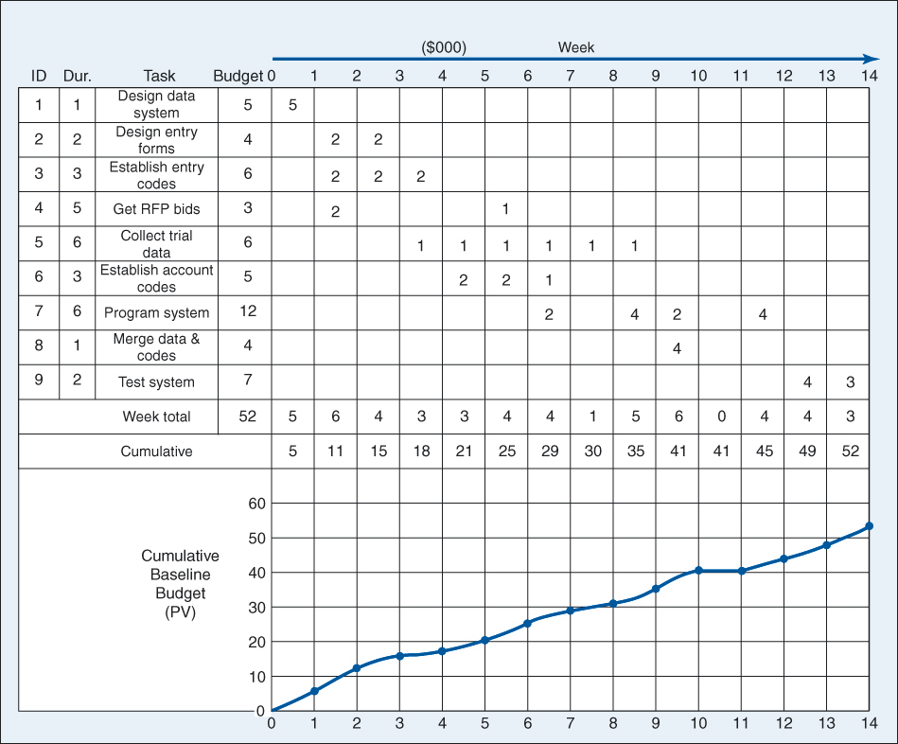
Combine time-phased work packages

Slide 33
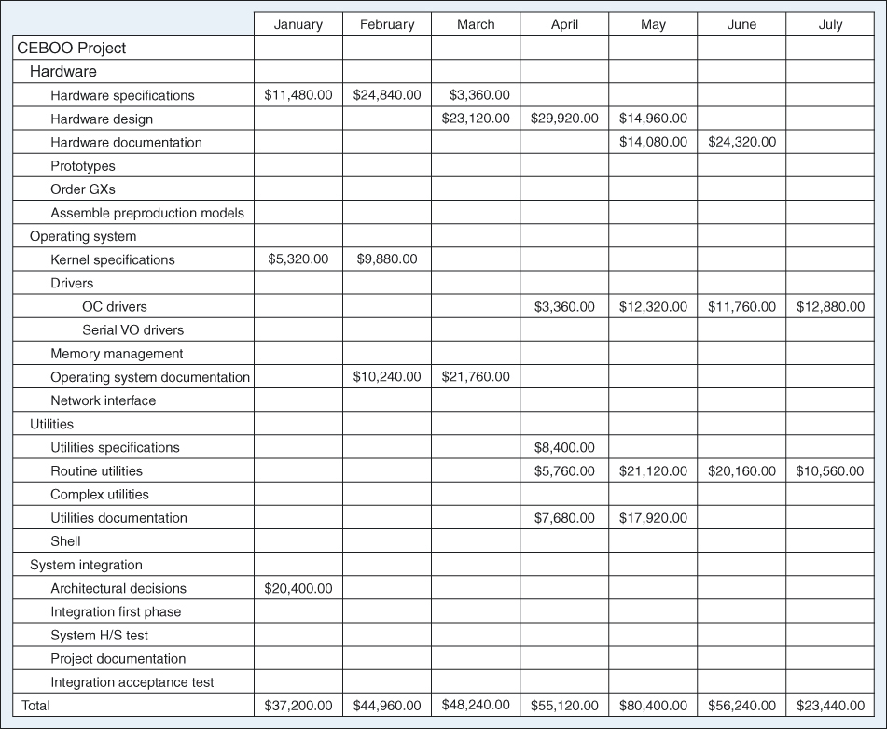
Obtain monthly cash flow...

Slide 34
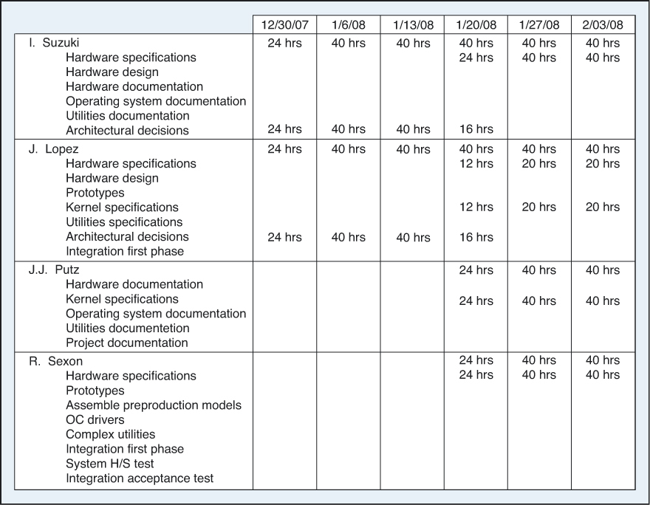
...and resource usage schedule

Slide 35
Discussion points
What is the main purpose of Scheduling Resources?
What is classification of Scheduling Problem?
Explain types of resource constraints
What is smoothing?

Slide 36
Practise assignment.
On page 292 there is Case 8.1
Those of you who want to practise, do that case. It‘s easy and straight forward. But gives you a good idea on how and why this has to be done.
And no, this does not count to your final grade, but will make you better program managers.

