Slide 1
Chapter nine – Reducing Project Duration
Stefán Guðnason

Slide 2
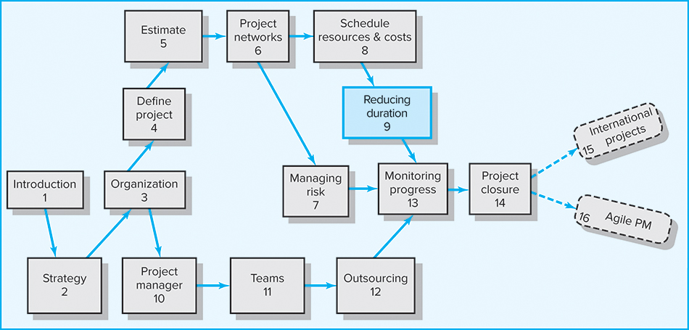
Where We Are Now?

Slide 3
Imagine this:
— After finalizing your project schedule, you realize the estimated completion date is two months beyond what your boss publicly promised an important customer.
— Five months into the project, you realize that you are already three weeks behind the drop-dead date for the project.
— Four months into a project top management changes its priorities and now tells you that money is not an issue. Complete the project ASAP!

Slide 4
Learning Objectives
Understand the different reasons for crashing a project
Identify the different options for crashing an activity when resources are not constrained
Identify the different options for crashing an activity when resources are constrained
Determine the optimum cost-time point in a project network
Understand the risks associated with compressing or crashing a project
Identify different options for reducing the costs of a project

Slide 5
Chapter Outline
9.1 Rationale for Reducing Project Duration
9.2 Options for Accelerating Project Completion
9.3 Project Cost-Duration Graph
9.4 Constructing a Project Cost-Duration Graph
9.5 Practical Considerations
9.6 What If Cost, Not Time, Is the Issue?

Slide 6
Rationale for Reducing Project Duration
Time Is Money: Cost-Time Tradeoffs
  Reducing the time of a critical activity usually incurs additional direct costs.
    Cost-time solutions focus on reducing (crashing) activities on the critical path to shorten overall duration of the project.
  Reasons for imposed project duration dates:
    Time-to-market pressures
    Customer requirements and contract commitments
    Unforeseen delays
    Incentive contracts (bonuses for early completion)
    Imposed deadlines and contract commitments
    Overhead and public goodwill costs
    Pressure to move resources to other projects

Slide 7
Options for Accelerating Project Completion when resources are NOT constrained
Resources Not Constrained
  Adding resources, most common way; adding staff or equipment, but it will not necessarily double output
  Outsourcing project work
  Scheduling overtime, avoid cost of hiring new people
  Establishing a core project team costly yes, but not if you satisfy the deadline! + more focus, speed!
  Do it twice—fast and then correctly

Slide 8
Options for Accelerating Project Completion when resources ARE constrained
  Improving project team efficiency
  Fast-tracking, rearrange the logic of the project network (focus on parallel activities = cuts time)
  Critical-chain, faster completion
  Reducing project scope, reassess the true specification of the project!
  Compromise quality, always an option, but rarely accepted

Slide 9
Reducing Project Duration to Reduce Project Cost
Identifying direct costs to reduce project time
Gather information about direct and indirect costs of specific project durations
Search critical activities for lowest direct-cost activities to shorten project duration
Compute total costs for specific durations and compare to benefits of reducing project time

Slide 10
Most common methods to crash projects
Scheduling overtime
Outsourcing
Adding resources.
Crashing: shortening the duration of an activity or the whole project, beyond what it can be normally done
The challenge for the project manager is to use a quick, logical method to compare the benefits of reducing the project time with the cost. The need to shorten projects will only increase!

Slide 11
Explanation of Project Costs
Project Indirect Costs
  Costs that cannot be associated with any particular work package or project activity
    Supervision, administration, consultants, and interest
  Costs that vary (increase) with time
    Reducing project time directly reduces indirect costs
Project Direct Costs
  Normal costs that can be assigned directly to a specific work package or project activity
    Labor, materials, equipment, and subcontractors
  Crashing activities increases direct costs.

Slide 12

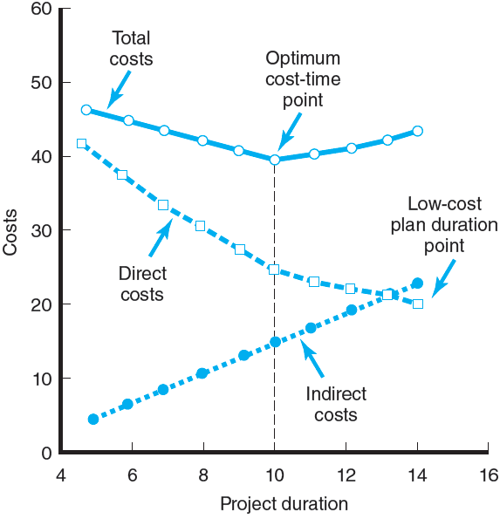
Project Cost–Duration Graph
FIGURE 9.1

Slide 13
Constructing a Project Cost–Duration Graph
Find total direct costs for
selected project durations
Find total indirect costs for
selected project durations
Sum direct and indirect costs for these selected project durations
Compare additional cost
alternatives for benefits

Slide 14
Constructing a Project Cost–Duration Graph
Determining Activities to Shorten
  Shorten the activities with the smallest increase in cost per unit of time
  Assumptions:
    The cost-time relationship is linear.
    Normal time assumes low-cost, efficient methods to complete the activity.
    Crash time represents a limit—the greatest time reduction possible under realistic conditions.
    Slope represents a constant cost per unit of time.
    All accelerations must occur within the normal and crash times.

Slide 15
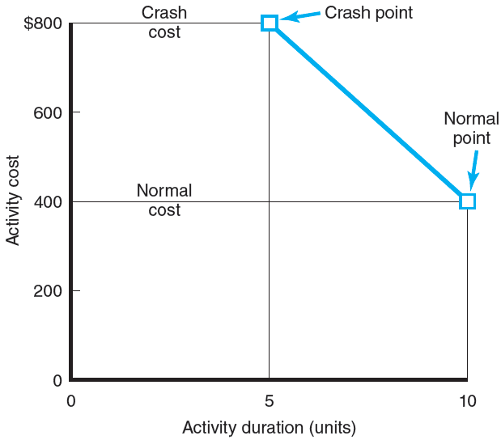
Activity Graph
FIGURE 9.2

Slide 16
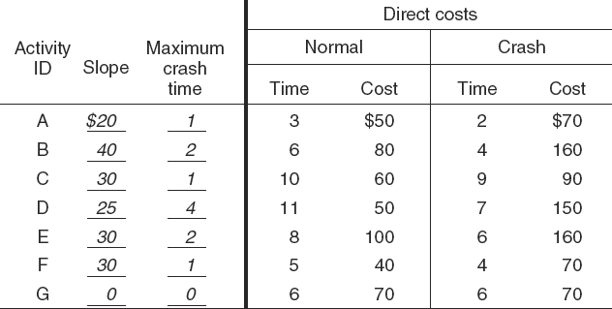
Cost–Duration Trade-off Example
FIGURE 9.3

Slide 17
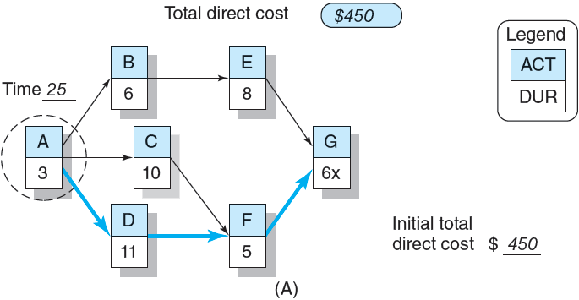
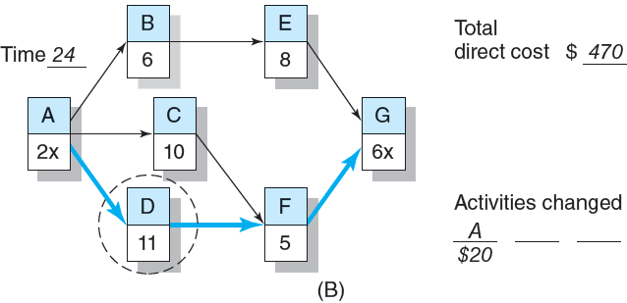
Cost–Duration Trade-off Example (cont’d)
FIGURE 9.3 (cont’d)

Slide 18
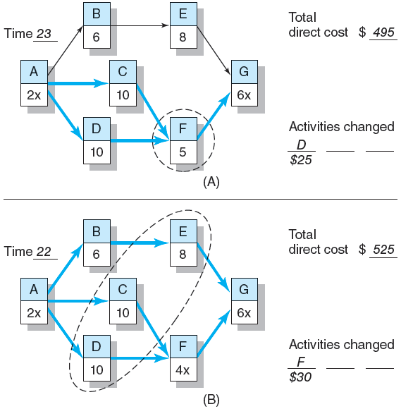
Cost–Duration Trade-off Example (cont’d)
FIGURE 9.4

Slide 19
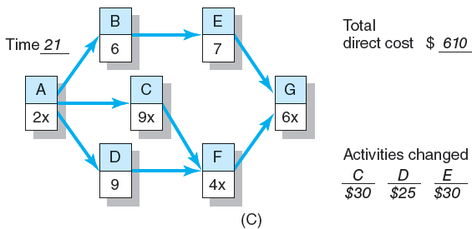
Cost–Duration Trade-off Example (cont’d)
FIGURE 9.4 (cont’d)

Slide 20
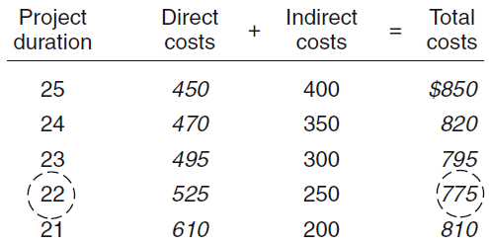
Summary Costs by Duration
FIGURE 9.5

Slide 21
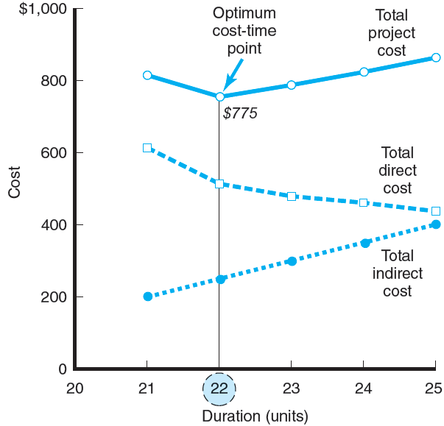
Project Cost–Duration Graph
FIGURE 9.6

Slide 22
Practical Considerations
Using the Project Cost–Duration Graph
Crash Times
Linearity Assumption
Choice of Activities to Crash Revisited
Time Reduction Decisions and Sensitivity

Slide 23
What if Cost, Not Time Is the Issue?
Commonly Used Options for Cutting Costs
  Reducing project scope
  Having owner take on more responsibility
  Outsourcing project activities or even the entire project
  Brainstorming cost savings options

Slide 24
Key Terms
Crashing
Crash point
Crash time
Direct costs
Fast-tracking
Indirect costs
Outsourcing
Project cost–duration graph

Slide 25
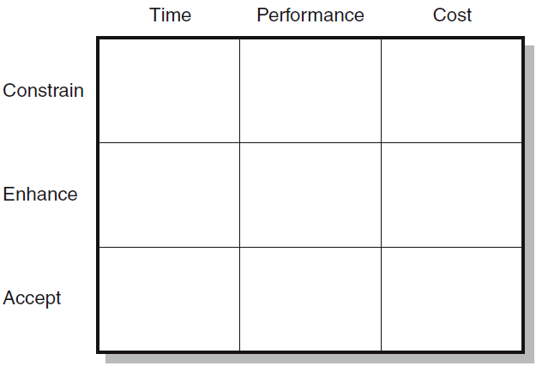
Project Priority Matrix: Whitbread Project
FIGURE C9.1

