Slide 1
Chapter Ten – Being an Effective Project Manager
Stefán Guðnason

Slide 2
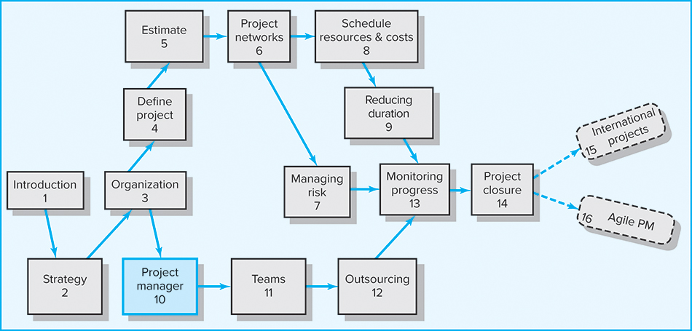
Where We Are Now

Slide 3
Learning Objectives
Understand the difference between leading and managing a project
Understand the need to manage project stakeholders
Identify and apply different “influence currencies” to build positive relations with others
Create a stakeholder map and develop strategies for managing project dependencies
Understand the need for a highly interactive management style on projects
More effectively manage project expectations
Develop strategies for managing upward relations
Understand the importance of building trust and acting in an ethical manner while working on a project
Identify the qualities of an effective project manager

Slide 4
Chapter Outline
10.1 Managing versus Leading a Project
10.2 Managing Project Stakeholders
10.3 Influence as Exchange
10.4 Social Network Building
10.5 Ethics and Project Management
10.6 Building Trust: The Key to Exercising
Influence
10.7 Qualities of an Effective Project Manager

Slide 5
Managing versus Leading a Project
Managing—coping with complexity
  Formulate plans and objectives
  Monitor results
  Take corrective action
  Expedite activities
  Solve technical problems
  Serve as peacemaker
  Make tradeoffs among time, costs, and project scope
Leading—coping with change
  Recognize the need to change to keep the project on track
  Initiate change
  Provide direction and motivation
  Innovate and adapt as necessary
  Integrate assigned resources

Slide 6
Managing Project Stakeholders
Project Management Maxims:
  You can’t do it all and get it all done.
    Projects usually involve a vast web of relationships.
  Hands-on work is not the same as leading.
    More pressure and more involvement can reduce
    your effectiveness as a leader.
  What’s important to you likely isn’t as important
  to someone else.
    Different groups have different stakes (responsibilities, agendas, and priorities) in the outcome of a project.
  Remember: project management is tough, exciting, and rewarding—endeavor to persevere.

Slide 7

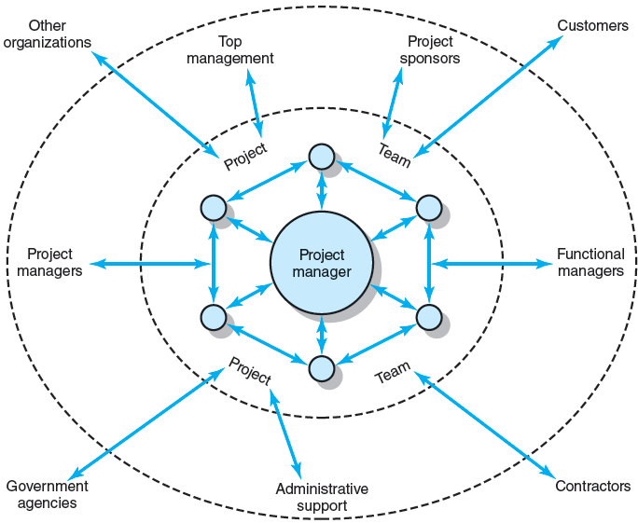
Network of Stakeholders
FIGURE 10.1

Slide 8
Influence as Exchange
The Law of Reciprocity
  One good deed deserves another, and likewise, one bad deed deserves another.
Quid pro Quo
  Mutual exchanges of resources and services
  (“back-scratching”) build relationships.
Influence “Currencies” (Cohen and Bradford)
  Cooperative relationships are built on the exchange
  of organizational “currencies” (favors).

Slide 9
Commonly Traded Organizational Currencies
Task-related currencies
  Resources Lending or giving money, budget increases, personnel, etc.
  Assistance Helping with existing projects or undertaking unwanted tasks.
  Cooperation Giving task support, providing quicker response time, or aiding implementation.
  Information Providing organizational as well as technical knowledge.
Position-related currencies
  Advancement Giving a task or assignment that can result in promotion.
  Recognition Acknowledging effort, accomplishments, or abilities.
  Visibility Providing a chance to be known by higher-ups or significant others in the organization.
  Network/ Providing opportunities for linking with others.
  contacts
Source: Adapted from A. R. Cohen and David L. Bradford, Influence without Authority (New York: John Wiley & Sons, 1990). Reprinted by permission of John Wiley & Sons, Inc.
TABLE 10.1

Slide 10
Organizational Currencies (cont’d)
Inspiration-related currencies
  Vision Being involved in a task that has larger significance for the unit, organization, customer, or society.
  Excellence Having a chance to do important things really well.
  Ethical correctness Doing what is “right” by a higher standard than efficiency.
Relationship-related currencies
  Acceptance Providing closeness and friendship.
  Personal support Giving personal and emotional backing.
  Understanding Listening to others’ concerns and issues.
Personal-related currencies
  Challenge/learning Sharing tasks that increase skills and abilities.
  Ownership/involvement Letting others have ownership and influence.
  Gratitude Expressing appreciation.
Source: Adapted from A. R. Cohen and David L. Bradford, Influence without Authority (New York: John Wiley & Sons, 1990). Reprinted by permission of John Wiley & Sons, Inc.
TABLE 10.1 (cont’d)

Slide 11
Social Network Building
Mapping Stakeholder Dependencies
  Project team perspective:
    Whose cooperation will we need?
    Whose agreement or approval will we need?
    Whose opposition would keep us from accomplishing the project?
  Stakeholders’ perspective:
    What differences exist between the team and those on whom the team will depend?
    How do the stakeholders view the project?
    What is the status of our relationships with the stakeholders?
    What sources of influence does the team have relative
    to the stakeholders?

Slide 12
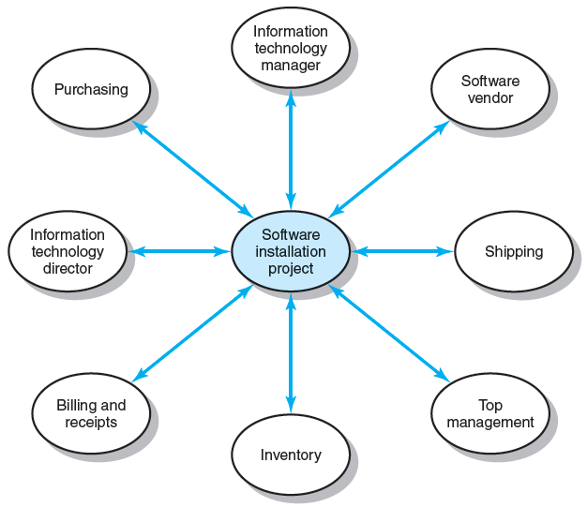
Stakeholder Map for Financial Software Installation Project
FIGURE 10.2

Slide 13
Management by Wandering Around
Management by Wandering Around (MBWA)
  Involves managers spending the majority of their time in face-to-face interactions with employees building cooperative relationships.
Characteristics of Effective Project Managers
  Initiate contact with key stakeholders
  Anticipate potential problems
  Provide encouragement
  Reinforce the objectives and vision of the project
  Intervene to resolve conflicts and prevent stalemates

Slide 14
Managing Upward Relations
Project Success = Top Management Support
  Appropriate budget
  Responsiveness to unexpected needs
  A clear signal to the organization of the importance of cooperation
Motivating the Project Team
  Influence top management in favor of the team:
    Rescind unreasonable demands
    Provide additional resources
    Recognize the accomplishments of team members

Slide 15
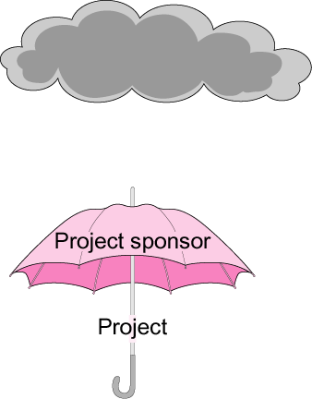
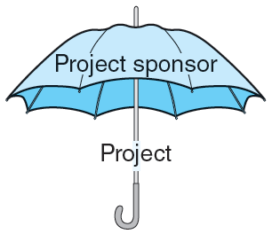
The Significance of a Project Sponsor
Upper management
FIGURE 10.3

Slide 16
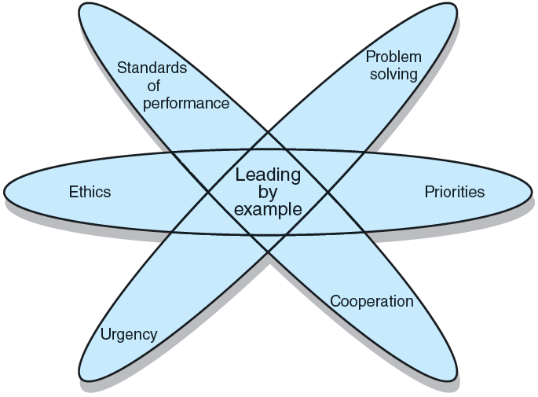
Leading by Example
FIGURE 10.4

Slide 17
Ethics and Project Management
Ethical Dilemmas
  Situations where it is difficult to determine whether conduct is right or wrong:
    Padding of cost and time estimations
    Exaggerating pay-offs of project proposals
    Falsely assuring customers that everything is on track
    Being pressured to alter status reports
    Falsifying cost accounts
    Compromising safety standards to accelerate progress
    Approving shoddy work
  Code of conduct
    Professional standards and personal integrity

Slide 18
Building Trust: The Key to Exercising Influence
Trust
  An elusive concept
  See it as a function of character and competence
    Character focuses on personal motives.
    Competence focuses on skills necessary to realize motives.
The core of highly effective people is a character ethic (Stephen Covey in Seven Habits of Highly Effective People).
  Consistency—more predictable
  Openness—more receptive to others
  A sense of purpose—what is best for the organization and the project

Slide 19
Contradictions of Project Management
Innovate and maintain stability
See the big picture while getting your hands dirty
Encourage individuals but stress the team
Hands-off/Hands-on
Flexible but firm
Team versus organizational loyalties

Slide 20
Traits of an Effective Project Manager
Systems thinker
Personal integrity
Proactive
High emotional intelligence (EQ)
General business perspective
Effective time management
Skillful politician
Optimist

Slide 21
Suggestions for Project Managers
Build relationships before you need them.
Trust is sustained through frequent
face-to-face contact.
Realize that “what goes around comes around.”

Slide 22
Key Terms
Emotional intelligence (EQ)
Inspiration-related currencies
Law of reciprocity
Leading by example
Management by wandering around (MBWA)
Personal-related currencies
Position-related currencies
Proactive
Relationship-related currencies
Social network building
Stakeholder
Systems thinking
Task-related currencies

