Slide 1
Chapter Thirteen - Progress and Performance Measurement and Evaluation
Stefán GUðnason

Slide 2
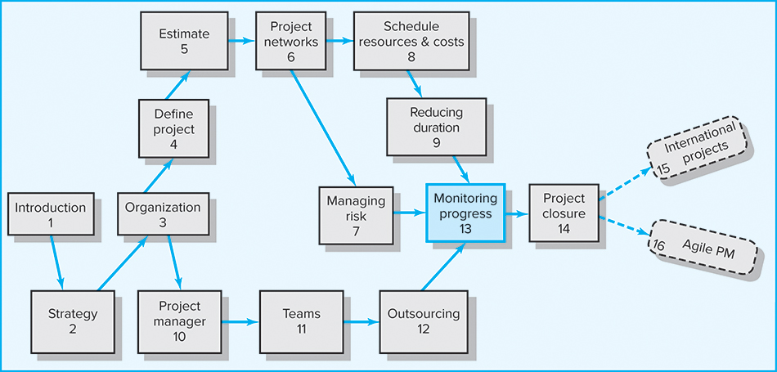
Where We Are Now

Slide 3
Learning Objectives
Identify the four steps for controlling a project
Utilize a tracking Gantt to monitor time performance
Understand and appreciate the significance of earned value
Calculate and interpret cost and schedule variance
Calculate and interpret performance and percent indexes
Forecast final project cost
Identify and manage scope creep

Slide 4
Chapter Outline
13.1 Structure of a Project Monitoring Information
System
13.2 The Project Control Process
13.3 Monitoring Time Performance
13.4 Development of an Earned Value
Cost/Schedule System
13.5 Developing a Status Report: A Hypothetical
Example
13.6 Indexes to Monitor Progress
13.7 Forecasting Final Project Cost
13.8 Other Control Issues

Slide 5
Structure of a Project Monitoring Information System
Creating a project monitoring system involves determining:
  What data to collect
  How, when, and who will collect the data
  How to analyze the data
  How to report current progress to management

Slide 6
Project Monitoring Information System
Information System Structure
  What Data Are Collected?
    Current status of project (schedule and cost)
    Remaining cost to compete project
    Date that project will be complete
    Potential problems to be addressed now
    Cost and/or schedule overruns and the reasons for them
    Forecast of overruns at time of project completion

Slide 7
Project Monitoring Info. System (cont’d)
Information System Structure (cont’d)
  Collecting Data and Analysis
    Who will collect project data?
    How will data be collected?
    When will the data be collected?
    Who will compile and analyze the data?
  Reports and Reporting
    Who will receive the reports?
    How will the reports be transmitted?
    When will the reports be distributed?

Slide 8
Project Progress Report Format
Progress since last report
Current status of project
  Schedule
  Cost
  Scope
Cumulative trends
Problems and issues since last report
  Actions and resolution of earlier problems
  New variances and problems identified
Corrective action planned

Slide 9
The Project Control Process
Control
  The process of comparing actual performance against plan to identify deviations, evaluate courses of action, and take appropriate corrective action
Project Control Steps
  Setting a baseline plan
  Measuring progress and performance
  Comparing plan against actual
  Taking action
Tools for Monitoring Time Performance
  Tracking Gantt chart
  Control chart
  Milestone schedules

Slide 10

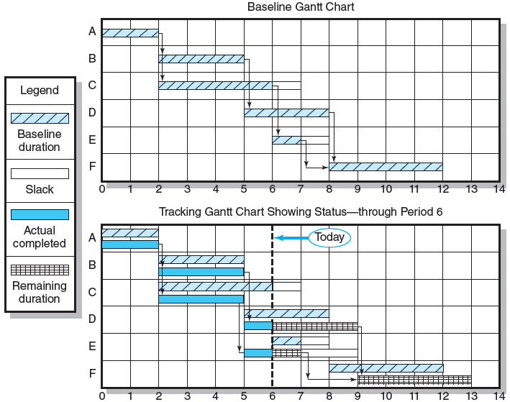
Baseline and Tracking Gantt Charts
FIGURE 13.1

Slide 11
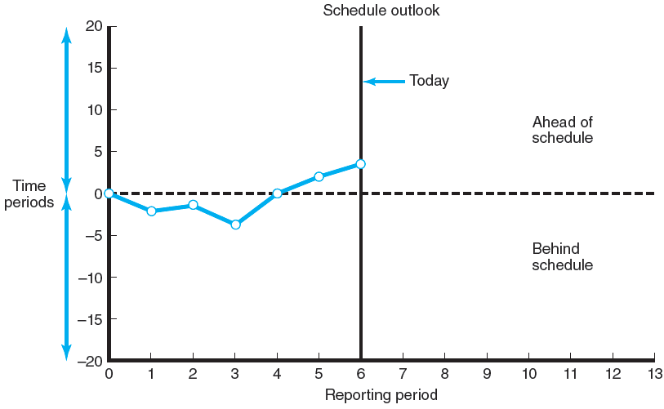
Project Schedule Control Chart
FIGURE 13.2

Slide 12
Development of an Earned Value Cost/Schedule System
Time-Phase Baseline Plan
  Corrects the failure of most monitoring systems to connect a project’s actual performance to its schedule and forecast budget.
    Systems that measure only cost variances do not identify resource and project cost problems associated with falling behind or progressing ahead of schedule.
Earned Value Cost/Schedule System
  An integrated project management system based on the earned value concept that uses a time-phased budget baseline to compare actual and planned schedule and costs

Slide 13
Glossary of Terms
EV | Earned value for a task is simply the percent complete times its original budget. Stated differently, EV is the percent of the original budget that has been earned by actual work completed. [BCWP—budgeted cost of the work performed].
PV | The planned time-phased baseline of the value of the work scheduled. An approved cost estimate of the resources scheduled in a time-phased cumulative baseline [BCWS—budgeted cost of the work scheduled].
AC | Actual cost of the work completed. The sum of the costs incurred in accomplishing work. [ACWP—actual cost of the work performed].
CV | Cost variance is the difference between the earned value and the actual costs for the work completed to date where CV = EV – AC.
SV | Schedule variance is the difference between the earned value and the baseline line to date where SV = EV – PV.
BAC | Budgeted cost at completion. Total budgeted cost of the baseline or project cost accounts.
EAC | Estimated cost at completion.
ETC | Estimated cost to complete remaining work.
VAC | Cost variance at completion. VAC indicates expected actual over- or under-run cost at completion.
TABLE 13.1

Slide 14
Developing an Integrated Cost/Schedule System
Define the work using a WBS.
  Scope
  Work packages
  Deliverables
  Organization units
  Resources
  Budgets
Develop work and
resource schedules.
  Schedule resources
  to activities
  Time-phase work packages into a network
Develop a time-phased budget using work packages included in an activity. Accumulate budgets (PV).
At the work package level, collect the actual costs for the work performed (AC). Multiply percent complete times original budget (EV).`
Compute the schedule variance (EV-PV) and the cost variance (EV-AC).

Slide 15
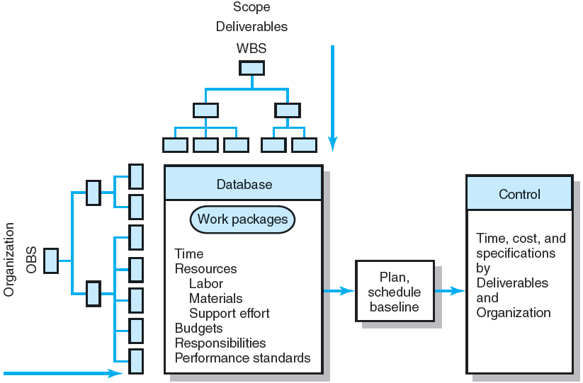
Project Management Information System Overview
FIGURE 13.3

Slide 16
Development of Project Baselines (cont’d)
Rules for Placing Costs in Baselines
  Costs are placed exactly as they are expected to be “earned” in order to track them to their point of origin.
  Percent Complete Rule
    Costs are periodically assigned to a baseline as units of work are completed over the duration of a work package.

Slide 17
Development of Project Baselines (cont’d)
Purposes of a Baseline (PV)
  An anchor point for measuring performance
    A planned cost and expected schedule against which actual cost and schedule are measured
    A basis for cash flows and awarding progress payments
    A summation of time-phased budgets (cost accounts as summed work packages) along a project timeline
What Costs Are Included in Baselines?
  Project direct overhead costs: labor, equipment, materials

Slide 18
Methods of Variance Analysis
Comparing Earned Value with:
  The expected schedule value
  The actual costs
Assessing Status of a Project
  Required three data elements
    Planned cost of the work scheduled (PV)
    Budgeted cost of the work completed (EV)
    Actual cost of the work completed (AC)
  Calculate schedule and cost variances
    A positive variance indicates a desirable condition, while a negative variance suggests problems or changes that have taken place.

Slide 19
Methods of Variance Analysis
Cost Variance (CV)
  Indicates if the work accomplished costs more or less than was planned at any point in the project.
Schedule Variance (SV)
  Presents an overall assessment in dollar terms of the progress of all work packages in the project scheduled to date.

Slide 20
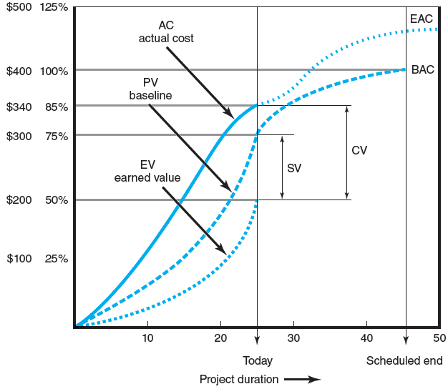
Cost/Schedule Graph
FIGURE 13.4

Slide 21
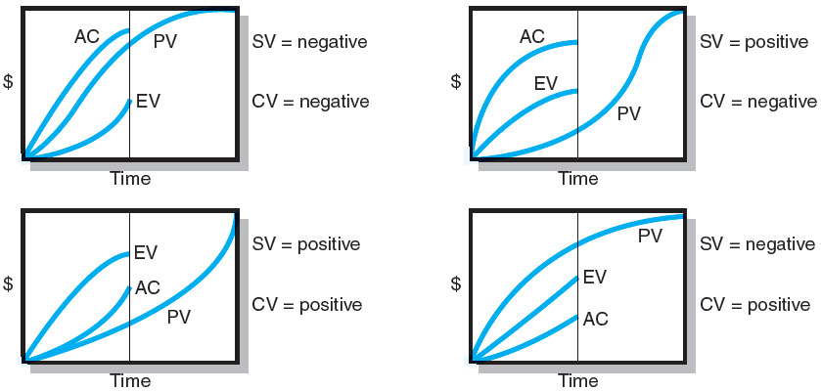
Earned-Value Review Exercise
FIGURE 13.5

Slide 22
Developing A Status Report:
A Hypothetical Example
Assumptions
  Each cost account has only one work package, and each cost account will be represented as an activity on the network.
  The project network early start times will serve as the basis for assigning the baseline values.
  From the moment work an activity begins, some actual costs will be incurred each period until the activity is completed.

Slide 23
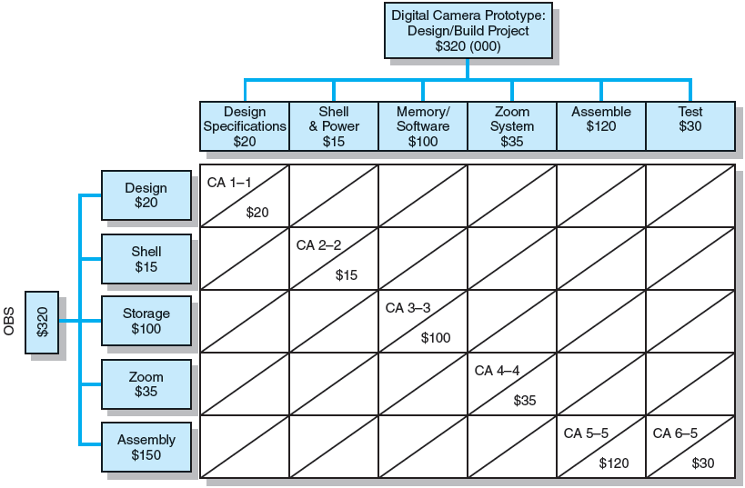
Work Breakdown Structure with Cost Accounts
FIGURE 13.6

Slide 24
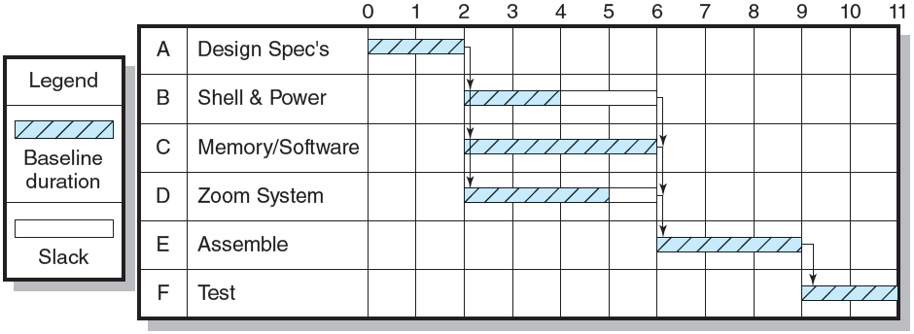
Digital Camera Prototype Project Baseline Gantt Chart
FIGURE 13.7

Slide 25
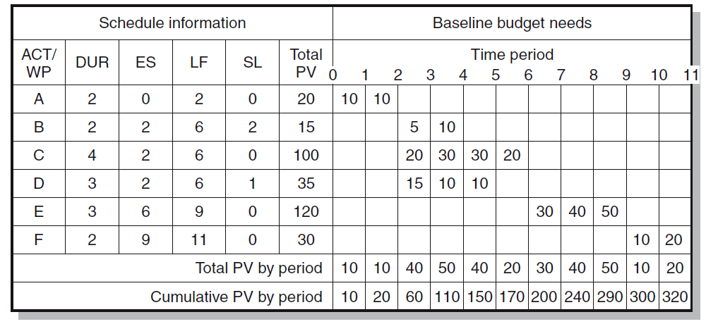
Digital Camera Prototype Project Baseline Budget ($000)
FIGURE 13.8

Slide 26
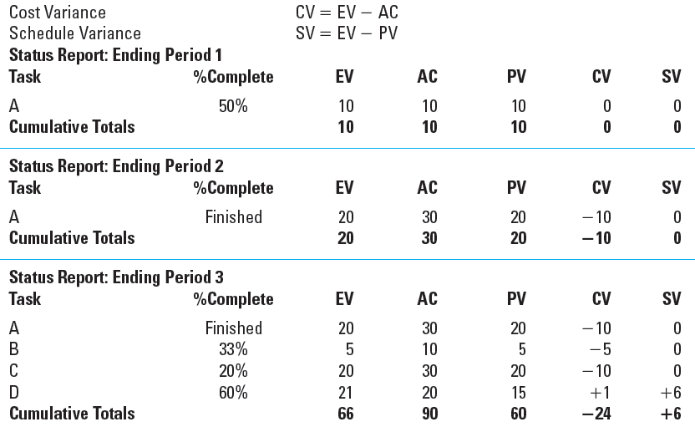
Digital Camera Prototype Status Reports: Periods 1–3
TABLE 13.2

Slide 27
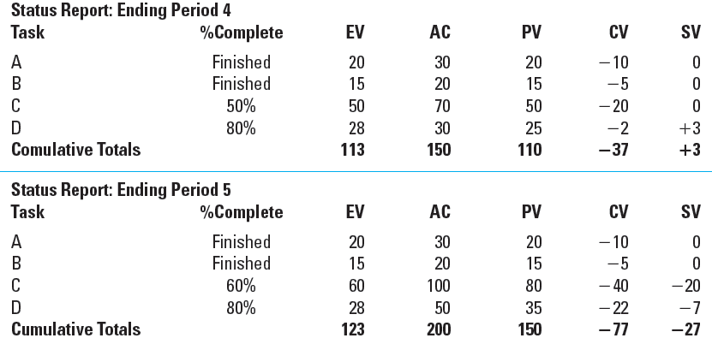
Digital Camera Prototype Status Reports: Periods 4 & 5
TABLE 13.2 (cont’d)

Slide 28
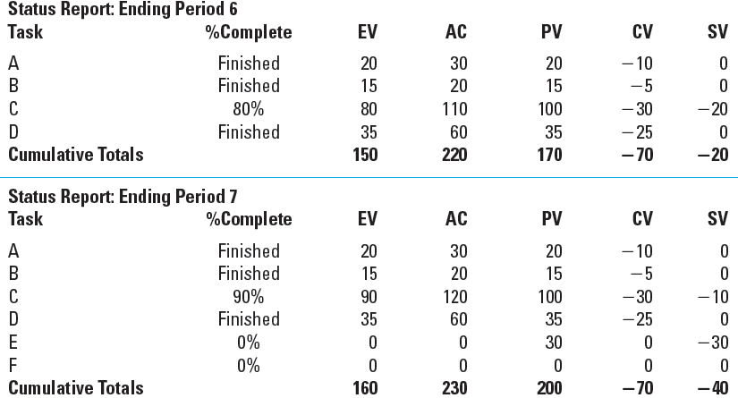
Digital Camera Prototype Status Reports: Periods 6 & 7
TABLE 13.2 (cont’d)

Slide 29
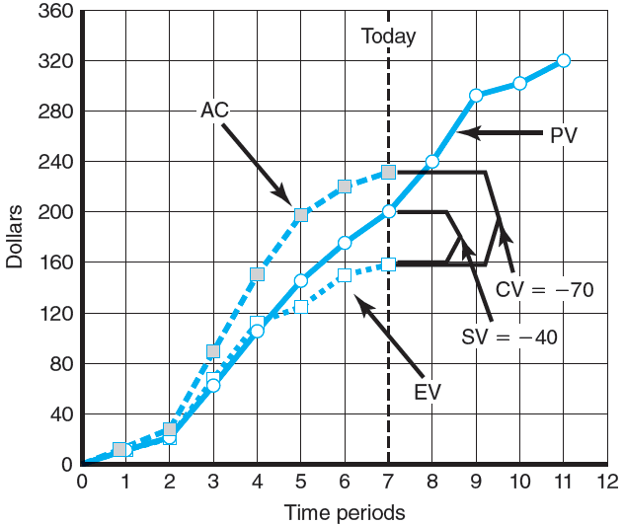
Digital Camera Prototype Summary Graph ($000)
FIGURE 13.9

Slide 30
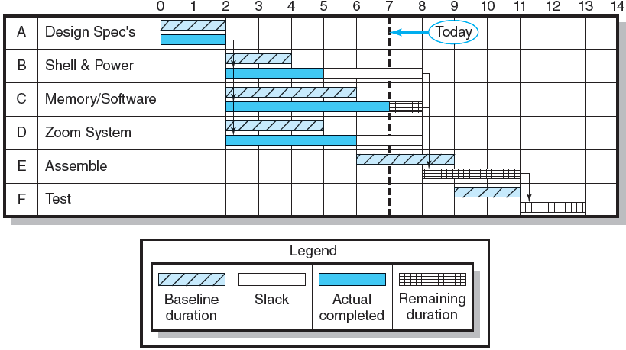
Digital Camera Project-Tracking Gantt Chart
Showing Status—Through Period 7
FIGURE 13.10

Slide 31
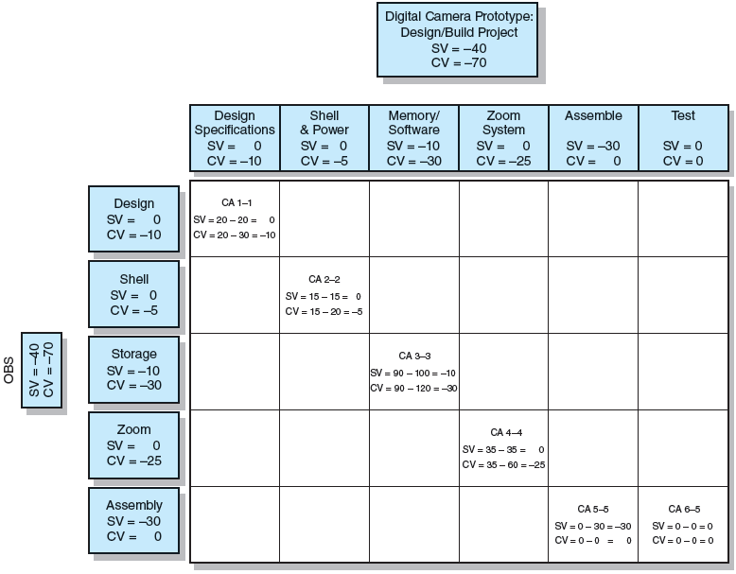
Project Rollup End Period 7 ($000)
FIGURE 13.11

Slide 32
Indexes to Monitor Progress
Performance Indexes
  Cost Performance Index (CPI) = EV/AC
    Measures the cost efficiency of work accomplished to date.
  Scheduling Performance Index (SPI) = EV/PV
    Measures scheduling efficiency to date.
  Percent Complete Indexes
    Indicate how much of the work accomplished represents of the total budgeted (BAC) and actual (AC) dollars to date.
    Percent Complete Index Budgeted Costs (PCIB) = EV/BAC
    Percent Complete Index Actual Costs (PCIC) = AC/EAC
    Management Reserve Index (MRI) = CV/MR
      Reflects the amount of Management Reserve (MR) that has been absorbed by cost over-runs.
      Is popular in the construction industry.

Slide 33
Interpretation of Indexes
Index | Cost (CPI) | Schedule (SPI)
>1.00 | Under cost | Ahead of schedule
=1.00 | On cost | On schedule
<1.00 | Over cost | Behind schedule
TABLE 13.3

Slide 34
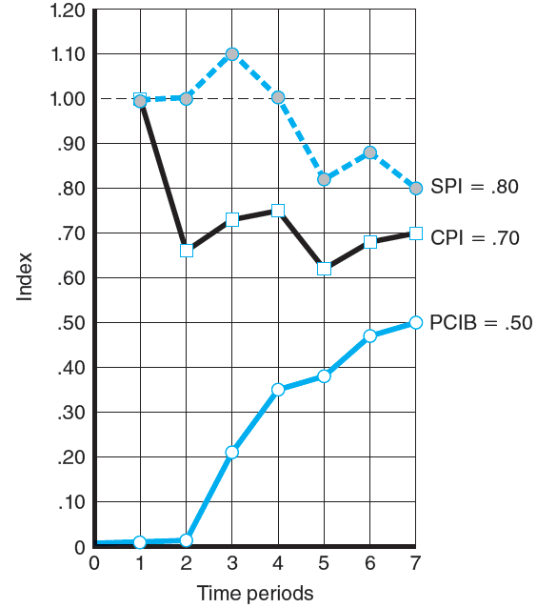
Indexes
Periods 1–7
FIGURE 13.12

Slide 35
Additional Earned Value Rules
Rules applied to short-duration activities and/or small-cost activities
  0/100 percent rule
    Assumes 100% of budget credit is earned at once and only when the work is completed.
  50/50 rule
    Allows for 50% of the value of the work package budget to be earned when it is started and 50% to be earned when the package is completed.
Ruled used gates before the total budgeted value of an activity can be claimed
  Percent complete with weighted monitoring gates
    Uses subjective estimated percent complete in combination with hard, tangible monitoring points.

Slide 36
Forecasting Final Project Cost
Methods used to revise estimates of future project costs:
  Revised estimated cost at completion (EAC_{re})
    Allows experts in the field to change original baseline durations and costs because new information tells them
    the original estimates are not accurate.
  Forecasting cost at completion (EAC_{f})
    Uses actual costs-to-date plus an efficiency index to project final costs in large projects where the original budget is unreliable.

Slide 37
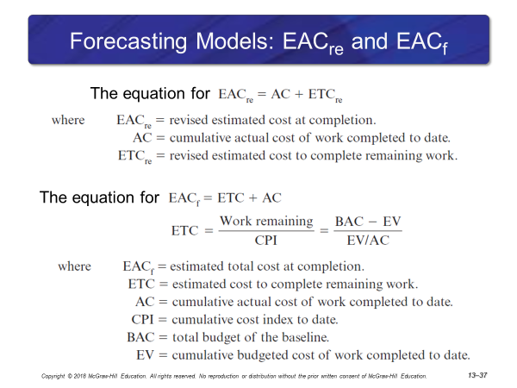

Slide 38

Forecasting Final Project Cost (cont’d)
Method supplemented to the estimate at completion (EAC_{f}) computation:
  To Complete Performance Index (TCPI)
    Measures the amount of value each remaining dollar in the budget must earn to stay within the budget.
    A ratio less than 1.00 indicates an ability to complete the project without using all of the remaining budget.
The equation for

Slide 39
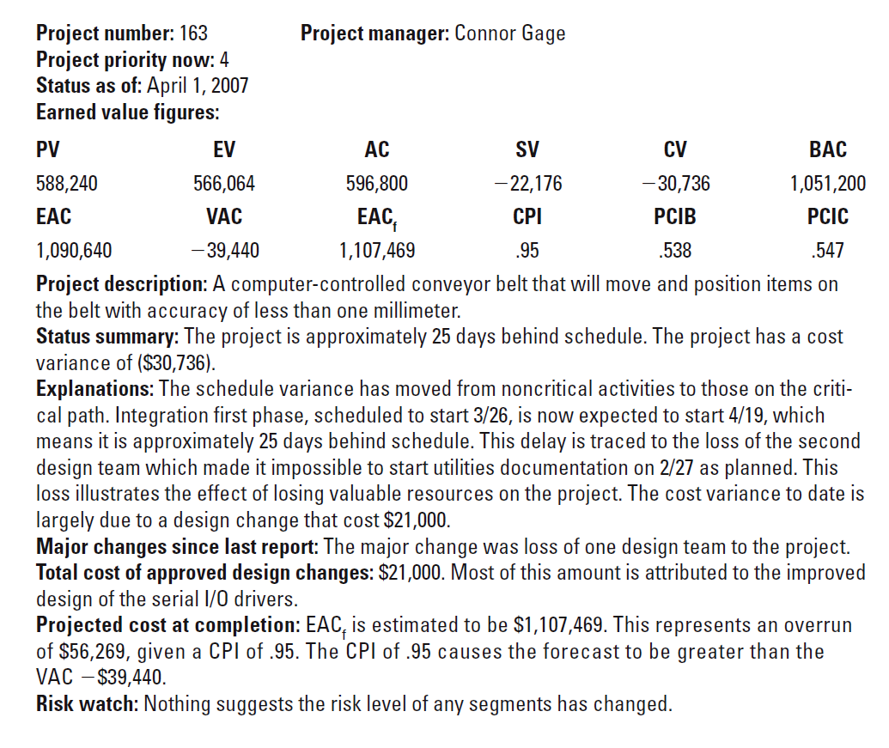
Monthly Status Report
EXHIBIT 13.1

Slide 40
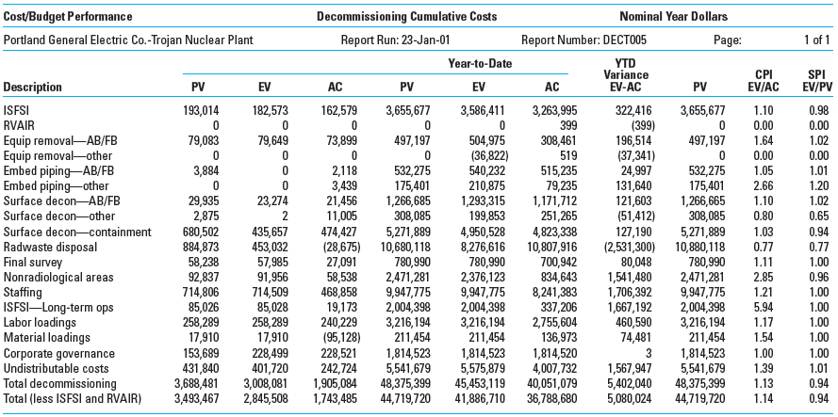
Trojan Nuclear Plant Decommissioning Earned Value Status Report
EXHIBIT 13.2

Slide 41
Other Control Issues
Issues In Maintaining Control of Projects
Technical Performance Measurement
Scope Creep
Baseline Changes
Data Acquisition Costs and Problems

Slide 42
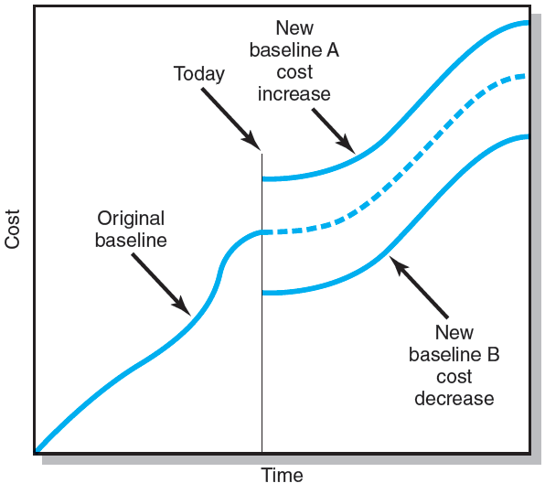
Scope Changes to a Baseline
FIGURE 13.13

Slide 43
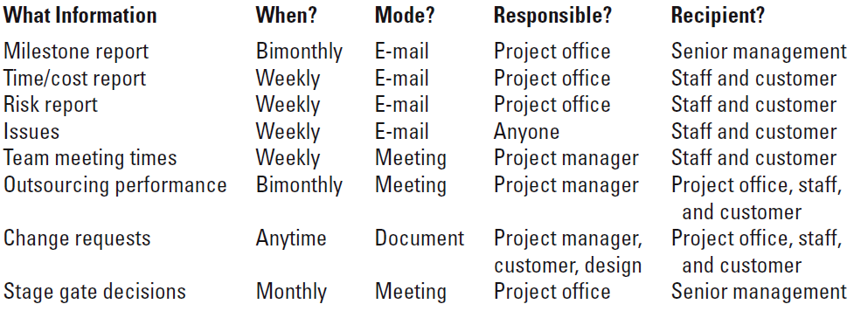
Conference Center WiFi Project
Communication Plan
FIGURE 13.14

Slide 44
Key Terms
Baseline budget
Budget at completion (BAC)
Control chart
Cost performance index (CPI)
Cost variance (CV)
Earned value (EV)
Estimated Cost at Completion—Forecasted (EAC_{f})
Estimated Cost at Completion—Revised Estimates (EAC_{re})
Percent complete index—budget costs (PCIB)
Percent complete index—actual costs (PCIC)
Schedule performance index (SPI)
Schedule variance (SV)
Scope creep
To complete performance index (TCPI)
Tracking Gantt chart
Variance at completion (VAC)

