Slide 1
Chapter Fourteen - Project Closure
Stefán Guðnason

Slide 2
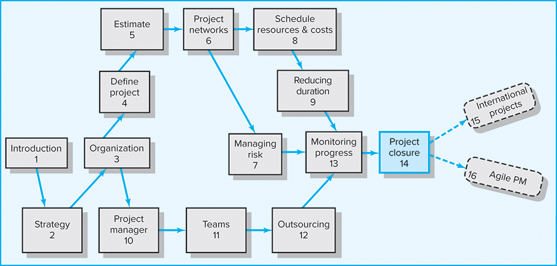
Where We Are Now
Copyright © 2018 McGraw-Hill Education. All rights reserved. No reproduction or distribution without the prior written consent of McGraw-Hill Education.

Slide 3
Learning Objectives
Identify different types of project closure
Understand the challenges of closing out a project
Explain the importance of a project audit
Know ho to use project retrospectives to obtain lessons learned
Assess level of project management maturity
Provide useful advice for conducting team performance reviews
Provide useful advice for conducting performance reviews of project members

Slide 4
Chapter Outline
14.1 Types of Project Closure
14.2 Wrap-up Closure Activities
14.3 Project Audits
14.4 Post-Implementation Evaluation

Slide 5

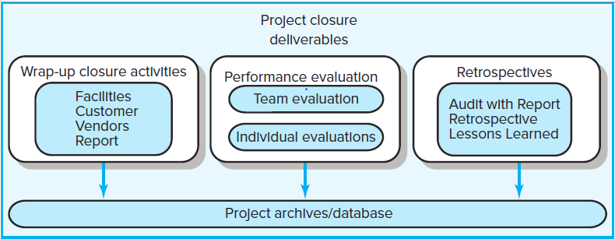
Project Closure and Review Deliverables
FIGURE 14.1

Slide 6
Project Closure
Types of Project Closure
  Normal
  Premature
  Perpetual
  Failed Project
  Changed Priority
Close-out Plan: Questions to be Asked
  What tasks are required to close the project?
  Who will be responsible for these tasks?
  When will closure begin and end?
  How will the project be delivered?

Slide 7
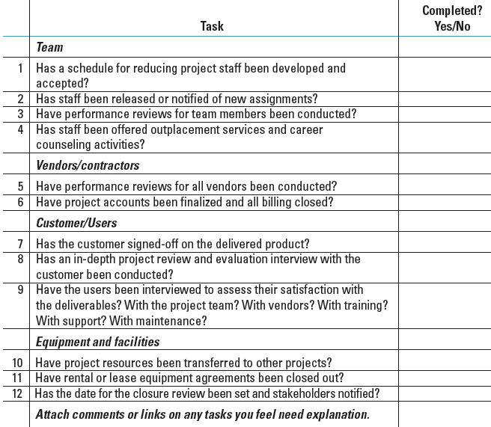
Wrap-up Closure Checklist
TABLE 14.1

Slide 8
Implementing Project Closedown
Getting delivery acceptance from the customer
Shutting down resources and releasing them to new uses
Reassigning project team members
Closing accounts and seeing all bills are paid
Delivering the project to the customer
Creating a final report

Slide 9
Project Audits
Examine project success and review why the project was selected.
Include a reassessment of the project’s role in the organization’s priorities.
Include a check on the organizational culture and external factors.
When to perform the project audits:
  In-process project audits
    Concentrate on project progress and performance.
    Perform early in projects to allow corrective changes.
  Post-project audits
    Emphasize on improving the management of future projects.
    Include more detail and depth than in-process project audits.

Slide 10
Guidelines for Conducting a Project Audit
The philosophy must be that the project audit is not a witch hunt.
Comments about individuals or groups participating in the project should be minimized.
Audit activities should be sensitive to human emotions and reactions.
Accuracy of data should be verifiable.
Senior management should announce support for the project audit.
The objective of project audits is not to prosecute but to learn and conserve valuable organization resources where mistakes have been made.
The audit should be completed as quickly as is reasonable.

Slide 11
The Project Audit Process
Initiating and Staffing
  Depends primarily on organization and project size
  The outcome must represent an independent, outside view of the project.
Data Collection and Analysis
  Gather information and data to answer questions from:
    Organization view
    Project team view
Reporting
  The report attempts to capture needed changes and lessons learned from a current or finished project.

Slide 12
A Common Outline for Project Audit Reports
Classification
  Project type
  Size
  Number of staff
  Technical level
  Strategic or support
Analysis
  Project mission and objectives
  Procedures and systems used
  Organization resources used
  Outcomes achieved
Recommendations
  Technical improvements
  Corrective actions
Lessons Learned
  Reminders
  Retrospectives
Appendix
  Backup data
  Critical information

Slide 13
Project Retrospectives
Retrospectives
  Denote specific efforts at identifying lessons learned on projects.
An Independent Facilitator
  Guides the project team through the analysis project activities.
  Uses several questionnaires focusing on project operations and on how the organization’s culture impacted project success and failures.
  Visits one-on-one with project participants to dive deeper into cause-effect impacts.
  Leads a team retrospective session.
  Works with the team to develop a system that prioritize information for different recipients.

Slide 14
Project Process Review Questionnaire
Were the project objectives and strategic intent of the project clearly and explicitly communicated?
Were the objectives and strategy in alignment?
Were the stakeholders identified and included in the planning?
Were project resources adequate for this project?
Were people with the right skill sets assigned to this project?
Were time estimates reasonable and achievable?
Were the risks for the project appropriately identified and assessed before the project started?
Were the processes and practices appropriate for this type of project? Should projects of similar size and type use these systems? Why/why not?
Did outside contractors perform as expected? Explain.
Were communication methods appropriate and adequate among all stakeholders? Explain.
Is the customer satisfied with the project product?
Are the customers using the project deliverables as intended? Are they satisfied?
Were the project objectives met?
Are the stakeholders satisfied their strategic intents have been met?
Has the customer or sponsor accepted a formal statement that the terms of the project charter and scope have been met?
Were schedule, budget, and scope standards met?
Is there any one important area that needs to be reviewed and improved upon? Can you identify the cause?
TABLE 14.2

Slide 15
Organizational Culture Review Questionnaire
Was the organizational culture supportive for this type of project?
Was senior management support adequate?
Were people with the right skills assigned to this project?
Did the project office help or hinder management of the project? Explain.
Did the team have access to organizational resources (people, funds, equipment)?
Was training for this project adequate? Explain.
Were lessons learned from earlier projects useful? Why? Where?
Did the project have a clear link to organizational objectives? Explain.
Was project staff properly reassigned?
Was the Human Resources Office helpful in finding new assignments? Comment.
TABLE 14.3

Slide 16
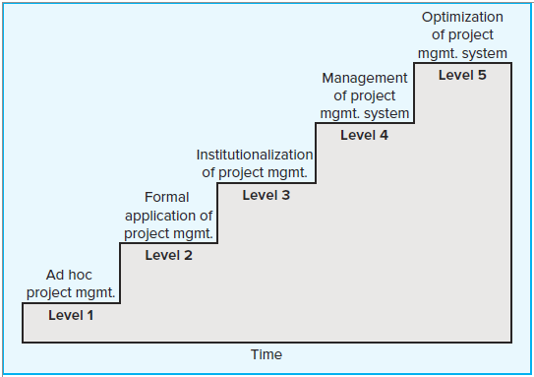
Project Management Maturity Model
FIGURE 14.2

Slide 17
Post-Implementation Evaluation
Reasons for Poor-Quality Project Performance Evaluations:
  Evaluations of individuals are left to supervisors of the team member’s home department.
  Typical measures of team performance center on time, cost, and specifications.

Slide 18
Pre-Implementation Conditions: Team
Do standards for measuring performance exist? (You can’t manage what you can’t measure.) Are the goals clear for the team and individuals? Challenging? Attainable? Lead to positive consequences?
Are individual and team responsibilities and performance standards known by all team members?
Are team rewards adequate? Do they send a clear signal that senior management believes that the synergy of teams is important?
Is a clear career path for successful project managers in place?
Is the team empowered to manage short-term difficulties?
Is there a relatively high level of trust emanating from the organization culture?
Are there criteria beyond time, cost, and specifications?

Slide 19
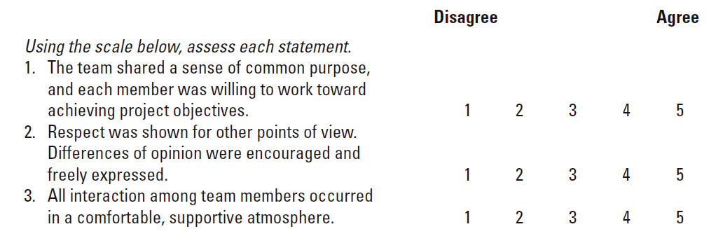
Sample Team Evaluation and Feedback Survey
TABLE 14.4

Slide 20
Project Performance Evaluation: Individual
Performance Assessment Responsibilities:
  Functional organization or functional matrix: the individual’s area manager.
    The area manager may solicit the project manager’s opinion of the individual’s performance on a specific project.
  Balanced matrix: the project manager and the area manager jointly evaluate an individual’s performance.
  Project matrix and project organizations: the project manager is responsible for appraising individual performance.

Slide 21
Conducting Performance Reviews
Begin by asking the individual to evaluate his or her own performance.
Avoid drawing comparisons with other team members; rather, assess the individual in terms of established standards and expectations.
Focus criticism on specific examples of behavior rather than on the individual personally.
Be consistent and fair in treatment of all team members.
Treat the review as one point in an ongoing process.

Slide 22
Individual Performance Assessment
Multiple rater appraisal (360-degree feedback)
  The objective is to identify areas for individual improvement.
  Involves soliciting feedback concerning team members’ performance from all of the people that their work affects.
    Project managers, area managers, peers, subordinates, and customers

Slide 23
Key Terms
Lessons learned
Performance review
Project closure
Project evaluation
Project facilitator
Retrospective
Team evaluation
360-degree review

Slide 24
Project Closeout Checklist

Slide 25
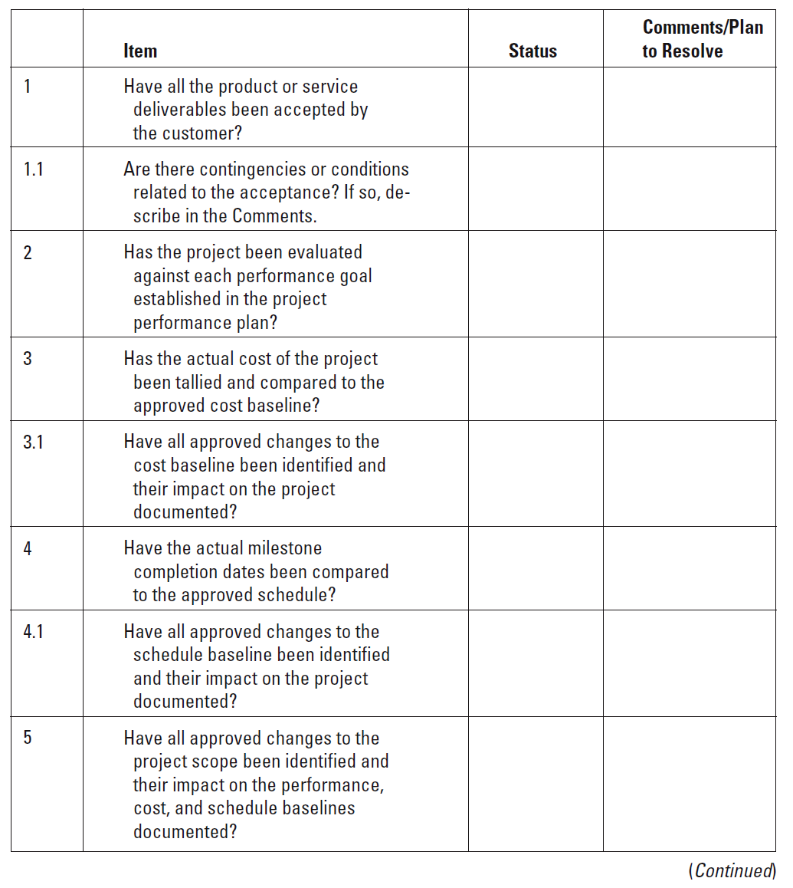
Project Closeout Checklist

Slide 26
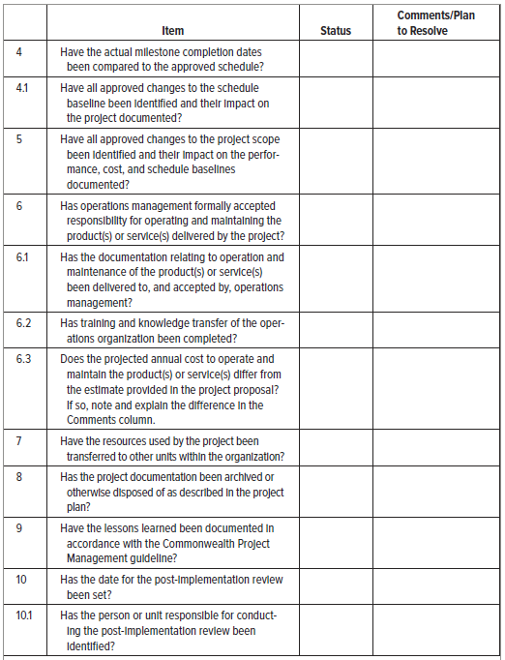
Project Closeout Checklist (cont’d)

Slide 27
Euro Conversion—Project Closure Checklist

Slide 28
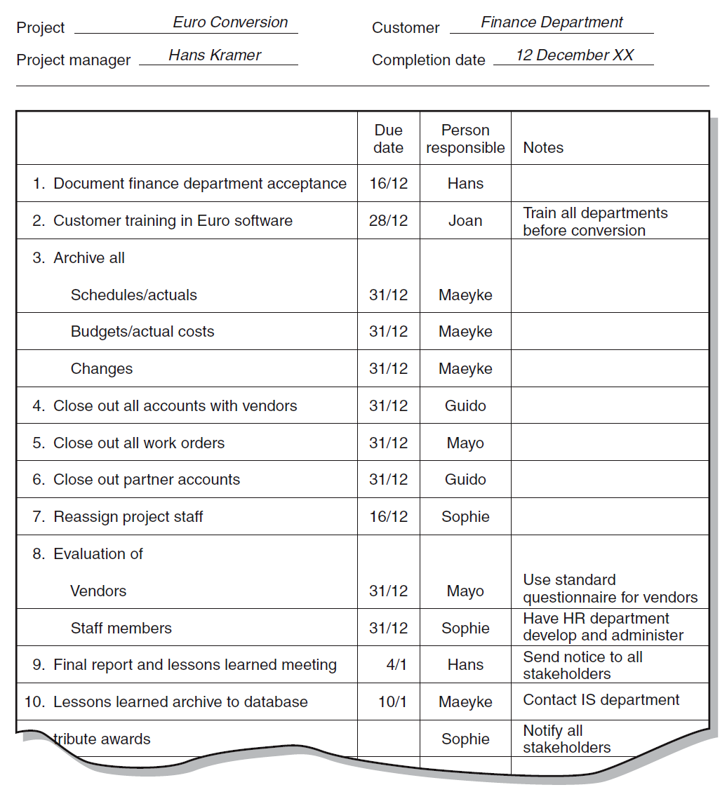
Euro Conversion—Project Closure Checklist

